Slide 1
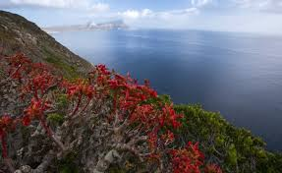
Welcome to all

Slide 2
Introduction
Md Shahneoaz
Assistant Teacher (English)
Jalalabad B/L High School,Sylhet.
E-mail: shahneoazmd@yahoo.com
Cell: 01631712091
Class: ix
English 1st paper
Unit-5, Lesson-3
Time- 45 Minutes

Slide 3
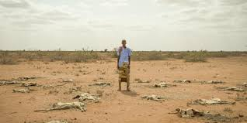
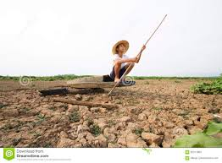
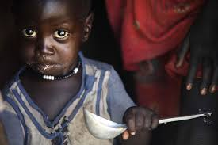
Can you say What the pictures are about?
What is the main cause of this affect and who/what are the worst sufferers of it?

Slide 4
Topic: Man and Climate

Slide 5
Learning Outcomes:
After finishing this lesson students will be able to-
say how the climate is changing.
describe where the fossil fuels are being used.
choose the best answers from the alternatives.

Slide 6
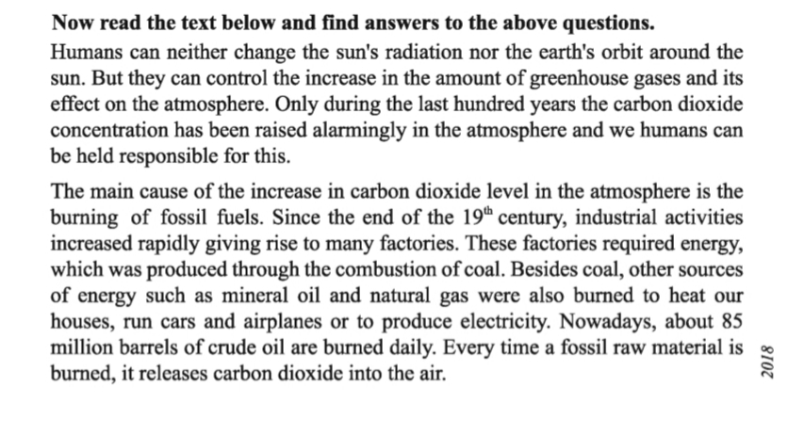
Read the passage in unit-5, lesson-3 (A)
Silent Reading

Slide 7
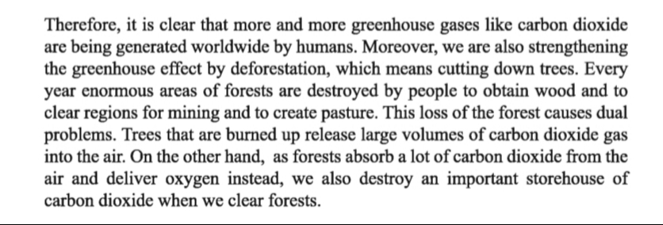
Read the passage in unit-5, lesson-3 (A)
Silent Reading

Slide 8
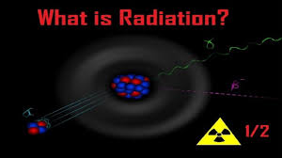
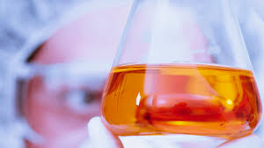
Let’s be introduced with new Words:
Radiation
The emission of energy as electromagnetic waves or as moving subatomic particles, especially high-energy particles which cause ionization
Accumulation/ Centralization
Concentration

Slide 9
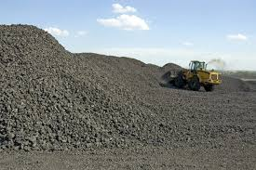
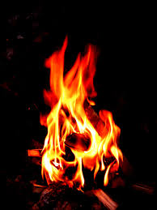
Let’s be introduced with new Words:
Fossil Fuel
A fossil fuel is a fuel formed by natural processes
Burning /Firing
Combustion

Slide 10
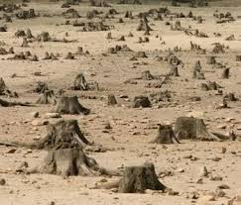
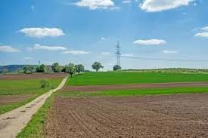
Let’s be introduced with new Words:
Deforestation
The action of clearing a wide area of trees
Enormous
Huge/Vast

Slide 11
Choose the best answer from the alternatives:
Group Work
1. What does ‘fossil’ mean?
a) ruins b) havocs c) debris d) impression of plant or animal hardened in rock
2. What does ‘rapidly’ mean?
a) suddenly b) swiftly c) drastically d) steadily
3. Which of the period describes the beginning of rapid industrialization?
a) The start of the 19th century b) The start of the 18th century
c) The end of the 18th century d) The end of the 19th century
4. Greenhouse is caused by-------
a) indiscriminate felling down of trees b) planting of more trees
c) forestation d) reforestation

Slide 12
Match the answers
Group Work
1. What does ‘fossil’ mean?
a) ruins b) havocs c) debris √d) impression of plant or animal hardened in rock
2. What does ‘rapidly’ mean?
a) suddenly √b) swiftly c) drastically d) steadily
3. Which of the period describes the beginning of rapid industrialization?
a) The start of the 19th century b) The start of the 18th century
c) The end of the 18th century √d) The end of the 19th century
4. Greenhouse is caused by-------
√a) indiscriminate felling down of trees b) planting of more trees
c) forestation d) reforestation

Slide 13
Choose the best answer from the alternatives:
Group Work
5. What is the figure related to barrels of crude oil burnt everyday?
a) 85 million b) 8.5 million c) 850 million d) 0.85 million
6. -------- is one of the greenhouse gases.
a) Oxygen b) Carbon dioxide c) Oxygen and Carbon dioxide d) Hydrogen
7. Who/what caused deforestation?
a) Human being b) Nature
c) Automatically d) Wild animals

Slide 14
Match the answers
Group Work
5. What is the figure related to barrels of crude oil burnt everyday?
√ a) 85 million b) 8.5 million c) 850 million d) 0.85 million
6. -------- is one of the greenhouse gases.
a) Oxygen √b) Carbon dioxide c) Oxygen and Carbon dioxide d) Hydrogen
7. Who/what caused deforestation?
√a) Human being b) Nature
c) Automatically d) Wild animals

Slide 15
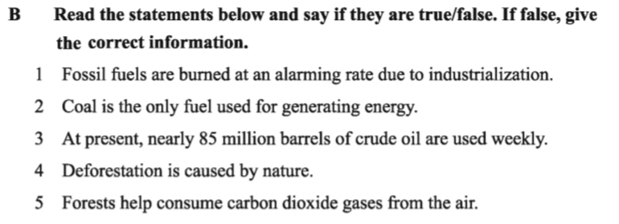

Slide 16
Thanks a lot for being with me

