Slide 1
Welcome

Slide 2
TEACHER INTRODUCE :
HASAN MD. ZONAYED
SENIOR TEACHER
CHANDGAON N.M.C MODEL HIGH SCHOOL
CHANDGAON,CHITTAGONG
Email ID – hasantr1971@gmail.com
Phone - 01715433150

Slide 3
Subject : English For Today
Class : Ten
Unit : Twelve
Lesson – 01: ‘My roots’
Time : 50 minutes

Slide 4
Learning outcome :
Ss will be able to :
1. increase four skills
2.Narrate an event
3.Compare between human roots and rootless persons.

Slide 5
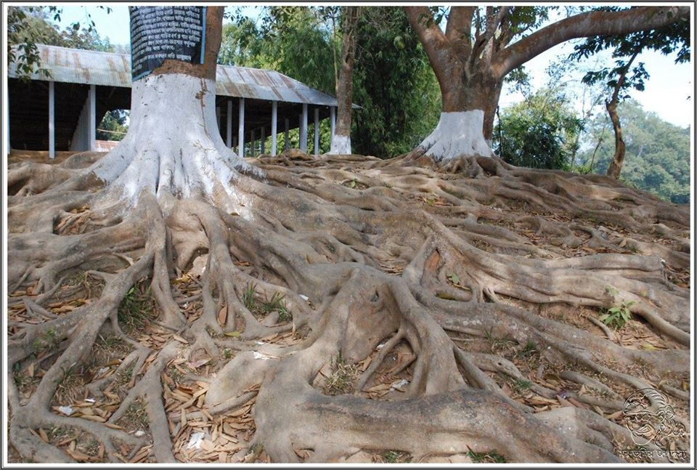
What do you see in the picture?

Slide 6
Today’s lesson is
My roots

Slide 7
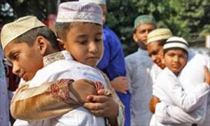
What are the people doing ?
What are they doing?
When people usually do this?

Slide 8
Let’s see some pictures. But
1.Why people rush ? 2.Where they go? 3.How are they feeling?

Slide 9
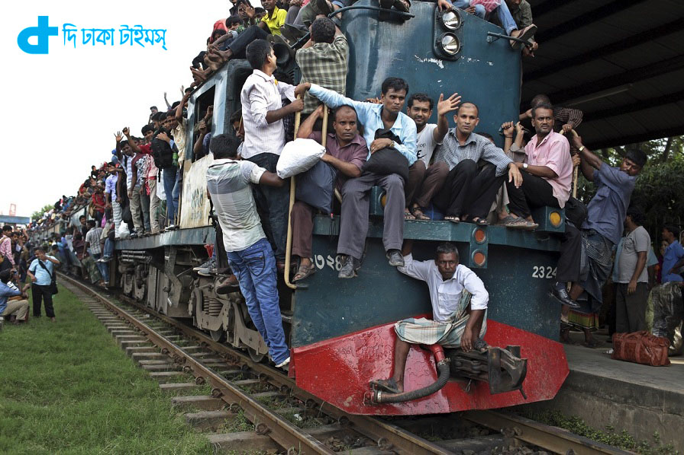
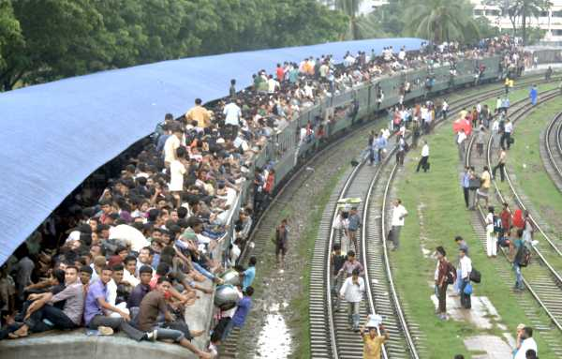
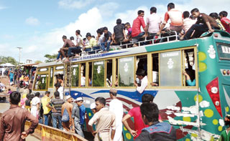

Slide 10
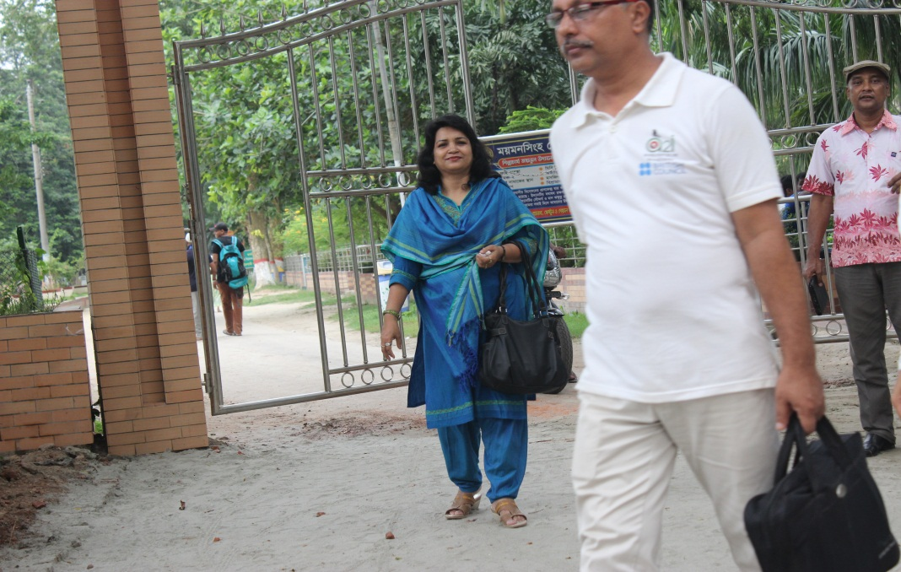
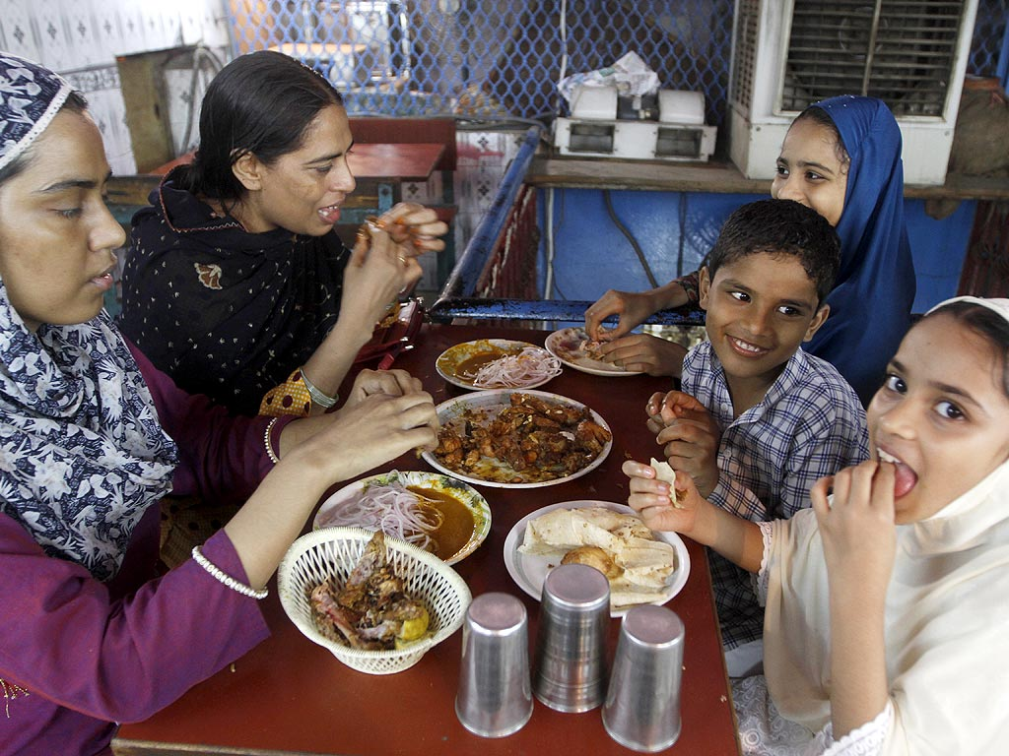
Where are they going?
How are they going?
What may happen?
How do they feel?

Slide 11
Group work : Discuss about the pictures and write not more than ten sentences. The presenter will present the writing. Use the clues bellow:
1.What do the people do who are living outside their house during Eid festival?
2.Whom do they want to meet?
3.What problems they might face on the roads?

Slide 12
Vocabulary :
Festival
An occasion of joy
Rush
A sudden movement of people
Invisible
That cannot be seen
Rootless
Having no identity

Slide 13
Now open your text at page 141 and read the text silently . But put plus (+) before the sentences that indicates the people who have roots, put minus (-) before the sentences that indicates rootless people.

Slide 14
Evaluation :
1.What is the biggest religious
festival for the Muslim?
2.Where do we go to celebrate Eid?
3.Why do we celebrate Eid with our near ones?
4.What are our roots?
5.Who are rootless people?

Slide 15
Homework :
Write a paragraph on ‘How you observed the Last Eid Festival’using past simple.
Not more than 100 words .

Slide 16
Thank you

