Slide 1
Good Morning

Slide 2
INTRODUCE
HASAN MD.ZONAYED
Senior Teacher
Chandgaon N.M.C model high school
Chandgaon,Chittagong
Mobile-01715433150

Slide 3
Presented for whom :
Class : Ten
Subject : English 1st paper
Unit : Ten
Lesson : Three
Duration : 5o Minutes

Slide 4
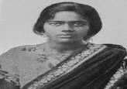
Look at the picture and try to answer the questions.
a) Are you familiar with
the pictures?
b) What’s her name and
what do you know about
her?
Pritilata Wadadder, an anti-British activist.

Slide 5
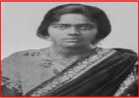
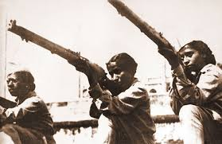
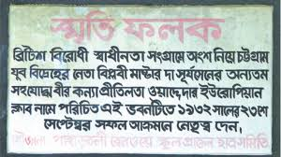
Observe some other pictures about her.
This great lady was one of
pioneers of the anti – British
movement and attacked
European club .

Slide 6
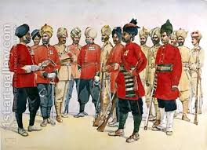
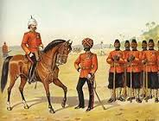
British Soldiers

Slide 7
Unit : Ten
Lesson : Three(They had Dreams-1)
Page No : (151-154)

Slide 8
Learning Outcomes :
Able to :
Know about anti-British Movement ,
make questions from the substitution table ,
write answer of the comprehensive questions,
Write an article on Pritilata Waddeddar.

Slide 9
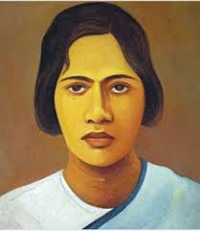
Let’s know more about this great lady
Name: Pritilata Waddeddar
Nick Name: Rani
Father: Jogotbondhu
Mother: Protiva Devi
Birth Date: 05 May 1911
Birth Place: Dhalghat,
Chittagong.

Slide 10
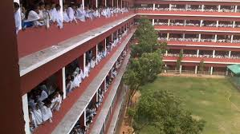
Dr. Khastagir Govt.Girls High School, Chittagong
She was a meritorious
Student this School.

Slide 11
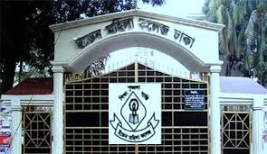
She studied at Eden College,Dhaka

Slide 12
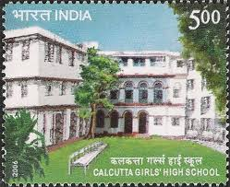
She finally graduated in philosophy with distinction from Bathune College in kolkata. In her college days, Pritilata was an activist in the anti British movement.

Slide 13
Her dream : All through her life , she dreamt of two things: a society without gender discrimination, and her motherland without British colonial rule.

Slide 14
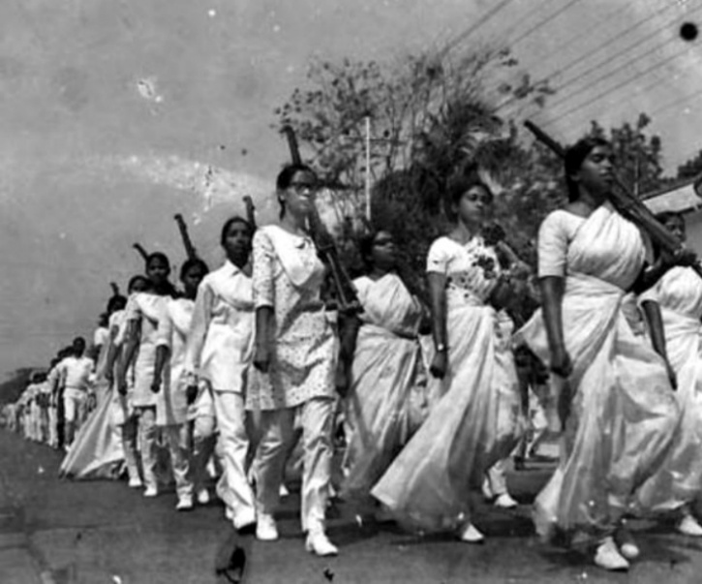
She received combat training to fight against British rule.

Slide 15
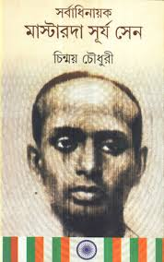
Gradually she involved herself in Surya Sen’s armed resistance movement. Surya Sen was a famous anti British movement organizer and activist in Chittagong area that time.

Slide 16
Fill the box in Group with correct
information of Pritilata
Events | Happenings/ Time/place
Birth
parents
Birth place
Secondary Edu.
Higher Secd. Edu.
B.A deg.
Her Dream

Slide 17
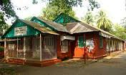
This is Pahartali European Club.The club was well known for its notorious sign ”Dog and Indians not allowed”. Surya Sen asigned Pritilata to lead a team of 10-12 men to attack the club. The raid was successful but Ptitilata dressed as a man failed to get out of of the club. She committed suicide by taking potssium cyanide to avoid arrest.

Slide 18
Read Section B of your text
and answer the question in
Section D.

Slide 19
Now read column A in section C
and match them with the
meanings in column B

Slide 20
Now match your answer
Column -B | Column –B
Activist | a member of a certain social or political group
Combat | fight
Graduated | took a university degre
Colonial rule | rule by another country
Resistance | battle
Gender discrimination | difference between male and female
Gradually | slowly
Assign | give responsibilities
Movement | activities
Notorious | dishonourable

Slide 21
Now make questions from substitution
table make answers in pair in Section –E
Page-154 . (The boy next to you is your partner)

Slide 22
Evaluation
a) Where did Pritilata fight?
b) When did She fight?
c) Why did she fight?
d) Who assigned Pritilata to attack European
Club?
e) How did Pritilata die?

Slide 23
Home Work
Write a short report about Pritilata
Waddedar for publishing in news paper.

Slide 24
goodbye

