Slide 1
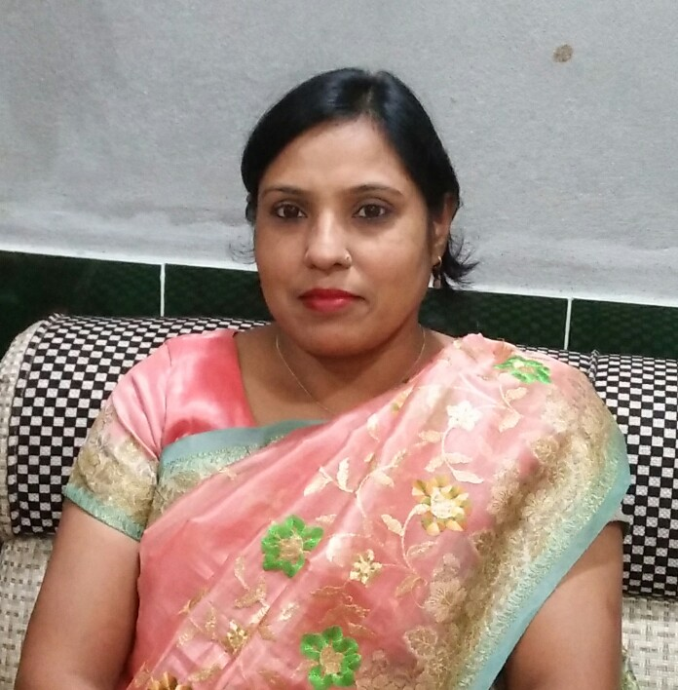
আজকের মাল্টিমিডিয়া ক্লাসে সবাইকে
স্বাগতম

Slide 2
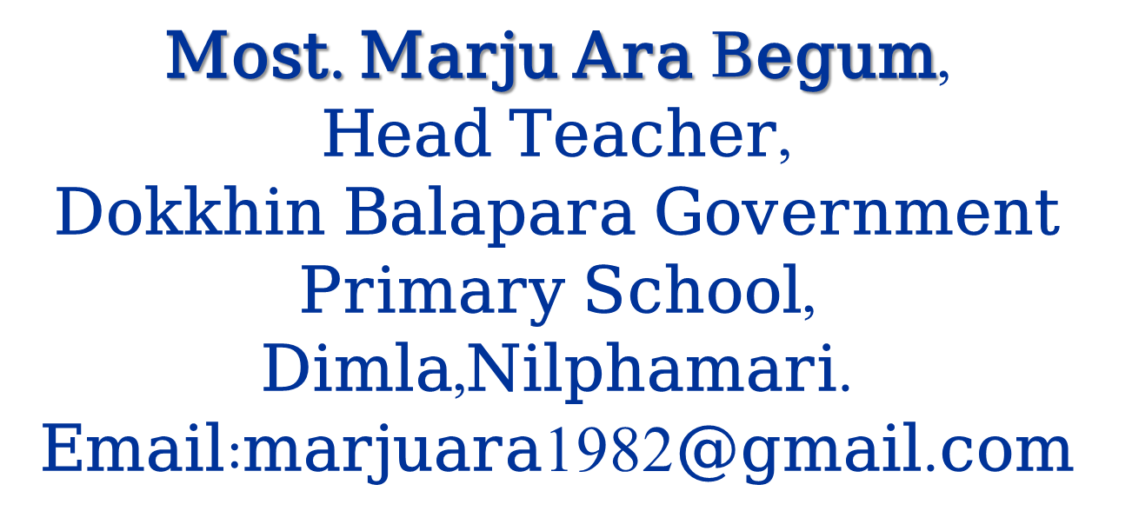

Slide 3
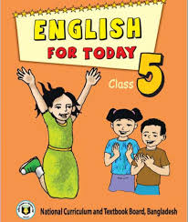
LESSON
INDENTITY
Class: Five
Subject: English

Slide 4
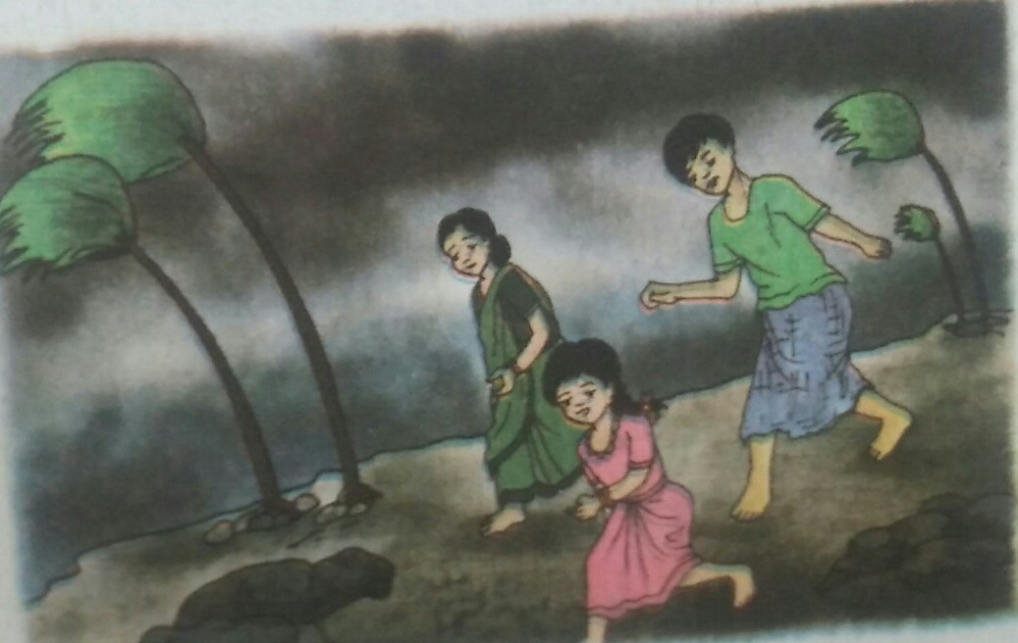
Look at the picture and think about this
What about the picture?

Slide 5
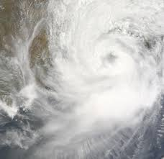
Today’s lesson is
Cyclone
Aila

Slide 6
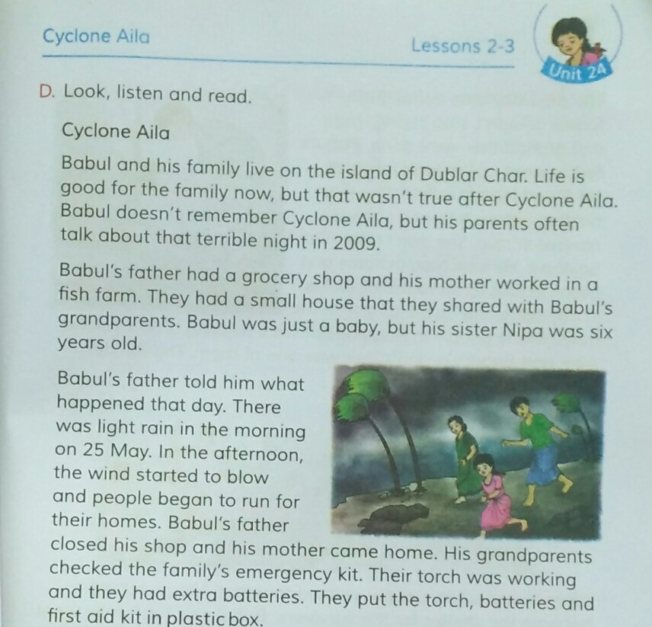
Every student open your book page at 95.

Slide 7
Let’s us now find new words from the text:
Island = দ্বীপ
Remember = স্মরণ করা
Terrible = ভয়ঙ্কর
Grocery = মুদি খানা

Slide 8
Fill in the blanks of the following sentences with words from the above box. There are three more words:
Ampan
Cloth
Island
Remember
Grocery
Saint Martin
Babul and his family live on the ___________ of Dublar Char.
Babul doesn’t ______________ Cyclone Aila.
Babul father had a ___________ shop.

Slide 9
True/ False? If true,write True and If false, write false.
Cyclone Aila happened March
Babul’s father is a small trader
Babul’s mother worked in a grocery shop
2009

Slide 10
Answer the following questions
What was Babul’s father?
Answer: Babul’s father had a grocery shop.
(b) What was Babul’s mother?
Answer: Babul’s mother worked in a fish farm.
(c) How was the day of Aila?
Answer: There was light rain in the morning of
Aila.

Slide 11
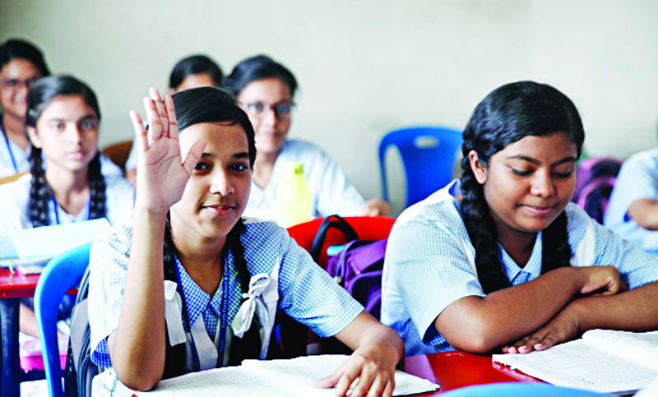
Evaluation

Slide 12
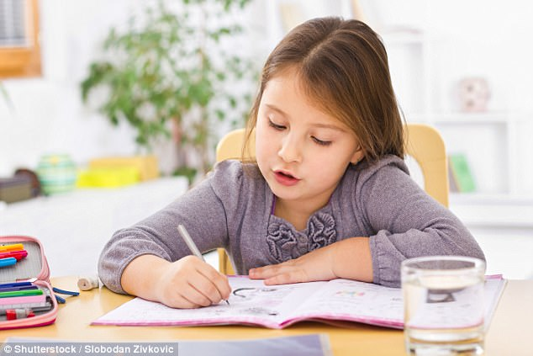
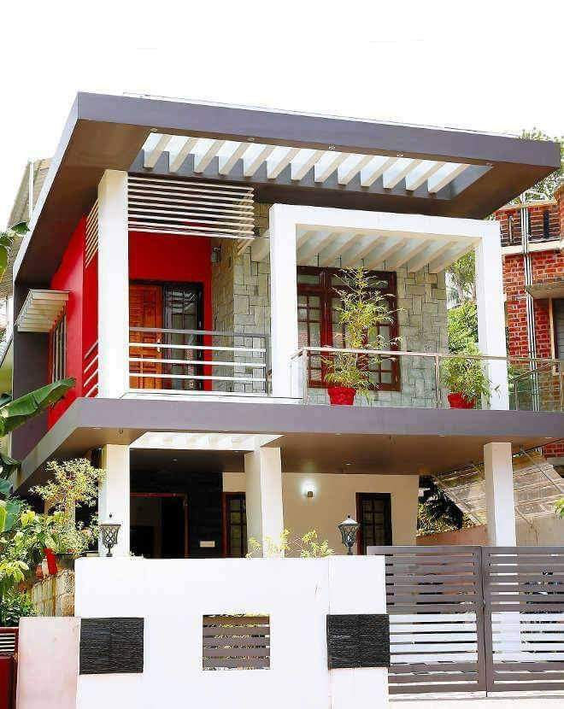
Homework
Write five sentence about cyclone Aila
Email: marjuara1982@gmail.com

