Slide 1
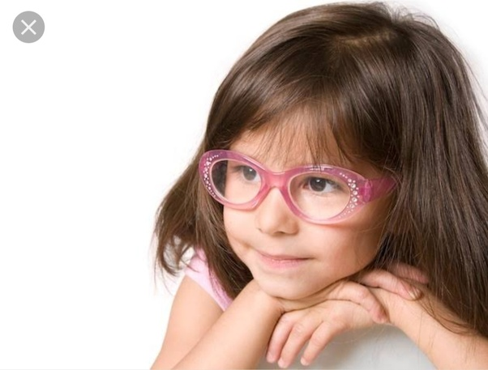
my
dear students

Slide 2
 Prepared By 
Md. Sultan-ul Arefin
Assistant Teacher
Gurudaspur Model Govt. Primary School
Gurudaspur, Natore.

Slide 3
 Lesson Detail 
Class: Five
Subject: English
Unit: 20, Lesson: 1-2
Title: Life is beautiful

Slide 4
Creating Emotion
Creating students’ emotion by showing a video on the-
“Blind Girl’s Story”

Slide 5
Showing a picture, I will ask some questions to my students
Look at the picture attentively and answer the questions.
Let’s watch the picture

Slide 6
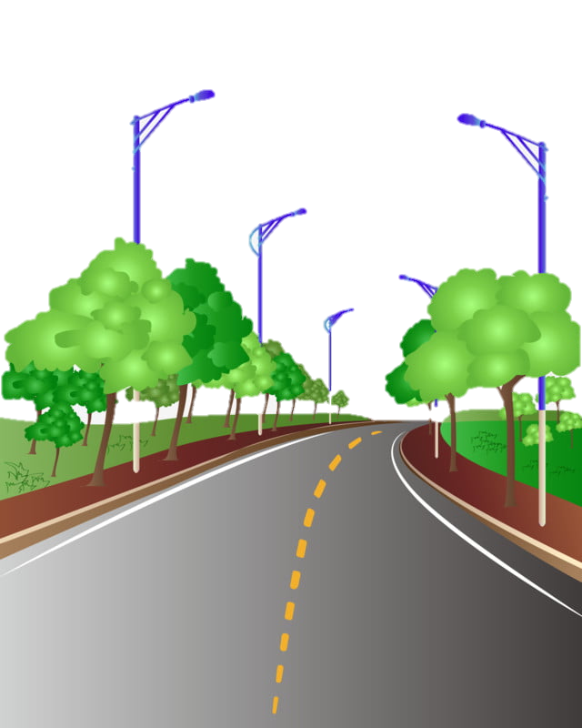

Slide 7
Questions:
1. What do you see in the picture?
2. Is there anything in his hand?
3. How is she walking?
4. Who walks with a stick?
Possible solutions:
A woman is walking.
2. Yes, there is a stick in his hand.
4. A blind person walks with a stick.
3. She is walking with a stick.

Slide 8
Lesson Declaration
Well, To day we are going to read-
Life is beautiful
- It’s a beautiful-----------------for school.

Slide 9
Learning outcomes--
Listening:
3.4.1: understand statements made by the teacher and students.
4.2.1: understand and enjoy simple stories.
Speaking:
1.1.1: say words ,phrase and sentences with proper sounds and stress.
6.2.1: talk about people, objects, events etc.
Reading:
1.5.1:Read words ,phrases and sentences in the text with proper pronunciation stress and intonation.
1.7.1: read paragraphs, dialogues ,stories ,letters and other texts.

Slide 10
Let’s see some pictures

Slide 11
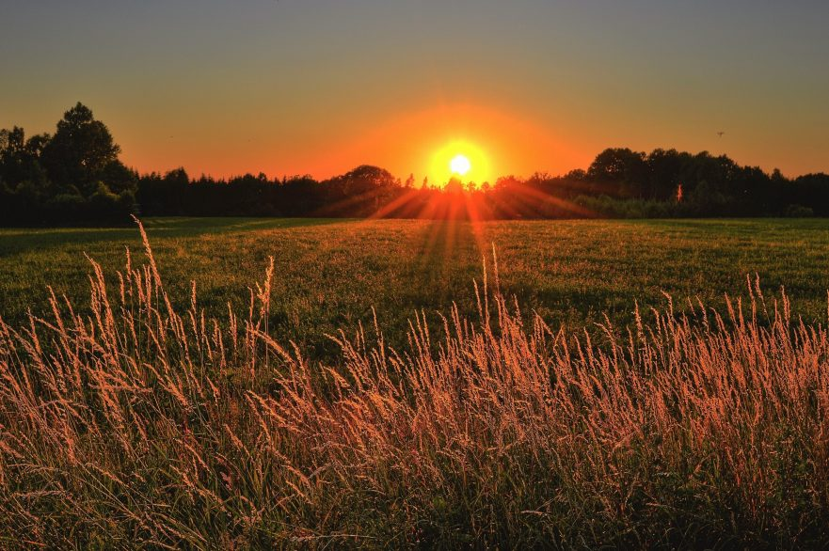
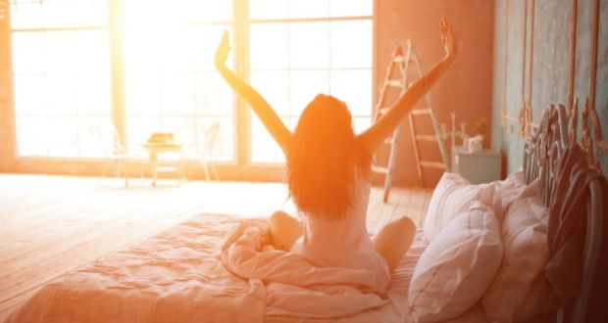
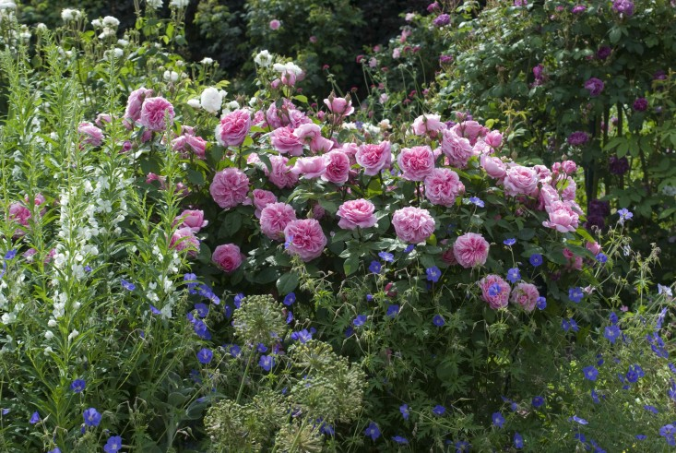
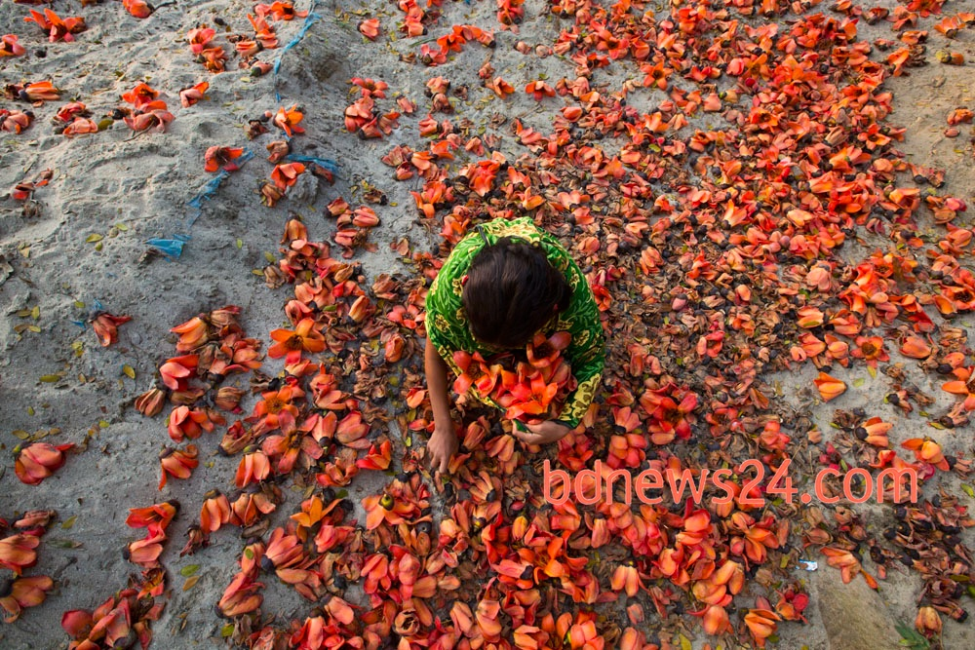
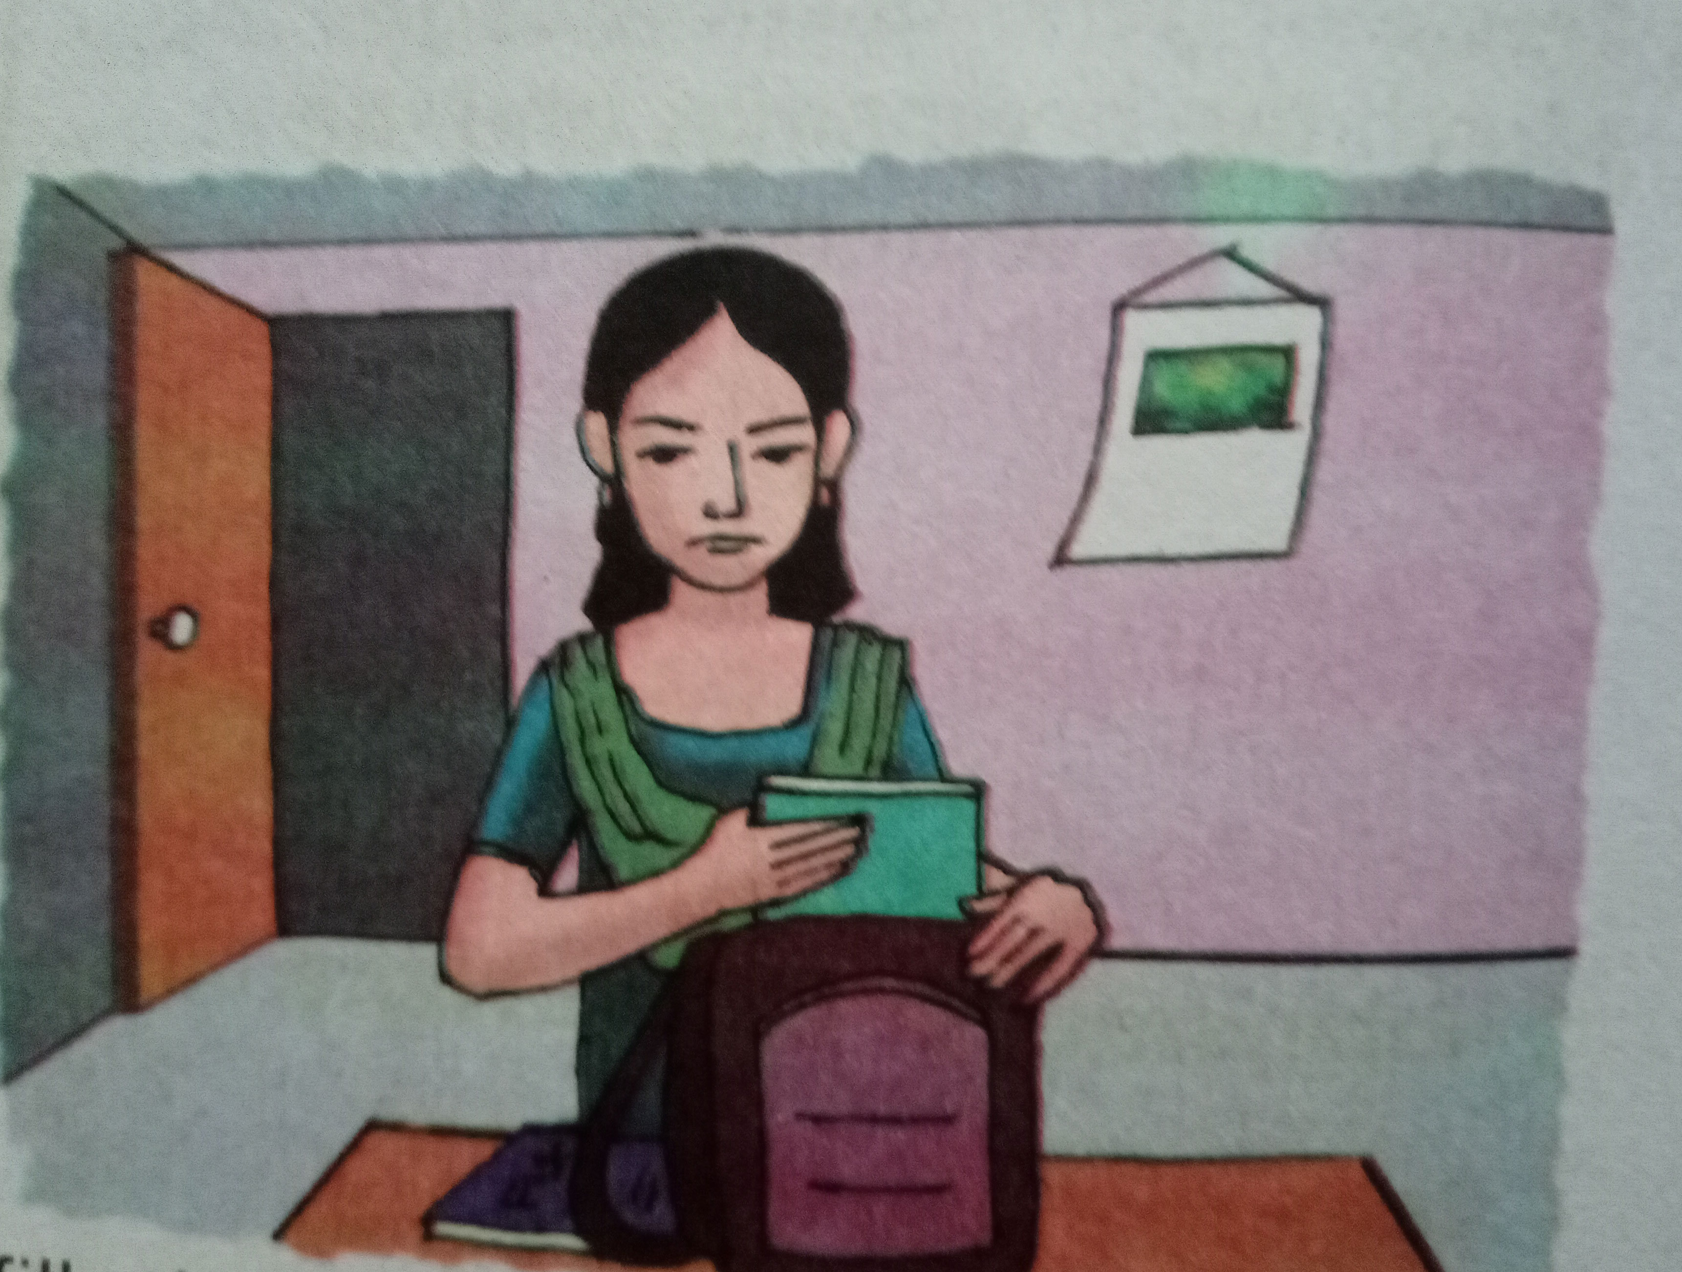
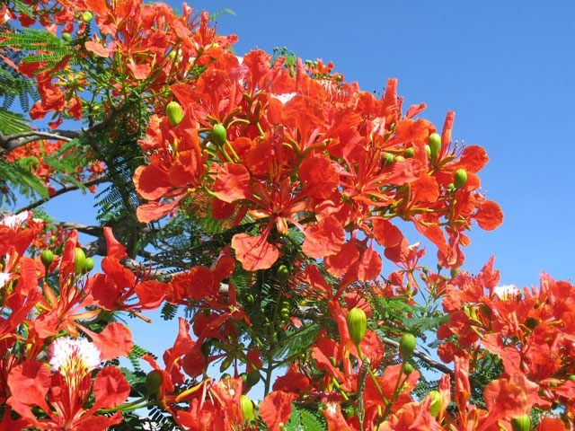
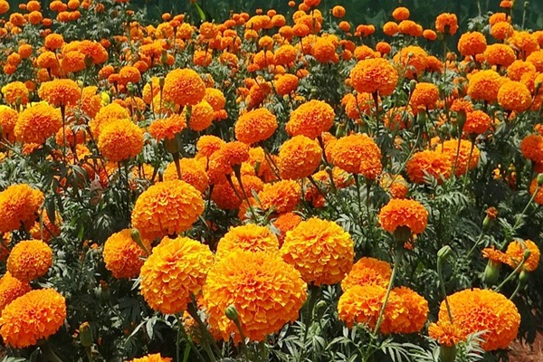
1. What do you see in picture-1?
2. What do you see in picture-2?
1
2
3. When do you see such type of scenery in picture-3?
4. What is the girl doing in picture 4?
3
4

Slide 12
Teaching Vocabulary
Do you know the meaning of these following words?
Beautiful, Spring, Get up, Early, Happy, Warm, Smell
.

Slide 13
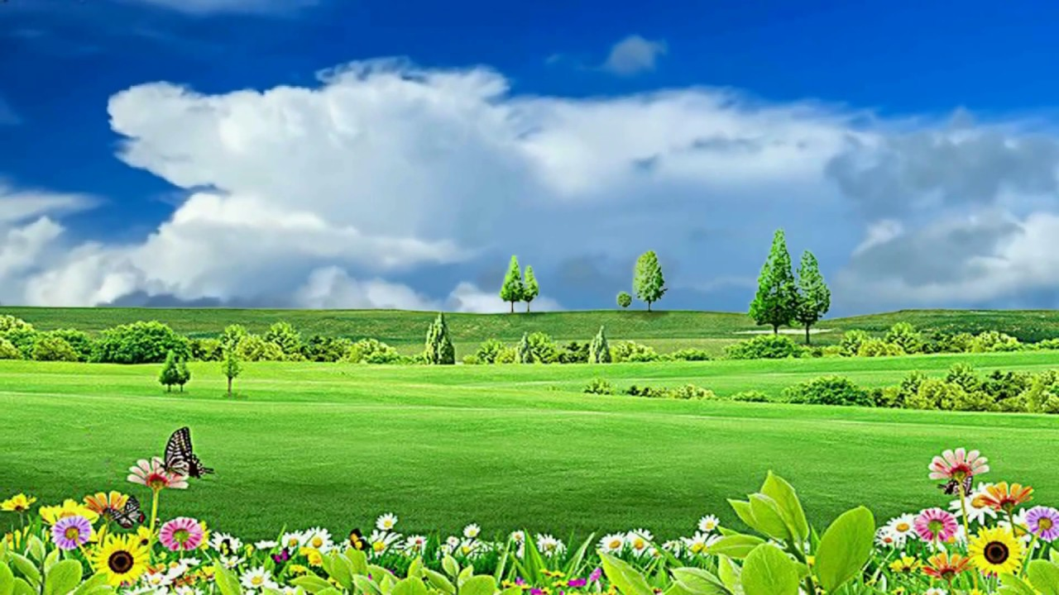
Beautiful
pleasing the senses or mind aesthetically.
Similar meaning
:
fine
Bangladesh is a very beautiful country.

Slide 14
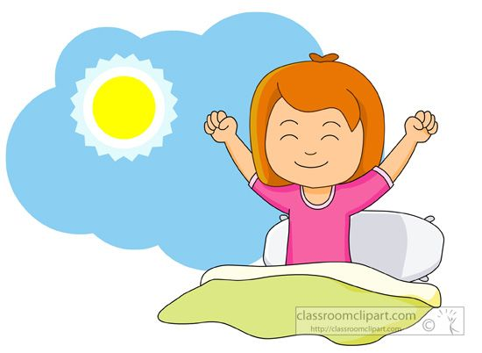
Get up
rise or cause to rise from bed after sleeping.
Similar meaning
:
Rise
I get up from bed at 5 a.m.

Slide 15
Early.
before the usual or expected time
Similar meaning
:
Soon
He gets up early. .

Slide 16
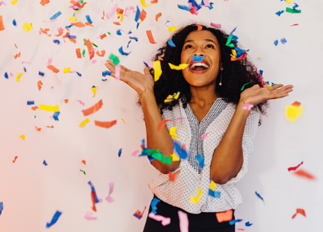
Happy
.
feeling or showing pleasure or contentment.
Similar meaning
:
cheerful
I am happy to see you.
.

Slide 17
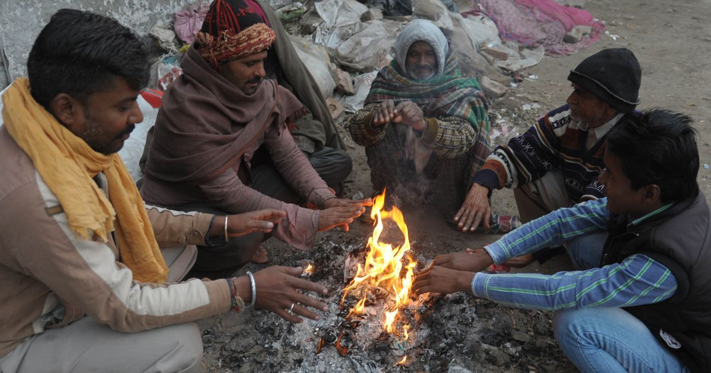
Warm
.
(especially of clothes or furnishings) providing physical ease and relaxation.
Similar meaning
:
Comfortable hot
The sunlight gives us warm in winter.
.

Slide 18
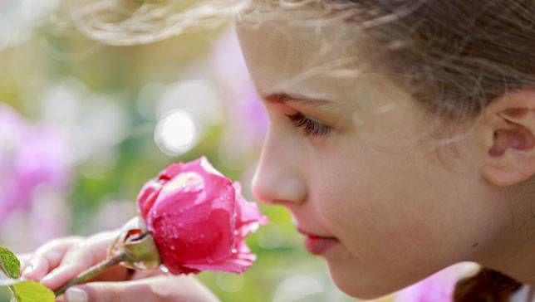
Smell
.
the faculty or power of perceiving odours or scents by means of the organs in the nose.
Similar meaning
:
scent
The rose smells sweet.
.

Slide 19
PRACTICE
Playing Game
Dear students, now we are going to play a game. It is called “Bingo Game”. Listen the instruction carefully.
After playing the game I will rewards the winner(s).

Slide 20
Let’s play the bingo game.
Beautiful
Get up
Spring
Happy
Early
Warm
Trip
Window

Slide 21
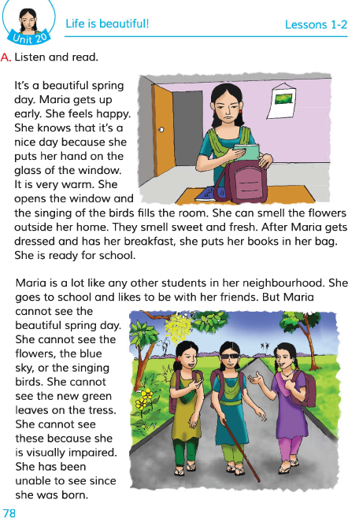
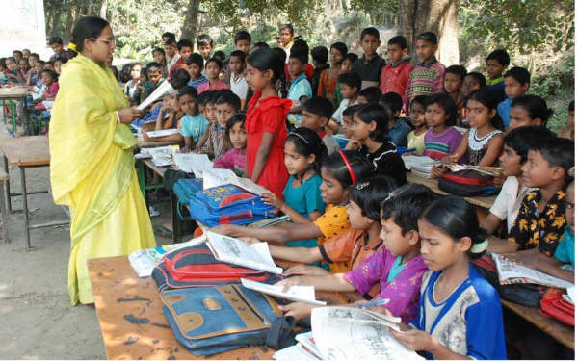
Teacher’s Model Reading
Dear students, open your English book at page 78. I am reading the text loudly, please put your fingers on the text.

Slide 22
Group Reading
In this stage the students will read the text in group.

Slide 23
Pair Reading
In this stage the students will read the text in pair.

Slide 24
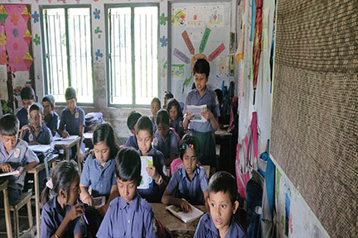
Student’s reading
In this stage one student reads the text and others listen.

Slide 25
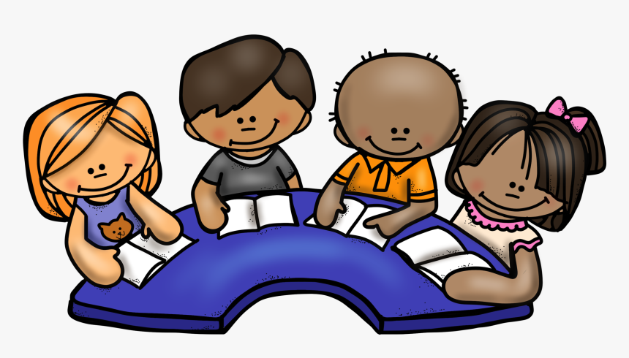
Silent Reading
Students, please read the
text silently and try to understand.

Slide 26
Group work
Now make 3 groups according to the previous class and make ready to say the answer.
:
Group A
Why does Maria feel happy?
:
Group B
2. When does Maris get up?
:
Group C
3. What season is mentioned in this text?

Slide 27
Solution to the question:
1. Maria feels happy because the weather is warm and the birds are singing. She smells the flowers outside her home. 2. Maria gets up early.
3. Spring season is mentioned in this text.

Slide 28
Pair work
Match the words in column A with their similar meaning in column B
Column A | Column B
Beautiful | Soon
Get up | Nice
Early | Comfortable hot
Warm | Scent
Smell | Rise

Slide 29
Evaluation
Solution:
Say true/ false.
It’s a beautiful winter day.
Maria is a school going girl
Maria is an early riser.
Maria is born blind.
Maria’s favourite subject is English.
False
True
True
True
False

Slide 30
Task
Make five sentences about “Your Morning activities” in your own words.

Slide 31
My dear students
very much
for your nice co-operation.

