Slide 1
Good morning

Slide 2
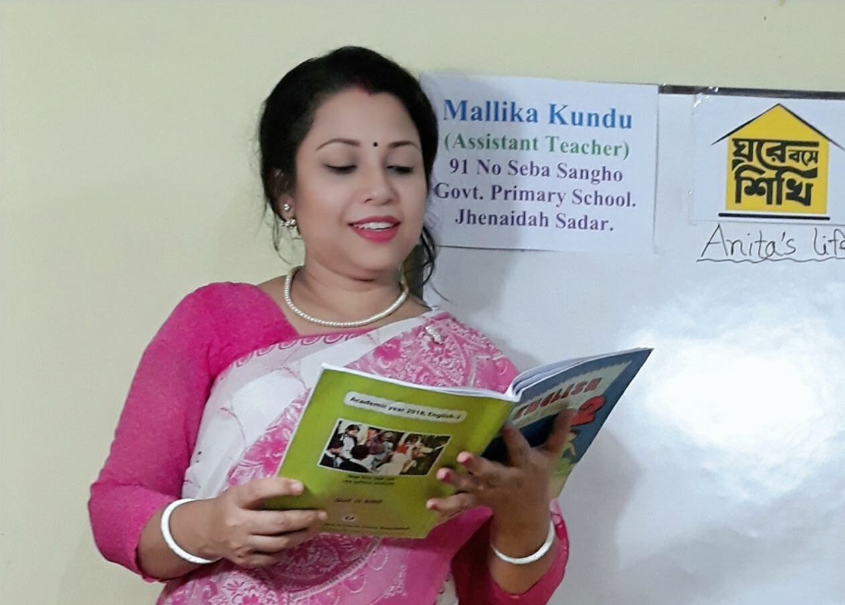
Teachers Identity
Mallika Kundu.
Assistant teacher.
91 No. Seba Sangho Govt. Primary School,Jhenaidah Sador,Jhenaidah.
mallikakundu1982@gmail.com

Slide 3
Lesson Introduction
Class- One
Subject- English.
Unit-20Alphabet(P,p)
Lesson- (4-6)
Time- 40 minute.

Slide 4
Learning Outcomes
Students will be able to-
Listening - 1.1.1- become familier with English sounds
by listening to common English word.
Speaking - 1.1.2- say simple words and phrases.
Reading - 1.2.1- recognize and read the alphabet.
Writing - 1.2.1-write non-cursive capital letters and
small letters.

Slide 5
Let’s enjoy the vedio
https://www.youtube.com/watch?v=ZVveMgtxdwY

Slide 6
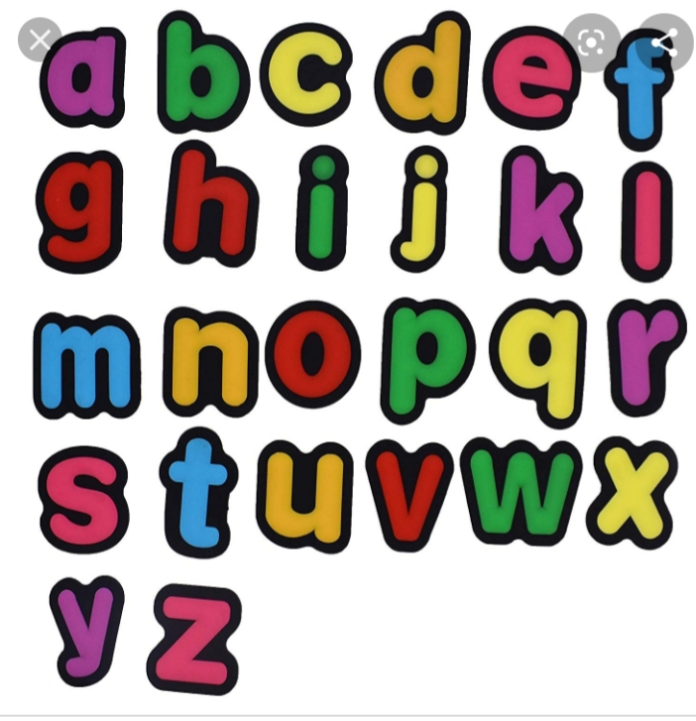
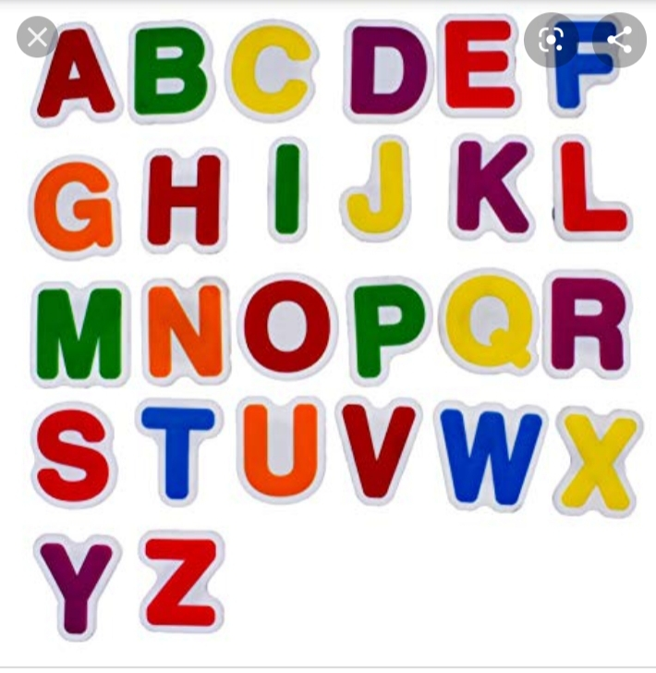
Look and think
What they are called?

Slide 7
Lesson Declaration
P p
Alphabet(P,p)

Slide 8
Open at page-41

Slide 9
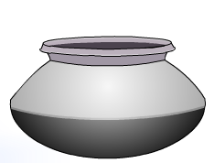
Loud reading by the teacher
WCW
P
P
encil
p
p
ot

Slide 10
Look and listen carefully
Pencil
Pot

Slide 11
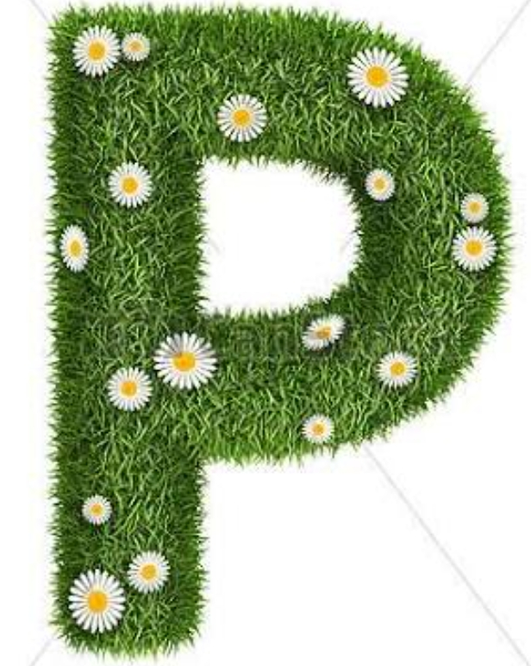
Prnounce the letter with me
Capital letter
Small letter
Capital letter
Small letter

Slide 12
Look,listen and say
Pencil

Slide 13
Look and Listen.Trace in the air
P

Slide 14
Look Listen and Say
pot

Slide 15
Look and Listen.Trace in the air
p

Slide 16
Match the picture with the letter
Group Work
p
P

Slide 17
Say and read.Trace and write.
WCW
P
P
P
p
p
p

Slide 18
Individual Work
Say ,trace and write
P
encil
P
ot
encil
ot
p
p
ncil
t

Slide 19
Evaluation
Write noncursive small letter-
p

Slide 20
GOOD BYE

