Slide 1
Welcome to all

Slide 2
Introduction
Md Shahneoaz
Assistant Teacher (English)
Jalalabad B/L High School,Sylhet.
E-mail: shahneoazmd@yahoo.com
Cell: 01631712091
Class: ix
English 1st paper
Unit-7, Lesson-2 (B)
Time- 45 Minutes

Slide 3
Click below and say who the performer is:
https://youtu.be/aUFIuE4MDNk
Can you say what it is called?

Slide 4
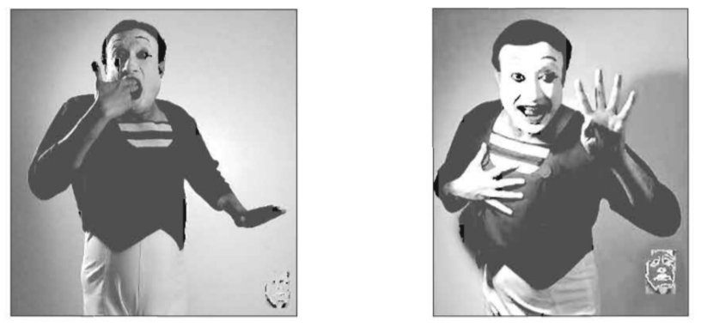
Topic: The Art of Silence

Slide 5
Learning Outcomes:
After finishing this lesson students will be able to-
say what the art of silence is.
describe the biography of Partha Pratim Majumdar.
ask answer some questions.

Slide 6
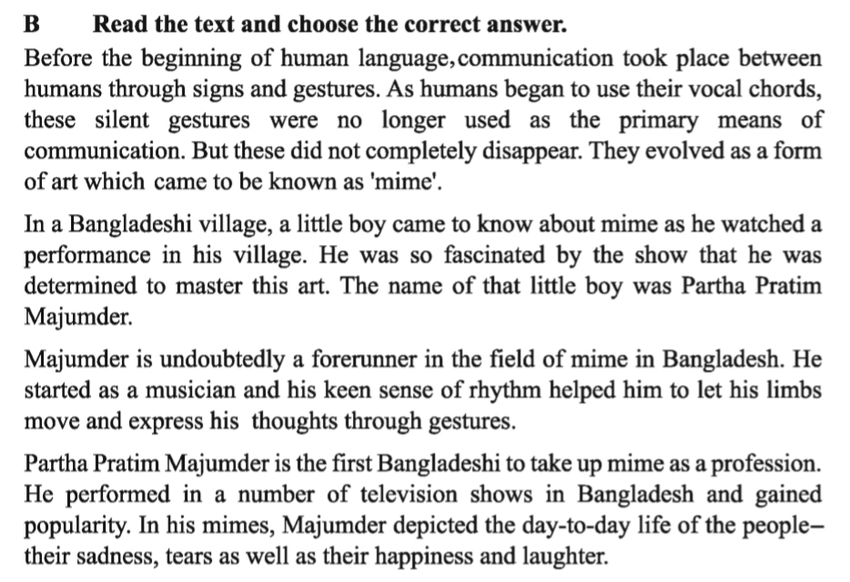
Read the passage in unit-5, lesson-1 (A)
Silent Reading

Slide 7
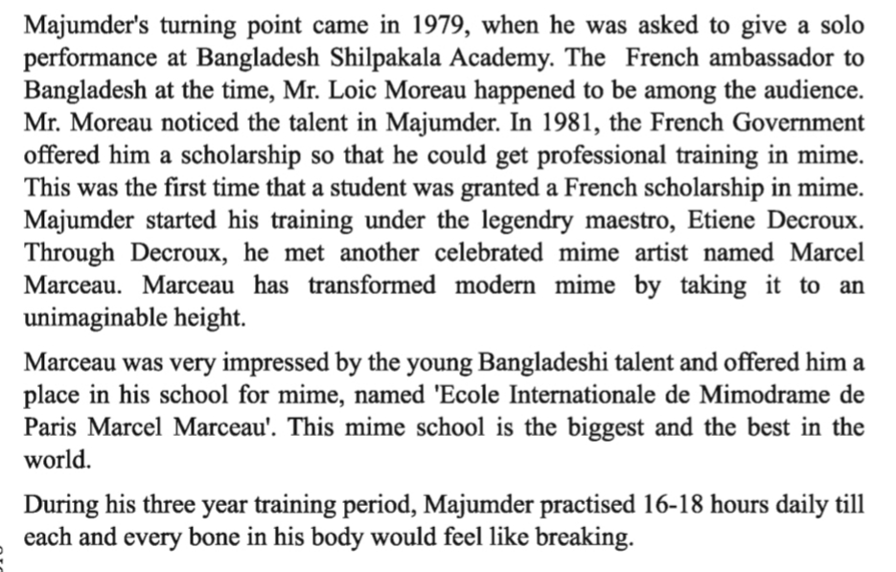
Read the passage in unit-5, lesson-1 (A)
Silent Reading

Slide 8
Read the passage in unit-5, lesson-1 (A)
Silent Reading

Slide 9
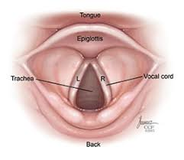
Let’s be introduced with new Words:
Gesture
Sign/Indication
Vocal Processes
Vocal Chords

Slide 10
Let’s be introduced with new Words:
Fascinated
strongly attracted and interested
A forerunner is someone or something that came before and paved the way for something today.
Forerunner

Slide 11
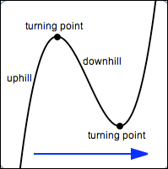
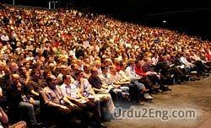
Let’s be introduced with new Words:
Turning Point
A point at which something changes direction
Spectators/listeners/viewers
Audience

Slide 12
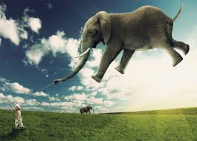
Let’s be introduced with new Words:
Unimaginable
Unthinkable/ inconceivable
In a way that shows enthusiasm
Enthusiastically

Slide 13
Open ended questions:
Group Work
1. What is mime?
Ans. Mime is the theatrical technique of suggesting action, character, or emotion without words, using only gesture, expression, and movement.
2. What helped Majumder to express himself clearly while performing mime?
Ans. His keen sense of rhythm helped him to express himself clearly while performing mime
3. What did he depict through his performance at the beginning?
Ans. He depicted the day-to-day life of the people- their sadness, tears as well as their happiness and laughter.

Slide 14
Open ended questions:
Group Work
4. Why was the French ambassador impressed when he saw Majumder’s performance?
Ans. The French ambassador was impressed noticing the talent of Majumder.
5. Describe the awards in art and culture that Majumder received. Why were they given to him?
Ans. Majumder won ‘Moliere Award’ in 2009, ‘Ekushe Padak’ in 2010 and ‘Chevalier de I’ odre des Arts et des Lettres’ in 2011. They were given to him in recognition of his outstanding contribution in the art of silence.

Slide 15
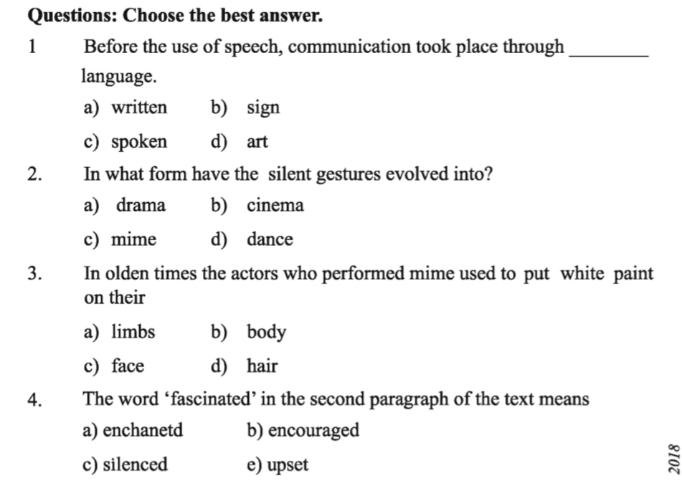

Slide 16
Thanks a lot for being with me

