Slide 2
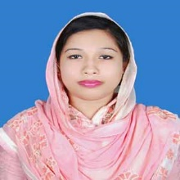
English 1st Paper, Class 9-10
Anjuman Ara Runu
Assistant Teacher( English)
Lohalia Union Secondary School.
Patuakhali sadar.

Slide 3
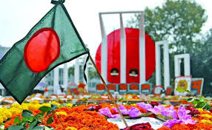
1.What do you see in the picture?
2.What is the other name of this day?

Slide 4
2
Unit 3, Lesson -4

Slide 5
Learning Outcomes:
At the end of the lesson ,ss will be able to-
read and understand the text.
Write answers to the questions.
Complete the passage with suitable words.

Slide 6
New Vocabs
Diversity (Noun)
Meaning-variety, multiplicity.
Example: Flowers have the diversity of colour.

Slide 7
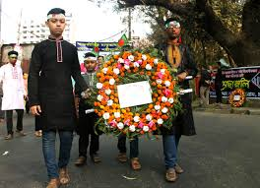
Wreaths (Noun ) –
Meaning – A garland, A chaplet
Example: In 21 February we place wreaths at the Shaheed Minar.

Slide 8
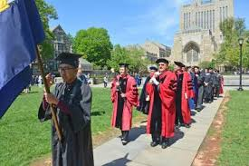
Procession (Noun)
A train of persons in a formal march
Example: Police opened fire on the procession of students in 1952.

Slide 9
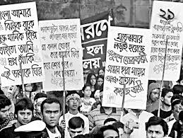
Organise (Verb)
Meaning -Bring into unity or working order.
Example:Students organized a procession on the 21 February.

Slide 10
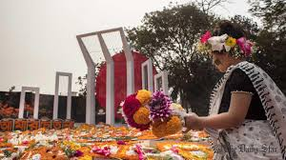
Observe (Verb).
See or behold with attention
Example:We observe Shaheed Dibos every year.

Slide 11
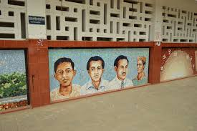
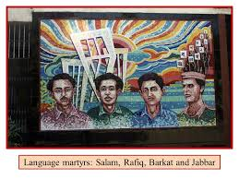
Martyrs
A sufferer for devotion to cause.
Example: The martyrs laid down their lives to establish Bengali language.

Slide 12
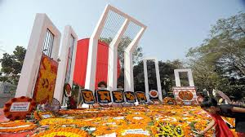
Read the text.
21 February is observed as Shaheed Dibosh every year throughout the country in remembrance of the martyrs of language movement of 1952.The commemoration begins at the early hours of the day with mourning songs that recall the supreme sacrifices of our language martyrs.

Slide 13
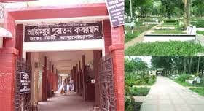
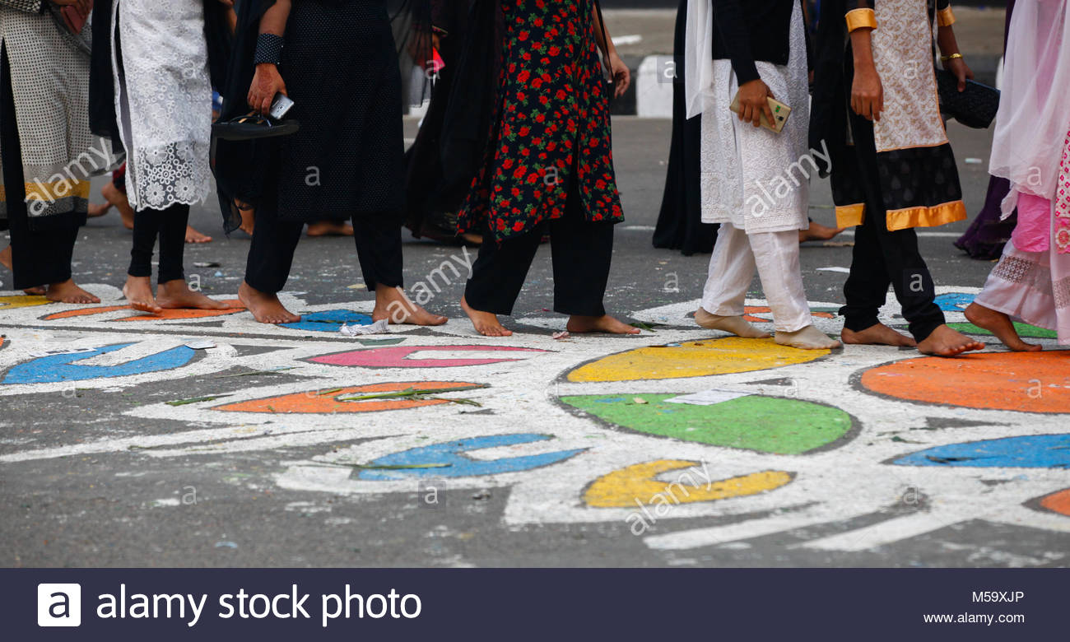
People wear black badges and go to the Shaheed Minar in barefoot processions,singing mourning songs.They place wreaths at the Minar. Many of them visit the graves of the martyrs at Azimpur graveyard and pray for them.They also attend various programmes organised in remembrance of the language martyrs.

Slide 14
The UNESCO (United Nations Educational, Scientific and Cultural Organisation) on 17 November in 1999 proclaimed February 21 as the International Morther Language Day in recognition of the sacrifices of the martyrs for the rightful place of Bangla. The day is now annually observed worldwide to promote awareness of linguistic and cultural diversity and multilingualism.

Slide 15
Pair Work
Answer the questions.
1.Why is 21 February called Shaheed Dibosh?
2.Why do people go to the Shaheed Minar? How do they go there?
3.Why is 21 February now observed throughout the world every year?

Slide 16
Match the answer.
1.It is called Shaheed Dibosh’ as our martyrs sacrificed their lives on this day for our language.
2.People go to the Shaheed Minar to show respect to the martyrs.They go there barefooted in procession singing mourning song.
3.21 February is observed throughout the world every year as on 17 November 1999 UNESCO has declared it as ‘International Mother Language Day’

Slide 17
Group Work
Complete the passage with suitable words.
On 21 February 1952 ---blood------- was shed at a place between Dhaka Medical College and Dhaka University----area--- to establish Bangla as a state --language------of Pakistan. All subsequent movements including----- struggles for independence had their origin in the historic language --movement-------. Shaheed Minar is the -symbol----------- of the supreme sacrifice -for------- the mother tongue.

Slide 18
Evaluation
1.What is the other name of 21 February?
2.When did UNESCO proclamation come?
3.Where do people go with wreaths on 21 February?

Slide 19
Homework
How did you observe this year’s 21 February at your school?Write about it in ten sentences at your own word.

