Slide 1
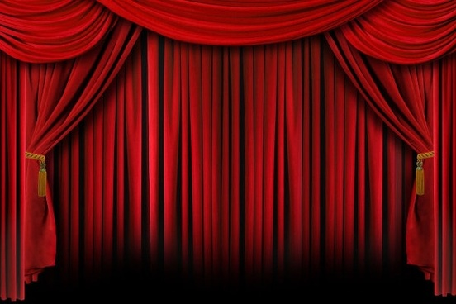

Slide 2
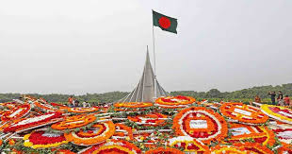
Welcome to English Class
Class 9, English For Today, Unit_3, Lesson_5
Notes:
Welcome slide. This picture is related to the topic. So I have chosen it. Teacher may change it if he wants.

Slide 3
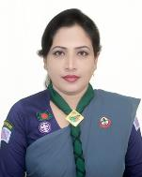
Information
Sunayana Roy
Secretary Bangladesh Scouts Kachua Upozilla,
Bagerhat,Khula.
somabgt@gmail.com
Class 9, English For Today, Unit_3, Lesson_5

Slide 4
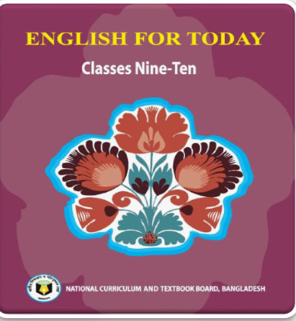
Class: Nine-Ten
English For Today
Unit: 3 “Events and festivals”
Time: 50 mins.
29/8/2020
Class 9, English For Today, Unit_3, Lesson_5

Slide 5
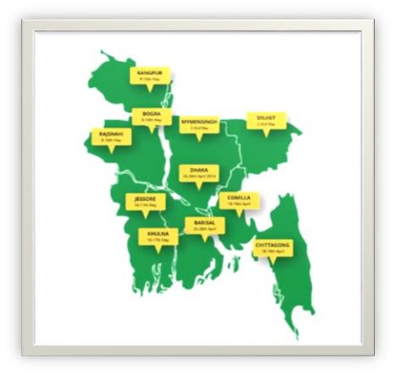
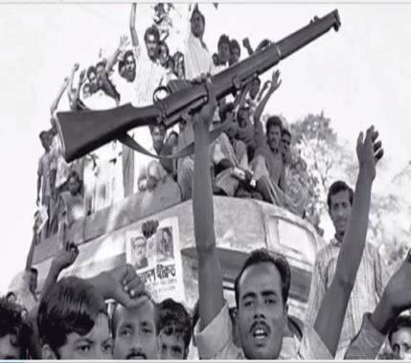
What do you see in this picture
What do you see in the picture
Excitement of independence
Map of independent Bangladesh
Class 9, English For Today, Unit_3, Lesson_5

Slide 6
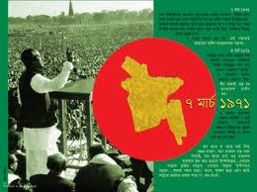
Class 9, English For Today, Unit_3, Lesson_5

Slide 7
Let’s watch a video
What do you enjoy at this video?
A song of our independence
Class 9, English For Today, Unit_3, Lesson_5

Slide 8
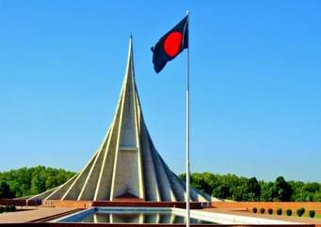
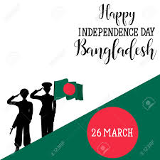
Unit: 3
Lesson: 5
Our topic is
Independence Day
Class 9, English For Today, Unit_3, Lesson_5

Slide 9
Aims and Objectives
After Ss, have studied this lesson they will be able to……
Talk about event and festivals .
Ask and answer questions and give opinions in a logical sequence.
Infer meaning from the context .
Describe the grammar point.
Class 9, English For Today, Unit_3, Lesson_5

Slide 10
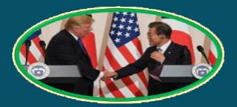
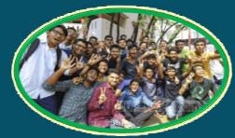
Word
Meaning
Diplomate
government representative abroad
A Korean diplomate is meeting with Trump
Enthusiasm
excited
The students enjoy the result with enthusiasm
Class 9, English For Today, Unit_3, Lesson_5

Slide 11
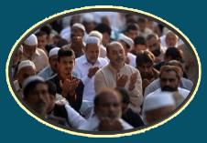
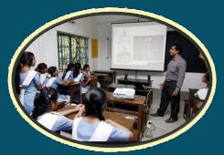
Word
Meaning
very strong feelings about something
Fervour
Eid ul Azha to be celebrated with religious fervour
Illuminate
light up
Education illuminates our life
Class 9, English For Today, Unit_3, Lesson_5

Slide 12
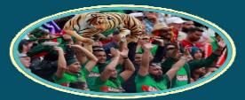
Word
Meaning
Spectacular
Extremely good
The scenery looks very spectacular.
Spectator
viewer
The spectators are enjoying the game.
Class 9, English For Today, Unit_3, Lesson_5

Slide 13
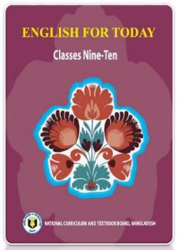
Open at page 36 and read the text
26 March, our Independence Day, is the biggest festival. The day is celebrated every year in the country with great enthusiasm and fervor. It is the national holiday. All offices, educational institutions, shops and factories remain closed on this day. The day begins with a 31 gun salute.
Early in the morning the President and the Prime Minister on behalf of the nation place floral wreaths at the National Mausoleum at Savar. Then other leaders, political parties, diplomates, social and cultural organizations, educational institutions and freedom fighters pay homage to the martyrs. People from all walks of life also go there in rallies and processions. There are many cultural programs throughout the day, highlighting the heroic struggle and sacrifice in 1971.
Class 9, English For Today, Unit_3, Lesson_5

Slide 14
The country also witnesses a spectacular parade of defence forces, border guards, police, ansars and the VDP (Village Defence Party) at the National Parade Ground near the National Parliament. In Bangabondhu National Stadium, school children, scouts and girl guides take part in various displays to entertain thousands of spectators. Educational institutions also organize their individual programs. Sports meets and tournaments are also organized on the day, including the exciting boat race in the river Buriganga.
In the evening, all major public buildings are illuminated with colorful lights. Bangla Academy, Bangladesh Shilpakala Academy and other socio-cultural organizations hold cultural functions are also arranged in other places in the country.
Class 9, English For Today, Unit_3, Lesson_5

Slide 15
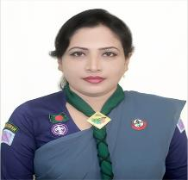
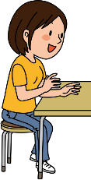
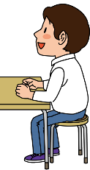
Individual work
12
1
Time 5mins
11
10
2
Match the words with their meanings.
9
3
Words | Meanings
fervour alike spectator displays Illuminate | acts of performing skills to light up in a similar way a strong feeling of excitement a person, who is watching an event
8
4
7
5
6
Check your answers.
fervour
a strong feeling of excitement
alike
in a similar way
spectator
a person, who is watching an event
displays
acts of performing skills
Illuminate
to light up
Class 9, English For Today, Unit_3, Lesson_5

Slide 16
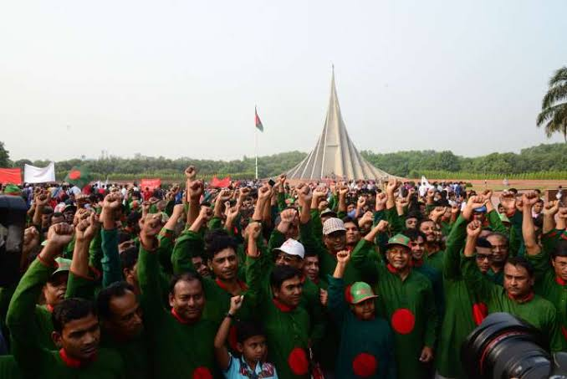
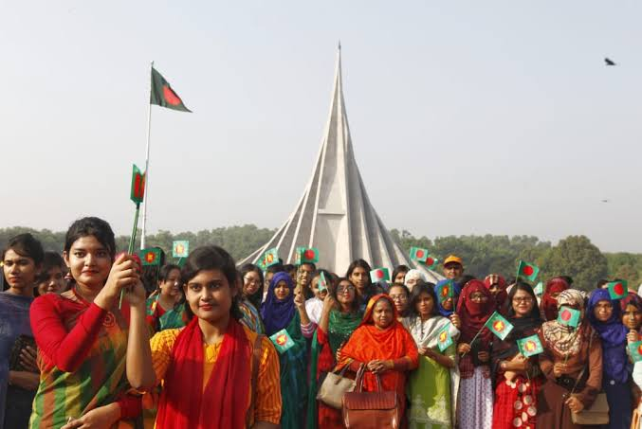
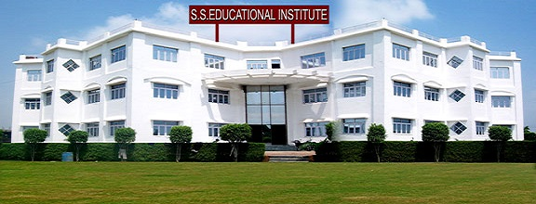
26 March, our Independence Day, is the biggest state festival.
The day is celebrated every year in the country with great enthusiasm and fervor.
It is a national holyday. All offices, educational institutions, shops and factories remain closed on this day.
The day begins with a 31 gun salute.
Class 9, English For Today, Unit_3, Lesson_5

Slide 17
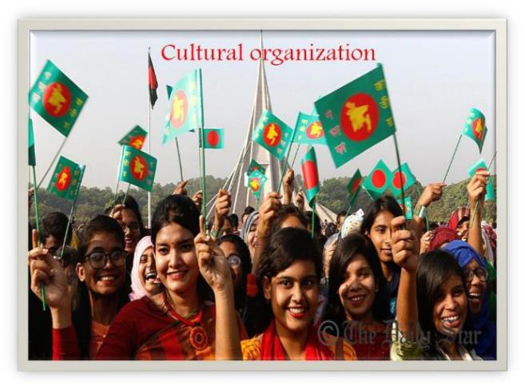
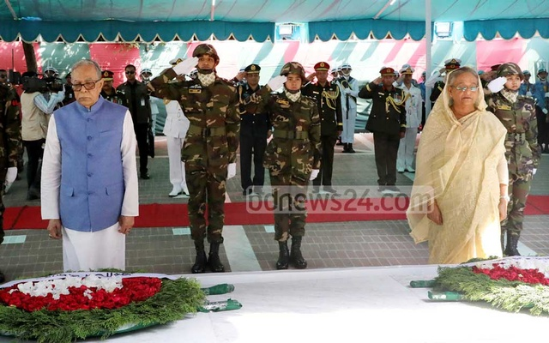
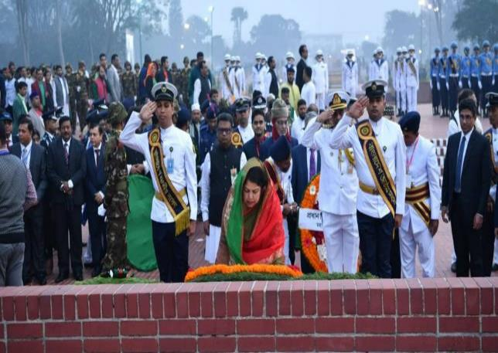
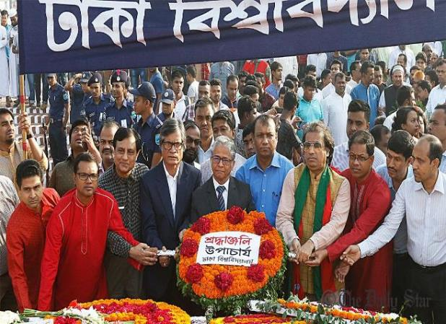
Early in the morning the President and the Prime Minister on behalf of the nation place floral wreaths at the National Mausoleum at Savar.
Then other leaders, political parties, diplomats, social and cultural organizations, educational institutions, and freedom fighters pay homage to the martyrs,
Class 9, English For Today, Unit_3, Lesson_5

Slide 18
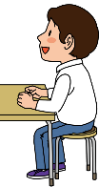
Time 5mins
12
1
Pair work
11
10
2
Answer the following questions
9
3
How do we pay homage to the martyrs?
2. Which leading organizations of our country organize
cultural programmers' on this day?
8
4
7
5
6
Check your answers.
Ans:
1. We pay homage to the martyrs by placing floral wreaths at
the National Mausoleum at Savar.
Ans:
2. Bangla Academy and Bangladesh shilpakala Academy
organize cultural programmes on this day.
Class 9, English For Today, Unit_3, Lesson_5

Slide 19
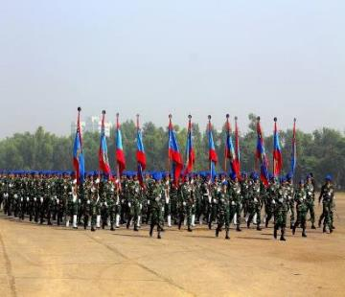
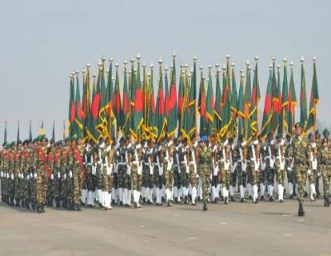
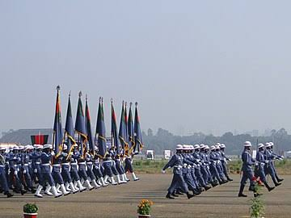
The country also witness a spectacular parade of defense forces, border guards, police, ansars and the VDP (Village Defense Party) at the National Parade Ground near the National Parliament. In Bangabandhu National Stadium, School children, scouts and girl guides take part in various displays to entertain thousand of spectators.
Class 9, English For Today, Unit_3, Lesson_5

Slide 20
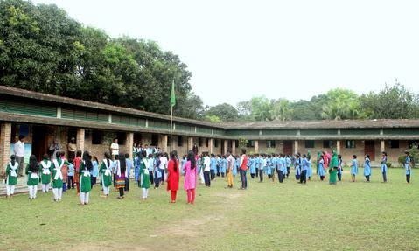
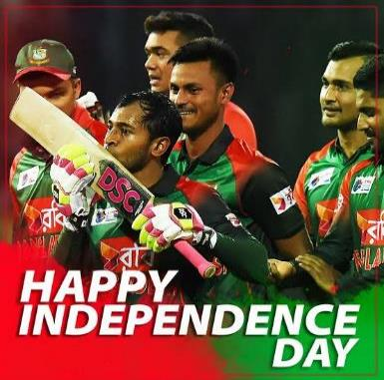
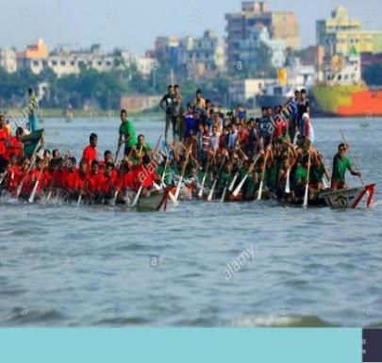
Educational institutions also organize their individual programs. Sports meets and tournaments are also organized on the day, including the exciting boat race in the river Buriganga
Class 9, English For Today, Unit_3, Lesson_5
Class 9, English For Today, Unit_3, Lesson_5

Slide 21
Group work
Time 5mins
12
1
11
10
2
Answer the following questions
9
3
Question:1
What do the cultural programmes highlight?
Question:2
How do we become inspired from this passage?
8
4
7
5
6
Check your answers.
Ans:1
The cultural programmes highlight the heroic struggle and sacrifice of our National Mausoleum located at Savar.
Ans:2
From this passage, we become inspired to sacrifice our lives for the cause of the country. We are encouraged to defend the honor and dignity of our motherland at any cost.
Class 9, English For Today, Unit_3, Lesson_5

Slide 22
Now tick the best answers from the alternative.
Our biggest state festival is –
(a) Victory day (b) Shahid Dibosh (c) Pahela Boishakh (d) Independence Day
The celebration of independence day begins with –
(a) procession (b) gun salute (c) playing wreaths at the National Mausoleum (d) parade
by defense forces
The National Mausoleum is –
(a) on Dhaka University Campus (b) Ramna Park (c) at Savar (d) near Dhaka
Medical College
On independence day various displays are held –
(a) at the National Parade Ground (b) in the street (c) in the decorated vehicles (d) in Bangabandhu Stadium
‘Enthusiasm’ means –
(a) ambition (b) celebration (c) dedication (d) zeal
Class 9, English For Today, Unit_3, Lesson_5
Class 9, English For Today, Unit_3, Lesson_5

Slide 23
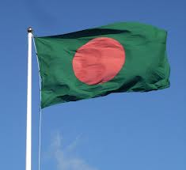
Home work
Write, In brief, how, in your school you celebrated this years--
“Independence Day”

Slide 24
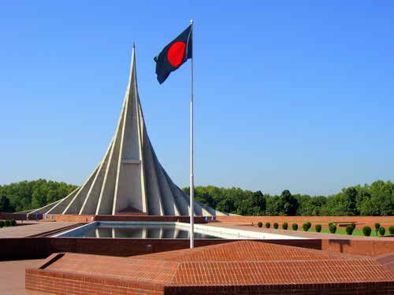
Thanks to
all

