Slide 1
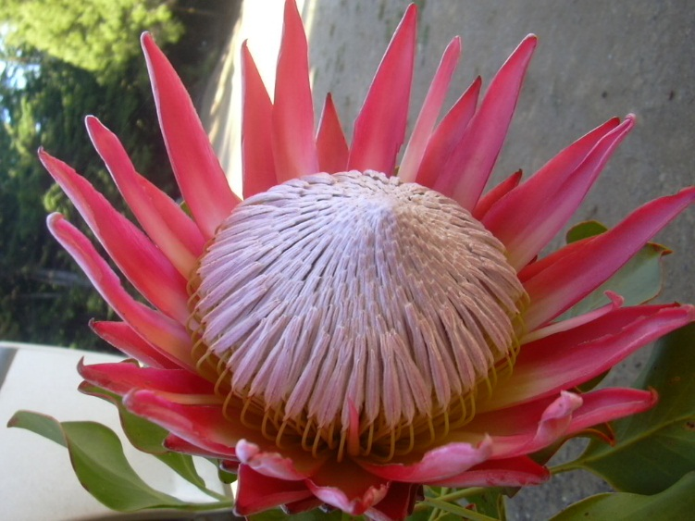
WELCOME
National flower of South Africa

Slide 2
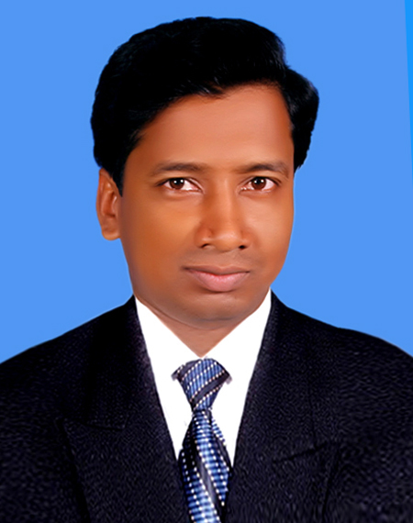
Teacher’s Introduction
Rafiqul Islam
B.A (Hons), M.A (English)
Lecturer in Enghlish
Cell:01748906711
E-mail:
prof.rafiqulislam1981@gmial.com

Slide 3
Subject Introduction
Class:Alim 1st year
Subject:English 1st paper
Unit:One
Lesson: Two
Time:45minutes

Slide 4
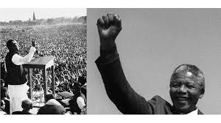

Slide 5
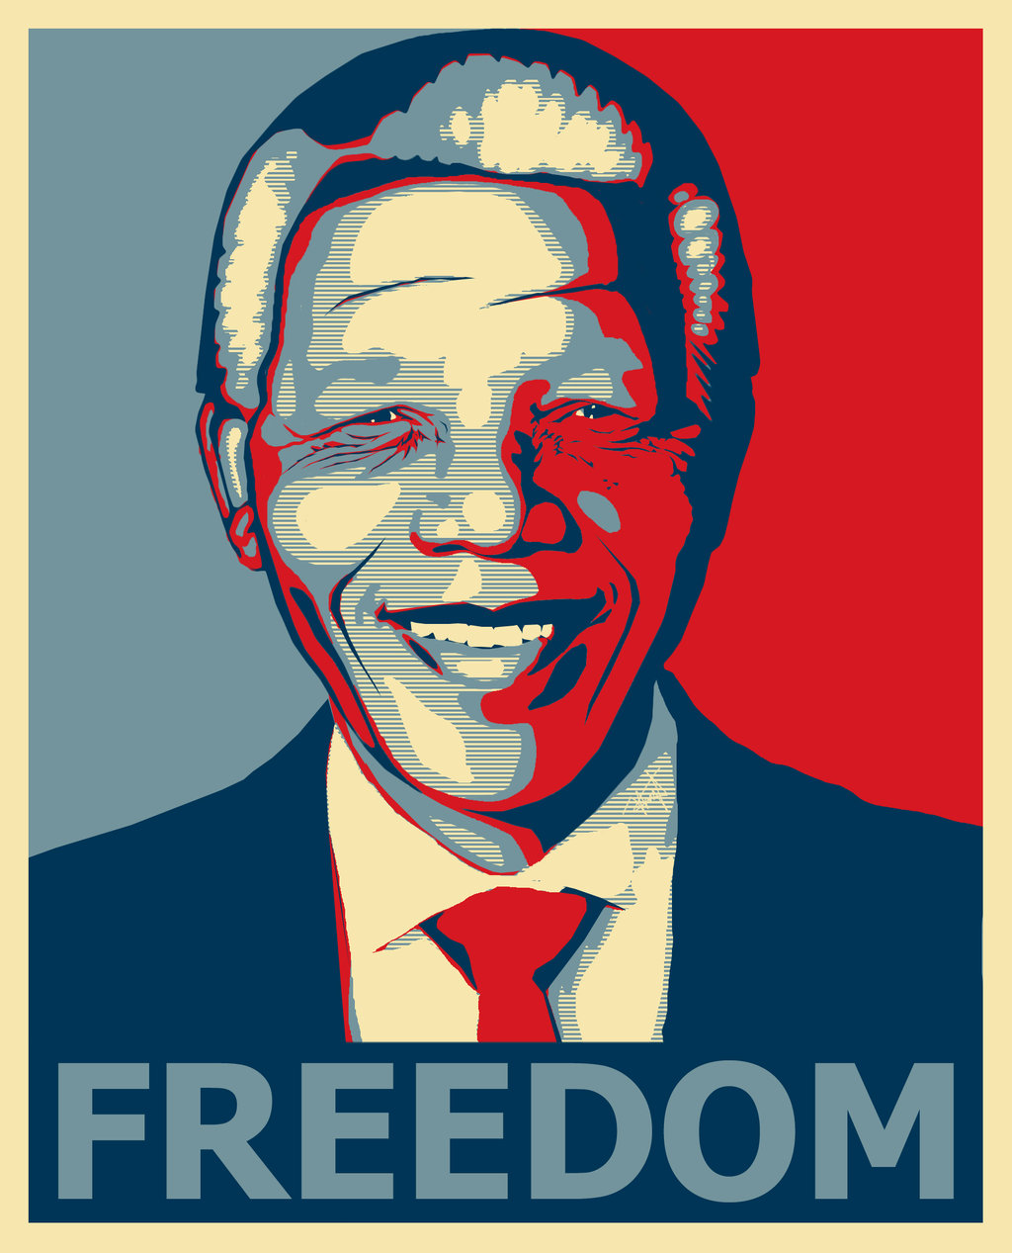

Slide 6
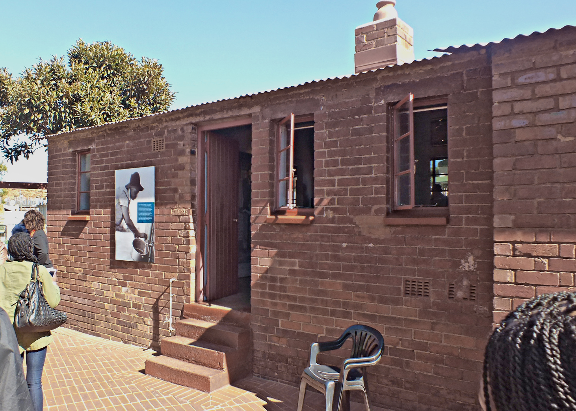
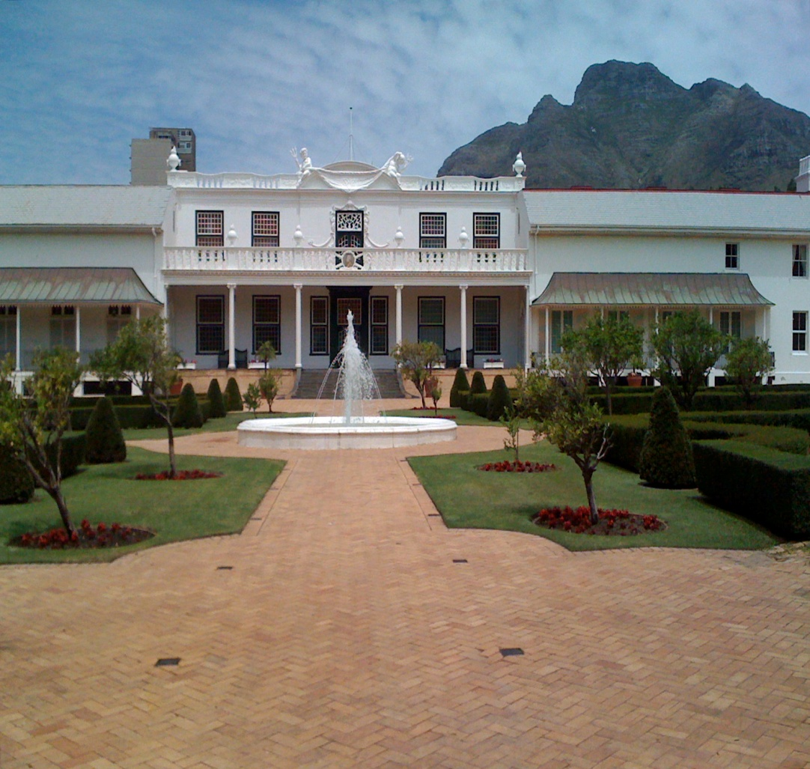
President House of South Africa
Paternal Residence of Nelson Mandela

Slide 7
Today’s Lesson
Nelson Mandela,from Apartheid Fighter to President.

Slide 8
Learning Outcomes
01.Identify some world famous personalities.
02.Describe the synonym & antonym some confusing words.
03.Speak about Nelson Mandela & his contribution.
04.Explain ‘a brief history of South Africa.’

Slide 9
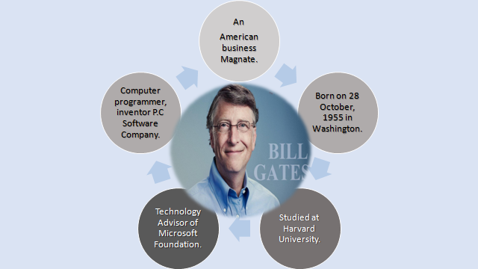

Slide 13
Individual Work
5 minutes
1. How many people describe?
2. What is the birth place of Mandela?
3. Who is our national poet?
4. Read the text loudly one by one.

Slide 14
Look at the video

Slide 15
Pair Work
4 minutes
Discuss about the synonym & antonym the following words in every pair.

Slide 17
antonym
freedom
factual
synonym
chain
unreal
word
shackle
apartheid
emancipation
mythic
charisma
chasm
Race hatred
personality
liberation
gap
unity
closure
bandage
repulsion

Slide 18
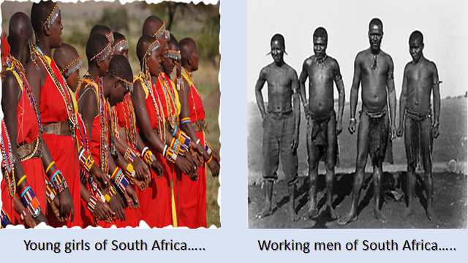

Slide 19
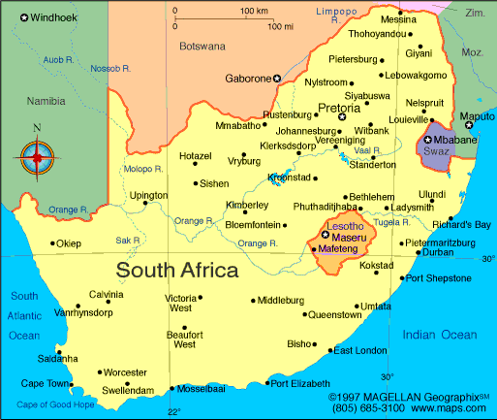
Republic of South Africa
Capital City – Pretoria
Largest City- Johannesburg
Official Languages in total -11
Ethnic group-80.2% Black African
Total Area-12,21,037 sq.km
Population- 5,49,56,900.
Population Density- 42.4 sq. km

Slide 21
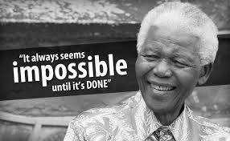
Icon: Icon means idol. It is a visual representation of an object or scene or person.

Slide 24
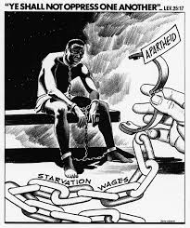
Apartheid: The term refers to race discrimination. Nelson Mandela fought against apartheid and struggled for everybody’s equal opportunities.

Slide 25
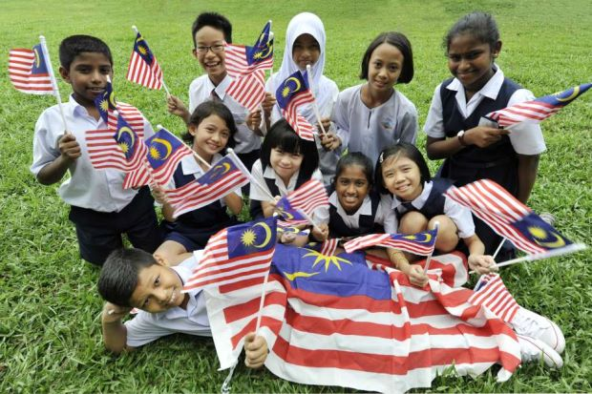
Multi-rascial Democracy: Multi-racial Democracy means equal right and justice for everyone irrespective of race, religion, caste, etc.

Slide 26
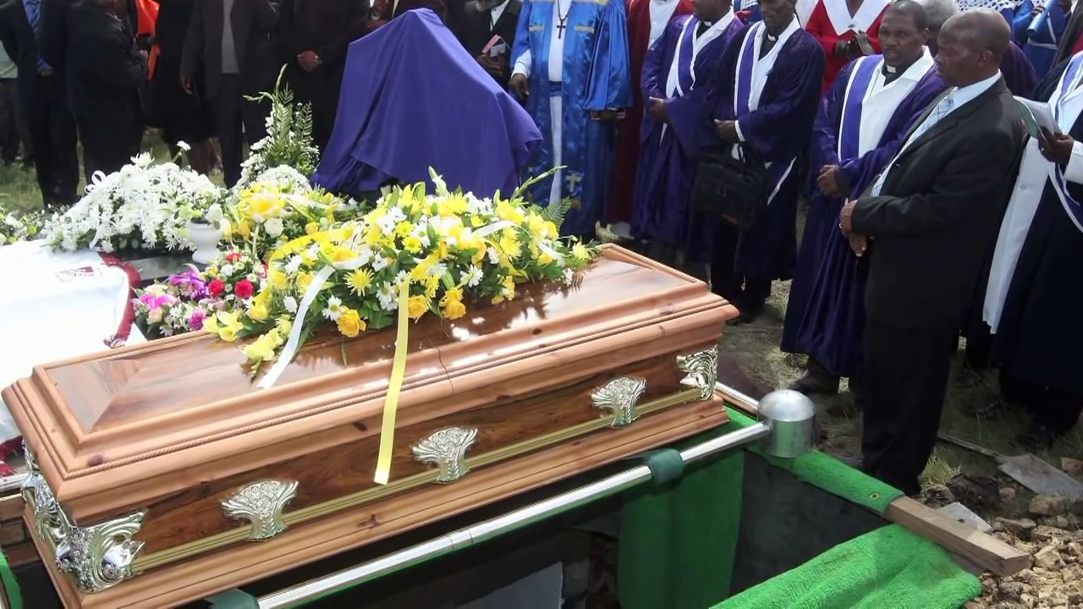

Slide 27
Group Work
10 minutes
01.Group( S).Write down a brief history of South Africa.
01.Group (M).Write with which leader of Bangladesh do you find a similarity with Mandela? How?

Slide 28
Evaluation
Fill up the blanks in the given sentences:
Icon means ……………………………….
Apartheid refers to………………………………..
Democracy refers to the equal right and justice for ……………………...
Mandela was imprisoned for nearly……………….years.

Slide 29
Home Assignment
Why is Nelson Mandela so famous? (Write in ten sentences)

Slide 30
Thank you Very Much

