Slide 2
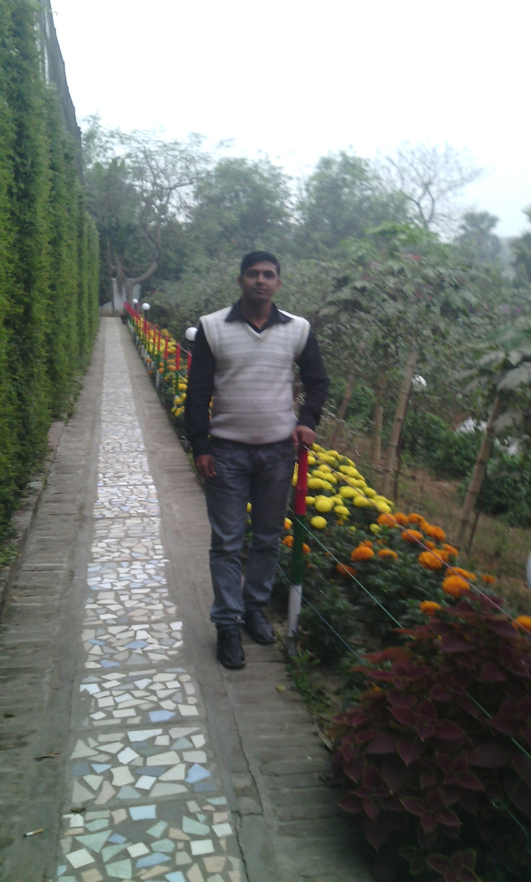
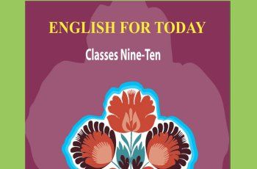
UJJAL KUMAR GHOSH
Assistant Teacher(English)
Chuadanga Krishnanagor High School
Panjia,Keshabpur Jassore.
Email:ujjalkumar106@gmail.com

Slide 3
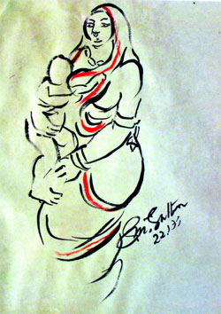
Affection of Mother
What are you looking In the picture?

Slide 4
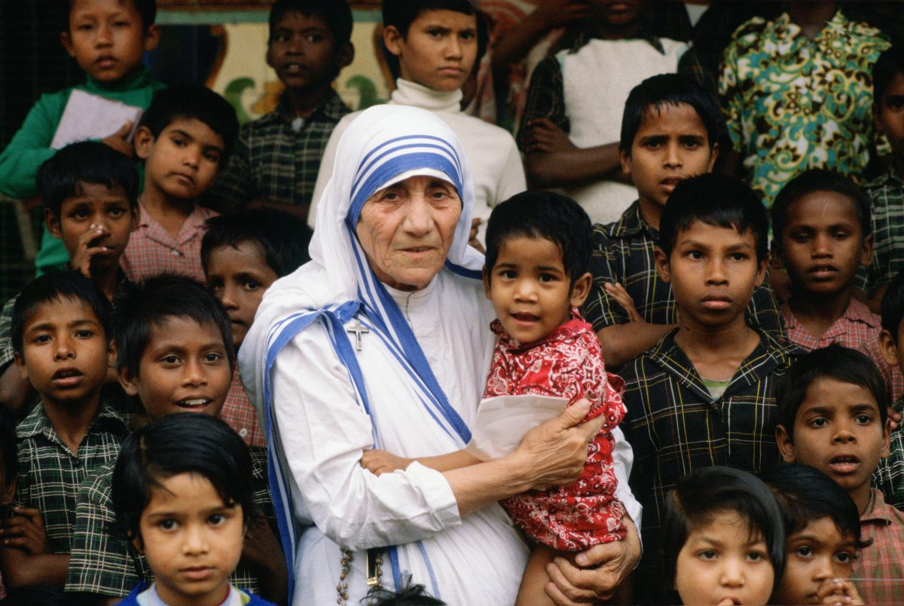

Slide 5
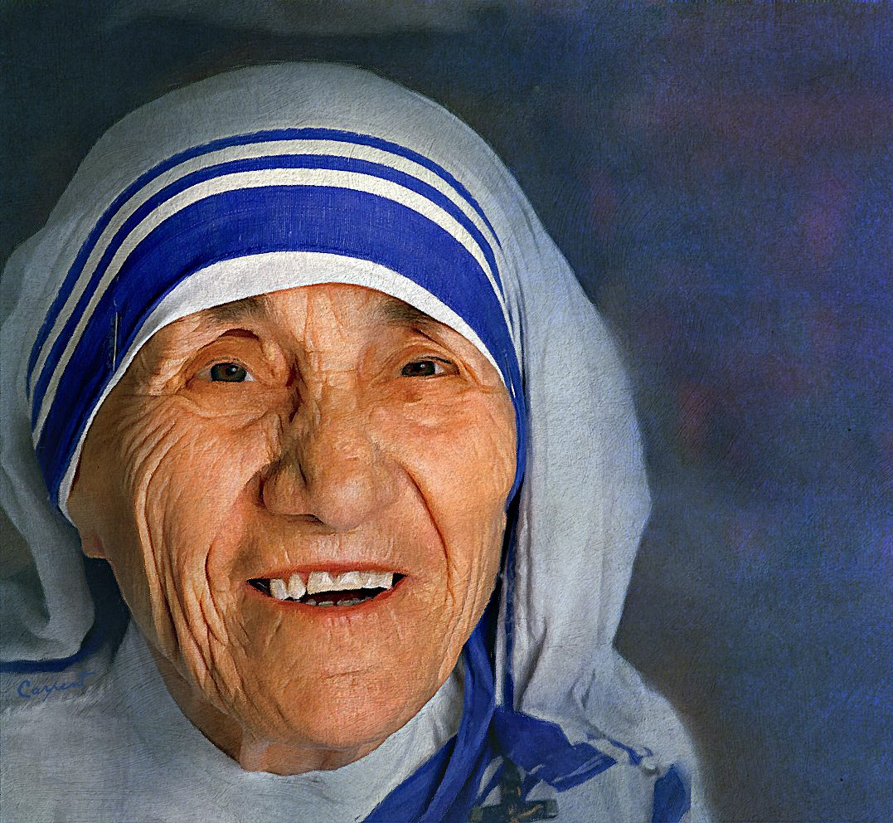
Who is this person?
Mother Teresa

Slide 6
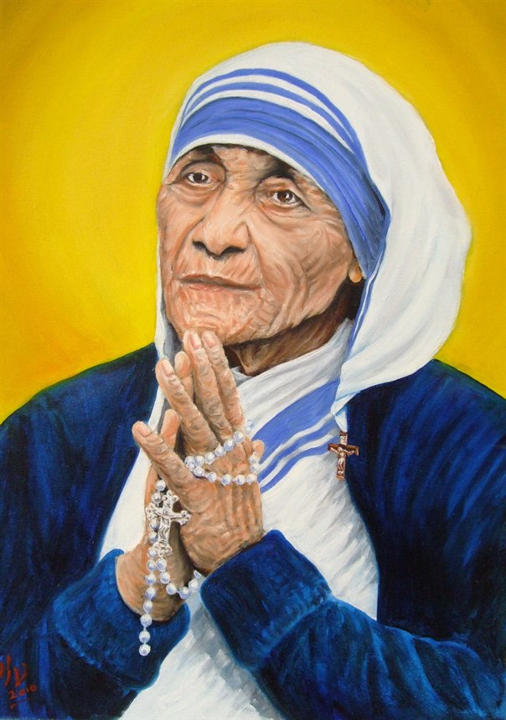

Slide 7
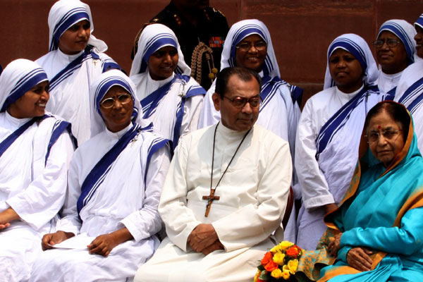
Today’s lesson
The beginning and the Missionary

Slide 8
Lesson introduction
English For Today
Unite -Seven
Lesson-Four , Five
The beginning and the Missionary

Slide 9
Learning outcomes
By the end of the lesson learning will be able to
Talk about the picture
Use new words and make sentences
Choose the correct answer from the alternative
Complete the chart
Write a paragraph

Slide 10
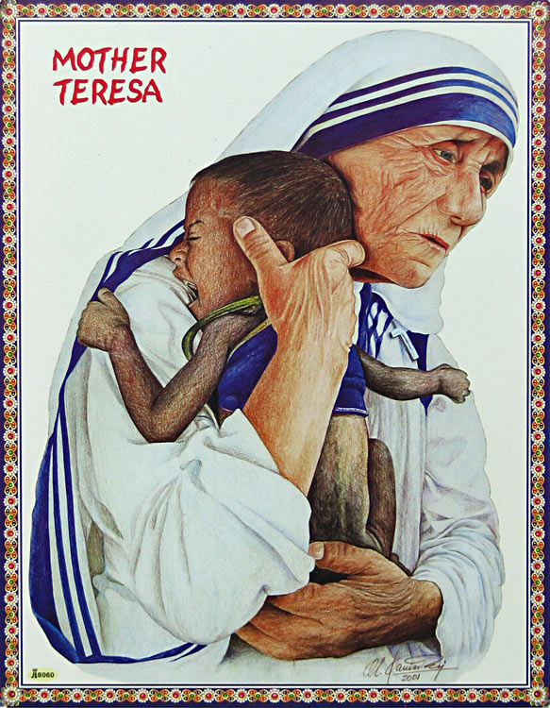
What are you looking in the picture?
Humanity

Slide 11
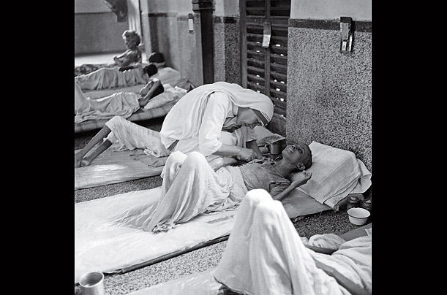
What type of people did She serve?
Destitute people

Slide 12
Look the following words and make sentences
Humanity
Mercy
Devote
Destine
Destitute
Poor
She was the mother of humanity.
She devoted herself to serve the poor.
She worked for destitute people.

Slide 13
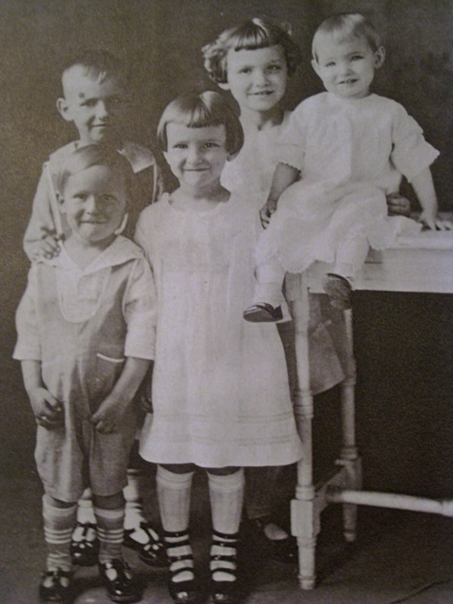

Slide 14
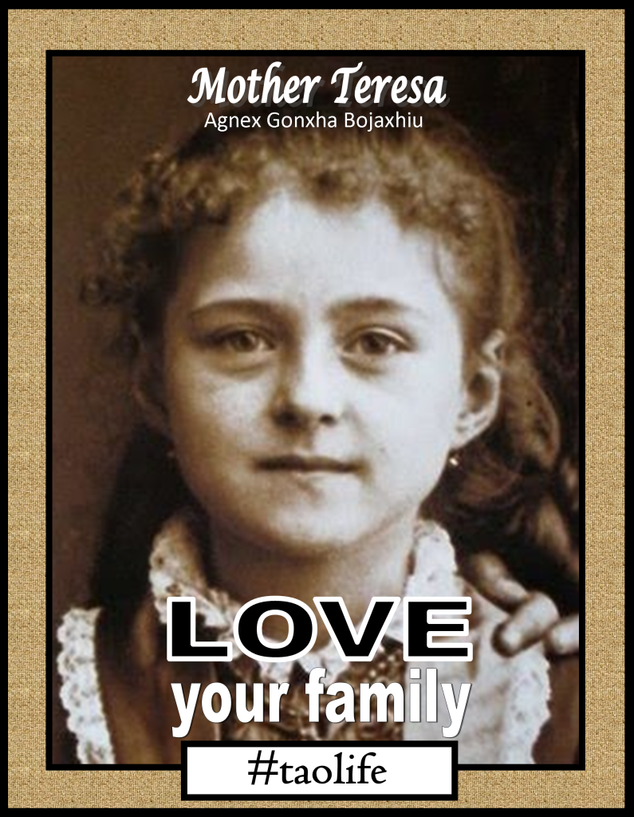

Slide 15
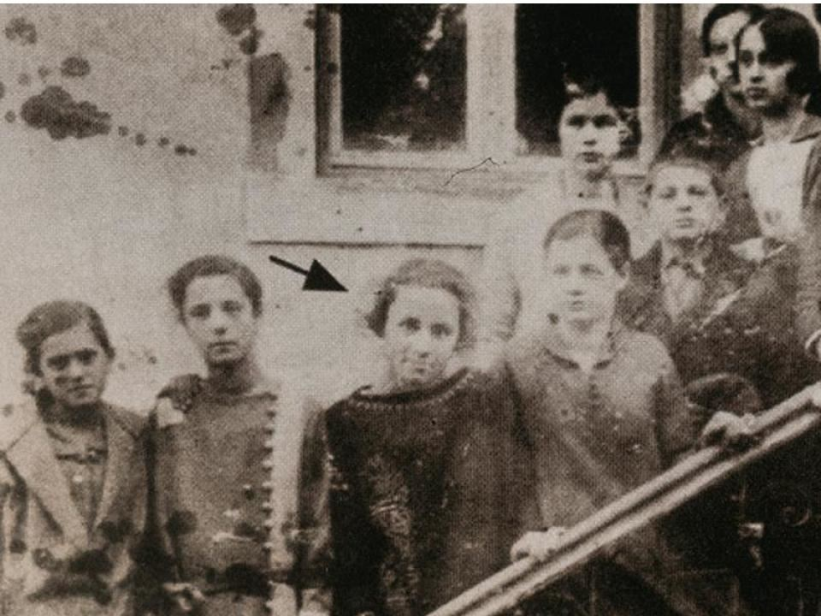

Slide 16
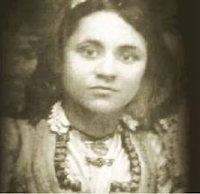
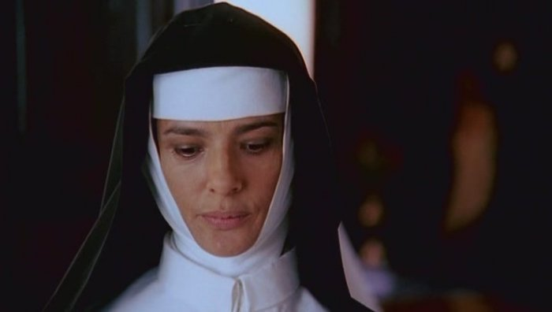

Slide 17
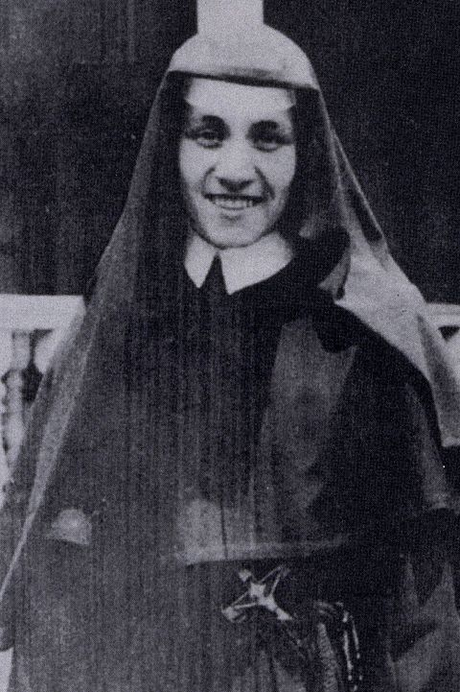

Slide 18
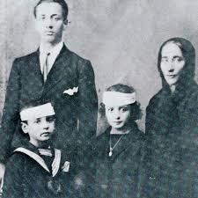

Slide 19
It was Autumn. August 26, 1910. A little girl was born to an Albanian descent, rich Catholic merchant’s family in a small town called Skopje, Macedonia. She was the youngest of the three siblings and was named Agnes Gonxha Bojaxhiu. Who had known that this tiny, little girl would one day become the servant of humanity– love and serve the poorest of the poor and become the mother of humanity. Yes, we are talking about none other than Mother Teresa.

Slide 20
At the age of 12, she heard a voice from within her that urged her to spread the love of Christ. She decided that she would be a missionary. At the age of 18 she left her parental home. She then joined an Irish community of nuns called the Sisters of Loreto, which had missions in India.

Slide 21
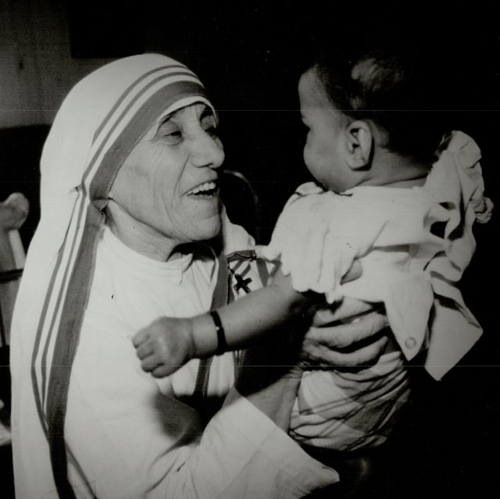

Slide 22
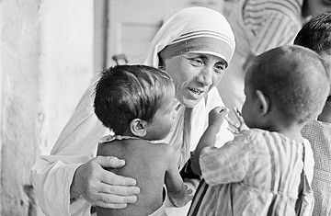

Slide 23
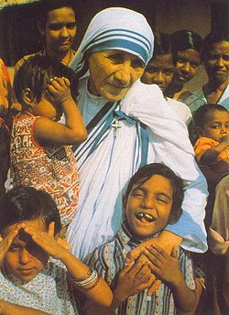

Slide 24
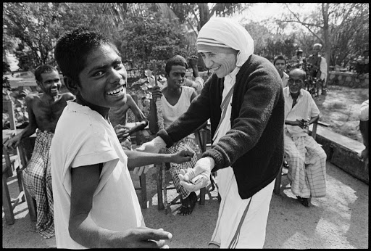

Slide 25
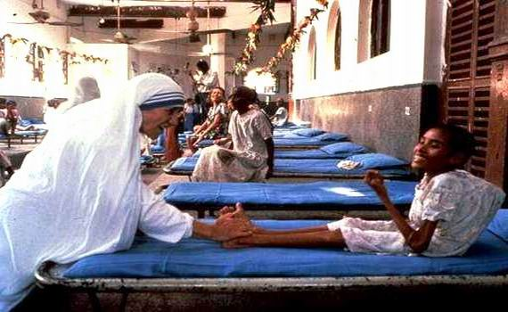

Slide 26
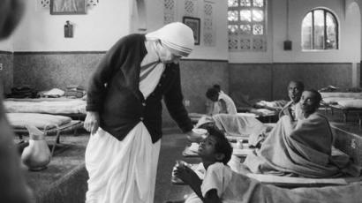

Slide 29
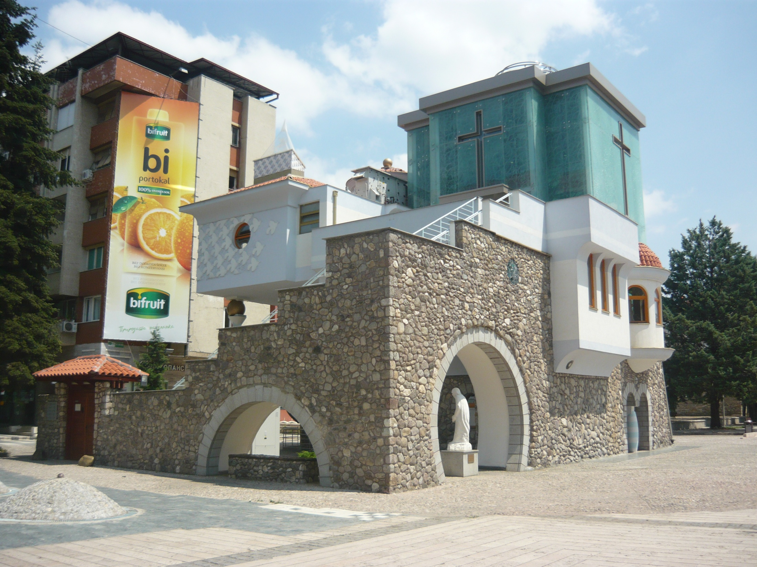

Slide 30
After a few months of training at the Institute of the Blessed Virgin Mary in Dublin,Mother Teresa came to India. On May 24, 1931, she took her initial vows as a nun.
From 1931 to 1948, Mother Teresa taught geography and catechism (religious instruction) at St. Mary's High School in Kolkata (then Calcutta). However, the prevailing poverty in Kolkata had a deep impact on Mother Teresa's mind, and in 1948 she received permission from her superiors to leave the convent and devote herself to work among the poorest of the poor in the slums of Kolkata.

Slide 31
Mother Teresa was moved by the presence of the sick and dying on the streets of Kolkata. She founded the home for the dying destitute and named it ‘NirmalHridoy’, meaning ‘Pure Heart’. She and her fellow nuns gathered the dying people off the streets of Kolkata and brought them to this home. They were lovingly looked after and cared for. Since then men, women and children have been taken from the streets and carried to NirmolHridoy. These unloved and uncared for people get an opportunity to die in an environment of kindness and love. In their last hours they get human and Divine love, and can feel they are also children of God. The Missionaries of Charity try to find jobs for Those who survive, or send them to homes where they can live happily for some more years in a caring environment.

Slide 32
Regarding commitment to family, Mother Teresa said, “ Maybe in our own family, we have somebody, who is feeling lonely, who is feeling sick, who is feeling worried. Are we there? Are we willing to give until it hurts in order to be with our families, or do we put our interest first? We must remember that love begins at home and we must also remember that future of humanity passes through the family”.

Slide 33
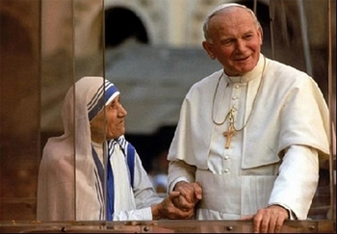

Slide 34
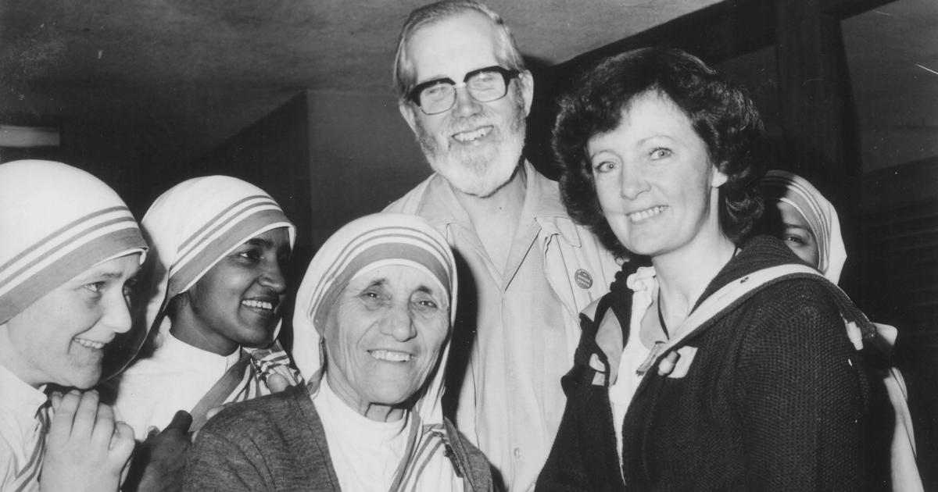

Slide 35
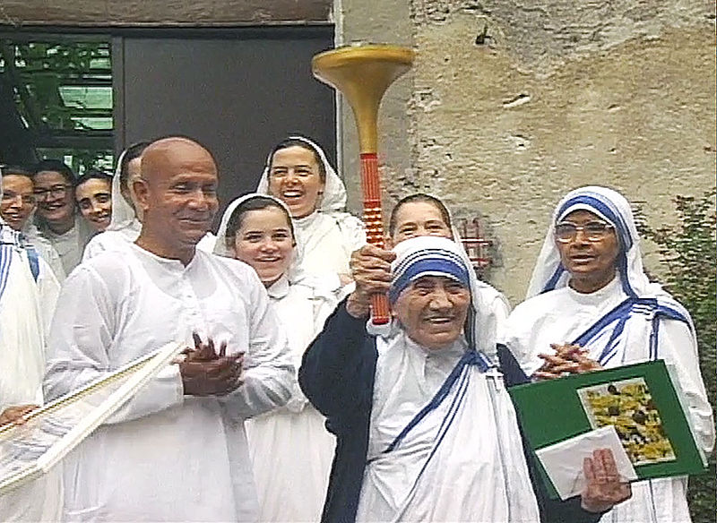

Slide 36
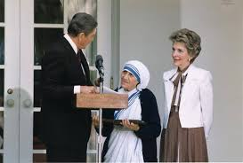

Slide 37
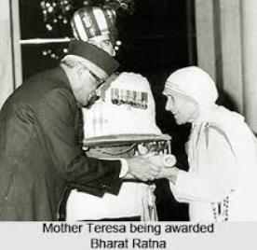

Slide 38
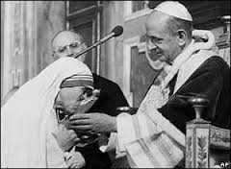

Slide 39
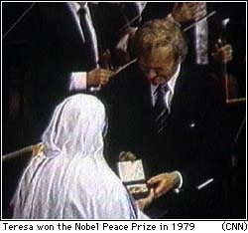

Slide 40
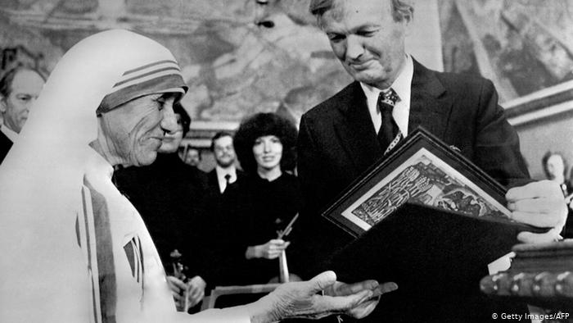

Slide 43
Mother Teresa's work has been recognised throughout the world and she has received a number of awards. These include the Pope John XXIII Peace Prize (1971), the Nehru Prize for Promotion of International Peace & Understanding (1972), the Balzan Prize (1978), the Nobel Peace Prize (1979) and the Bharat Ratna (1980).
Mother Teresa died at the age of 87, on 5 September 1997.The world salutes her for her love and compassion for humanity. She has taught us how to extend our hand towards those who need our love and support irrespective of creed, caste and religion. Draped in a white and blue-bordered sari, wrinkled face, ever soft eyes and a saintly smile, is the picture of Mother Teresa in our mind.

Slide 44
Pair Work
Choose the correct answer from the alternative:
1. What does ‘servant of humanity’ mean in the text?
a) becoming a slave.
b) to work in other people’s house.
c) to be oppressed by others.
d) to serve the needy.
2. Why did Mother Teresa want to be a missionary?
Because she heard
a) the voice of her neighbours discussing it.
b) a voice in her dream.
c) heard a voice within herself.
d) heard the voice of her parents talking about it.

Slide 45
3 Mother Teresa set out to join the missionary of the Sisters of Loreto in the year
a 1927. b. 1928.
c 1929 d. 1930.
4 Mother Teresa took her first vows at the age of
a 18. b. 19.
c 20. d. 21.
Answer:
1. d) to serve the needy.
2. c) heard a voice within herself.
3. b. 1928.
4. d. 21.

Slide 46
Individual Work
B Read the completed text and say if the following statements are true or
false? If false give the correct information.
1. Mother Teresa took a thorough medical training from the USA.
2. At first she collected children from the streets and gave them food and
clothing.
3. She and her group started to look after and care for the lepers.
4. It took them a long time to go to other cities of India.
5. Mother Teresa went to several countries.

Slide 47
Fill in the chart
Group work(Time-10 minutes)
Dates | Events
1950
1957
1970
1979
Called the missionary of charity.
They began to work with lepers.
They continued to expand their missionaries
They worked in over twenty five countries

Slide 48
Homework
Do you know anyone in your locality , who helps the needy and does so to make others happy? Write a paragraph about him/her.

Slide 49
Goodbye

