Slide 1

Welcome

Slide 2

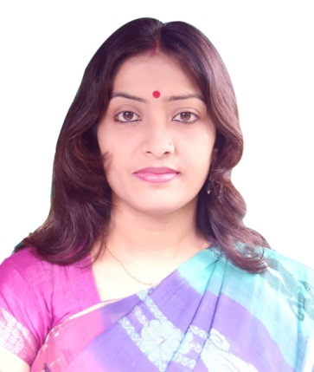
Introduction
Shuli Chakraborty
Asst. Teacher
Jahanara Smrity Girls High School,Netrakona.
Email:shuliict@gmail.com
English For Today
Class :9/10
Unit:3,Lesson :1

Slide 3
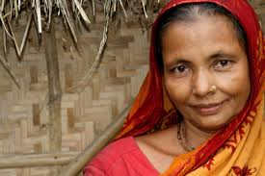
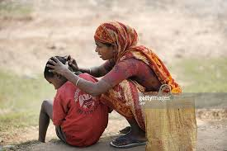
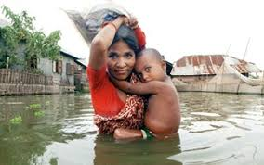
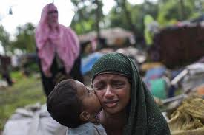
Look at the pictures.

Slide 4
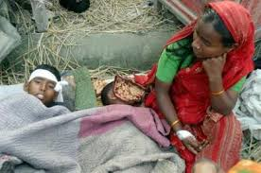
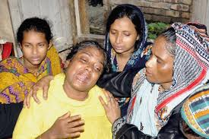
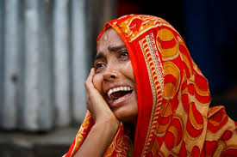
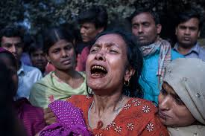
What do you see in the pictures?

Slide 5

So Today’s Lesson is
“Mother’s Day”

Slide 6
Learning Outcomes
By the end of the lesson, Students will be able to :-
# Talk about events and festivels.
# Ask and answer questions.

Slide 7
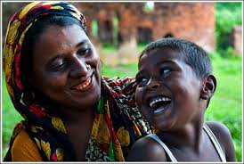
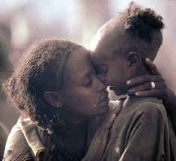
What do you see here?

Slide 8


Slide 9
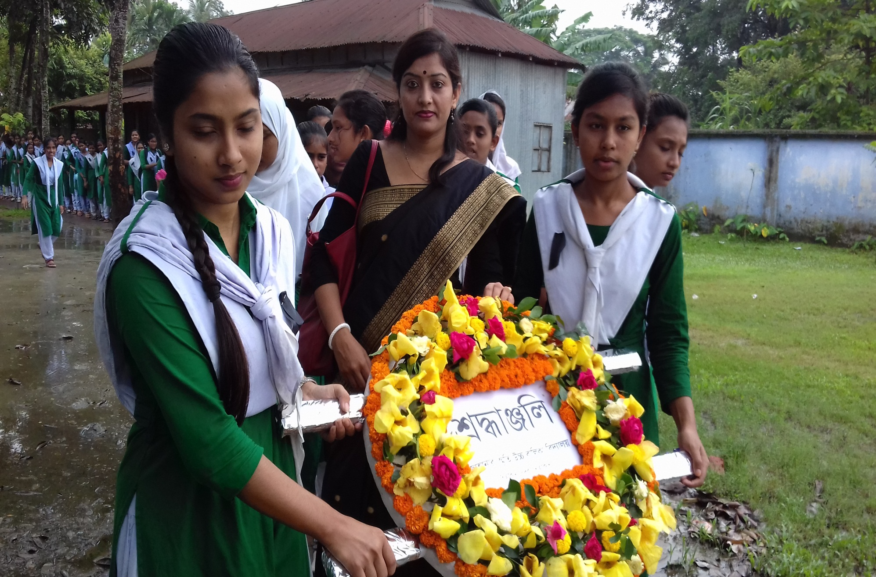
What do you see here?

Slide 10


Slide 11

Look here.

Slide 12
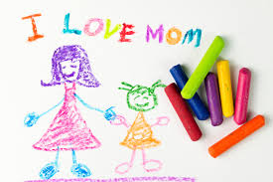
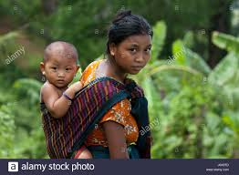
Motherly affection

Slide 13
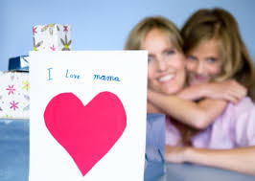

See here.

Slide 14
Answer these questions
1.What country first oberved Mother’s Day
as a national holiday?
2.When is Mother’s Day now celebrated by most of the countries in the world?

Slide 15
Pair work
Chose the correct answer.
1.According to ancient Greek myths Rhea is the
a mother of gods. b goddess of love
c goddess of wealth. d goddess of health.
2.The name of Jesus Christ’s mother was
a Rhea b Marry
c Anna d Anna Junior
3. Julia Ward Howe was
a Dutch b English
c Australian d American

Slide 16

Answer to the question no. 1
(a) mother of gods.

Slide 17
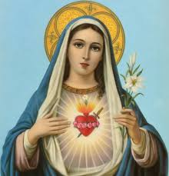
Answer to the question no. 2
(b) Mary.

Slide 18
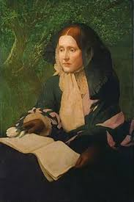
Answer to the question no.3
(d) American

Slide 19
Home work
Write a paragraph by answering each of the following questions.
1.Do you help your mother with her housework? How?
2. Do you celebrate Mother’s Day? If yes, when and how?

Slide 20
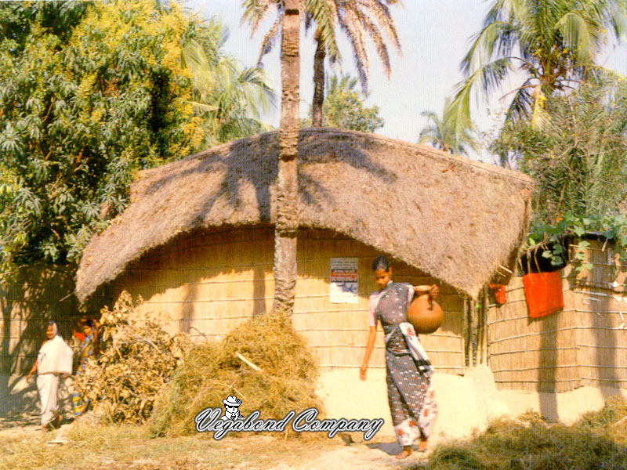
Thanks to all

