Slide 1

WELCOME TO THE CLASS
HOW ARE YOU?

Slide 2

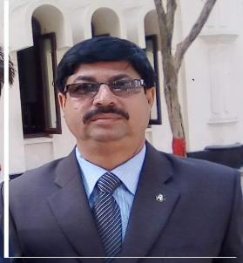
IDENTITY
MD. AFSAR ALI
Mobile-01757-966577
E-mail:afsar0903@gmail.com

Slide 3
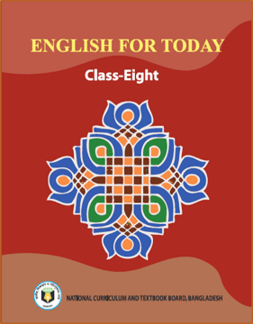
IDENTITY
Class: Eight
Unit-5 Making difference
Lesson:1 The beginning (A)

Slide 4

Look at the picture and try to guess what our today’s lesson is.
Unit-5 Making difference
Lesson:1 The beginning (A) Page: 45
Yes, your answer is correct. Today we will learn-----

Slide 5

Learning outcomes
After finishing this lesson the students will be able to-
1. ask and answer questions
2. infer meaning from context
3. choose the best answer
4. read and understand through silent reading

Slide 6
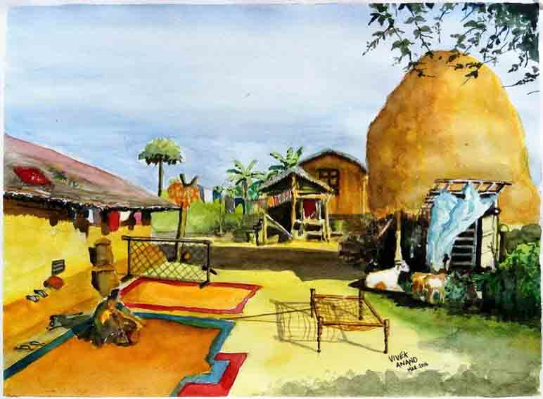
Read the passage carefully.
There is a small village called Bhabanipur in Jhenaidah.

Slide 7
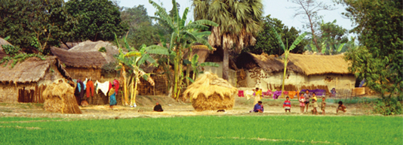
Read the passage carefully.
It is a typical Bangladeshi village.

Slide 8
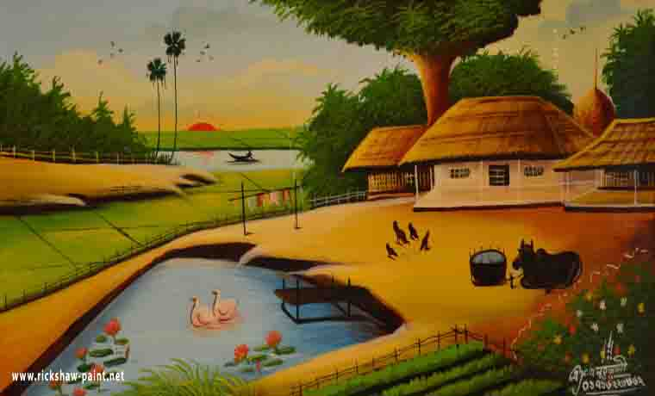
Read the passage carefully.
People here spend their day-to-day life mostly working in the fields and doing household work.

Slide 9
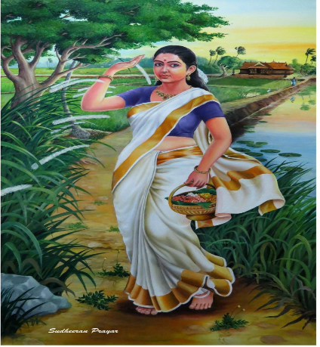
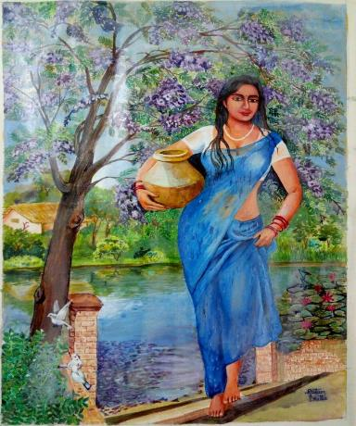
Read the passage carefully.
In this ordinary village, there lives an extraordinary woman named Shamima Akther Maya.

Slide 10
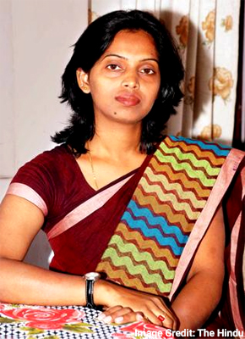
Read the passage carefully.
Shamima’s will power and determination have made her extraordinary.

Slide 11
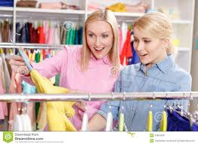
Read the passage carefully.
She has seen the most cruel aspect of life. But the cruelty could not defeat her sprit.

Slide 12

Read the passage carefully.
She has come out as a winner, defying all the odds of life.

Slide 13
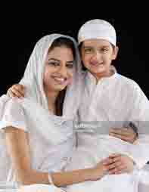
Read the passage carefully.
Shamima is now 32 years old. She has only one son named
Ashikur Rahman Kanok.

Slide 14
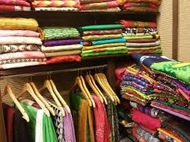
Read the passage carefully.
She runs a small boutique called “Oiko Nari Kollayan
Shangstha” in her village.

Slide 15

Read the passage carefully.
Let’s hear from Shamima, how she succeeded in setting
up her boutique.

Slide 16

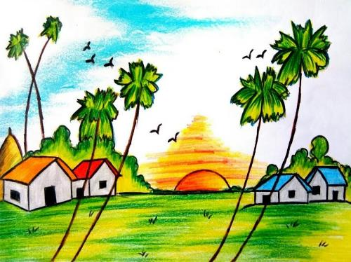
Typical
Meaning
(Click here)
Key word
Classic
Usual
Characteristic
Distinctive
Emblematic
She lives in a typical village of Rangpur

Slide 17

Willpower
Meaning
(Click here)
Key word
Strength of will
Strength of mind
Determination
Resolve
Resulation
To suddenly break into small pieces

Slide 18

4
Determination
Meaning
(Click here)
Willpower
Key word
Resolve
Fortitude
Grit
Strength of mind
Unforgiving

Slide 19

Aspect
Meaning
(Click here)
Feature
Key word
Part
Phase
Side
Trait
She has seen the most cruel aspect

Slide 20
Spirit
Meaning
(Click here)
Life force
Key word
Enthusiasm
Passion
Zeal
Soul
The cruelty could not defeat her spirit

Slide 21
Individual work
1. Bhabanipur is a typical village. Here Typical means.........
√
a) usual
X
b) unusual
X
c) famous
X
d) infamous
2. ‘Extraordinary’ means...............
X
a) Common.
X
b) Simple
√
c) Amazing
X
d) Normal
Click on the correct option.

Slide 22
Individual work
1. ‘The people of’ means.........
√
a) Wind that blows with a hissing sound.
X
b) Wind that blows from across the river.
X
c) Wind that helps someone make afire
X
d) Wind that blows in summer.
2. ‘Dancing of the flame’ means...............
X
a) A traditional form of folk dance.
X
b) A flame that makes people dance around it.
√
c) A flame that is made unstable by the blast of air.
X
d) A flame made by people to remember their pasts.
Click on the correct option.

Slide 23
Discuss with your partner and answer the following questions
a) What type of village does Shamima live in?
b) What do the people of ‘Bhabanpur’ village usually do?
c) What has Shamima done to make herself extraordinary?

Slide 24
Group work
Read the text B again and match the phrases with the meanings.
Columa A | Column B
(a) Day to day life | (i) Unkind happenings in life.
(b) Household work | (ii) Become victorious.
(c) Cruel aspect of life | (iii) Everyday life.
(d) Come out as a winner | (iv) Difficulties of life.
(e) All the odds of life | (v) Having all the regular features of a Bangladeshi village.
(f) Typical Bangladeshi village | (vi) Domestic chores.

Slide 25
Evaluation
Answer the following questions.
1. What type of village does Shamima live in?
2. What do the people of ‘Bhabanipur’ village usually do?
3. What has Shamima done to make herself extraordinary?

Slide 26
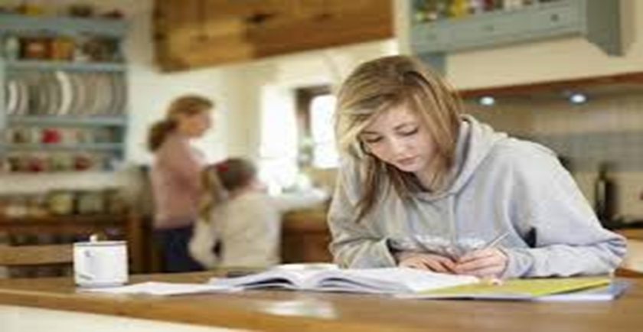
Home work
Write a paragraph about Shamima from your imagination. In your paragraph write what Shamima should do for the good of her own family as well as the other families in the village.

Slide 27

Good bye
Have a nice day

