Slide 1
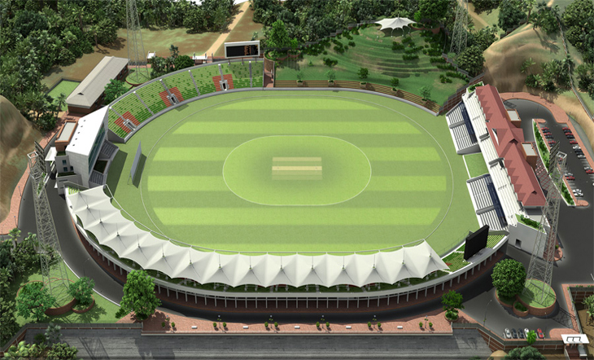
Welcome

Slide 2
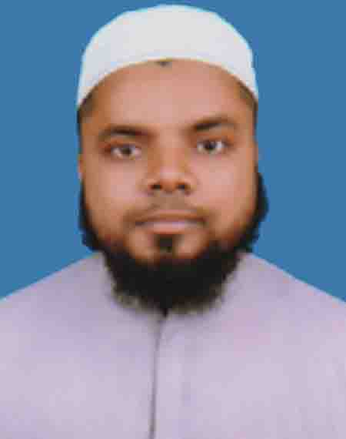
Identity
Teacher’s
Lesson’s
Md. Hasnain
Ibtedaie Head teacher
Dakhin Koralmara Hossainia Swatantra Ibtedaie Madrasa.
Tazumuddin, Bhola
Class – V
Unit- 17
Lesson – 66-69
Sports
Activity - H

Slide 3
Students will b able To -
1.3.1. recognize which words in a sentence are stressed
3.3.1 understand questions about objects around them
3.4.1 understand statements made by the teacher and students.
1.1.1 say words, phrases and sentences with proper sounds and stress.
1.1.2 say sentences with proper intonation
1.7.1 read paragraphs, dialogues, stories, letters and other texts

Slide 4
Olympic Games

Slide 5
New words
Biggest: very big in size
Big
Bigger
Biggest

Slide 6
New words
Host: one who organizes.
Almost: near about
Started : began

Slide 7
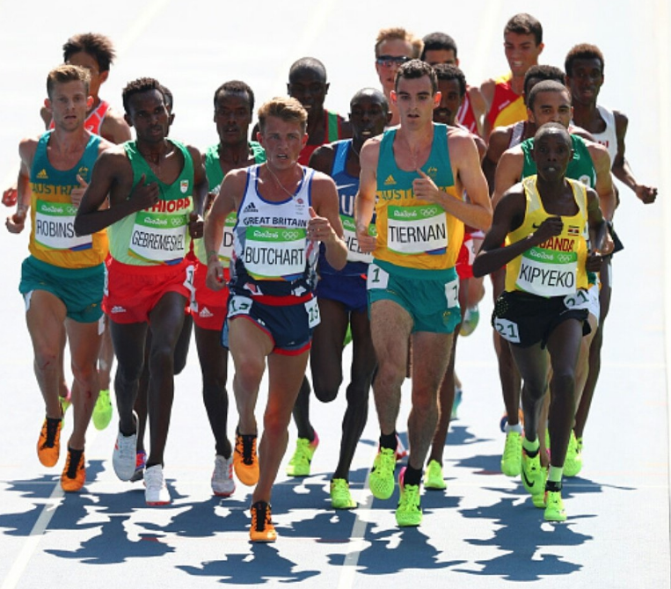
New words
Athletes: a person who is proficient in sports and other forms of physical exercise.

Slide 8
The Olympic Games is the biggest sports competition in the world

Slide 9
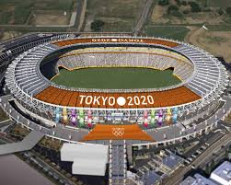
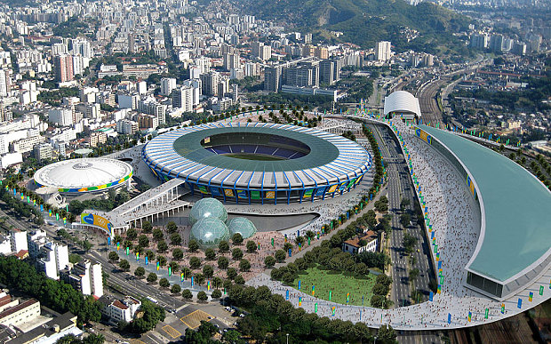
Tokyo -2020
Rio De Janeiro - 2016
The Olympics are held every four years in different host city

Slide 10
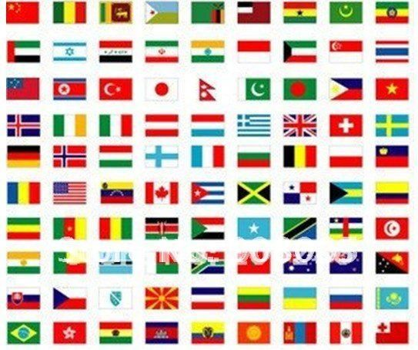
More than 200 nations send a total of about 13,000 athletes to compete in more than 30 different sports.

Slide 11
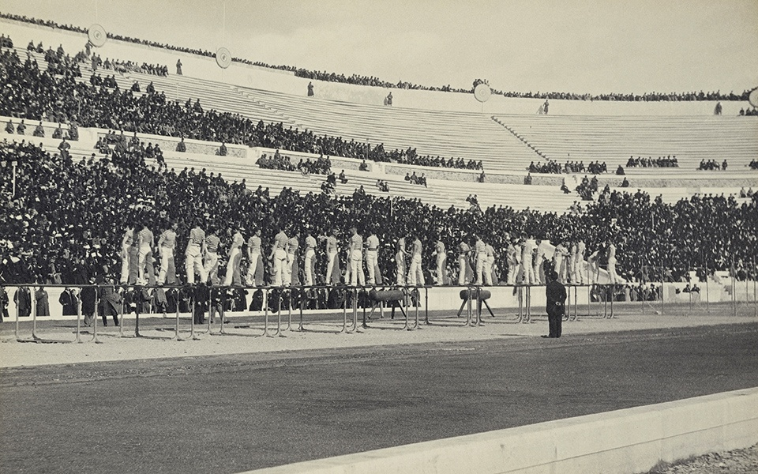
The first Olympic games was held in Greece almost 3,000 years ago.

Slide 12
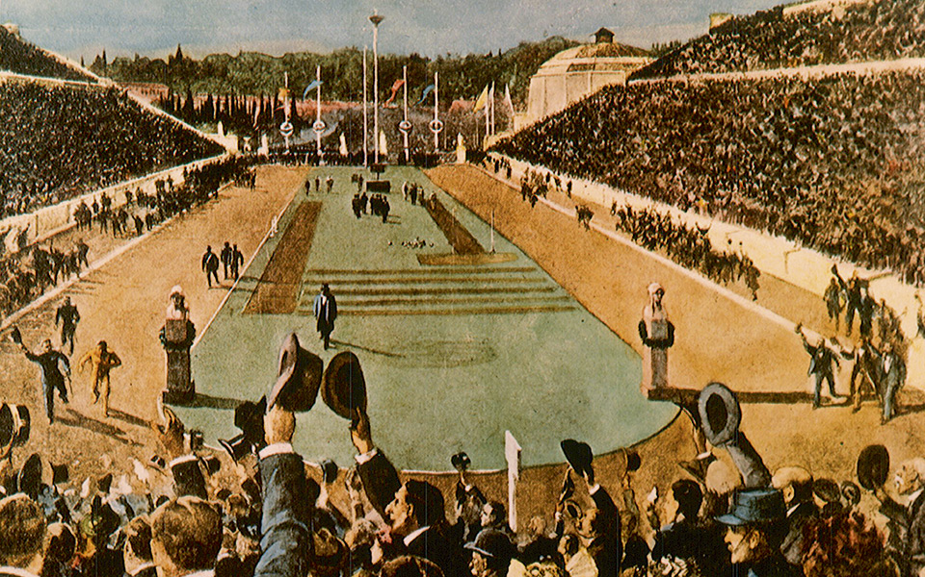
The modern Olympic Games started in 1896 , and there have been 31 Olympic competitions since then.

Slide 13
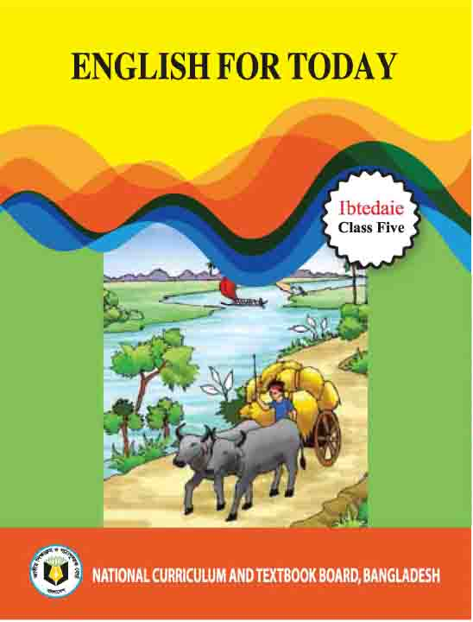
Now take your English book

Slide 14
Open at page - 68

Slide 15
Group work instruction :
Take your English book . Open at page – 68. Read the text.

Slide 16
Pair Work

Slide 17
Pair Work instruction:
Write ‘True’ for correct statement or ‘False’ for incorrect statement
1. The text is about the greatest sports competition in the world.
2. The modern Olympic Games were held 96 years ago.
3. More than thirty events are held in the Olympics.
4. The Olympic Games are still held only in Greece.
5. The Olympics are held in every year.

Slide 18
Home Work
You will write the activity I ( page-68) in your notebook.

Slide 19
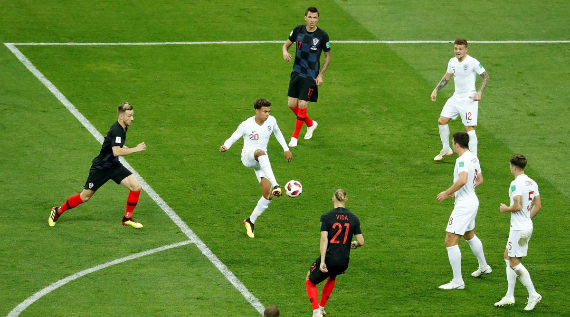
See you next class

