Slide 1
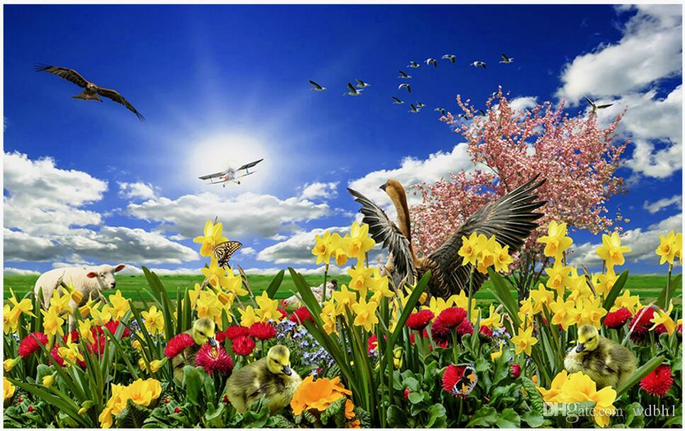
Welcome

Slide 2
Teacher’s Identity
Md. Hasnain
Ibtedaie Head teacher
Dakhin Koralmara Hossainia Swatantra Ibtedaie Madrasa.
Tazumuddin, Bhola

Slide 3
Lesson identity
Class – Five
Unit – 20
Lessons – 5-6
Life is beautiful
Activity – C
Part – 5

Slide 4
Learning outcomes:
Listening
1.3.1 recognize which words in a sentence are stressed.
3.4.1 understand statements made by the teacher and student.
4.2.1 understand and enjoy simple stories.
Speaking
1.1.1 say words, phrases and sentences with proper sounds and stress.
6.2.1 talk about people, objects, events, etc.
Reading
1.5.1 read words, phrases and sentences in the text with proper pronunciation, stress and intonation.
1.7.1 read paragraphs, dialogues stories, letters and other texts.

Slide 5
What was our previous lesson?
Do you think a blind student can get admitted to a university? How?

Slide 6
Life is beautiful (Part -5)

Slide 7
What is your impression about this picture?
What is Maria doing in the picture?
How can she operate computer?

Slide 8
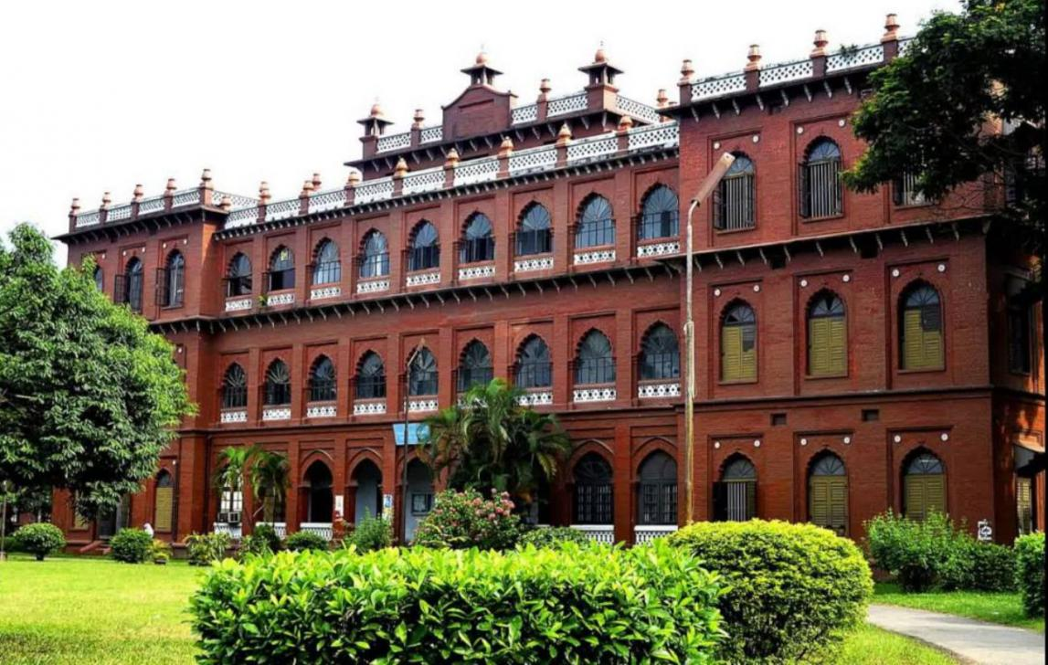
Maria hopes to go to university one day.

Slide 9
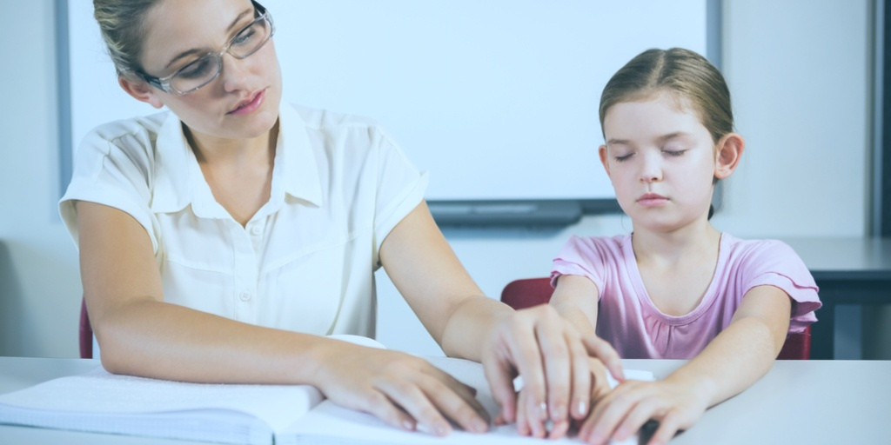
Her teachers think that she can

Slide 10
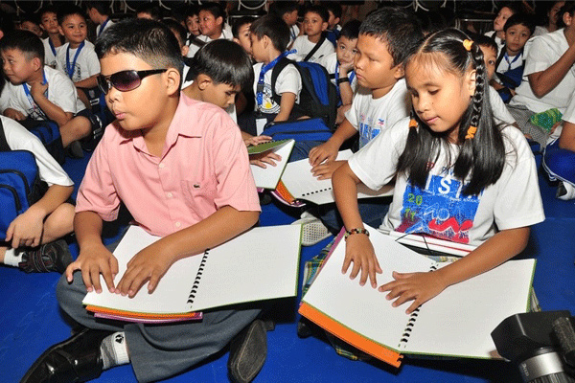
Maria wants to set up a school of her own so that she can teach visually impaired children.

Slide 11
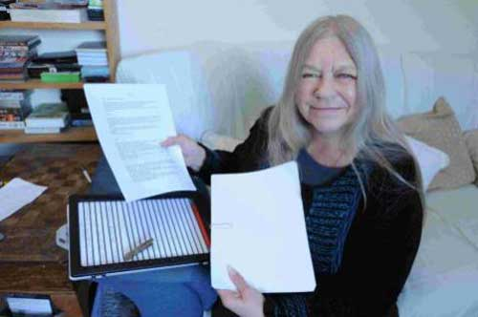
Before this, Maria wants to be a writer.

Slide 12
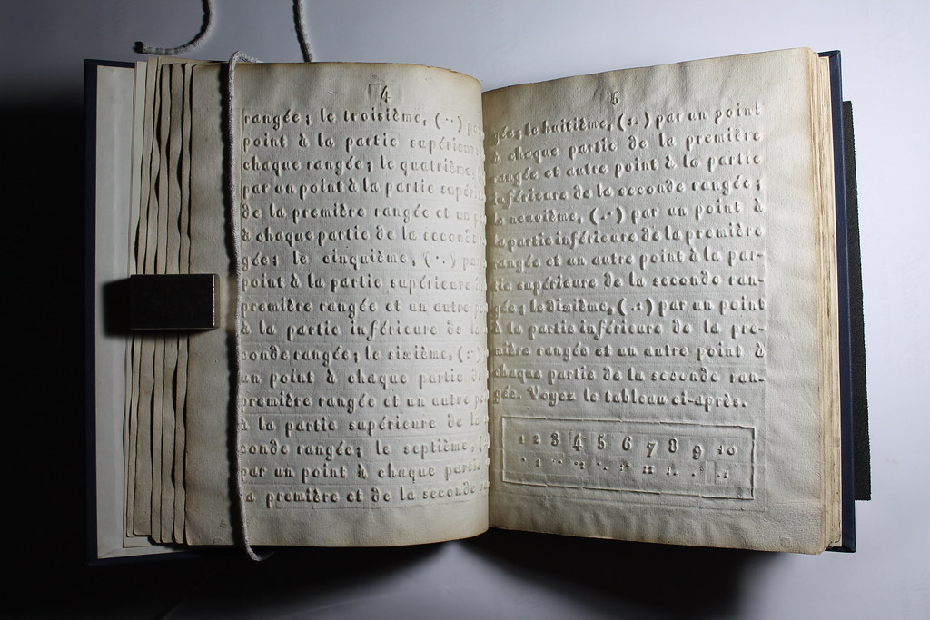
She wants to write a book about her feelings and experiences.

Slide 13
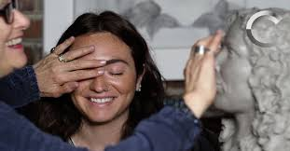
She wants to show other impaired people that they can do amazing things in their lives

Slide 14
Peer Work
Discuss with your partner and find out the new words.

Slide 15
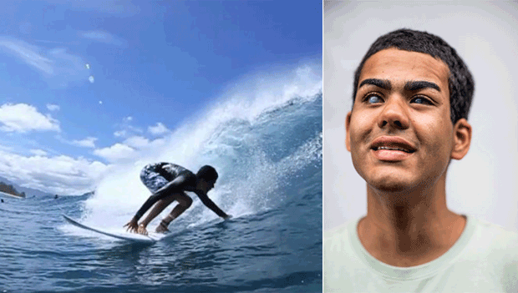
New Words
Braille: causing great surprise or wonder

Slide 16
Group Work
Read the text one by one

Slide 17
Checking learning
When I do any mistake you should say ‘stop’
Maria hopes to go to college one day. Her teacher think that she can not. Maria wants to set up a shelter of her own so that she can take visually impaired children. After this, Maria wants to be a writer. She wants to write a story about her feelings and experiences. She wants to show other impaired people that they can not do amazing things in their lives.

Slide 18
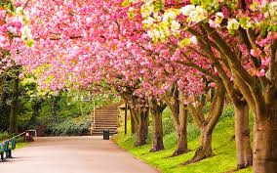
Thank you

