Slide 2
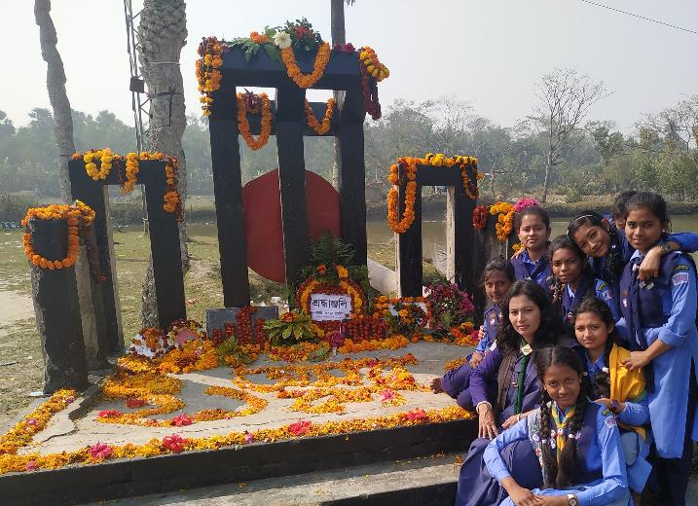
Welcome to English Class
Notes:
Welcome slide. This picture is related to the topic. So I have chosen it. Teacher may change it if he wants.

Slide 3
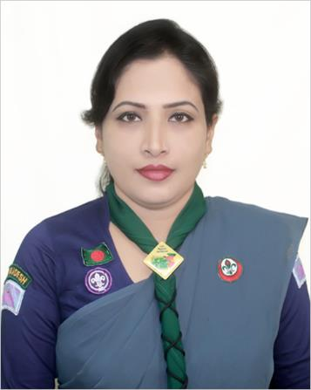
Teacher information
Sunayana Roy
Assistant teacher
Goalmath Secondary Girls School
Kachua, Bagerhat.
somabgt@gmail.com

Slide 4
Class information
Class : Ten
Subject : English 1st paper
Time: 50 min.
Date : 05/01/2020

Slide 5
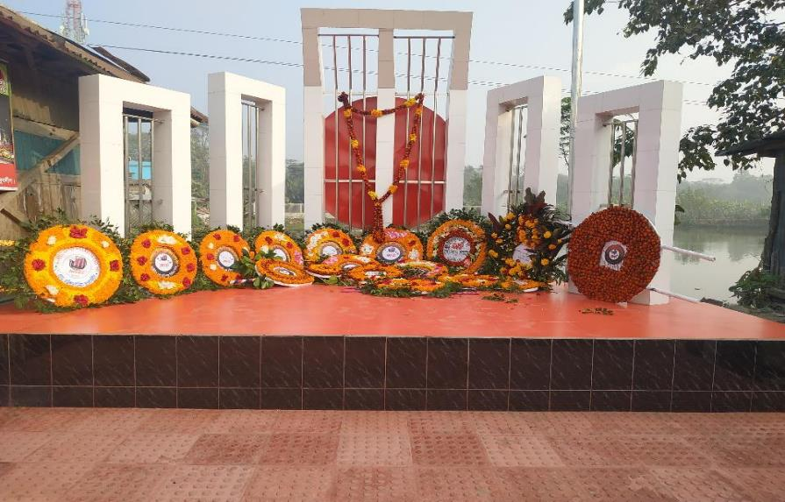
A.Look at the pictures and say what about it .
1. What is the picture about?
2. Where do you think it is?
3. Why was it built?

Slide 6
1. The picture is about “Shahid Minar.”
2. I think it is in near Dhaka Medical College.
3. It was build to honour and commemorate the sacrifices of the language martyrs

Slide 7
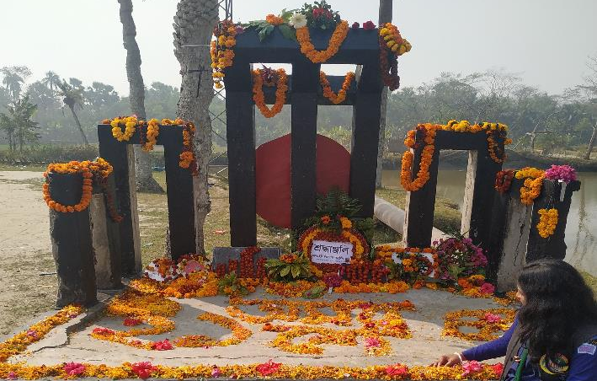
Lesson Diclaration
Yes, Your answer is correct.
Today's lesson is—
International Mother language Day

Slide 8
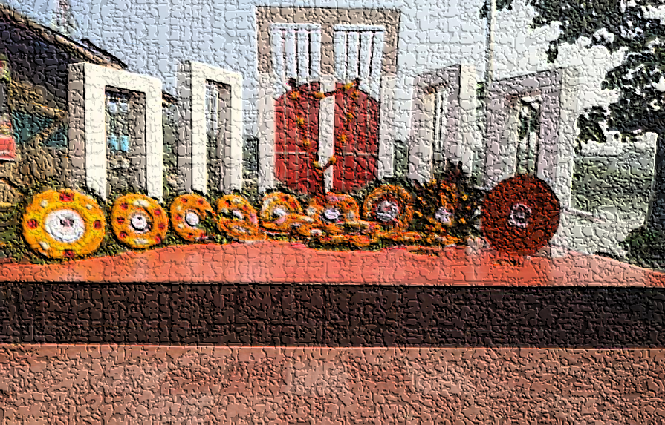
LESSON OUTCOMES
After finishing the lesson the students will be able to know that-
What is International Mother Language Day?
2. What happened on 21 February in 1952?
3. What is the importance of the day?

Slide 9
Read the passage loudly.
21 February is a memorable day in our national history. We observe the day every year as International Mother Language Day. The day is a national holiday. On this day, we pay tribute to the martyrs who laid down their lives to establish Bangla as a state language in undivided Pakistan in 1952.This is known as the Language Movement.
The seed of the Language Movement was sown on 21 March 1948 when Mohammad Ali Zinnah, the then Governor General of Pakistan, at a public meeting in Dhaka declared that Urdu would be the only official language of Pakistan. The declaration raised a storm protest in the eastern part of the country. The protest continued nonstop, gathering momentum day by day. It turned into a movement and reached its climax in 1952.
The government outlaw all sorts of public meetings and ralies to prevent it. The student of Dhaka University defied the law and they brought out a peaceful protest procession on 21 February 1952. When the procession reached near Dhaka Medical College, the police opened fire on the students, killing Salam, Rafiq, Barkat and Jabbar. So we should respect to the Martyrs. This enkindled the sparks of independent movement of Bangldesh.

Slide 10
C. Complete the chart
Time | What happened
1947
1948
1952

Slide 11
Answer
Time | What happened
1947 | Pakistan and India became independent.
1948 | Mohammad Ali Zinnah declared that Urdu would be the only official language of Pakistan.
1952 | The student of Dhaka University broght out a peaceful protest procession on 21 February.

Slide 12
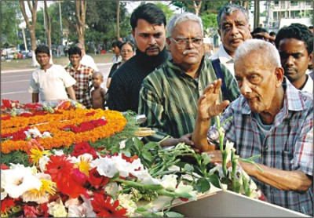
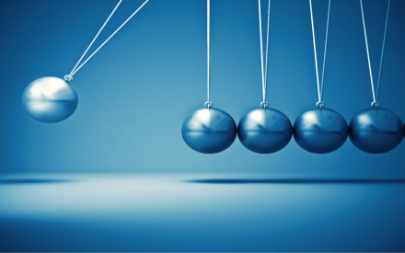
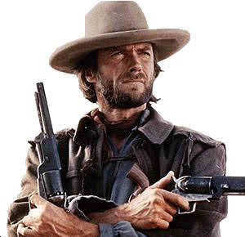
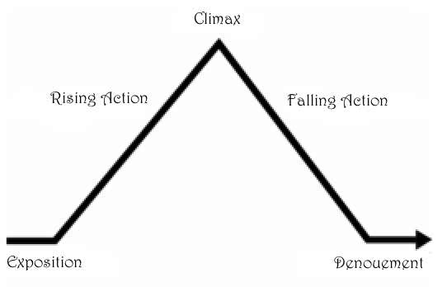
Vocabulary
An act or gift intended to show respect
Tribute
Momentum
Impetus gained by movement
A person who has broken the law and remains at large.
Outlaw
Climax
The most exciting point

Slide 13
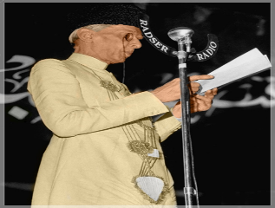
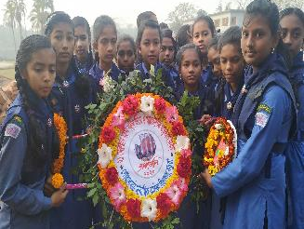
E. Discuss in a group and answer the following questions.
Why do we observe 21 February as the International Mother language Day?
(b) What happen when Urdu was declared as the only official
language of Pakistan.
“The seed of independence was sown in 21 February 1952”. Do you agree with the comment? Why? .

Slide 14
Answer
The UNESCO has proclaimed February 21 as the International Mother Language Day in 1999. So we observe 21 February as International Mother Language Day.
2. The declaration raised a storm of protest in East Pakistan. It continued non-stop. The government banned all types of public meetings.
3. Yes, I agree. On this day, by protesting the one sided decision of the then Government of Pakistan, the people of East Pakistan understood how to struggle against illegal decision and oppression. So the people of East Pakistan dreamt to be free from West Pakistan.

Slide 15
Evaluation
Fill in the blanks
February 21 is a glorious (a)……………..for Bangalee nation. We are always (b)…………..against the (c)……………and untruth. Let us (d)……………..our pledge on (e)……………….day and (f)…………….our motherland a “Sonar Bangla” so (g)……………our next (h)……………….can hold their (i)…………………high in the (j)………………… .

Slide 16
Answer
a) milestone b) vocal
c) injustice d) renew
e)this f) build
g) that h) generation
i) heads j) world

Slide 17
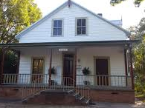
Home Work
Write a paragraph about International Mother language Day.

Slide 18
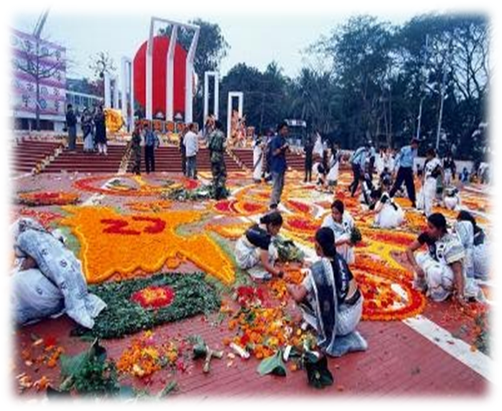
আমার ভাইয়ের রক্তে রাঙানো একুশে ফেব্রুয়ারি, আমি কি ভুলিতে পারি?
Thanks for all students

