Slide 1
Welcome to all

Slide 2
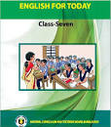
Introduction
Md Shahneoaz
Assistant Teacher (English)
Jalalabad B/L High School,Sylhet.
E-mail: shahneoazmd@yahoo.com
Cell: 01631712091
Class: vii
English 1st paper
Unit-6, Lesson-5(B)
Time- 45 Minutes

Slide 3
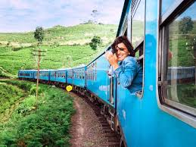
Let’s see a piture and say what’s the picture about

Slide 4
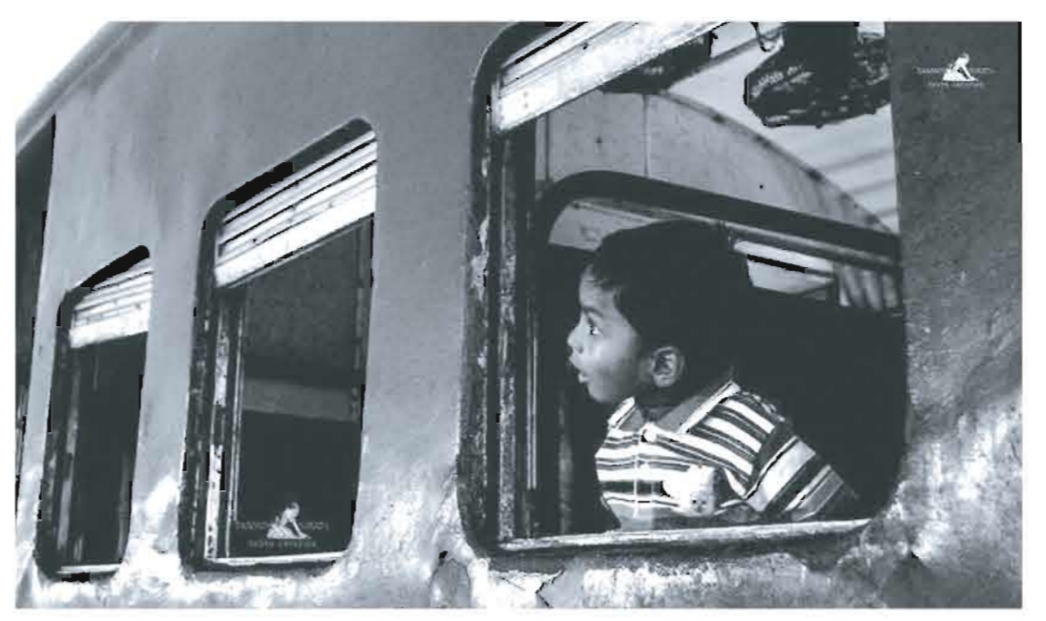
Topic: Travelling by Train (2)

Slide 5
Learning Outcomes:
After finishing this lesson students will be able to-
describe the common scenes of railway stations
choose the correct answers from the alternatives
answer to some questions.

Slide 6
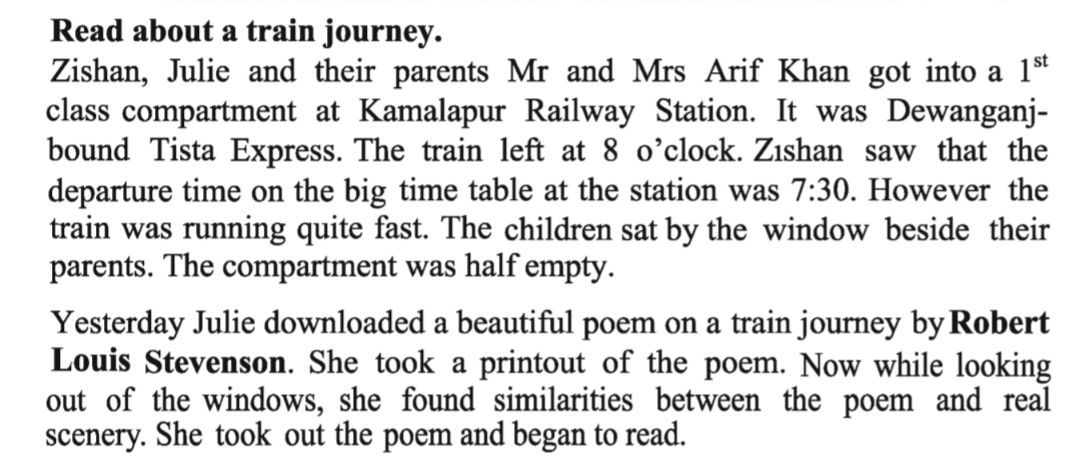
Open the page no. 58 of your eft and read the passage in Unit 6, Lesson 5 (b)
Silent Reading

Slide 7
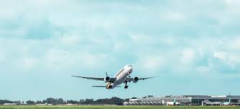
Let’s be introduced with new Words:
Departure
Leaving/ The act of leaving a place
Our departure was delayed because of bad weather

Slide 8
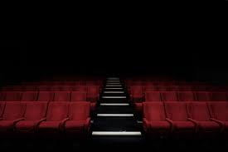
Let’s be introduced with new Words:
Empty
Vacant/Unoccupied
The hall was empty.

Slide 9
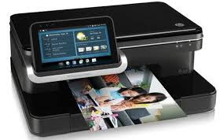
Let’s be introduced with new Words:
Printout
A printed record
He gifted me a printout of my family picture.

Slide 10
Choose the correct answer from the alternatives given below:
Pair Work
i) The poem that Julie downloaded was written by…….?
a)Robert Louis Stevenson b) Zishan
c) Julie d) None of them
ii) The word compartment means…..
a) Department b) Apartment
c) Chamber d)Complement

Slide 11
Choose the correct answer from the alternatives given below:
Pair Work
iii) Who are the passengers mentioned in the passage?
a) Zishan b)Julie
c)Mr. and Mrs. Arif Khan d) All above
iv) Tista Express was the name of a …….
a) Steamer b) Train
c) Airplane d) Bus

Slide 12
Choose the correct answer from the alternatives given below:
Pair Work
v) The antonym of the word empty is…..
a)Vacant b)cool
c) occupied d) blank
vi) Tista Express started for …..
a)Dhaka b) Dewanganj
c) Kamalapur d) nowhere

Slide 13
Choose the correct answer from the alternatives given below:
Pair Work
vii) When was the train supposed to leave the station?
a) at 7:15 am b) at 7:30 am
c) at 8:00 am d) at 8:30 am
vii) What did Julie download?
a) a song b) a poem
c) a picture d) a movie

Slide 14
Choose the correct answer from the alternatives given below:
Pair Work
ix) She found similarities ……the poem and the real scenery.
a) among b) between
c) to d) of
x) However the train was running quite fast. Here the word ‘Quite’ refers to…..
a) quite b) calm
c) very d) partly

Slide 15
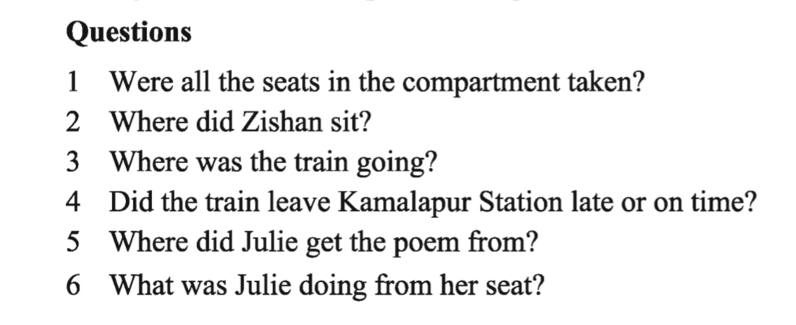
Answer the following questions

Slide 16
Thanks a lot for being with me

