Slide 2
Welcome to my multimedia grammar class.

Slide 3
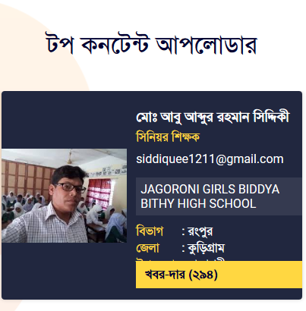
IDENTITY OF THE TEACHER
Md. Abu Abdur Rahman Siddiquee
(M. A, B. Ed)
Senior Assistant Teacher (English)
Jagoroni M. L Girls’ High School
Newashi, Nageswari, Kurigram.
Master Trainer, UITRCE, BANBEIS.
E-mail: siddiquee1211@gmail.com
Contact No. 01743943113

Slide 4
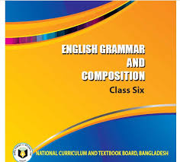
IDENTITY OF THE SUBJECT
English Grammar
Class : 6
Total Ss: 43
Present Ss: 40
Duration: 50 Minutes
Date: 10/09/2020

Slide 5
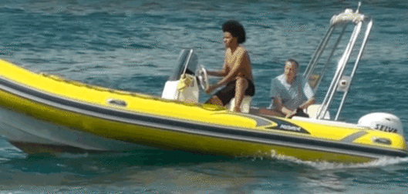
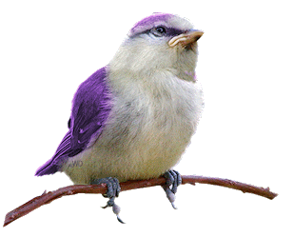
Answer the following Questions:
What are the boatmen doing?
The boatmen are sailing.
What is the bird doing now?
The bird is chirping now.

Slide 6
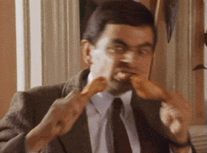
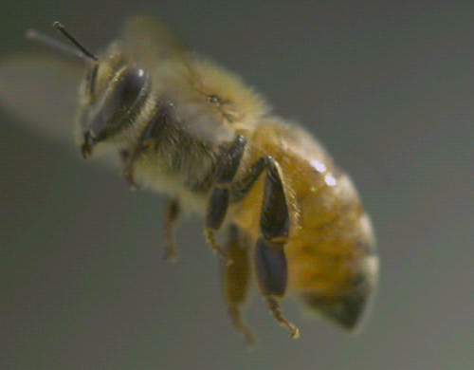
What is Mr. Bean doing?
Mr. Bean is eating.
What is the bee doing?
The bee is flying.
Can you realize what’s our today’s lesson?

Slide 7
Todays’ lesson is-
Present Continuous Tense
Unit: 2, Lesson: 3, Page 30

Slide 8
Learning Outcomes
By the end of the lesson, students will be able to…
give questions’ answer using present continuous tense.
identify present continuous tense.
make sentences with present continuous tense .

Slide 9
Present Continuous Tense:
The present continuous tense is used for something happening now. The action is not finished.
Structure of Present Continuous
Subject + am/is/are +V-ing/ Present Participle

Slide 10
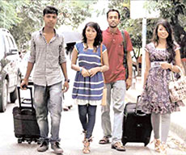
Examples
Affirmative | Negative | Interrogative
I am going | I am not going | Am I going?
You are going | You aren't going. | Are you going?
He/ she/ it is going | He/ she/ it isn't going | Is he/ she/ it going?
We are going | We aren't going | Are we going?
You are going | You aren't going | Are you going?
They are going | They aren't going | Are they going?

Slide 11
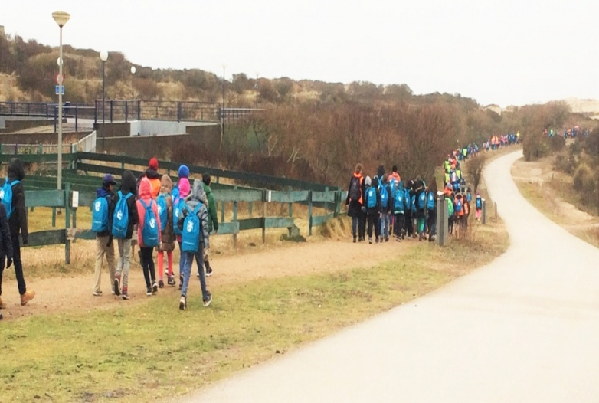
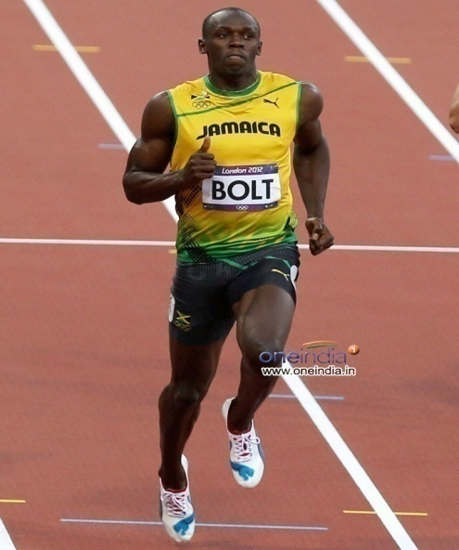
What are you observing? Answer the questions:
What are they doing now?
They are walking now.
What is Usaine Bolt doing?
Usaine Bolt is running.

Slide 12
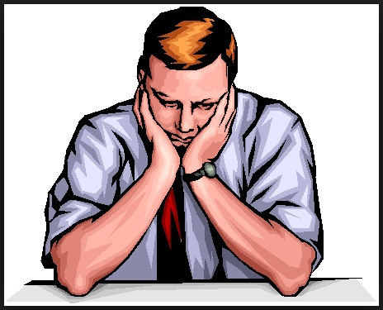
Are you sleeping in the office?
No, I’m thinking about something.

Slide 13
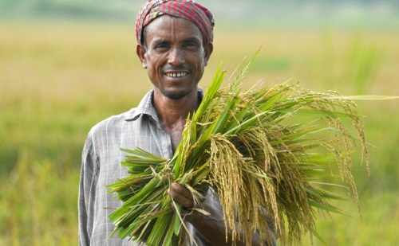
Are you cutting paddy?
Yes, I’m cutting paddy.

Slide 14
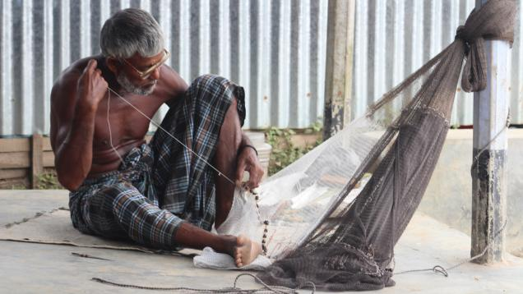
Is he making his net?
No, he is repairing his net.

Slide 15
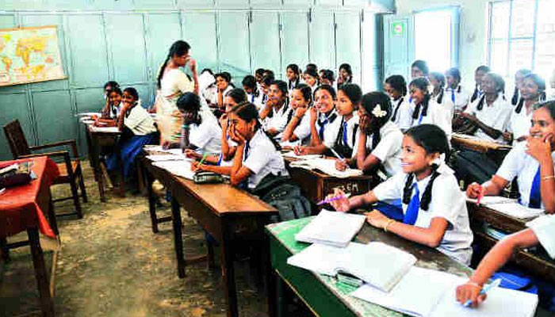
Isn’t she teaching the students?
Yes, she is teaching them.

Slide 17
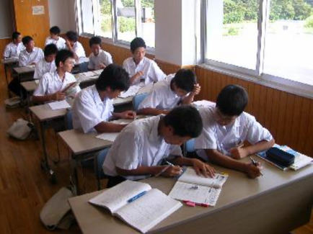
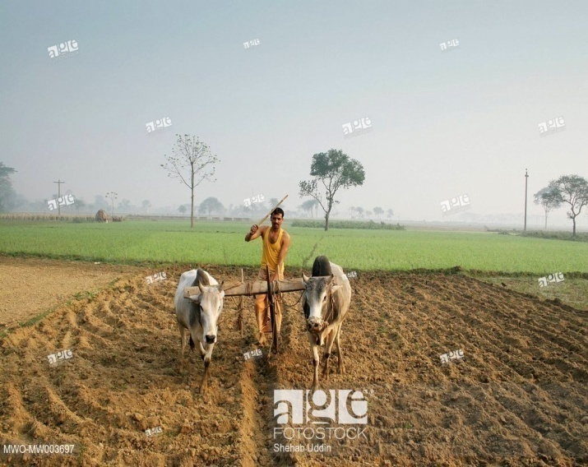
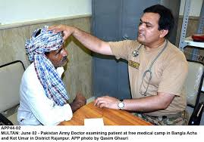
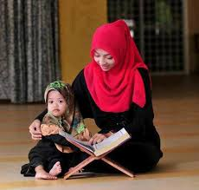
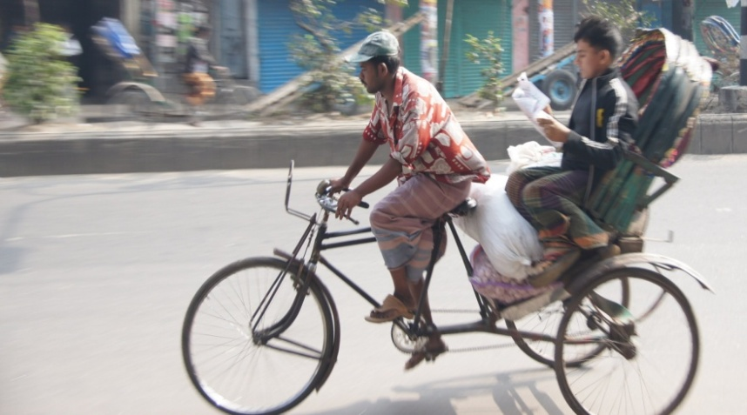
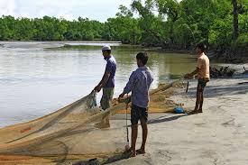
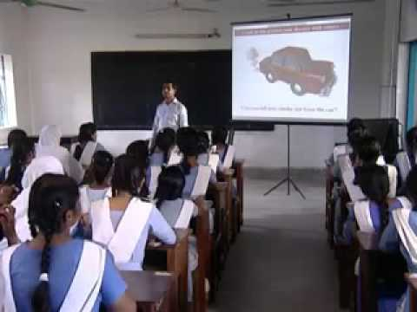
Pair Work
Look at the following pictures and write who is doing what in it.

Slide 18
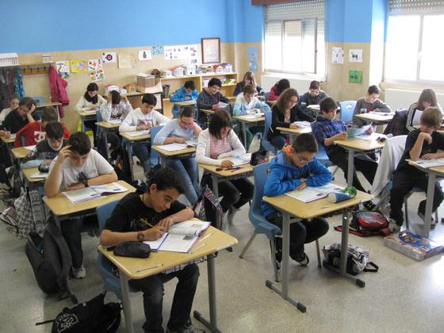
Individual Work
Rewrite the following sentences in present continuous tense:
They work very hard.
She learns English.
Nafisa helps her mother in the kitchen.
We watch sports program on TV.
Ducks swim in the pond.
These two boys quarrel with each other.

Slide 19
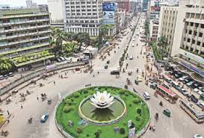
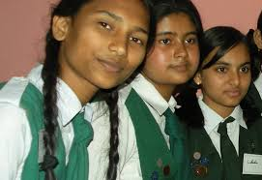
Use of Present Continuous Tense
Present Indicating Future
I am going to Dhaka tomorrow.
They are going to read in a new class from next month.

Slide 20
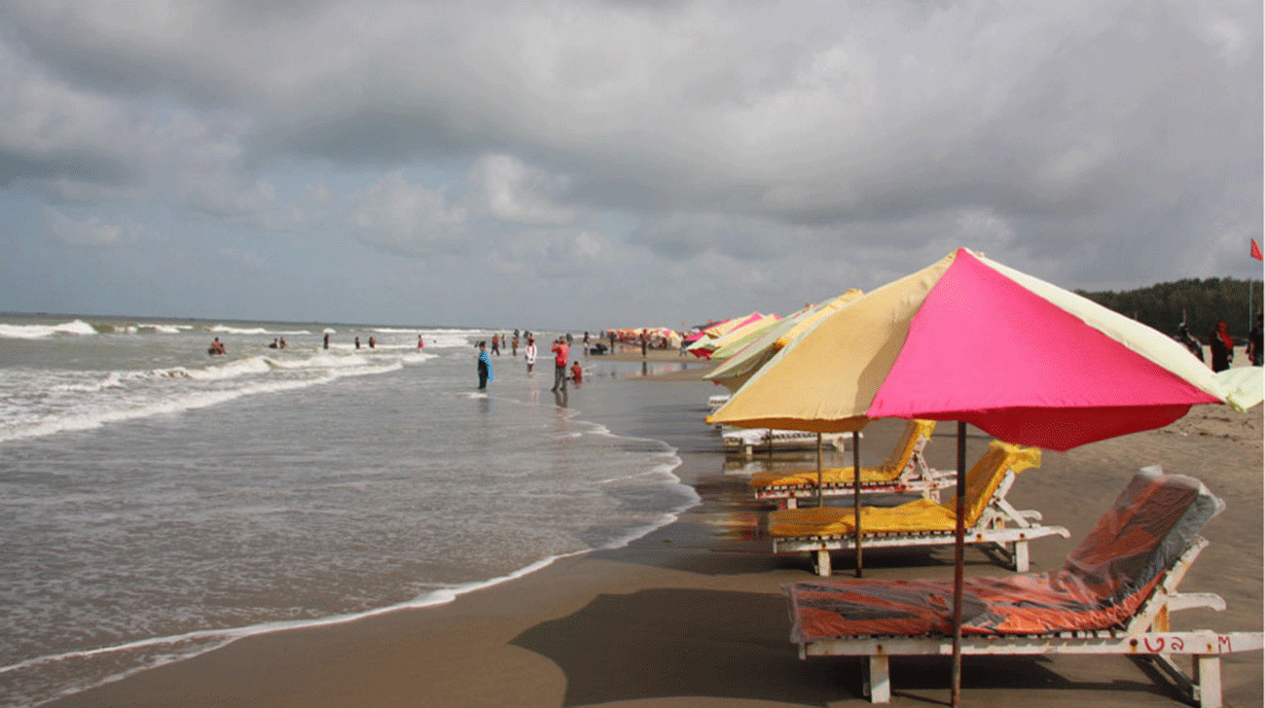
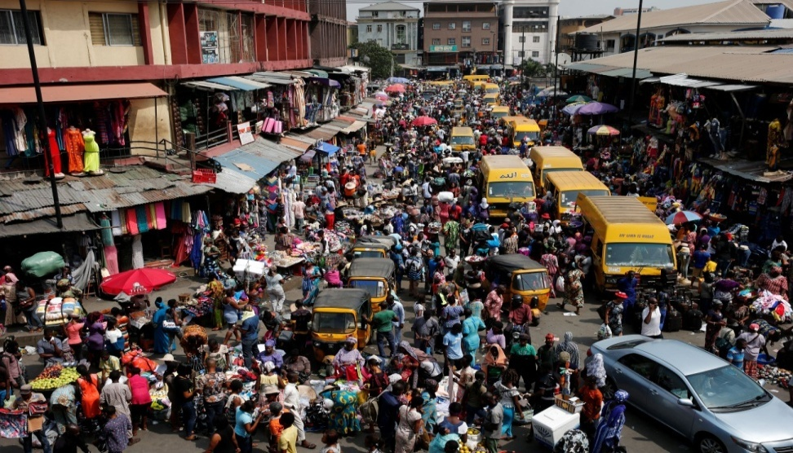
Changing Situation
The number of tourists is decreasing day by day.
The population of Bangladesh is growing rapidly.

Slide 21
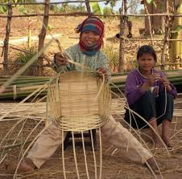
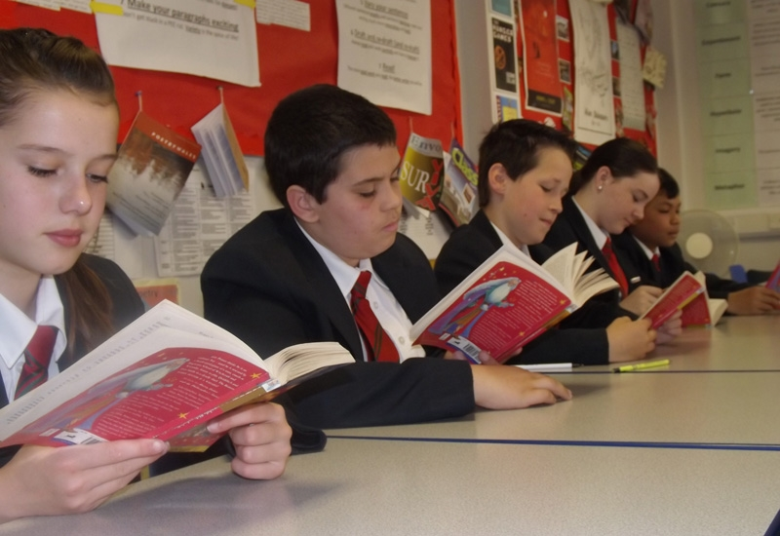
Adverb of Time
Now, at this time, at this moment, at present, today
Now he is making a basket .
They are reading at this time.

Slide 22
Remember
Non-Continuous Verb Always Simple Present Tense
Know, hear, believe, see, feel, notice, fear, think, realize, smell, wish, understand, hate, love, like, want, sound, have, need, appear, seem, taste, own, be, become

Slide 23
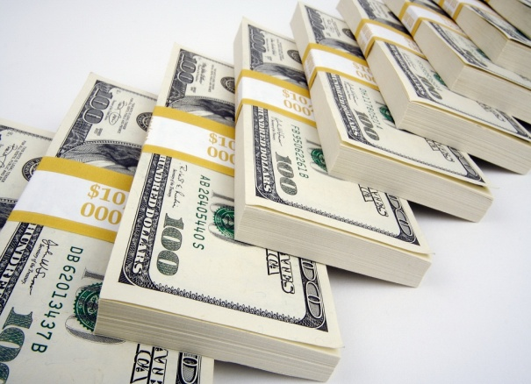
Example
I am not happy now though I have a lot of dollar. So, I want peace instead of dollar.

Slide 24
Group Work
Complete the following sentences in present continuous tense:
I -----(go) to Dhaka by bus.
It ----- (rain) very hard.
So the bus ----- (not run) very fast.
Some passengers ----- (sleep).
Some ----- (gossip).
Some young boys ----- (sing).

Slide 25
Assessment for Learning
Read the following dialogue and complete it in present continuous tense:
Sharmin: What --- you---- (do) there?
Sharif : I --- ---- (get) ready to go to market.
Sharmin: What --- you ----- (go) to buy?
Sharif : My son is home tomorrow. So I ---- --
- (go) to buy some sweets.

Slide 26
Write sentences of your own using the following verbs in the present continuous tense:
Walk, work, eat, drink, drive and wait

Slide 27
