Slide 1
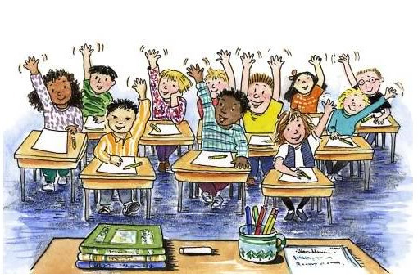
Welcome
Subject: English 2 Class: Ten

Slide 2
Teacher’s Introduction
Rajon Mahmood
B.A. (Hons) & M.A. in English (Major in ELT)
Assistant Teacher
Dariapur Secondary School
Mujibnagar, Meherpur
E-mail: raz_bd@live.com
Mobile: 01719-271306

Slide 4
Today’s Lesson
People Who Stand Out
Unit: 7
Lesson 2: The Art of Silence
Reference Book: English For Today
Page No: 94-97

Slide 5
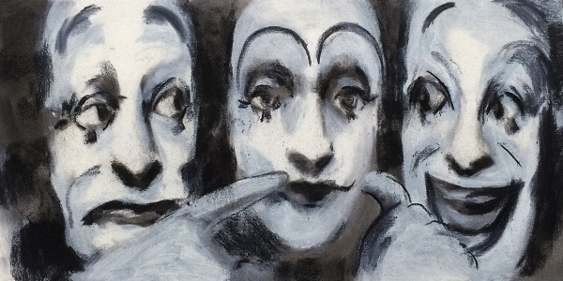
Do you know who is the pioneer of mime in Bangladesh?

Slide 6
Learning Outcomes
At the end of this lesson, students will be able to –
describe the life and the contributions of Partha Partim Majumder
scan and skim through the text for particular information
apply some key words from the text
write a summary of the text

Slide 7
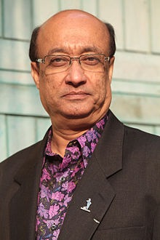
Biography Timeline
Born
18 January, 1954
Birth Place
Kalachadpara , Pabna, East Bengal
Education
Dr. Shitol Prasad Ghosh Ideal School
Jogesh Dutta Mime Academy
Known For
Mime
Master of Mime , Master of the World,
Molière Award
Munier Chowdhury Award , Ekushey Padak
Awards
Premanshu Kumar Biswas

Slide 8
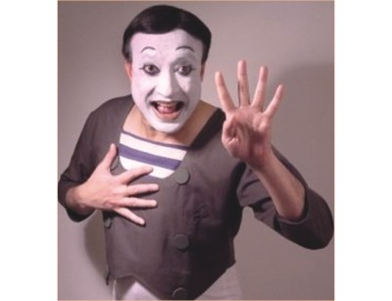
Can you understand?
.

Slide 9
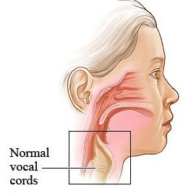
Key Vocabularies
The woman gave a
sad gesture.
Vocal cords (noun) =
vocal folds or voice reeds
Gesture (n) =
a movement of part of the body, especially a hand or the head, to express an idea or meaning.
Our vocal cords help us to speak.

Slide 10
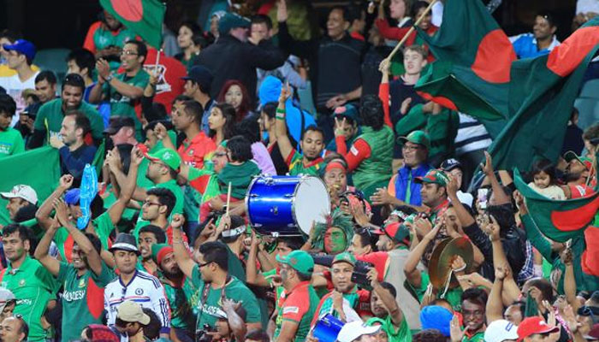
Key Vocabularies
.
Disappear (v) =
vanish/ fade
Evolve (v) = to develop gradually
Fascinate (v) = attract/captivate
The spectators were fascinated by the performance of our cricket.

Slide 11
Key Vocabularies
.
Master (v) = Learn
Undoubtedly(Adv) = Surely
Forerunner (adj.)
= Harbinger/Pioneer
Undoubtedly, Majumder is the forerunner in the field of mime in Bangladesh.

Slide 12
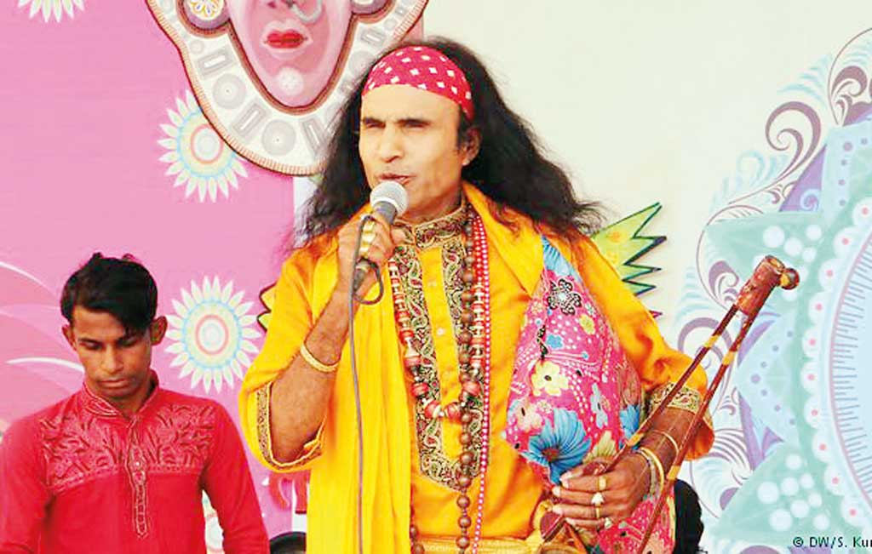
Key Vocabularies
express (verb) = represent/reflect
depict (n) = represent
solo (adj.) = single/lone
We enjoyed a solo performace of Abdul Kuddus Boyati.

Slide 13
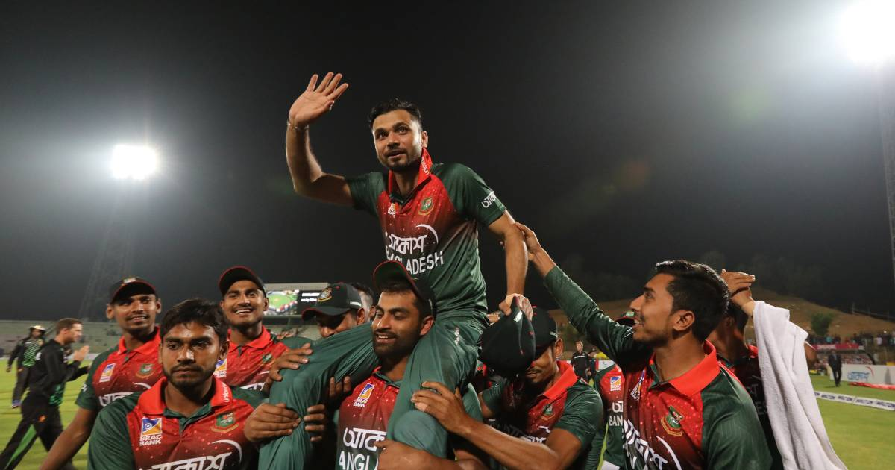
Key Vocabularies
.
legendary (adj) = very famous and admired
unimaginable (adj.) =incredible
Mashrafe Bin Mortaza is a legendary figure in Bangladesh. Our team won many matches for his unimaginable performance.

Slide 14
Key Vocabularies
.
Enthusiastically (adj) = willingly
Majumder won the highest distinction in the French Theatre in 2009.
Distinction (n) = Title
Vatiali is a genre of folk song.
Genre (n) = form

Slide 15
Text
Before the beginning of human language, communication took place between humans through signs and gestures. As humans began to use their vocal chords, these silent gestures were no longer used as the primary means of communication. But these did not completely disappear. They evolved as a form of art, which came to be known as ‘mime’.
In a Bangladeshi village a little boy came to know about mime as he watched a performance in his village. He was so fascinated by the show that he was determined to master this art. The name of that little boy was Partha Pratim Majumder.

Slide 16
Majumder is undoubtedly a forerunner in the field of mime in Bangladesh. He started as a musician and his keen sense of rhythm helped him to let his limbs move and express his thoughts through gestures. Partha Pratim Majumder is the first Bangladeshi to take up mime as a profession. He performed in a number of television shows in Bangladesh and gained popularity. In his mime, Majumder depicted the day-to-day life of the people-their sadness, tears as well as their happiness and laughter.

Slide 17
Majumder’s turning point of life came in 1979, when he was asked to give a solo performance in Bangladesh Shilpakala Academy. The then French ambassador to Bangladesh Mr. Loic Moreau happened to be among the audience. Mr. Moreau noticed the talent in Majumder. In 1981, the French Government offered him a scholarship so that he could get professional training in mime. This was the first time that a student was granted a French scholarship in mime. Majumder started his training under the legendry maestro, Etiene Decroux. Through Decroux, he met another celebrated mime artist named Marcel Marceau. Marceau has transformed modern mime by taking it to an unimaginable height.

Slide 18
Marceau was very impressed by the young Bangladeshi talent and offered him a place in his school for mime, named ‘Ecole Internationale de Mimodrame de Paris Marcel Marceau’. This school of mime is the biggest and the best in the world.
During his three year training period, Majumder practiced 16-18 hours daily till each and every bone in his body would feel like breaking.
After his time with Marceau, there was no looking back for Majumder. He staged solo performances in England, Belgium, Germany, Spain, Italy and the USA. French, Canadian and American TV channels enthusiastically aired his shows.

Slide 19
In 2009, a French play featuring Majumder won the “Moliere Award” which is the highest distinction in the French Theatre.
As a pioneer of the art of mime in Bangladesh and for popularizing the artistic genre, Bangladesh Government honoured the artiste with the “Ekushey Padok” in 2010.
The Government of France has also honoured him for his contribution to the art of mime throughout the world with one of the highest cultural awards of France titled “Chevalier de L’odre des Arts et des Letters” (Knight in the order of Arts and Letters) in the year 2011.

Slide 20
Choose the best answer
1. Before the use of speech, communication took place through __ language.
written (b) sign (c) spoken (d) art
2. In what form have the silent gestures evolved into?
drama (b) cinema (c) mime (d) dance
3. In older times the actors who performed mime used to put white paint on their __.
limbs (b) body (c) face (d) hair
2. The word ‘fascinated’ in the text means ___.
enchanted (b) encouraged (c) silenced (d) upset

Slide 21
Individual Work
Answer the following questions using your own words.
What is ‘mime’?
What helped Majumder to express himself clearly while performing mime?
What did he depict through this performance at the beginning?

Slide 22
Homework
Write down the summary of the text using your own language within 150 words.

