Slide 1
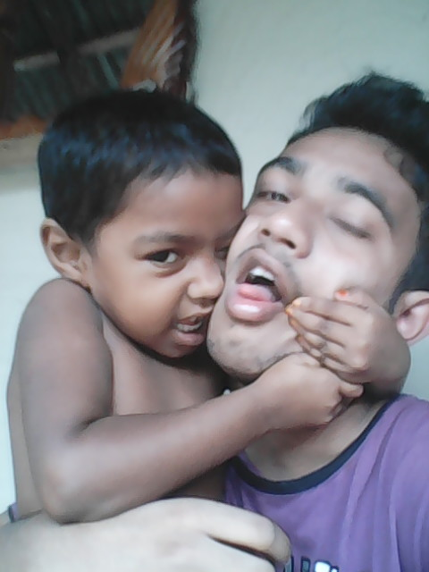
Welcome to all

Slide 2
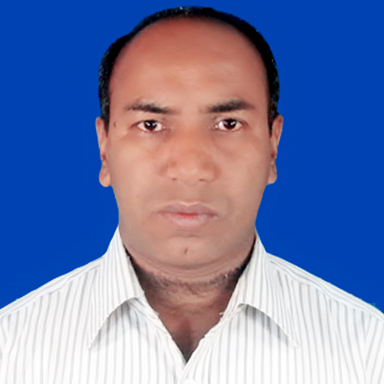
Identity
Md. Alamgir Hossain
Assistant Teacher(ict)
Rahimapur Fazil Madrasah,
Patnitala , Naogaon.
Phone No: 01723626108
G-mail: alamgirchz@gmail.com

Slide 3
Identity
Sub: English 2nd paper.
Class: six,seven,eight,nine,ten.
Transformation of sentence

Slide 4
Follow the sentences
What type of sentences are these?
What type of sentences are these?
Only you can call me.
Alone he will go there.
He is not present today.
None can avoid death.
So today we are going to learn how to change affirmative to negative and vice versa(Edited)

Slide 5
Transformation
of Sentence

Slide 6
Learning outcomes
Ss can be able to-
Format affirmative sentences
Format negative sentences.
Change affirmative to negative.
Change to negative to affirmative

Slide 7
1. Sentence অর্থ অনুসারে ৫ প্রকার ।
AFFIRMATIVE TO NEGATIVE
Rule 1: Only/ alone/ merely → স্থানে→ None but(ব্যক্তি)/ nothing but(বস্তু)/ not more than or not less than(সংখা)
Rule 1: Affirmative বাক্যের শুরুতে বা মাঝে Only বা alone থাকলে Negative করার সময় Only বা alone এর পরিবর্তে উত্তর বাক্যের শুরুতে None but বসে । আর কোন পরিবর্তন হয়না ।
Example:
Aff: Allah Only can help us.
Neg: None but Allah can help us.
Affirmative: Only he can play good cricket.
Negative: None but he can play good cricket.

Slide 8
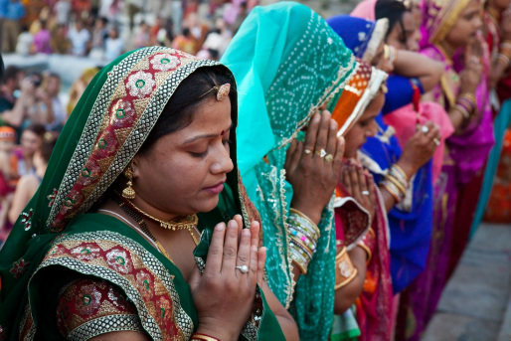
2. Allah can help us.
= Allah can help us.
Only
None but

Slide 9
For practice
Only he can play well.
Alone you are permit to go.

Slide 10
Note: বস্তুর ক্ষেত্রে only এর পরিবর্তে only এর স্থানে
nothing but বসে + বাঁকি সব ঠিক থাকে ।
Example
Aff: He has only a ball.
Neg: He has nothing but a ball.
Aff: He has only a story book.
Neg: He has nothing but a story book.

Slide 11
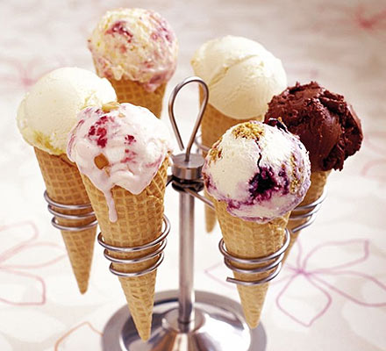
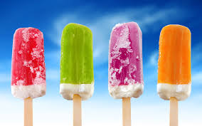
He likes Ice-cream.
= He likes Ice-cream.
Only
nothing but

Slide 12
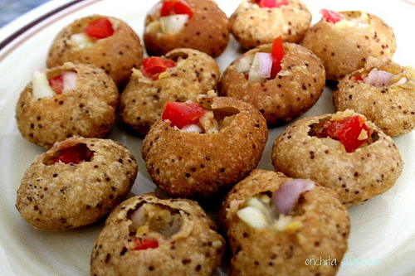
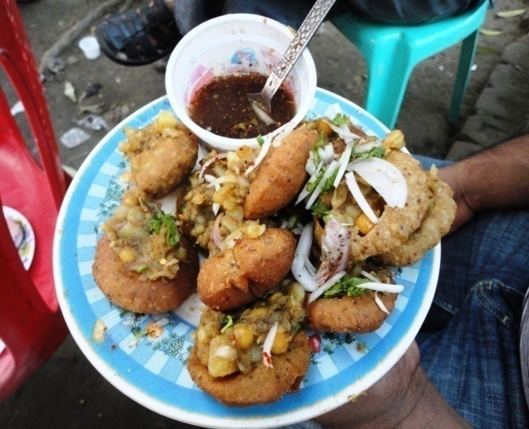
2. He likes Fusca.
= He likes Fusca
Only
nothing but

Slide 13
For practice
I like to eat only Jung food.
He likes to drink only milk.

Slide 14
Note: বয়সের ক্ষেত্রে বা সংখ্যার ক্ষেত্রে only এর পরিবর্তে only এর স্থানে
not more than বসে + বাঁকি সব ঠিক থাকে ।
Example
Affirmative: He is only four.
Negative: He is not more than four.
Affirmative: They have only two cars.
Negative: They have not more than two cars.

Slide 15
2. It is 50 kg.
= It is 50 kg
Only
50 Kg
not more than

Slide 16
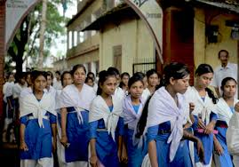
1. They are 13 years old
= They are thirteen years old.
Only
not more than

Slide 17
For practice
I like to eat only Jung food.
He likes to drink only milk.

Slide 18
Rule 2: Must/Have to /Has to → স্থানে → Cannot but+মূল verb/ Cannot help+ (v+ing).
Affirmative sentence এ must থাকলে negative করার সময় must এর পরিবর্তে can not but/ can not help বসে ।
তবে can not help এর পরে যে verb থাকে তার সাথে ing যুক্ত করতে হয় ।
Example:
Aff: We must obey our parents.
Neg: We cannot but obey our parents
or
We cannot help obey our parents.
ing

Slide 19
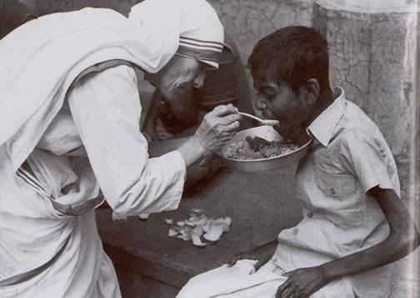
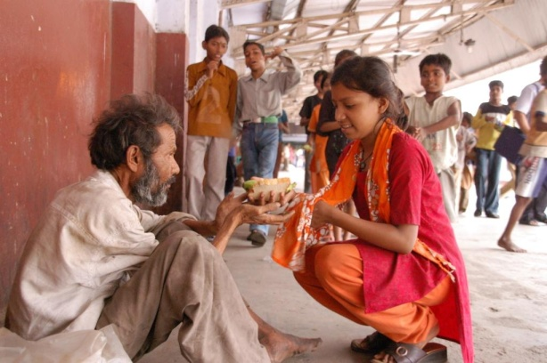
You help the poor.
= you help the poor
must
Cannot but

Slide 20
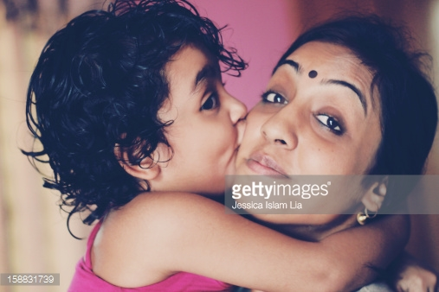
We love our mother.
= we love our mother.
must
cannot but

Slide 21
For practice
1.Every man must die.
2. Every one must present there.

Slide 22
Affirmative বাক্যের শুরুতে Every থাকলেক Negative করতে হলে every এর পরিবর্তে There is no বসে + every এর পরের শব্দটি বসে + but + প্রদত্ত sentence এর বাকী অংশ ।
Example:
Affirmative: Every one hates a terrorist.
Negative: There is no.
one
but
hates a terrorist
Affirmative: Every body fears a lion.
Negative: There is no
body
but
fears a lior.

Slide 23
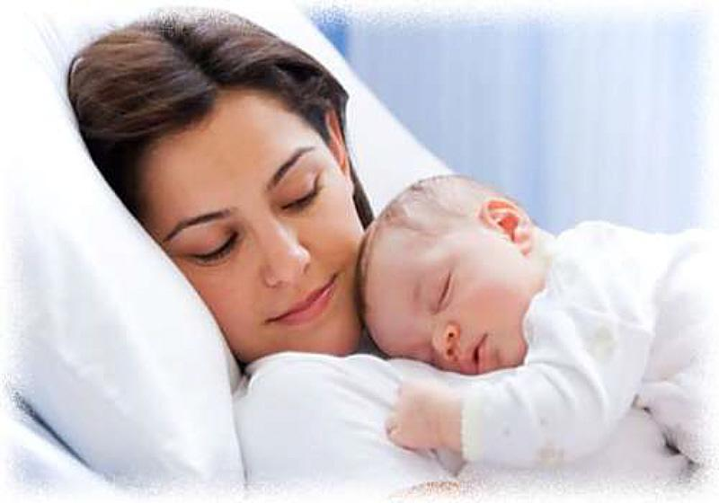
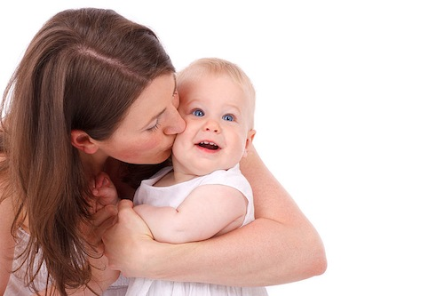
mother loves her child
= m mother but loves her child
Every
There is no

Slide 24
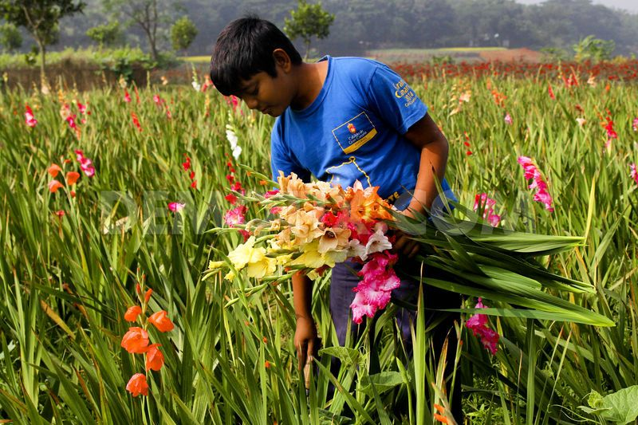
loves flower.
= loves flower. Or There is no none but loves flower.
Everybody
There is nobody but

Slide 25
For practice
Every one likes to play.
Every sister likes her brother.

Slide 26
Affirmative sentence এর শুরুতে বা মাঝে Both----and থাকলে Negative করার সময়→ Both এর স্থানে not only ---- and এর স্থানে but also বসে । বাঁকি সব ঠিক থাকে ।
Example:
Aff: Both Dolon and Dola were excited
Neg: Not only dolon but also Dola were excited
Aff: I know both Rahim and Karim
Neg:
I know not only Rahim but also Karim

Slide 27
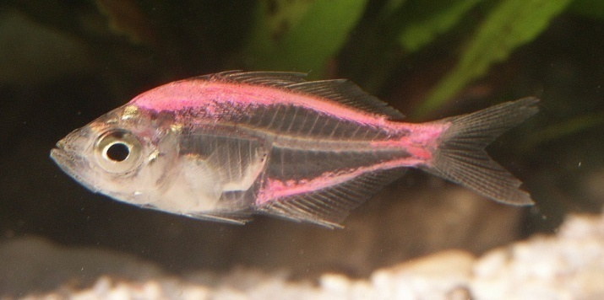
I like meat fish.
= I like meat fish.
both
and
not only
but also

Slide 28
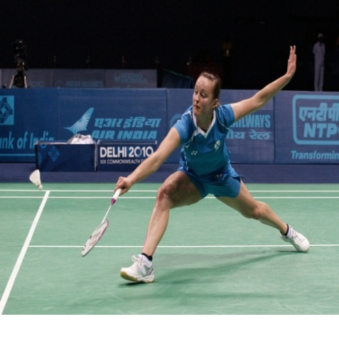
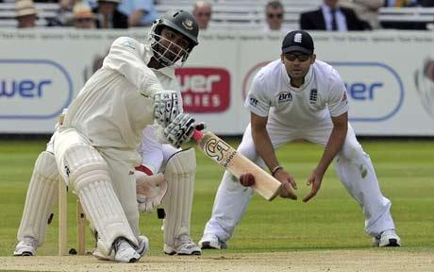
I like to play badminton cricket
I like to play badminton cricket.
both
and
not only
but also

Slide 29
Affirmative sentence মাঝে and দ্বারা যদি দুটি Adjective or দুটি Noun যোগ থাকে) তাহলে Negative করার সময় ১ম Adjective or Noun আগে not only বসে + ২য় Adjective or Noun আগে but also বসে । বাঁকি সব ঠিক থাকে ।
Example:
aff: He was obedient and gentle.
not only
Neg: He was obedient gentle.
but also

Slide 30
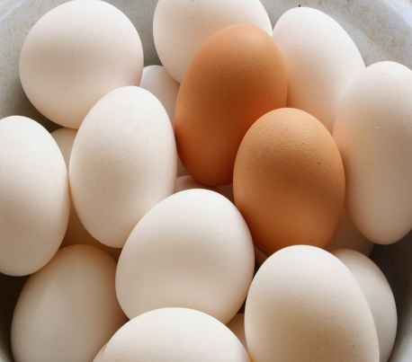
I want to eat egg vegetable.
= I want to eat not only egg vegetable.
and
but also

Slide 31
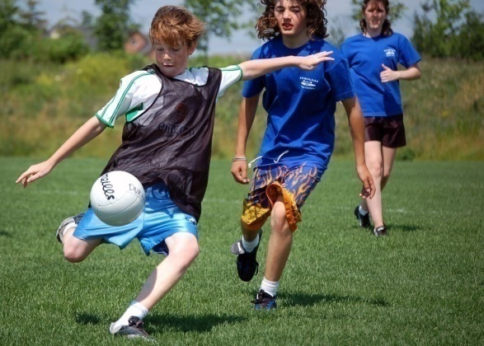
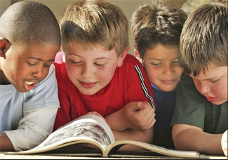
They like playing reading.
=They like not only playing reading.
And
but also

Slide 32
For practice
I like to eat butter and ghee.
They like to play cheese and ludu
They like games and sports.

Slide 33
Rule 5: Everyone/ everybody/every person/ (every + common noun)/all → স্থানে → There is no + attached word + but.
Example:
Aff: Every mother loves her child.
Neg: There is no mother but loves her child.

Slide 34
Affirmative sentence এর শুরুতে As soon as থাকলে Negative করার সময় As soon as এর স্থানে no sooner had বসে + প্রদত্ত Sentence এর কর্তা বসে + সে Sentence এর মূল verb এর v3 বসে + কমা পর্যন্ত বসে + কমার স্থানে than + দ্বিতীয় বাক্য বসে ।
Example:
Aff: As soon as the thief saw the police, he ran away.
seen
Neg: the thief the police he ran away.
No sooner had
than

Slide 35
the thief saw the police he ran away.
= the thief seen the police than he ran away.
As soon as
,
No sooner had

Slide 36
Than any other/than all other যুক্ত comparative degree কে Negative করতে হলে –
প্রথমে No other +
any other/all other এর পরের অংশ বসে +
প্রদত্ত verb +
comparative degree এর positive form +
as
so/as বসে +
+
প্রদত্ত sentence এর subject.
Example:
Affirmative: He is better than any other boy in the class.
Negative:
No other
boy in the class
is
as
good
as
he.
Better
Affirmative: Dhaka is bigger than all other cities in Bangladesh.
Negative: No other city in Bangladesh is as big as Dhaka.

Slide 37
Superlative degree যুক্ত Affirmative sentence কে Negative করতে হলে –
No other +
superlative এর পরের অংশ +
verb +
as +
superlative degree এর positive form
+ as +
প্রদত্ত sentence এর subject.
aff: Dhaka is the biggest city in Bangladesh.
Neg:
No other
City in Bangladesh
is
as
big
as
Dhaka
biggest
Affirmative: You are the best boy in the class.
Negative: No other boy in the class is as good as you.

Slide 38
Rule 9: Affirmative Sentence এর মধ্যে Always থাকেলে Negative করার সময় Alwaysএর পরিবর্তে Never বসে + মূল ক্রিয়া বা (p.v) এর বিপরির্ত শব্দ বসে + বাঁকি সব ঠিক থাকে ।
Example:
Aff: I shall always remember you.
Aff: I shall remember you.
Neg: I shall never forget you.
never
Forget
always

Slide 39
Rule 9: Affirmative Sentence এর মধ্যে শুধু Adjective থাকেলে Negative করার সময় উক্ত
Adjective এর বিপরিত শব্দ বসে এবং উক্ত বিপরিত শব্দের আগে Not বসে + বাঁকি সব ঠিক থাকে ।
Example:
Affirmative: He is a good man.
not
bad
Negative: He is a good man.

Slide 40
Healthy
Unhealthy
Honest
Dishonest
Hard
Easy
Kind
Unkind
Morral
Immorral
Ordinary
Extraordinary
Rich
Poor
Obedint
Disobedient
Please
Displease

Slide 41
মূল শব্দ | বিপরীত শব্দ
Able | Unable
Absent | Present
Active | Inactive
Always | Never
Agree | Disagree
Arrive | Depart
Beautiful | Ugly
Believe | Disbelieve
Bright | Dark
Confortable | Unconfortable
Complex | Simple
Correct | Incorrect
Defend | Attack
Equal | Unequal
Fat | Thin
Fortunate | Unfortunate
Freedom | Bondage
Friend | Foe
Good | Bad
Greatful | Ungreatful
Happy | Unhappy

Slide 42
Sincher
Insincher
Sorrow
Joy
Useful
Uselose
Love
Hate
Mortal
Immortal
Punctual
Late
Real
Unreal
Top
Bottom
Wish
Unwise

Slide 43
True
False
Unity
Disunity
Solvent
Insolvent
Young
Old
Mad
Sane
Remember
Forget
Right
Wrong

Slide 44
Willing
Unwilling
Common
Uncommon
Obey
Disobey
Doubtful
Undoubtful
Litarate
Illitarate
Responsibily
Irresponsibily
Regular
Irregular

Slide 45
Affirmative: Rakib is an honest boy.
not
Negative: Rakib is an honest boy.
dishonest
Affirmative: This was an ordinary ship
not
Negative: This was an ordinary ship
extra-ordinary

Slide 46
Affirmative sentence এর মধ্যে Too.....to যুক্ত sentence কে Negative করতে হলে – Too এর জায়গায় so /very বসে + Too এর পর থেকে to পূর্ব পর্যন্ত + to এর পরির্বতে that বসে + প্রথম subject + Present tense হলে can not/may not Past হলে could not/might not বসে + প্রদত্ত to এর পরের অংশ বসে । + বাঁকি সব ঠিক থাকে ।
Example:
Aff: He is too weak to walk.
that
Neg: He is too weak to walk.
so
he cannot

Slide 47
Affirmative sentence এর মধ্যে Too.....to যুক্ত sentence কে Negative করতে হলে – Too এর জায়গায় so /very বসে + Too এর পর থেকে to পূর্ব পর্যন্ত + to এর পরির্বতে that বসে + to এর পূবে যে object থাকে তার Subject বসে + Present tense হলে can not/may not Past হলে could not/might not বসে + প্রদত্ত to এর পরের অংশ বসে । + বাঁকি সব ঠিক থাকে ।
Example:
Affirmative: The sum was too difficult for me to work out.
Negative: The sum was so difficult for me that
I could not work out.

Slide 48
Afftrmative Sentence এর মধ্যে As...As থাকলে Negative করার সময় – ১ম As এর জায়গায় not less বসবে এবং ২য় as এর জায়গায় thanবসবে + বাঁকি সব ঠিক থাকবে ।
Example:
Aff: Simi was as wise as Rimi.
Aff: Simi was as wise as Rimi.
not less
than
Neg: Simi was not less wise than Rimi.

Slide 49
Afftrmative Sentence এর মধ্যে Less...than থাকলে Negative করার সময় – Less এর জায়গায় not as বসবে এবং than এর জায়গায় as বসবে + বাঁকি সব ঠিক থাকবে ।
Example:
Affirmative: He is less ugly than you said.
as
Affirmative: He is less ugly than you said.
not as
Negative: He is not as ugly as you said.

Slide 50
Rule 12: Affirmative ‍বাক্যটি Universal truth(চির সত্য) হলে negative করার সময় interrogative + negative তৈরী করতে হবে.
Example:
Aff: The Sun sets in the west.
Neg: the Sun set in the west.
Doesn’t
AFF - Milk is White
Isn’t
Neg – Milk White

Slide 51
Affirmative ‍বাক্যটির মধ্যে যদি Sometimes থাকলে negative করার সময় Subject এর পরে do not/ does not + Sometimes এর পরিবর্তে always বসে + বাঁকি সব ঠিক থাকে .
Example:
Aff: Rahim sometimes visits me.
Aff: Rahim sometimes visits me.
doesn’t always
Neg: Rahim doesn’t always visit me.

Slide 52
Affirmative ‍বাক্যটির মধ্যে যদি Many থাকলে negative করার সময় Subject এর পরে do not/ does not +Have Many এর পরিবর্তে a few/few বসে + বাঁকি সব ঠিক থাকে . Example:
Aff: I have many friends.
Aff: I have many friends.
donot have few
Neg: I donot have few friends.
Neg: I donot have few friends.

Slide 53
Affirmative ‍বাক্যটির মধ্যে যদি a few/few থাকলে negative করার সময় Subject এর পরে do not/ does not + Have + a few/few এর পরিবর্তে Not Many বসে + বাঁকি সব ঠিক থাকে . Example:
Aff: Bangladesh has a few scholars.
Neg: Bangladesh doesn’t have many scholars.

Slide 54
Affirmative ‍বাক্যটির মধ্যে যদি belongs + Much থাকলে negative করার সময় Subject এর পরে do not/ does not + উক্ত belongs + Much এর পরিবর্তে A Littlr বসে + বাঁকি সব ঠিক থাকে .
Example:
Aff: He belongs much money.
Aff: He belongs much money.
doesn’t belong a little
Neg: He doesn’t belong a little money.

Slide 55
Affirmative ‍বাক্যটির মধ্যে যদি A Little থাকলে negative করার সময় Subject এর পরে do not/ does not + Have+ A Little এর পরিবর্তে Much বসে + বাঁকি সব ঠিক থাকে . Example:
Aff: Dolon has a little riches.
Aff: Dolon has a little riches.
doesn’t have much
Neg: Dolon doesn’t have much riches.

Slide 56
Form some groups and change the sentences as directed-
We must obey our parents.( Neg)
None but he can deny the matter. (Affirmative)
They like to play nothing but cricket. (Affirmative)
I like both banana and apple. (Neg)
No sooner had I reached the station than the train left. (Affirmative)

Slide 57
Good Bye
No more today
Thank you

