Slide 1
Good Morning

Slide 2
Teachers Introduction
Name: Md. Babul Hasan
Assistant Teacher
Kashimpur Purbo Govt. Primary School
Keshabpur, Jashore.

Slide 3
Lesson Information
Class
One
Lesson
4-6
Page
7

Slide 4
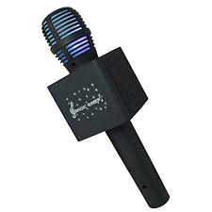
Lets sing a song !

Slide 5
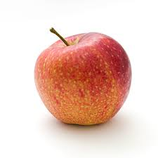
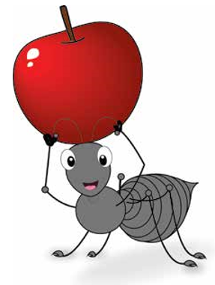
Showing Picture

Slide 6
Learning Outcomes: Students will be able to..
1.1.1 become familiar with English sounds by listening
to common English words.
Listening
Speaking
1.1.2 say simple words and phrases.

Slide 7
Lesson Declaration
Alphabet

Slide 8
WCW Work
a
a

Slide 9
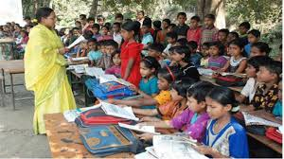
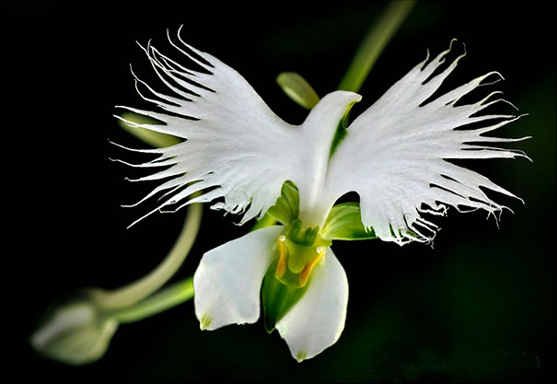
Teachers Reading

Slide 10
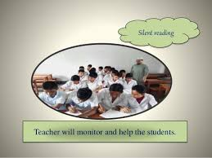
Silent reading
Teacher will monitor and help the students

Slide 11
Evaluation
a
For
a
For

