Slide 2
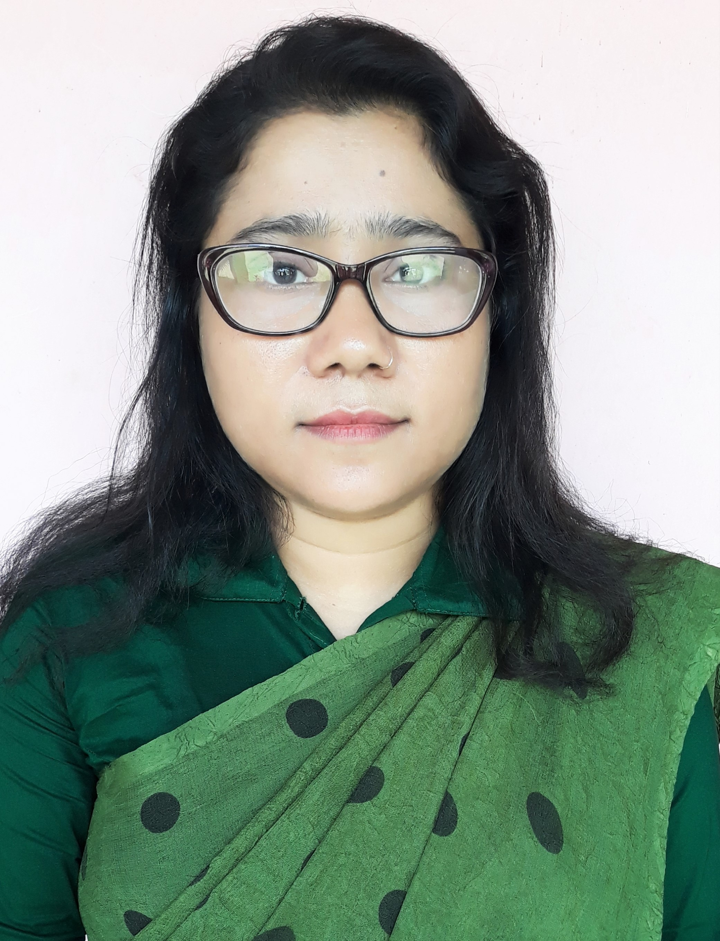
Hosneara Khatun
Assistant Teacher(ICT)
B.S.C Secondary School
Bagerhat Sadar, Bagerhat
Mobile No : 01725666394
E-mail: hosnearakhatun4@gmail.com
Class: IX-X
Subject : English For Today
Time : 50 Minute
Date : 13/09/2020

Slide 3
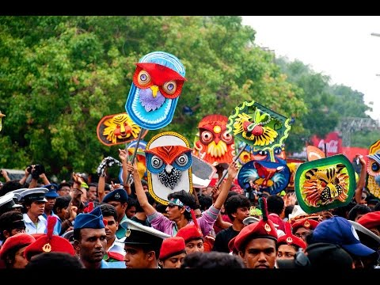
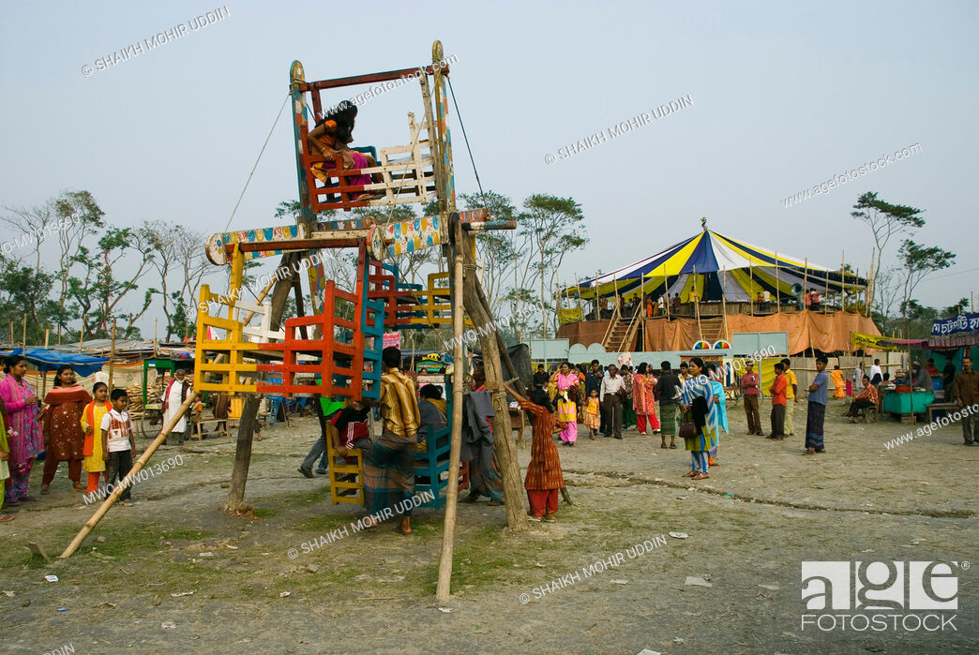
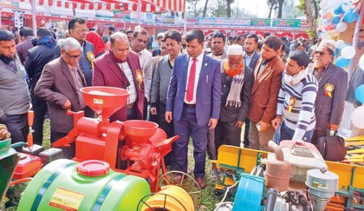
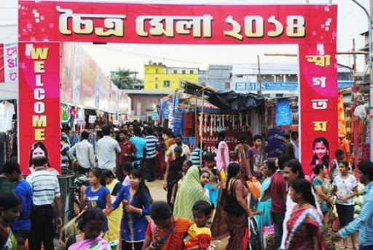
Let us watch some images
Boishakhi fair
Village fair
Cottage fair
Choitra mela

Slide 4
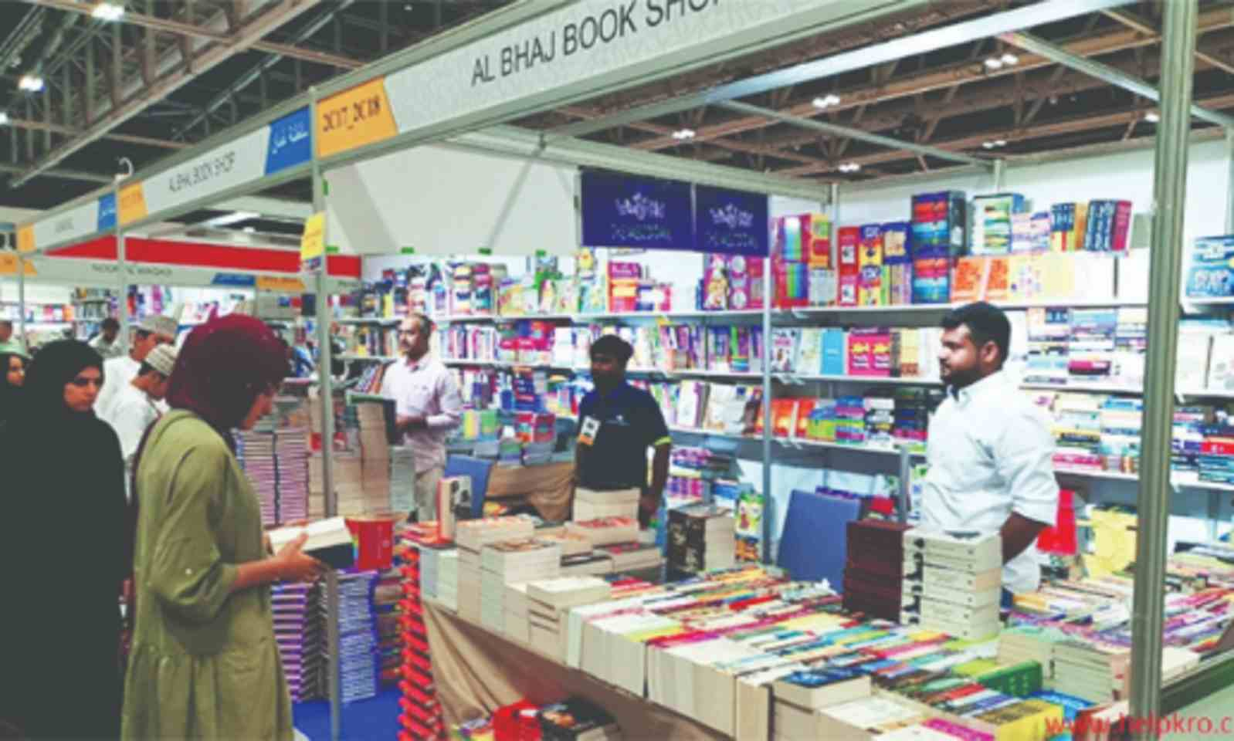
But what is this?
It
is
a
book
fair

Slide 5
Let’s see, what is our today’s lesson?
It is a paragraph
“ A Book Fair”
Writing part.

Slide 6
Learning outcomes
listen information
know about a book fair
ask and answer questions
write a paragraph.

Slide 7
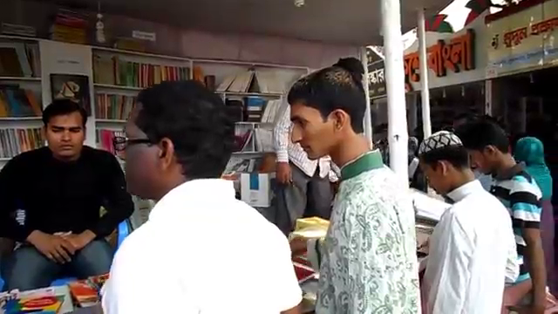
What is the video about?
It is about a book fair.

Slide 8
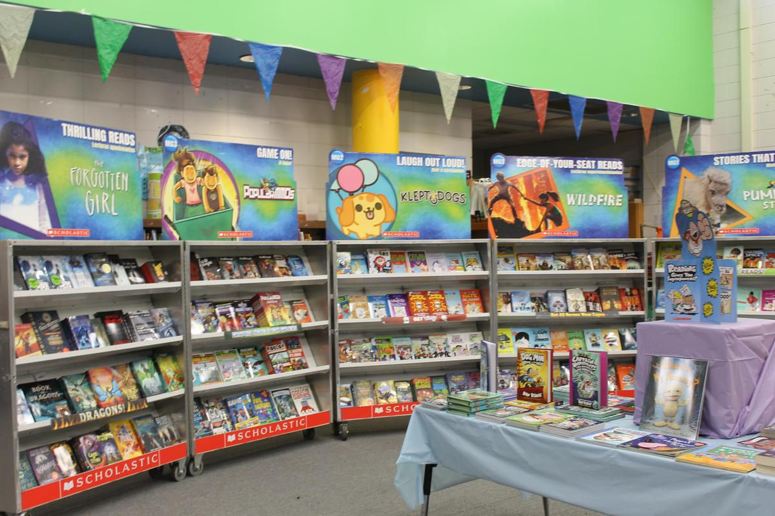
What is a book fair?
Book fair is a fair where books are displayed and sold.

Slide 9
When and where is it held in our country?
It is held all over the
country in February.

Slide 10
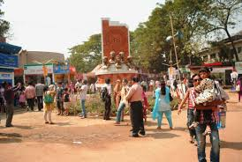
Where is the biggest book fair held in our country?
The biggest book fair in our country is held at Bangla Academy, Dhaka.

Slide 11
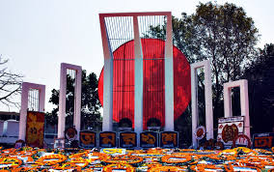
What is the starting and ending time of
the book fair?
1
28

Slide 12
But how is it started?
It is started with an inaugural ceremony.

Slide 13
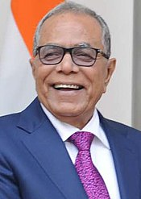
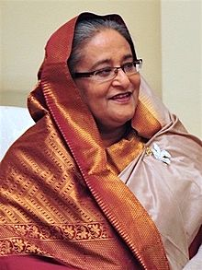
Who attends as the
chief patron of the ceremony?
President
Prime Minister
Sometimes the President, sometimes the prime minister and sometimes the education minister attends as the chief patron of the ceremony.

Slide 14
When and Which book fair did you visit?
I visited the Ekushey book fair last year with some of my friends.

Slide 15
What things did you visit in the book fair?
In the book fair I visited more than hundreds of stalls set up in different rows. All the stalls were laden with different books like-

Slide 16
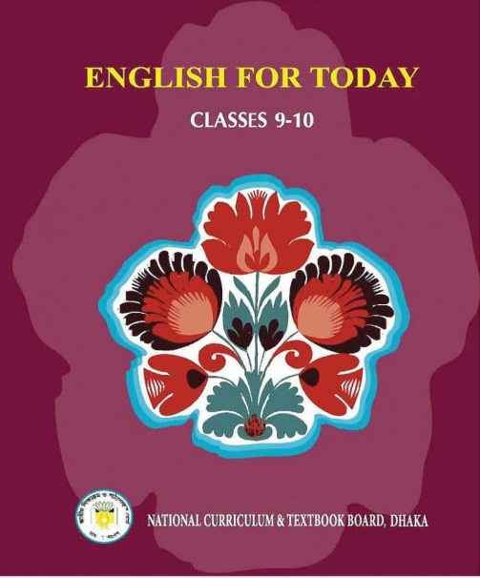
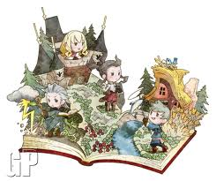
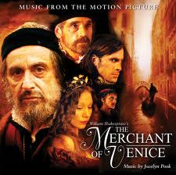
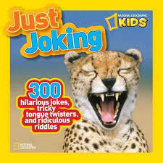
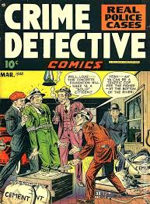
Text books
Books on geography
Children books
Ghost books
Books on history
Books on jokes
Detective books
Story books

Slide 17
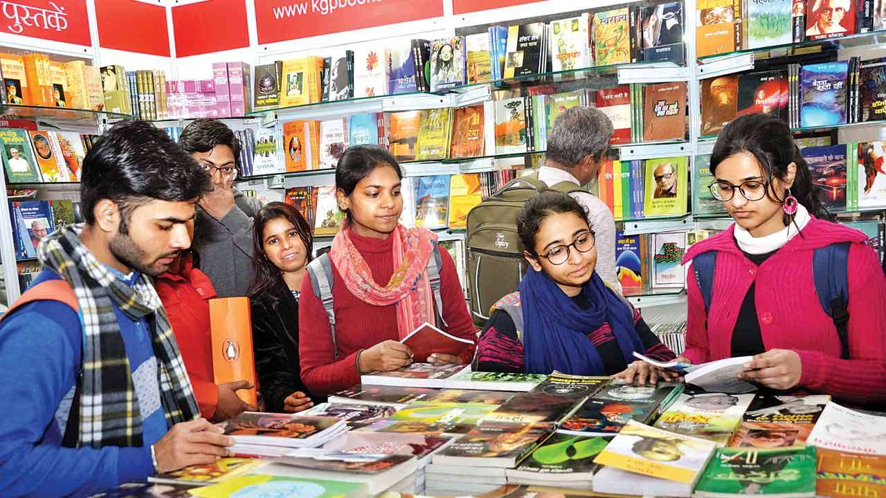
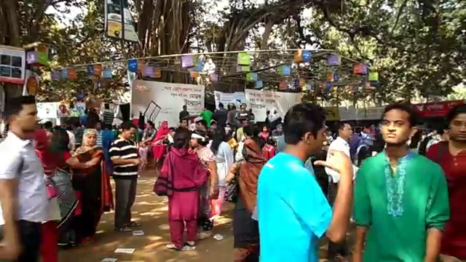
Who came to the book fair?

Slide 18
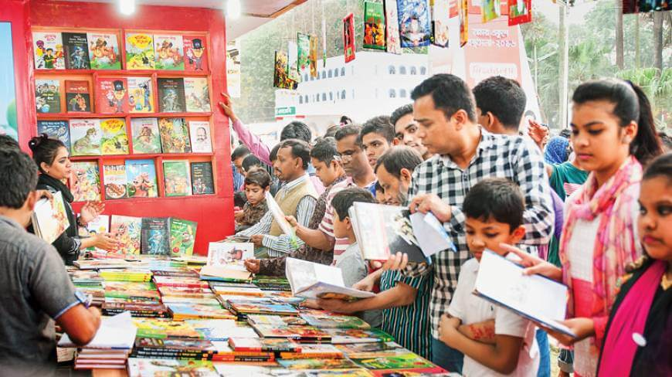
All classes of people came to the book fair.

Slide 19
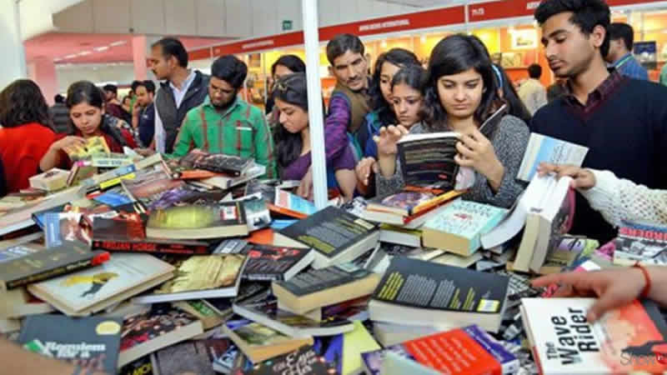
But why did they come
to the book fair?
Some of them came to visit only and some of them came to buy books.

Slide 20
Evaluation
What is a book fair?
When is it arranged?
Who attends the book fair?
Why do the people come to the book fair?
What is the importance of a book fair?

Slide 21
Home work
Write a paragraph on
“A book Fair You Visited”

