Slide 1
Welcome

Slide 2
MD.ABDUR ROUF
Lecturer of English
Khalna Islamia Fazil(Degree) Madrasah Patnitala,Naogaon.
Email: rouf301285@gmail.com
Mobile: 01767650169

Slide 3
Class: XI
Sub: English 1st Paper
Time: 45 Minutes

Slide 4
Look at the following pictures and guess about the pictures .

Slide 6
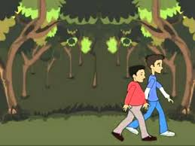

Slide 7
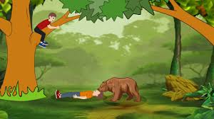

Slide 8
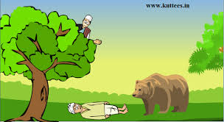

Slide 9
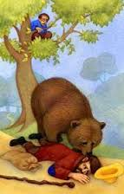

Slide 10
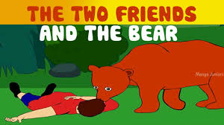

Slide 11
Lesson :
A friend in need is a friend indeed
Completing Story

Slide 12
Learning Outcomes
After reading this lesson students will be able to-
1.Know the benefit of reading story
2.Ask and Answer the Question
3.Learn how to write a story

Slide 13
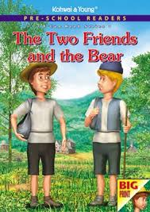
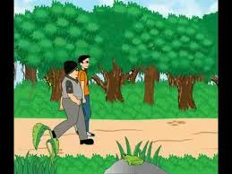
There were two friends. They lived in a certain village.

Slide 14
One day they were passing through a jungle.
They promised that they would help each other at the time of danger.

Slide 15
Suddenly they saw a bear coming towards them. Both of them got afraid.

Slide 16
One of them knew how to climb up a tree.
So, he climbed up a nearby tree without thinking about his friend.

Slide 17
The other was fatty and did not know how to climb up a tree.

Slide 18
But he knew that a bear does not touch a dead body.

Slide 19
So he fell flat on the ground like a dead person and stopped breathing. The bear came near him, smelt him all over the body and thought him to be a dead man.

Slide 20
So, without touching him, it went away slowly and gently.

Slide 21
The friend who was on the tree saw everything.

Slide 22
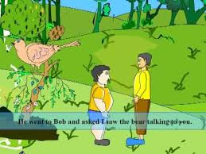
He got down from the tree , went to his friend and asked eagerly. “ Oh! Dear, what did the bear whisper to your ear?”

Slide 23
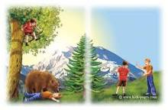
The other friend said, “ The bear advised me not to trust a friend who leaves his friend alone in time of danger.”

Slide 24
Individual Work
Where did the two friends live?
What did they promise?
What did they see?
What did a friend do?
What did an other friend do?
What did the bear do?

Slide 25
HOMEWORK
Write the story from your own idea.

Slide 26
Thank you

