Slide 2
TEACHER IDENTITY
Md. Shahidul Islam
Assistant teacher.
Kaliaish Govt Primary School
Satkania, Chottogram.

Slide 3
Introduction of the lesson
Class: Three
Unit: 29
Lesson: 01
Lesson Title: Where is it?
Today’s Lesson: A (Read)
Total Time: 35 minutes

Slide 4
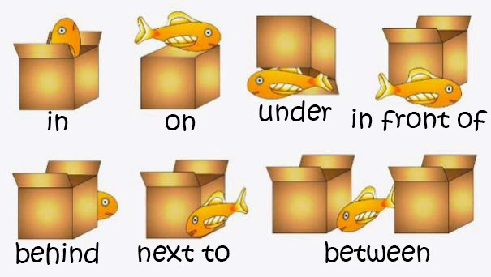
Where is the fish ?

Slide 5
Open your book at page 58

Slide 6
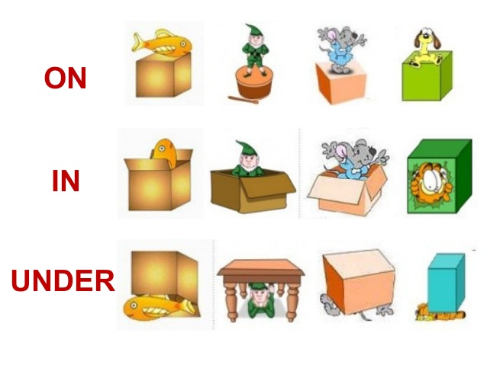
On, In, Under

Slide 7
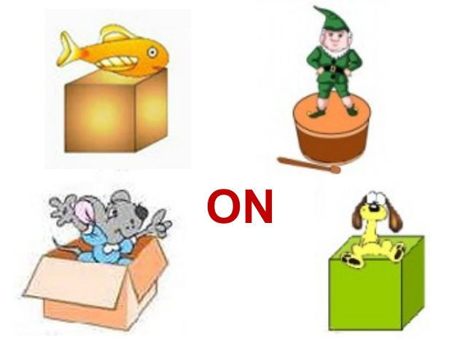
Which isn’t on?

Slide 8
Which isn’t under?

Slide 10
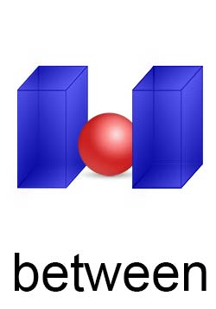
Between the box

Slide 11
Evaluation of the Class
(Questions and answers)
Where is the dog?

Slide 12
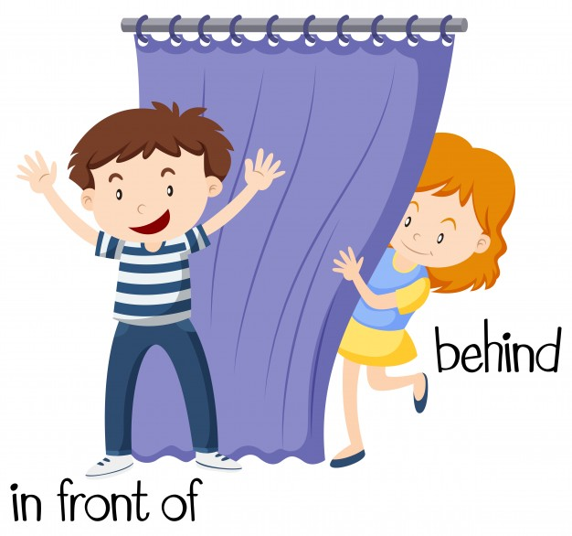
Where is the boy?
Notes:
Rule: 1. Teacher will show the word chart 2. Students will chose three words and write down 3. Teacher will say any three words randomly one after one. 4. Students will cross the name if it matches with the teacher 5. The students who cross all of the three will shout “BINGO’ and will be the winner.

Slide 13
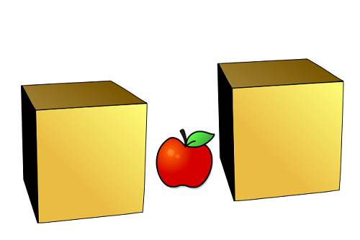
Where is the apple?

Slide 14
Home Work
Make at lest one sentence for each word
With their meanings.
Write down the sentences at your note
book to show me tomorrow in the class.

