Slide 1
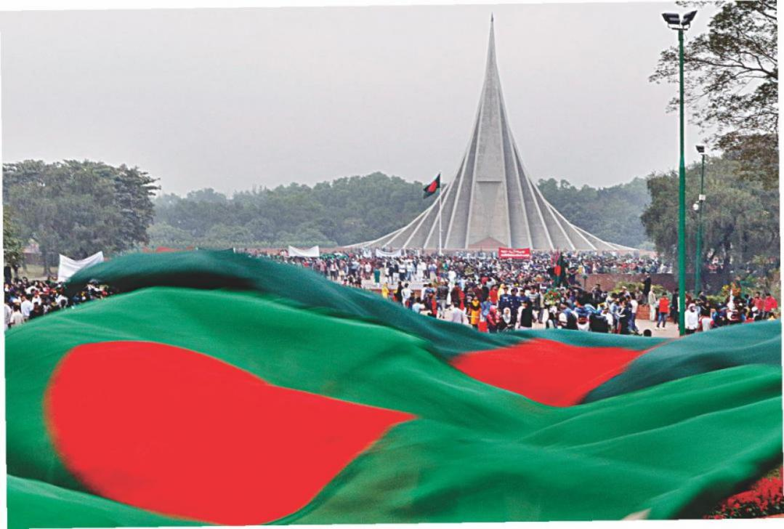
Welcome

Slide 2
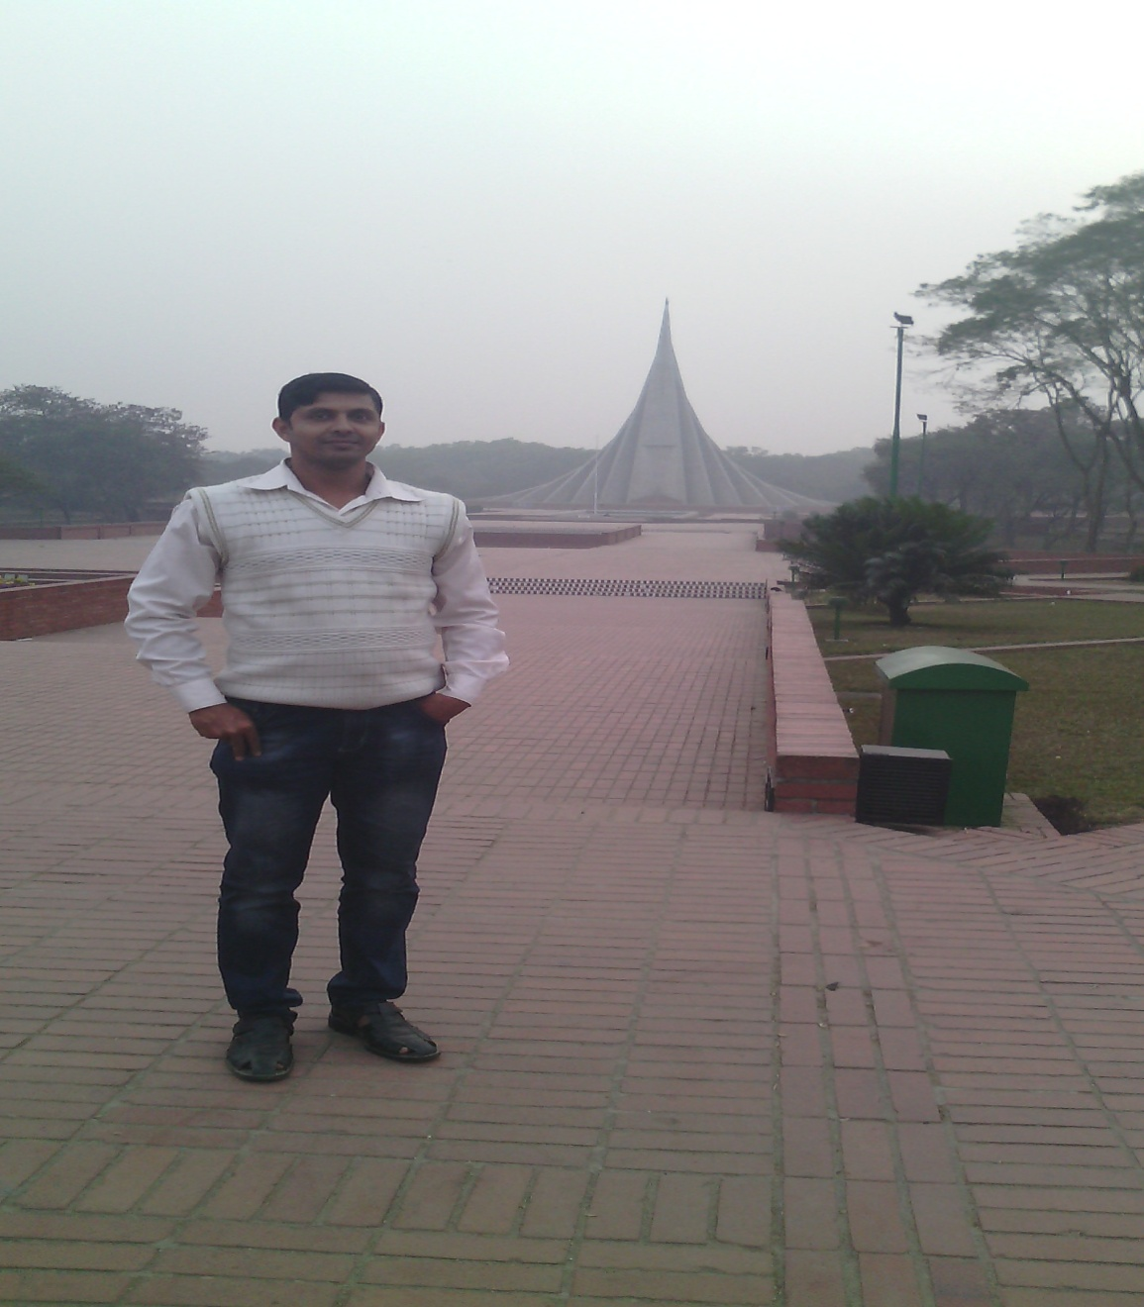
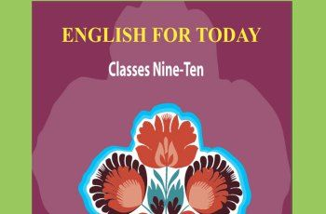
Ujjal Kumar Ghosh
Assistant Teacher(English)
Chuadanga Krishnanagor high School
Panjia,Keshabpur,Jassore
Email:ujjakumar106@gmail.com

Slide 3
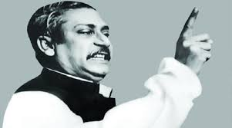
Do you know this man?
Bangabandhu Sheikh Mujibur Rahman

Slide 4
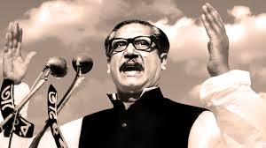
What did Bangabandhu call?

Slide 5
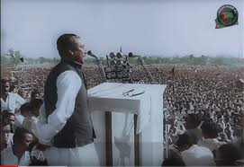
Bangabandhu called for independence

Slide 6
Today,s Lesson is------
Independence Day
Unit Three
Lesson 5
Page number -41

Slide 7
Learning outcomes
By the end of the lesson learning will be able to
Talk about the picture.
Use new words and make sentences.
Write a summary.
Matching Words.
Choose the correct answer from the alternative.
Write a paragraph

Slide 8
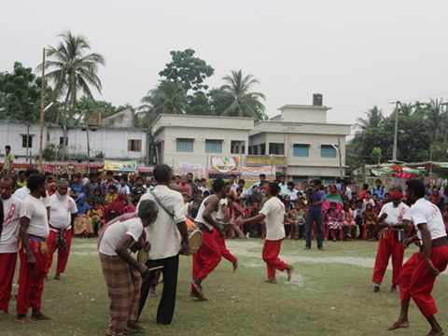
Festival
Festival means Joyful celebration
26 March is the biggest state festival.

Slide 9
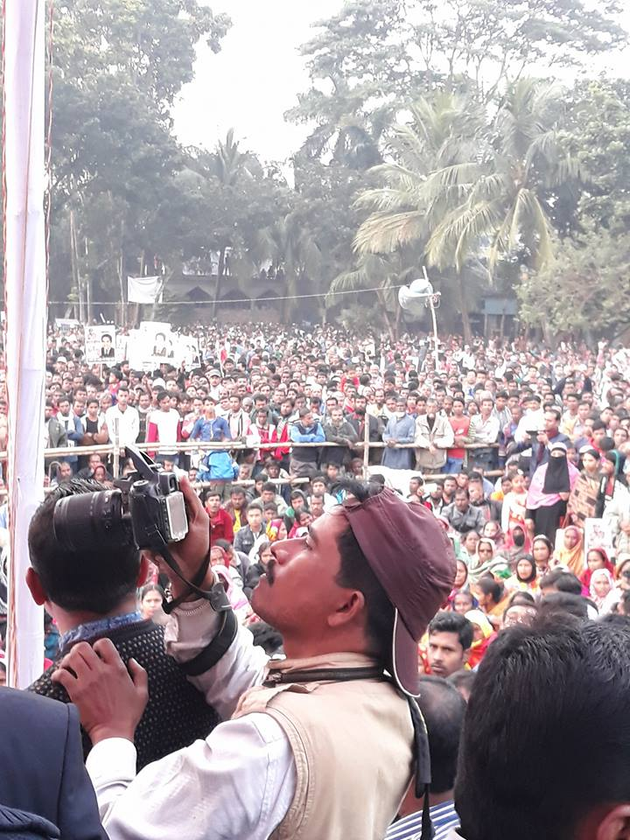
Enthusiasm
Enthusiasm means Passionate
The day is celebrated every year in the country with great enthusiasm and fervour.

Slide 10
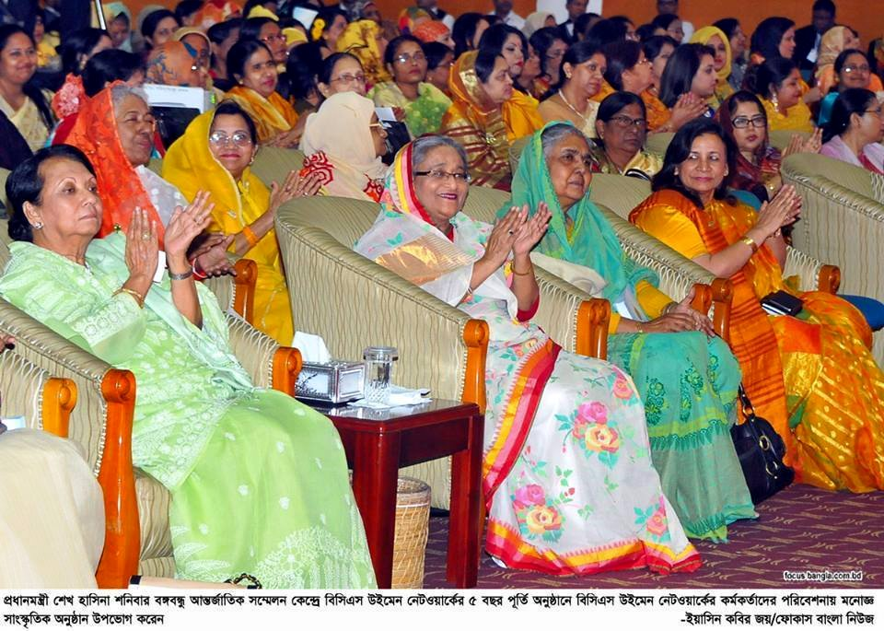
Spectator
Spectator means viewer
Thousands of Spectators watch cultural programs.

Slide 11
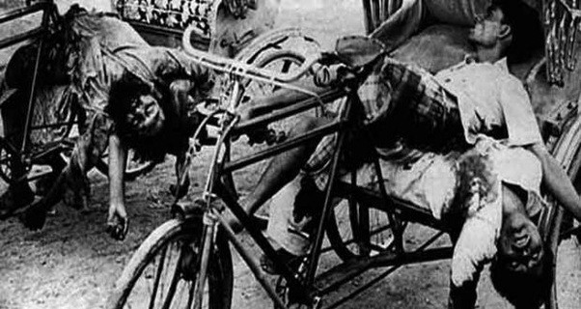
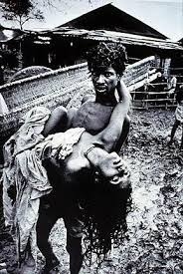
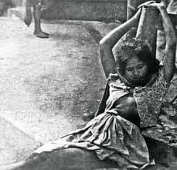
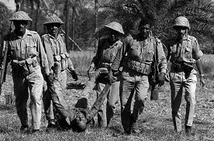

Slide 12
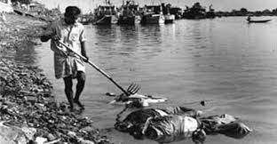
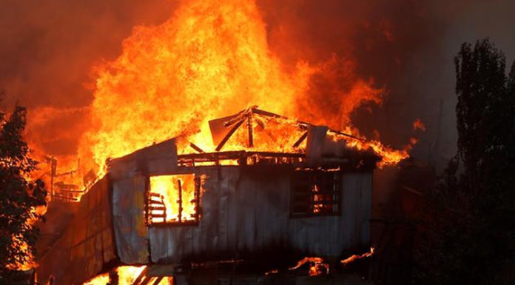
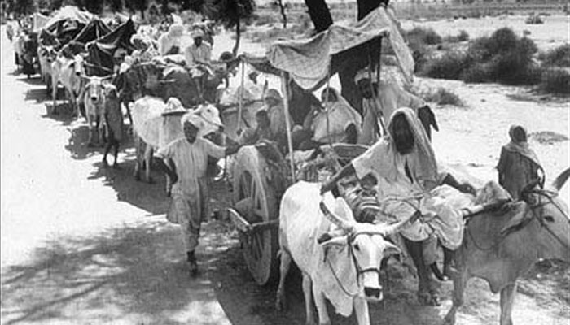
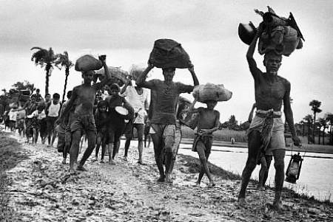

Slide 13
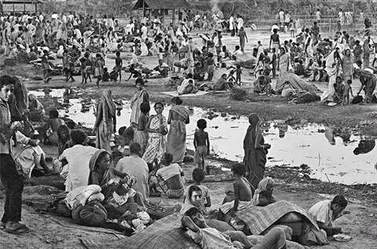
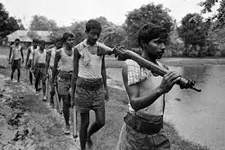
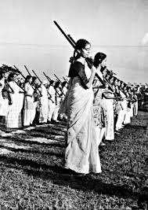
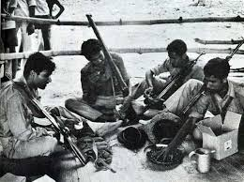

Slide 14
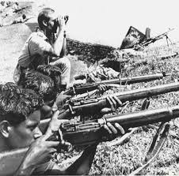
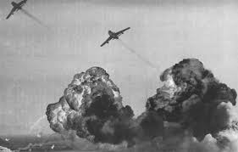
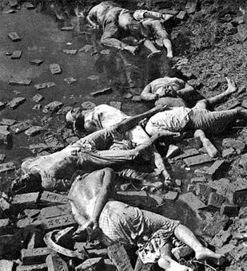
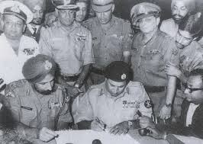

Slide 15
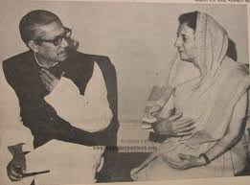
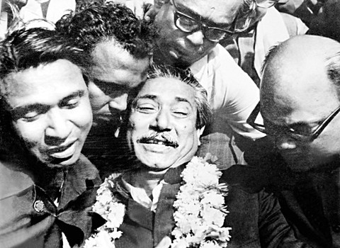

Slide 16
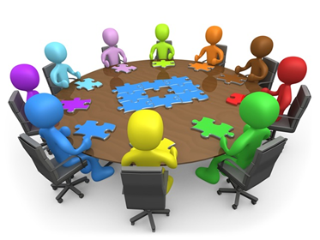
Group work
Write a summary about above picture within 10 sentences.

Slide 17
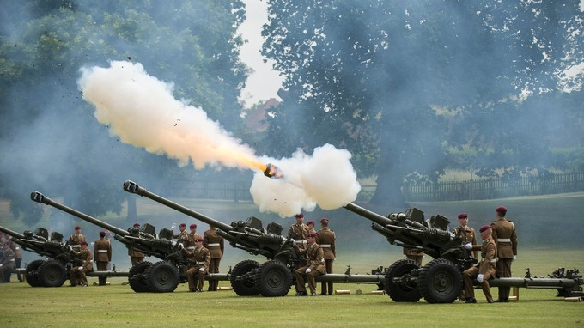

Slide 18
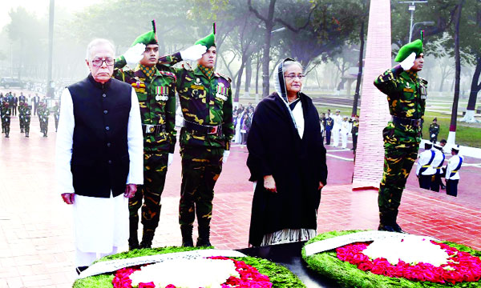

Slide 19
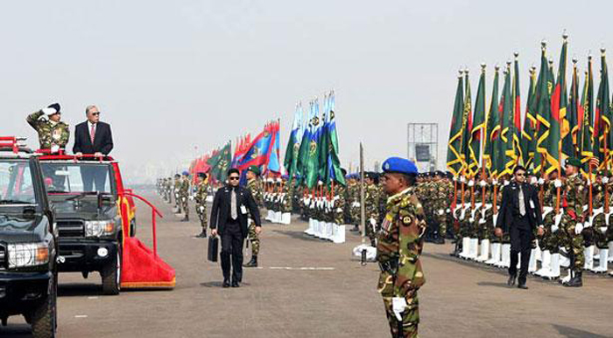

Slide 20
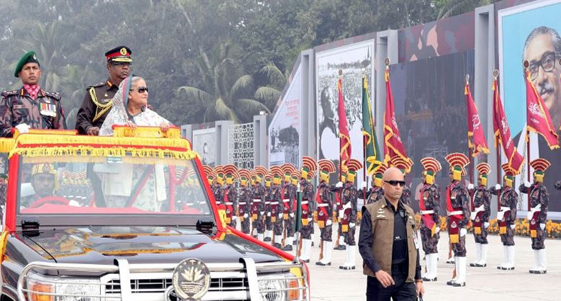

Slide 21
Please open your text book .page number- 41
26 March, our Independence Day, is the biggest state festival. The day is celebrated
every year in the country with great enthusiasm and fervour. It is a national holiday. All offices, educational institutions, shops and factories remain closed on this day.
The day begins with 31 gunshots.

Slide 22
Early in the morning the President and the Prime Minister on behalf of the nation place floral wreaths at the National Musolium at Savar. Then diplomats, political parties, social and cultural organisations, and freedom fighters pay homage to the martyrs. People from all walks of life also come there with rallies and processions. There are several cultural programmes throughout the day highlighting the heroic struggle and sacrifice in 1971.

Slide 23
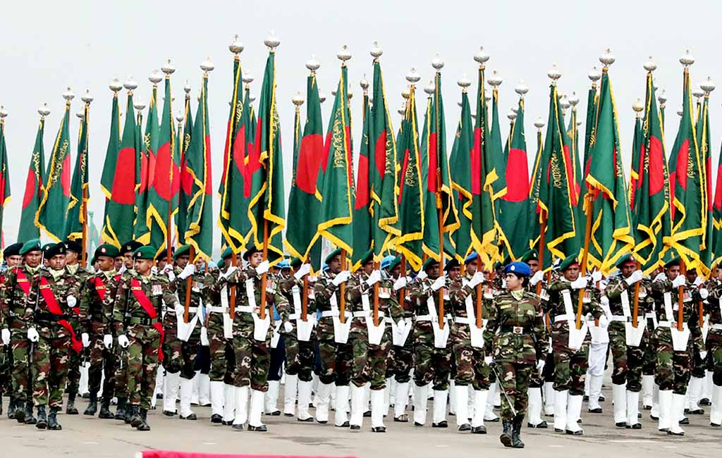

Slide 24
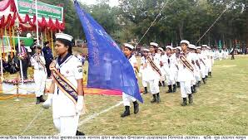

Slide 25
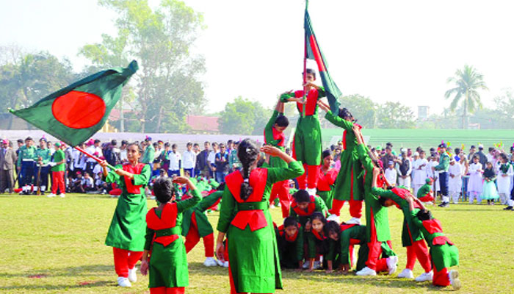

Slide 26
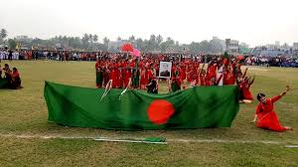

Slide 27
The country also witness a smartly dressed parade of defence forces, border guards, police, ansars and the VDP (Village Defense Party) at the National Parade Ground near the National Parliament. In Bangabandhu Stadium, school children, scouts and girl guides take part in various displays to entertain thousands of spectators. The educational institutions also organise their individual programmes. Sports meets and tournaments are also organised on the day including the exciting boat race in the river Buriganga.

Slide 28
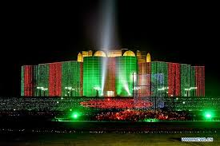
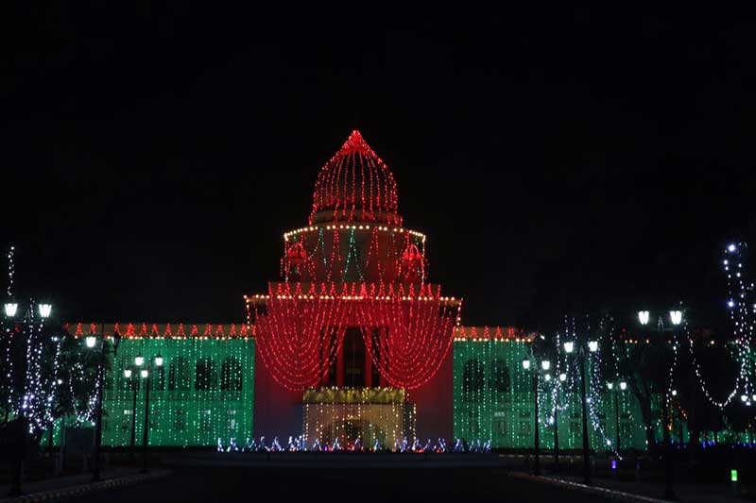
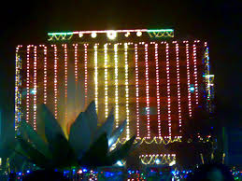
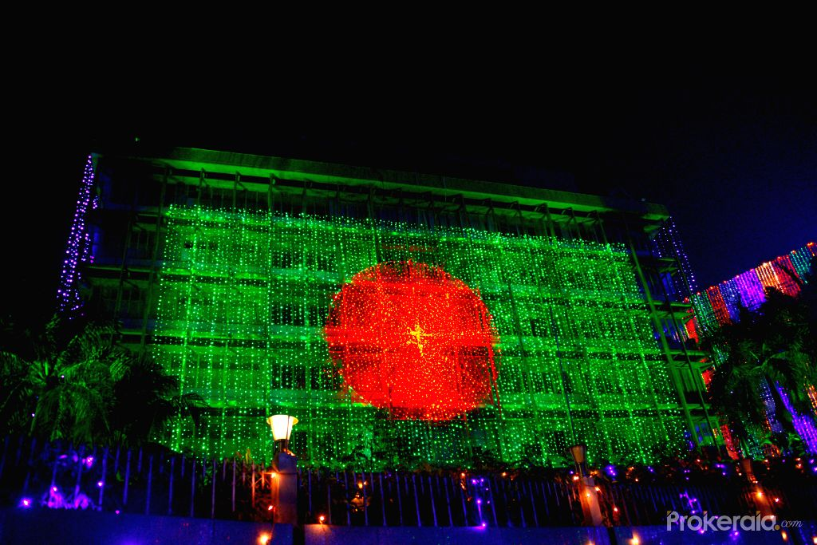

Slide 29
In the evening, all major public buildings are illuminated with colourful lights. Bangla Academy, Bangladesh Shilpakala Academy and other socio-cultural organisations hold cultural functions. Similar functions are also arranged in other places in the country.

Slide 30
pair work
C Match the words with their meanings.
Words | Meanings
fervour alike spectator displays illuminate | acts of performing skills to decorate a building with bright lights in a similar way a strong feeling of excitement a person who is watching an event

Slide 31
Individual Work
D Choose the best answer.
1. Our biggest state festival is
a) Victory Day.
b) Shaheed Dibosh.
c) Pahela Baishakh.
d) Independence Day.
2. The celebration of Independence Day begins with
a) processions.
b) gunshots.
c) placing wreaths at the National Memorial.
d) the display of parades by defence forces.
d) Independence Day.
b) gunshots.

Slide 32
3 .The National Musolium is
a) on Dhaka University campus.
b) at Ramna Park.
c )at Savar.
d )near Dhaka Medical College.
4 .On Independence Day the National Parade is held
a) at the National Parade ground.
b) in the streets.
c) in the decorated vehicles.
d) in Dhaka Stadium.
c )at Savar.
a) at the National Parade ground.

Slide 33
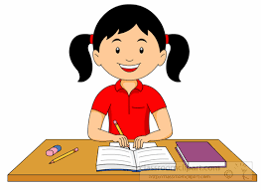
Home Work
Write a paragraph , in brief, how you celebrated this year’s ‘Independence Day’ at your school.

Slide 34
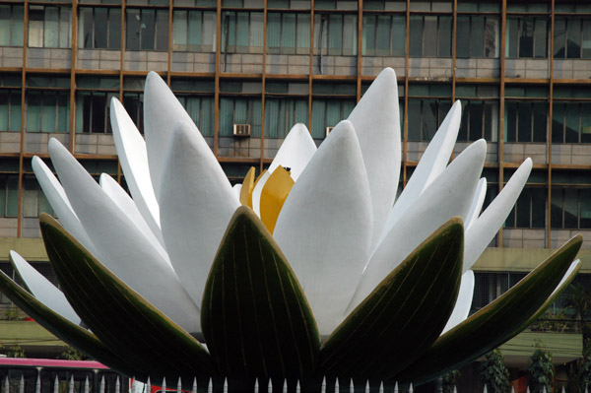
Goodbye

