Slide 1
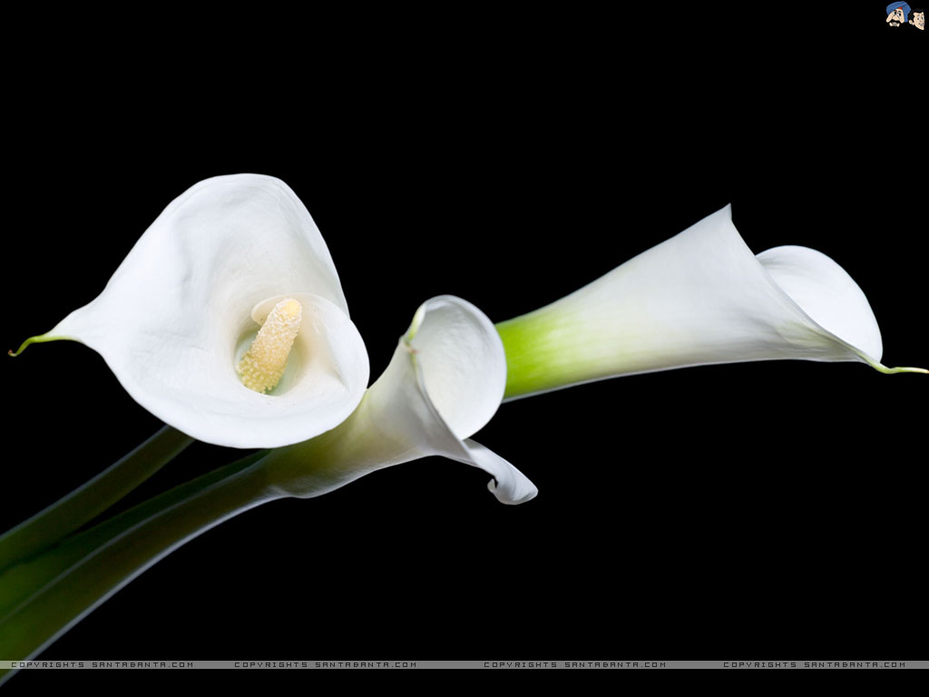
Welcome dear students.
Notes:
This is a welcome slide.

Slide 2
Identity
MD. MOMEN RANA
B.A. (HONS.), M.A. (ENGLISH)
ASST. TEACHER (ENGLISH)
ARAISIDHA KAMIL MADRASAH
ASHUGONJ, BRAHMANBARIA
Mob: 01818563452
Presentation made for class IX-X
English 1st paper

Slide 3
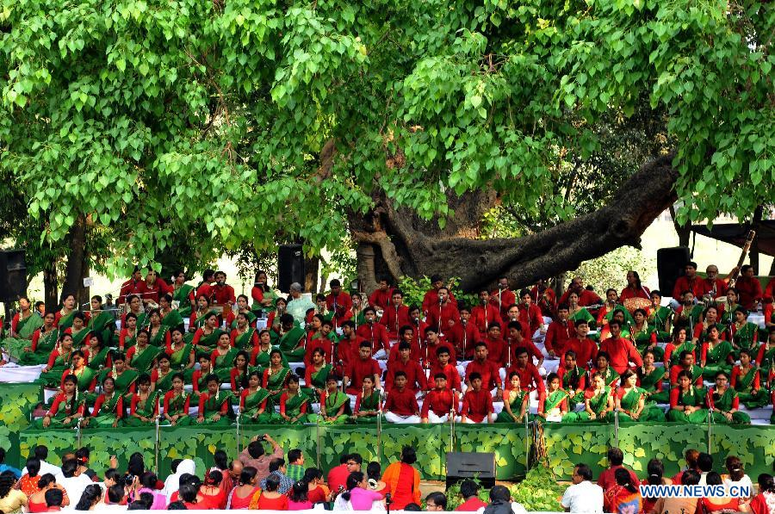
A. Look at the picture. Then ask & answer questions about it.

Slide 4
1.What is the picture about?
2.Where do you think it is?
3.What are the people doing?

Slide 5
Answer:
The picture is about the cultural function of Pahela Boishakh at Ramna Batamul organised by Chhyanata.
2. It is at Ramna Batamul.
3. They are celebrating Pahela Boishakh by singing the famous Tagore song Esho-he-Boishakh, Esho Esho…..

Slide 6
Our Today's Lesson
Pahela Boishakh
Unit: Three, Lesson: Six

Slide 7
Learning outcomes
After completing the lesson, students will be able to—
Ask & answer questions
Understand text
Fill in the gaps
describe their own cultural or religious festival

Slide 8
B. Read the text
Unit-Thee, Lesson-Six

Slide 9
Main features of Pahela Boishakh
“Pahela Boishakh” is the first day of Bangla new year. The day is a public holiday. This day has a special significance for us as it forms a part of Bangalee culture and tradition.

Slide 10
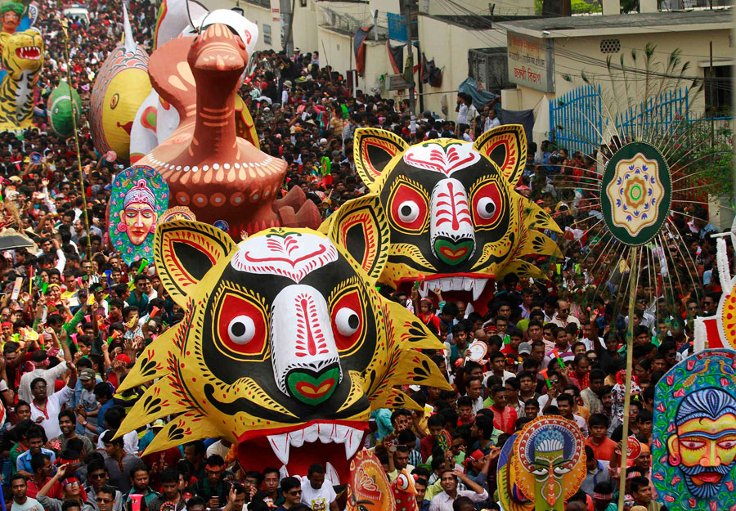
People from all walks of life celebrate the day with traditional festivities. On this day, the whole Bangladesh is in a festive mood.

Slide 11
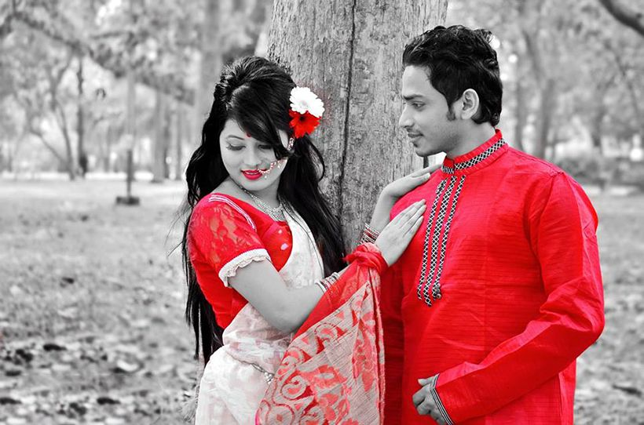
Women wear white saries with red borders and adorn themselves with colorful churis and flowers, while men dress themselves with pajamas and punjabis.

Slide 12
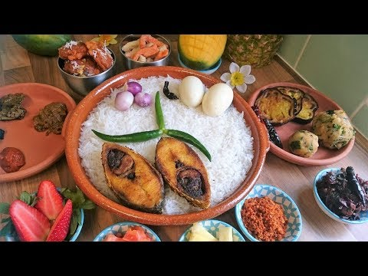
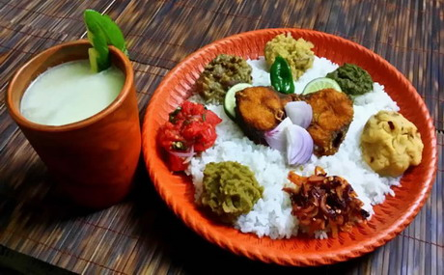
It is a day when people love eating traditional food.

Slide 13
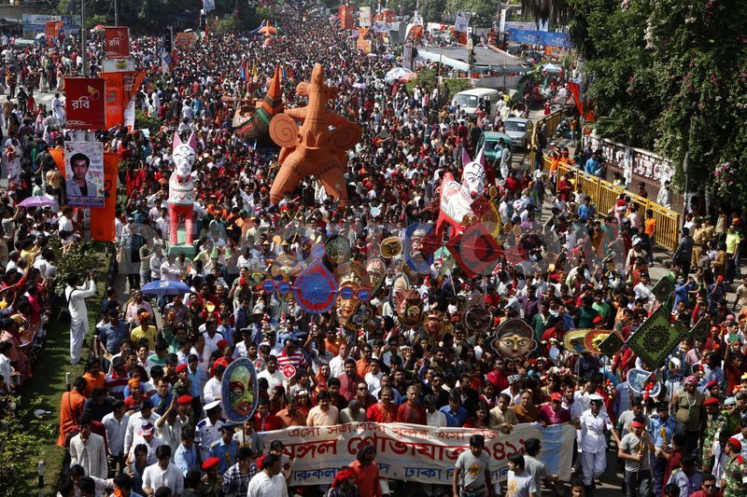
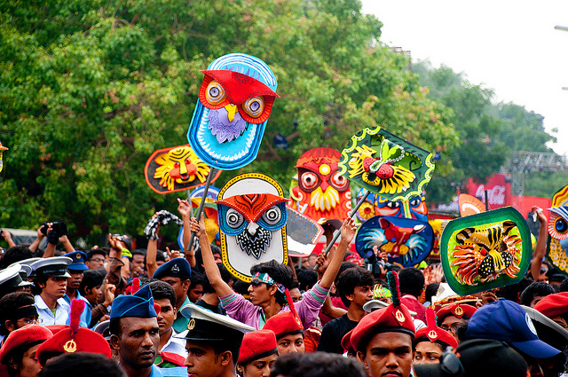
People also come to join the colorful processions, the biggest carnival organized by the Fine Arts students of Dhaka University. It displays the traditional practices of Bangalee culture.

Slide 14
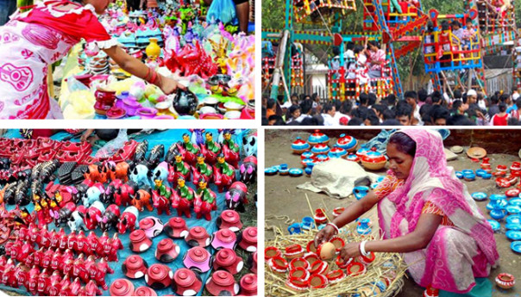
The day is also observed all over the country. Different social & cultural organizations and institutions celebrate the day with their own cultural programmes.

Slide 15
PAIR WORK
C. Ask and answer these questions in pairs.
1.Do you go out in the morning of Pahela Boishakh? If you do, where do you go? If not, what do you do?
2.What kind of food do you eat in the morning of Pahela Boishakh?
3.Do you wear any special clothes on this occasion?

Slide 16
EVALUATION
Fill in the gaps.....
The ........... is observed in a befitting manner .......... The country. ..................... organisations and educational institutions observe the day. Newspapers ................. out special supplements and the radio and television broadcast ............. programmes.

Slide 17
Answer:
The day is observed in a befitting manner across the country. Various organisations and educational institutions observe the day. Newspapers bring out special supplements and the radio and television broadcast special programmes.

Slide 18
HOME WORK
E. Describe you own cultural or religious festival that you celebrate. You can use the following words. You can also use other words relevant to the festival.
Colorful special traditional religious dance
Cultural flowers food songs festive

Slide 19
See You Again

