Slide 1
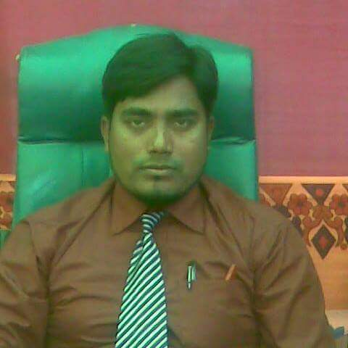
Md.Moynal Hossain.
Assistant Headmaster.
Deora high school.
Barura,Cumila.
Sub:English 2nd paper.
Class:Six/Seven.

Slide 2
Welcome

Slide 3
Look at the picture and think

Slide 4
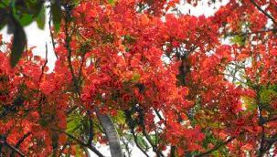
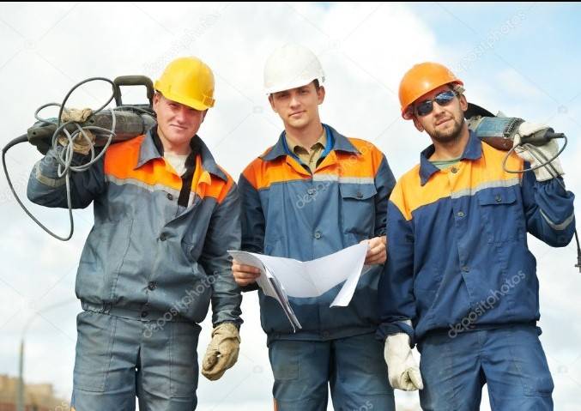
Red flower.
Strong worker.

Slide 5
So,Today topic is
Adjective

Slide 6
Learning Outcomes
By the end of the lesson students will have…
a.explained what an adjective is.
b.identified adjectives from a text.
c.matched adjectives with picture.

Slide 7
What is adjective?
An adjective is a word that describes/qualifies a noun or a pronoun.

Slide 8
Worried
Angry
Sad
Sleepy
Happy

Slide 9
Kinds of adjective.
a.Adjectives of Quality.
b.Adjectives of Quantity.
c.Ajective of Number.
d.Pronominal adjective.

Slide 10
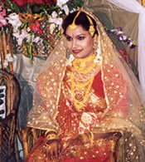
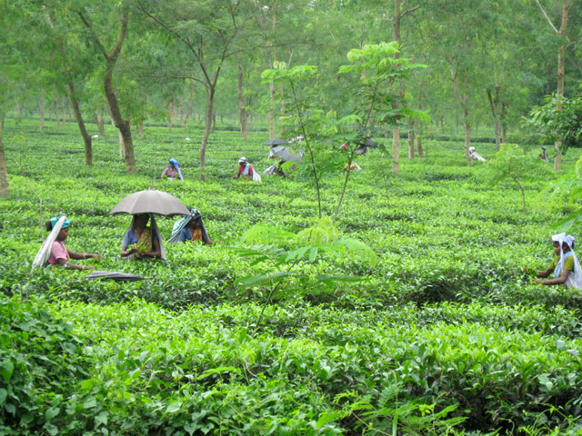
What is adjective of Quality?
Adjective of Quality show the quality of a person or thing.
Rita looks beautiful.
Tea garden is green

Slide 11
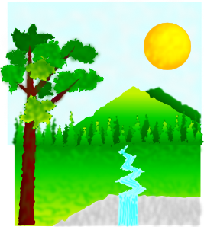
What is Adjective of Quantity?
An adjective of quantity shows the quantity of a thing.
This place is sunny.
It is verry nice.

Slide 12
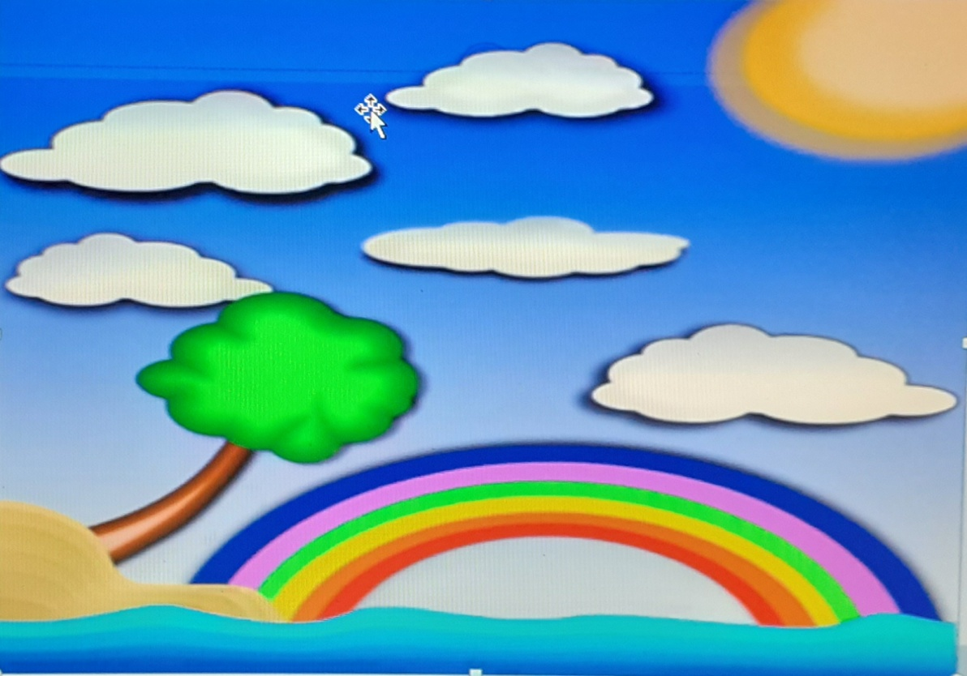
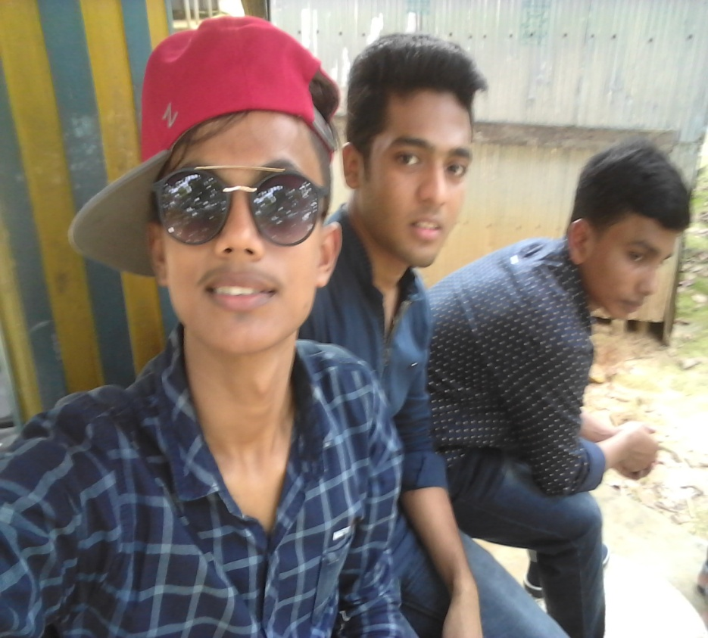
What is Number of Adjective?
Number of Adjective show how many persons or things are meant.
Five flower
Three boys

Slide 13
What is pronominal adjective?
A pronominal adjective is a definitive adjective that would be a pronoun if it astood by itself.
Exa:This is my pen.
Each baby has a doll.

Slide 14
Pair works
Work with your partner and write five sentences about your favourite person using some adjectives.

Slide 15
Home works
Describe your home within five sentences using some adjectives.

Slide 16
Thanks to all

