Slide 2
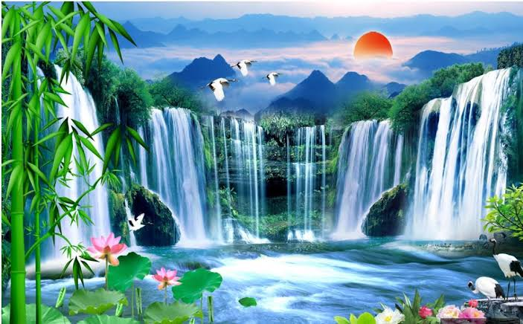
Welcome

Slide 3
Md. Abdur Razzak
Assistant Teacher(English)
Satgram Akota High School
Baniachang, Habiganj

Slide 4
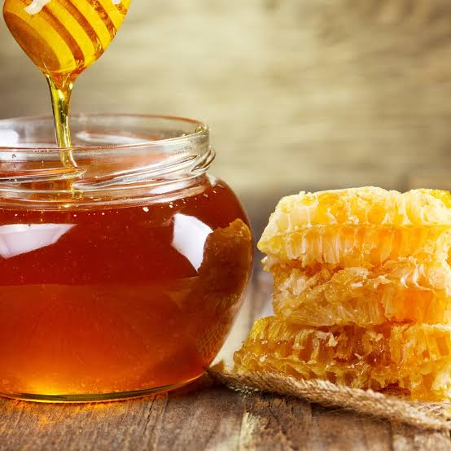
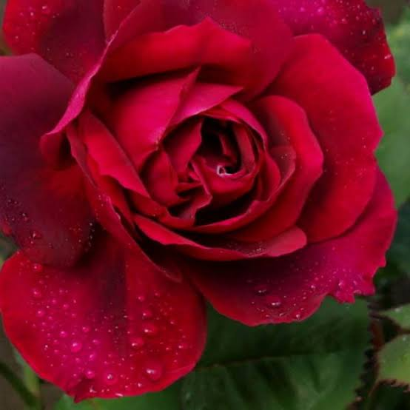
Notice the following sentences
Honey is sweet,-----------?
isn't it?
Every rose has a thorn,-------?
hasn't it?
What kind of question do you get in the above ?

Slide 5
Possible Answer
Tag Question

Slide 6
Today we shall discuss on
Tag Question (Part Two)

Slide 7
Class Introduction
Class:Nine + Ten
Subject: English Grammar and Composition
Unit: Nine
Time: 40 minutes

Slide 8
Learning Outcome
By the end of the lesson,the learners will be able to-
Make tag question of helping verb+not.
make tag question of sentence begin with do not +verb.
make tag question of sentence begin with let.
make tag question of sentence having negative words.

Slide 9
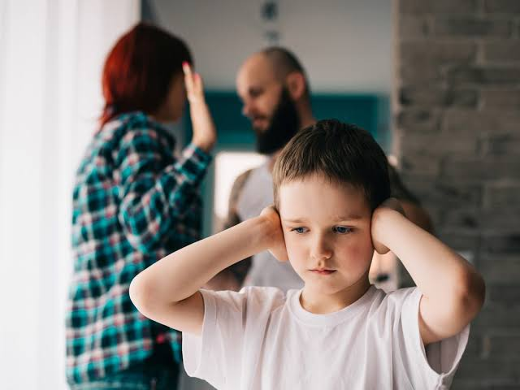
Notice the following sentences
We must not disobey our parents,---------?
must we?

Slide 10
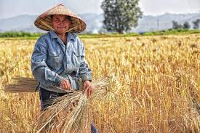
1.We are not farmer,
are we?

Slide 11
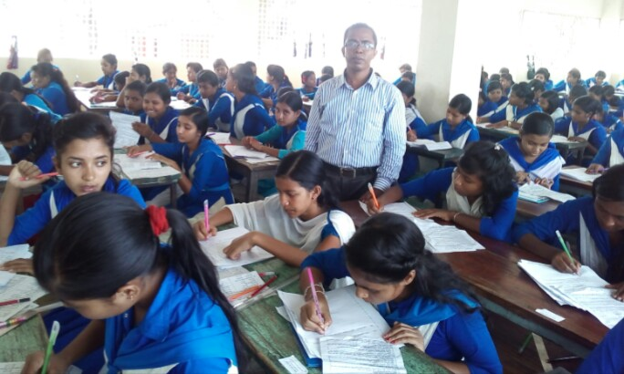
We don't have many students,------?
do we?

Slide 12
Among these three sentences ,we get a similarity.
In every sentence, we get helping verb+ not
If we get
helping verb+ not
We should write
helping verb+pronoun of subject+?

Slide 13
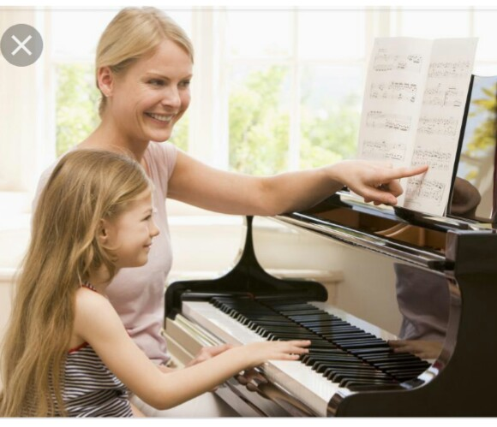
Let' Practise

Slide 14
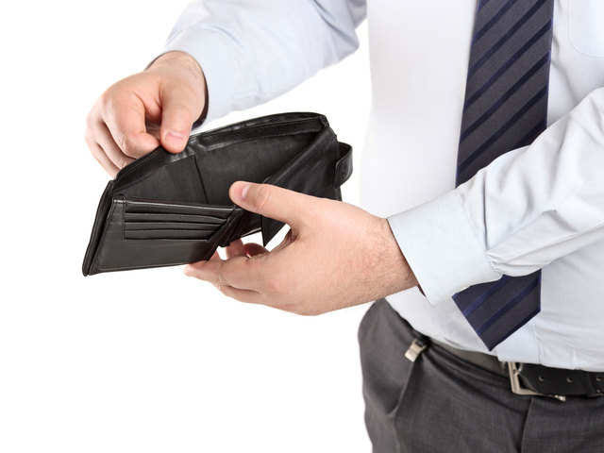
1.He is not solvent,-------?
is he?

Slide 15
2.He is not suitable for this job--------?
is he?

Slide 16
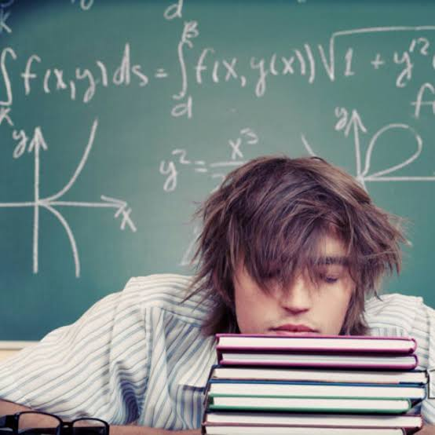
3.Ratul is not a good student--------------?
is he?

Slide 17
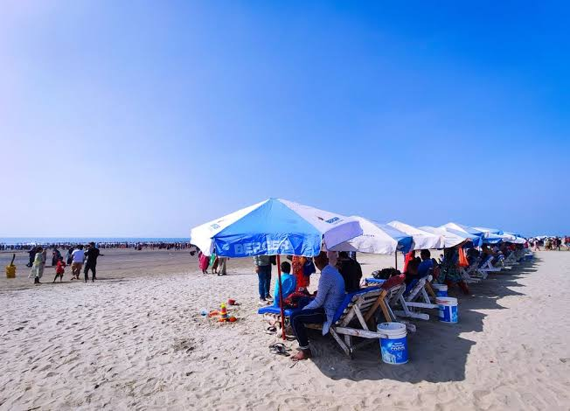
4.We need not go to Cox's bazar-----------?
need we?

Slide 18
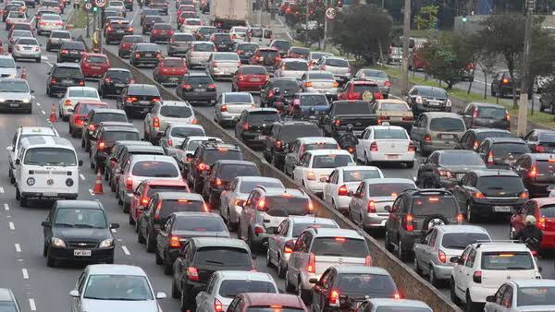
5.Traffic Jam is not out of control------------?
is it?

Slide 19
Instead of
not
we may get
no,never,none, nobody,no one nothing,seldom, scarcely, hardly,rarely,few, little
If we get any of these words in a sentence ,we should not write not for tag Question.

Slide 20
Let's practise
No one can deny his roots,----------?
can he?
He seldom goes to school,--------?
does he?

Slide 21
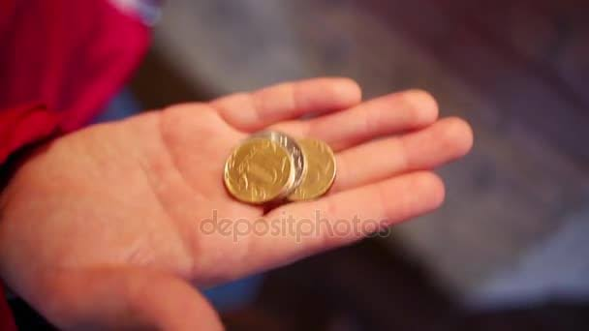
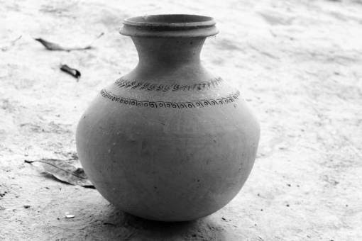
He has few coins,-------?
has he?
There is little water in the jar----------?
is there?

Slide 22
Notice the following sentences
Love your country,------?
won't you?
Go to school,-----------?
won't you?
Rule:
Main verb+Extension=
won't you?

Slide 23
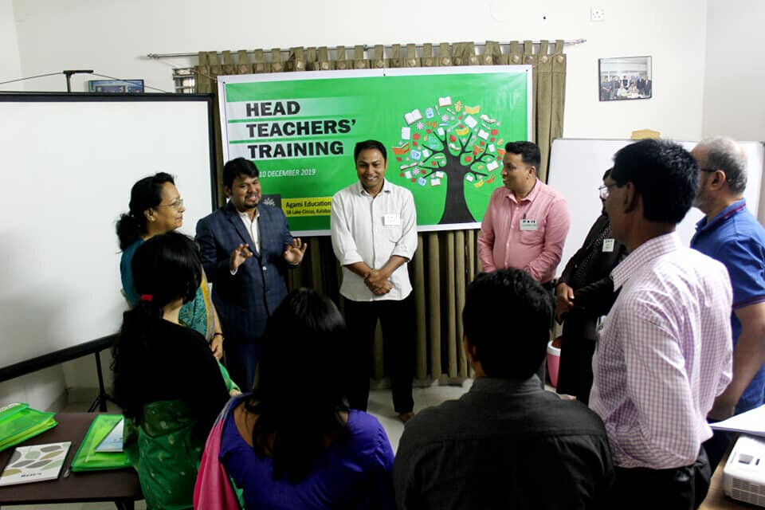
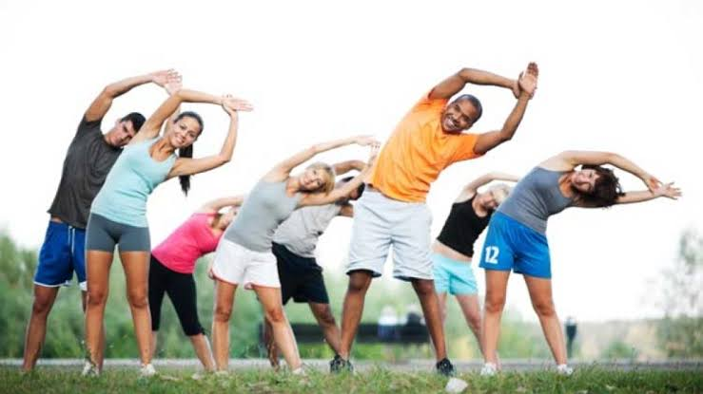
Respect your teachers--------?
won't you?
Take excercise regularly,--------?
won't you?

Slide 24
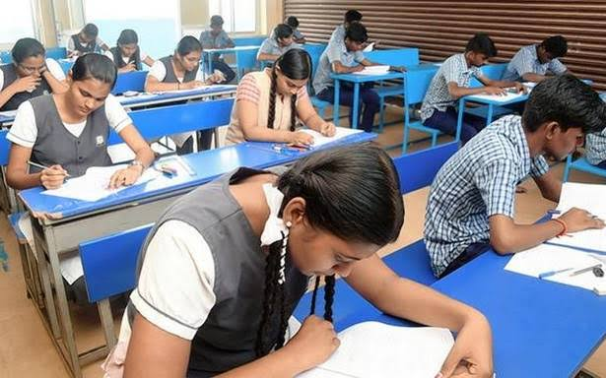
Help the helpless,-------------?
Won't you?
Prepare yourself for exam,---------?
won't you?

Slide 25
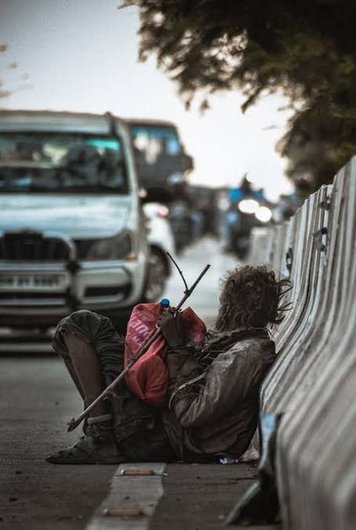
Notice the following sentences-
Do not waste your time------------?
will you?
Do not hate the poor,-------------?
will you?

Slide 26
Rule-
do not + Verb=
will you?

Slide 27
Let's practise
Do not miss the class----------?
will you?
Do not disobey your parents-------?
will you?

Slide 28
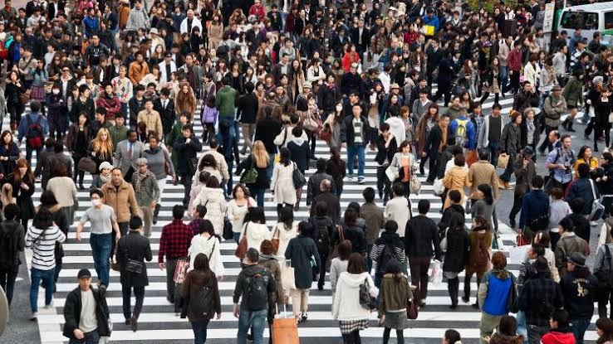
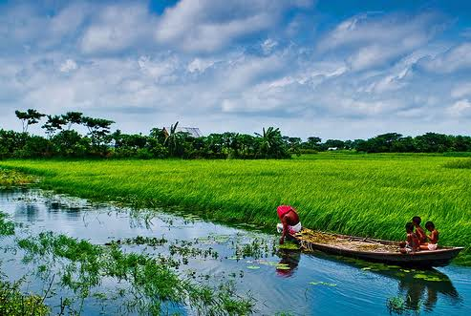
Notice the following sentences-
Let's change the society-------------?
shall we?
Let's love our country----------?
shall we?

Slide 29
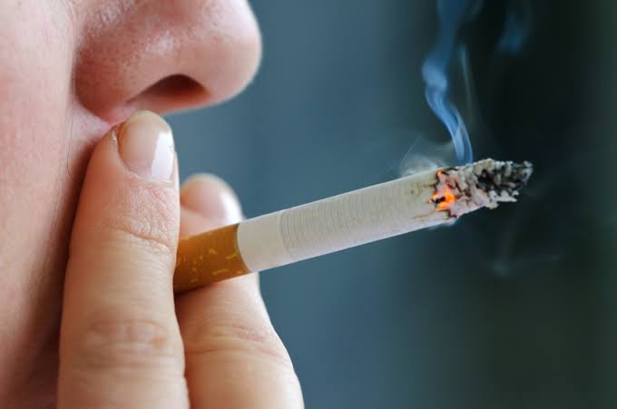
Let's change our bad habit-----------?
shall we?

Slide 30
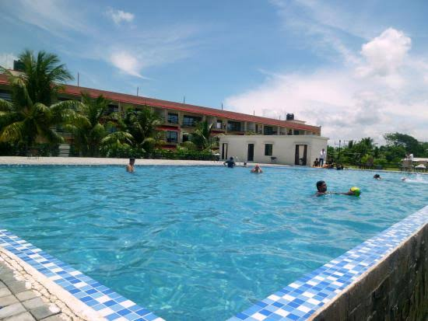
Let's build up Sonar Bangla,-----------?
shall we?

Slide 31
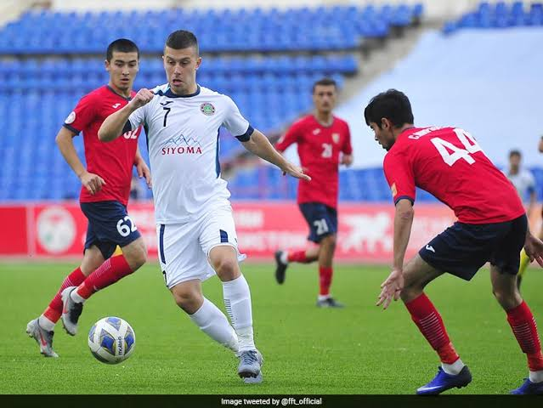
If we get other object after let instead of us,the answer will be
Won't you?
For an example
Let them play football,-----------?
won't you?

Slide 32
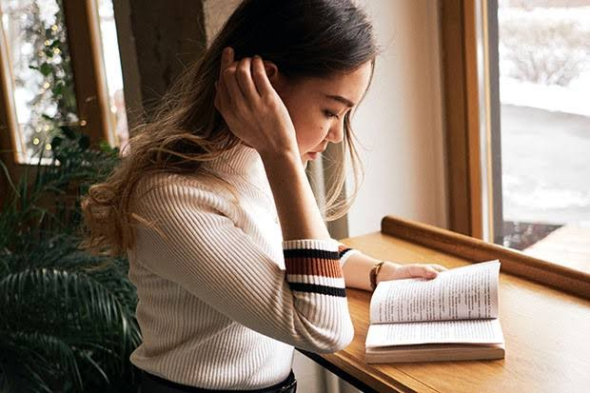
Evaluation
Read the book attentively----------?
won't you?

Slide 33
Do not laugh at the tiny creatures,--------?
will you?
Open your book,-----------?
won't you?

Slide 34
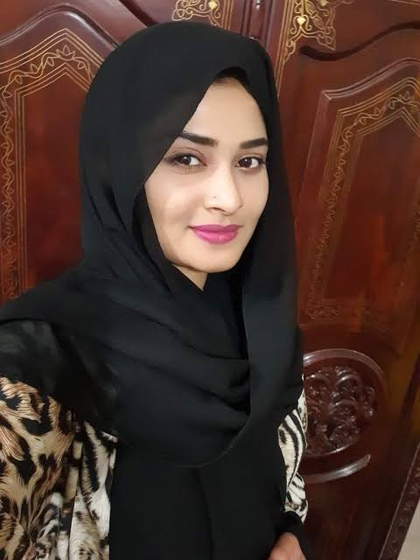
He never came again-------------?
did he?
She can rarely come these days-----?
can she?

Slide 35
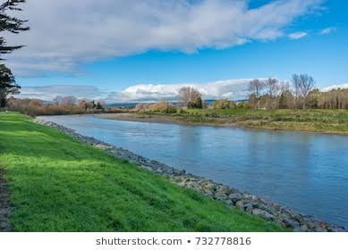
Let's go to the bank of a river-----------?
shall we?
Let him plant tree,---------?
won't you?

Slide 36
Homework
Write six sentences using V1 ,V2, do not + verb + extension, helping verb ,helping verb + not and let's and make tag Question with them.

Slide 38
Acknowledgement
We would like to express our cordial gratitude to the Ministry of Education, Directorate of Secondary & Higher Education, NCTB, A2i and the panel of honorable editors ( Md. Jahangir Hasan, Assistant Professor (English) TTC, Rangpur, Ranjit Poddar, Associate Professor (English) TTC, Dhaka, and Urmila Khaled, Assistant Professor (English) TTC, Dhaka, to enrich the contents.

