Slide 1
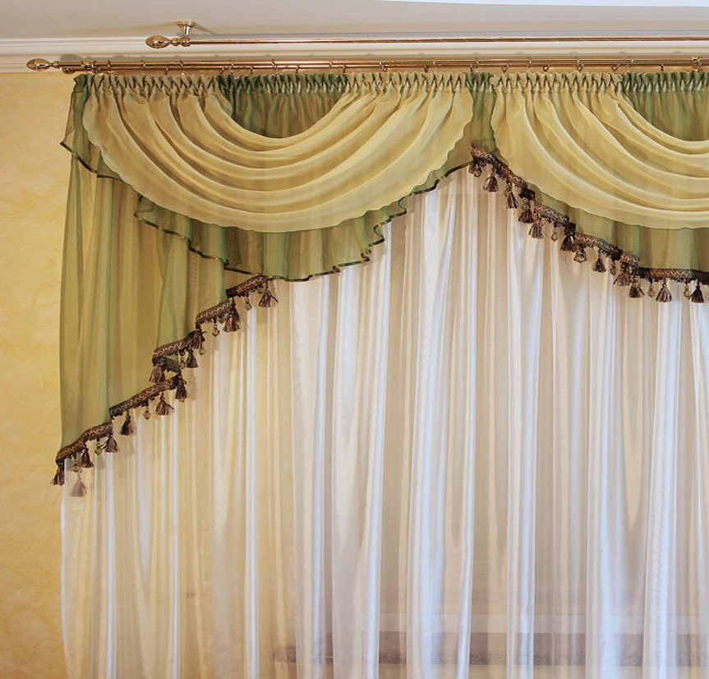
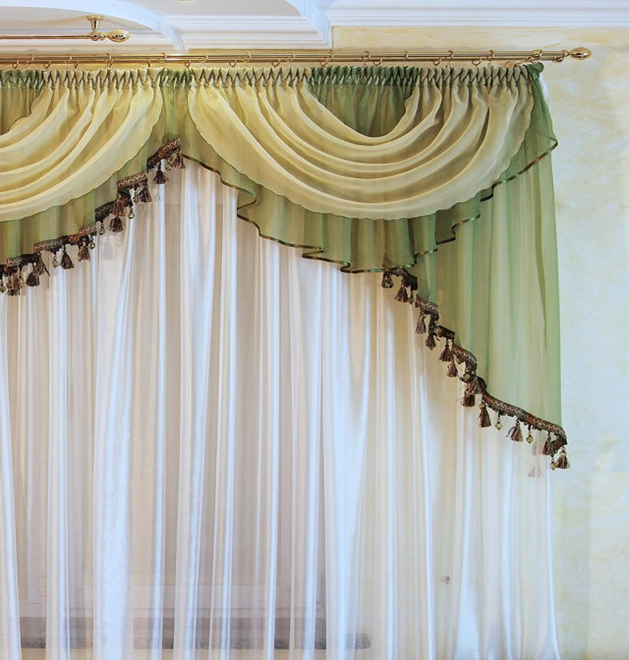

Slide 2
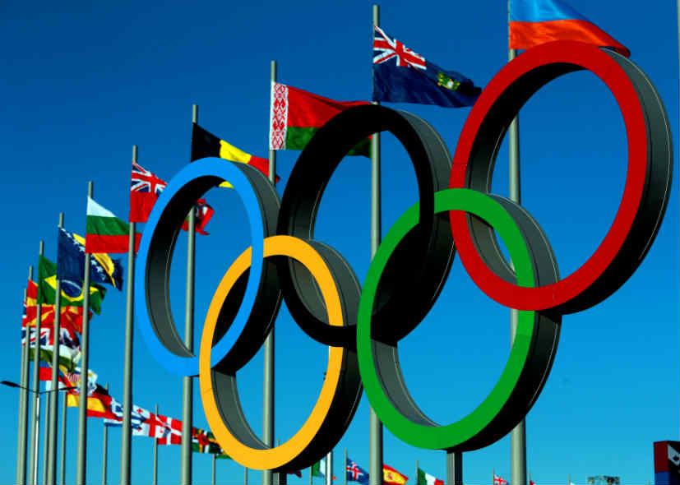
Welcome

Slide 3
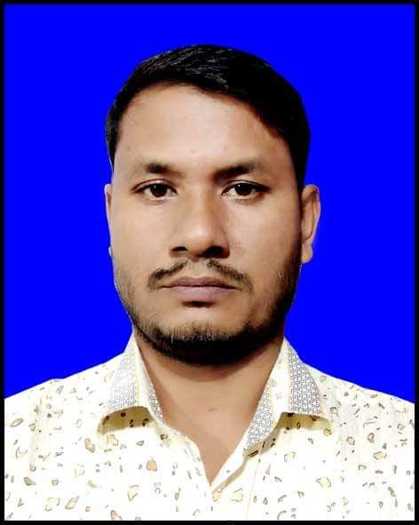
TEACHER’S IDENTITY
Md Sazzadur Rahman
Assistant teacher
Jaliurpur Govt.Primary School
Companigonj,Sylhet.

Slide 4
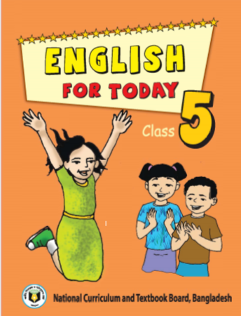
LESSON IDENTITY
Class: Five
Sub:English
Unite:17
Lesson:5-6

Slide 5
LEARNING OUTCOMES
Students will be able to-
4.2.1 understand and enjoy the topic.
3.1.1 ask and answer Wh-questions.
5.1.4 read the text with understanding.
10.1.1 write a short composition by
answering a set of questions.

Slide 6
Let’s go watch a video

Slide 7
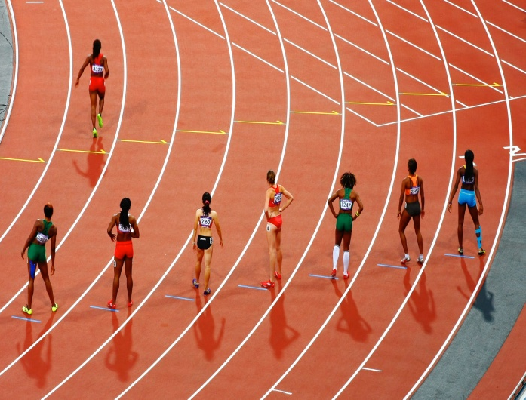
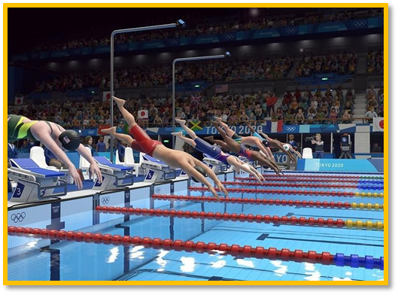
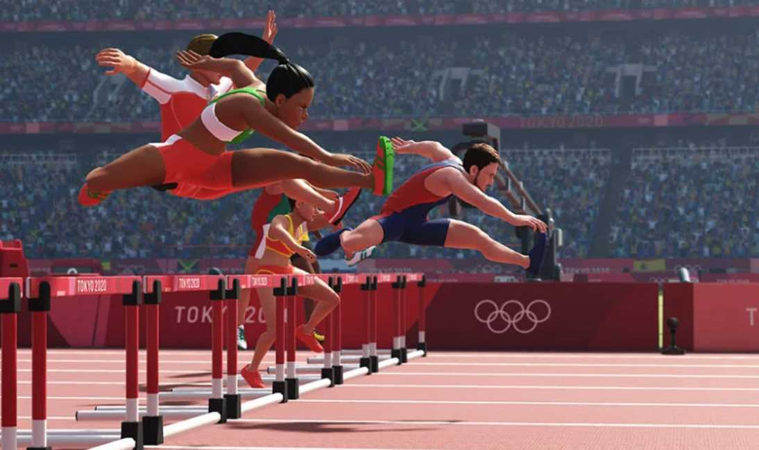
Look at the pictures:
Can you guess, what are the pictures about?
Yes, the pictures are about ‘Sports’.

Slide 8
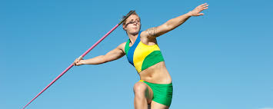
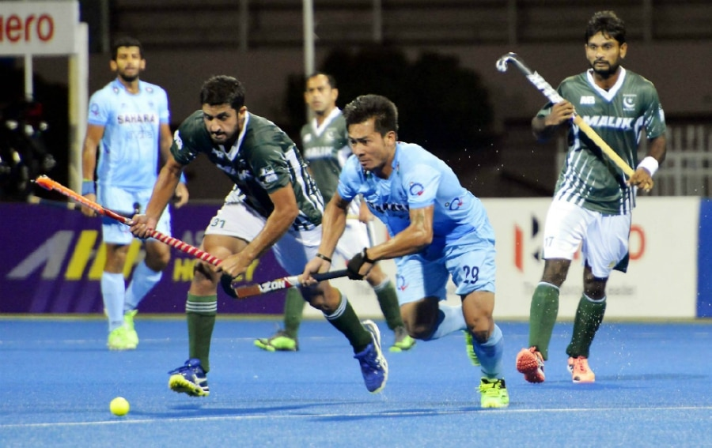
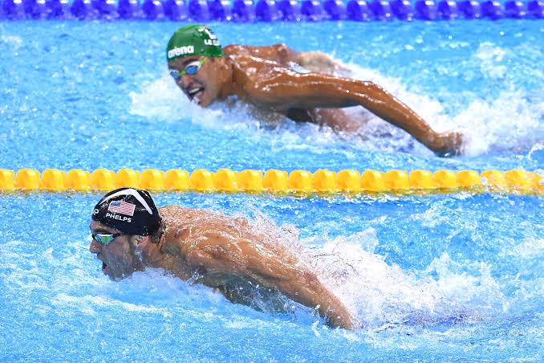

Slide 9
Lesson Declaration
Today we learn-
Unit:17
Lesson:5-6
Topic: Sport ( The Olympic.
…….since then).

Slide 10
Open page no.-68 and follow teacher
The Olympic games is the biggest sports competition in
The world. The Olympics are held every four years in a
different host city. More than 200 nations send a total of
about 13,000 athletes to compete in more than 30
different sports.

Slide 11
The first Olympic Games were held in Greece almost
3,000 years ago. The modern Olympic Games started
in 1896, and there have been 31 Olympic competition
since then.

Slide 12
Word meaning:
New word
meaning
Similar word
Competition
প্রতিযোগীতা
a contest
Different
ভিন্ন/আলাদা
not same
Athlete
ক্রীড়াবিদ
Sports man
Nation
জাতি
the people of a country
Game
খেলা
Sport

Slide 13
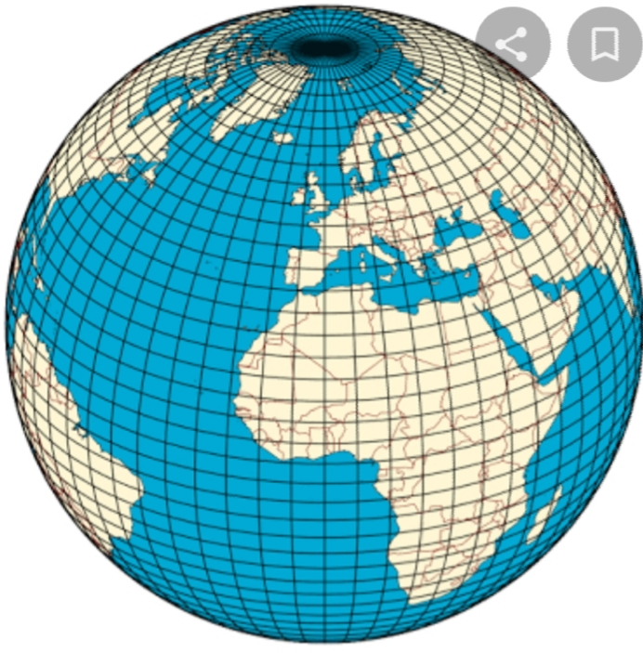
Today’s new word:
World
পৃথিবী
The Olympic game is the biggest sport in the world.

Slide 14
Make sentence with the following words
word | sentence
biggest
modern
athlete
competition

Slide 15
Make sentence with the following words
word | sentence
biggest | The Padma is the biggest river.
modern | Computer is a modern technology.
athlete | Usine bolt is a great athlete.
competition | The Olympic games is a popular sports competition.

Slide 16
Group works
Answer the following question:
How often are the Olympics held ?
2) How many countries compete in the Olympics ?
3)How many athletes compete in the
Olympics ?
4) How many sports are there in theOlympics ?
5) Where was the first Olympics games held?

Slide 17
Match the answers:
1)The Olympics are held every four years.
2) More than 200 countries compete in the Olympics.
3) There are 13000 athletes compete in the Olympics.
4)There are more than 30 sports in the Olympics.
5)The first Olympic games were held in greece.

Slide 18
Now read the text silently:
The Olympic games is the biggest sports competition in
The world. The Olympics are held every four years in a
different host city. More than 200 nations send a total of
about 13,000 athletes to compete in more than 30
different sports.

Slide 19
Evaluation
Write a short composition about “The OlympicGames”by answering the following questions:
What is the biggest sports competition in the world ?
b)How often are the Olympics held ?
c) How many countries and athletes compete in the Olympics ?
d) How many athletes compete in the Olympics ?

Slide 20
Match the words:
Match the words in column A with their meaning in column B
Column A | Column B
Games | Earth
Biggest | Sportsman
World | Sports
Athlete | Before
Ago | Largest

Slide 21
HOME WORK
Write a short composition about “Olympic Games”
in 5 sentences.

Slide 22
THANK YOU

