Slide 1
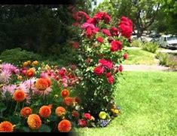
WELCOME TO ENGLISH CLASS

Slide 2
ENGLISH CLASS ENG 2ND PAPER
VOICE CHANGE
PART 03
VARIATION

Slide 3
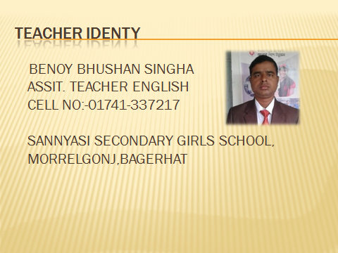

Slide 4
*****pART –03>> VERIATION RULE:- 09> [WITH SELF] =SUB>SUB+AUXI+MV3+EXT.+BY+OBJ>OBJ.
EXAMPLE
SHE KILLED HERSELF.
SHE WAS KILLED BY HERSELF.
HE HUNG HIMSELF.
HE WAS HUNG BY HIMSELF.
EXERCISE
SHE SAW HERSELF.

Slide 5
RULE:-10 > VERBAL PHRASES/DOUBLE PREPOSITION[SAME RULE NO –01]
EXAMPLE
MY FATHER LOOKED AFTER ME.
I WAS LOOKED AFTER BY MY FATHER.
I HAVE TAKEN CARE OF MY DUTIES.
MY DUTIES HAVE BEEN TAKEN CARE OF BY ME.
EXERCISE

Slide 6
RULE:-11>HIDDEN PREPOSITION [TO]
MAKE,LET,SEE,NEED,BID,DARE,HEAR,FEEL ETC
EXAMPLE
I SAW HIM GO.
>HE WAS SEEN TO GO BY ME.
HE LET ME SOLVE THE PROBLEM.
>I WAS LET TO SOLVE THE PROBLEM.
EXERCISE
HE MADE ME DO THE WORK.

Slide 7
RULE:-12> FIXED PREPOSITION
SURPRISED AT, SEIZED WITH, SATISFIED WITH, ANNOYED WITH, BASED ON, CONTAINED ON, SHOCKED AT, KNOWN TO ETC.
I KNEW HIM.
>HE WAS KNOWN TO ME.
THE NEWS SHOCKED ME.
>I WAS SHOCKED AT THE NEWS.

Slide 8
RULE:- 13>QUASI-PASSIVE VERB
SUB+AUXI+ADJ+WHEN+IT+AUXI+Q.P. VERB.
EXAMPLE
HONEY TASTS SWEET.
>HONEY IS SWEET WHEN IT IS TASTED.
RICE SELLS CHEAP.

