Slide 1
Welcome

Slide 2
IDENTITY
Azizul F
Azizul Fakir
Assistant teacher
Dighirjan secondary school
Nazirpur, Pirojpur
Mobile: 01710745128
Email: azizul.nk@gmail.com
Azizul Fakir
Assistant teacher
Dighirjan secondary school
Nazirpur, Pirojpur
Mobile: 01710745128
Email: azizul.nk@gmail.com
Class 9
English For Today
Unit 3
Events and festivals
Time : 50 mins
11/9/2020

Slide 3
Dear students let’s watch a video.
May Day
Can you tell me what is the video about?

Slide 4
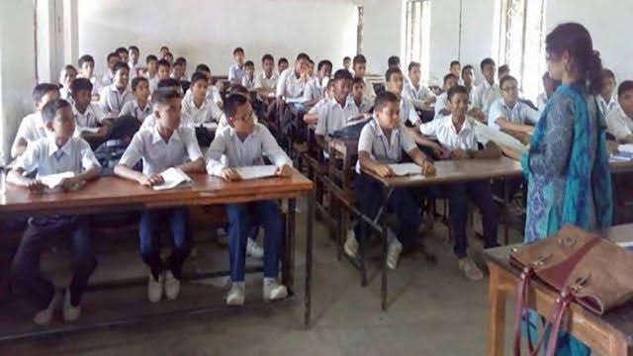
“May Day”
Unit : 3
Lesson : 2

Slide 5
Learning outcomes
After completing this lesson, we will be able to ----
infer meaning from the context
1
talk about the pictures
2
write answers to the questions
3
tick best answers from the alternatives
4
listen for information to the CD
5

Slide 6
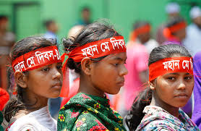
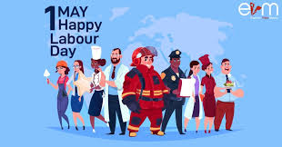
Key word
Part of speech
Meaning
Antonym
Observe -
verb
Notice or perceive (something) and register it as being significant.
ignore
recall and show respect (somebody/something)
Commemorate -
verb
ignore

Slide 7
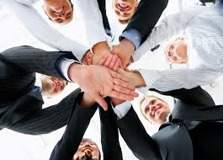
Key word
Part of speech
Meaning
Antonym
the fact of giving up something important or valuable.
Sacrifice -
noun
---
to start or create a system, an organization.
Establish -
verb
abolish

Slide 8
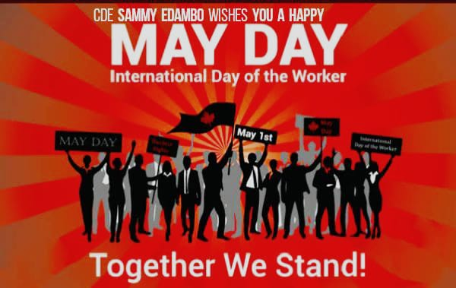
Key word
Part of speech
Meaning
Antonym
Demand -
verb
to ask for something very firmly
---
to advise or try hard to persuade somebody to do something
Urge -
verb
oppose

Slide 9
Key word
Part of speech
Meaning
Antonym
Instantly -
adverb
immediately
---
to treat somebody unfairly
Exploit -
verb
liberate

Slide 10
Open at page 31 and read text carefully.
May Day or International Workers’ Day is observed on May 1 all over the world today to commemorate the historical struggle and sacrifices of the working people to establish an eight-hour workday. It is a public holiday in almost all the countries of the world.
Since the Industrial Revolution in the 18th and 19th centuries in Europe and the US, the workers in mills and factories had been working a long shift 14 or even more hours a day
On may 1st in 1886 inspired by the trade unions half of the workers at the McCormick Harvesting Machine Company in Chicago went to strike demanding an 8 hour work day. Two days later a workers rally was held near the McCormick Harvester Machine Company and about 6,000 workers joined it. The rally was addressed by the labour leaders. They urged the workers to stand together, to go on with their struggle and not to give into their bosses. At one point of the rally, some strikebreakers started leaving the meeting place. The striker's went down the street to bring them back. Suddenly about 200 policemen attacked them with clubs and revolvers. One striker was killed instantly, five or six others were seriously wounded and many others were injured
The events of may 1, 1886 are a reminder that workers will continue to be exploited until they stand up and speak out to gain better working conditions, better pay and better lives

Slide 11
Important note of the lesson:
Industrial Revolution: the period, especially in the 18th
and 19th centuries Europe, when
machines were invented and first
factories were established.
2. Trade Union: an organization that represents workers
of mills and factories.

Slide 12
Time 5mins
12
1
11
10
2
9
3
Individual works
8
4
7
5
6
Answer the following question
Q1. What does May Day refer to?
Q2. How long did the workers have to work in a day before the May 1 strike?
Q3. Why did the workers in Chicago go on a strike?

Slide 13
You may check your answers
Ans1: May Day refers to May 1 in 1886 when the workers laid down their
lives to establish an eight-hour work day.
Ans2: The workers had to work fourteen hours or even more in a day before
the May 1 strike.
Ans3: The workers in Chicago went on a strike to establish an eight-hour
work day.

Slide 14
Fill in the blanks with the verb given in the box. Put them into their correct forms.
Pair works
add arrive begin do here live seen support tread work
12
1
Tania is a poor garment worker. She ---- in big garment factory in Gazipur. She ---- in a slum with a few fellow workers. She works eight hours a day on a monthly salary of Tk. 3000/-, she does overtime to ---- some more money to her income. If she can save something, she ---- it to her father to ---- the family.
11
10
2
5mins
9
3
8
4
7
5
6
One day Tania was busy ---- her work in factory. Suddenly she ---- someone shouting “Fire! Fire!” The workers were panic-stricken and everyone ---- to rush to the stairs. There were not enough staircases in the factory building. So some workers were ---- under the foot and others were injured in some other ways. However, the fire brigade ---- there in minutes and nothing serious happened.

Slide 15
You may check your answers
Tania is a poor garment worker. She works in big garment factory in Gazipur. She lives in a slum with a few fellow workers. She works eight hours a day on a monthly salary of Tk. 3000/-, she does overtime to add some more money to her income. If she can save something, she sends it to her father to support the family.
One day Tania was busy doing her work in factory. Suddenly she heard someone shouting “Fire! Fire!” The workers were panic-stricken and everyone began to rush to the stairs. There were not enough staircases in the factory building. So some workers were troden under the foot and others were injured in some other ways. However, the fire brigade arrive there in minutes and nothing serious happened.

Slide 16
Time: 6mins
12
1
Group works
11
10
2
Now read the completed passage silently and answer the following questions.
9
3
8
4
7
5
6
Tania is a poor garment worker. She works in big garment factory in Gazipur. She lives in a slum with a few fellow workers. She works eight hours a day on a monthly salary of Tk. 3000/-, she does overtime to add some more money to her income. If she can save something, she sends it to her father to support the family.
One day Tania was busy doing her work in factory. Suddenly she heard someone shouting “Fire! Fire!” The workers were panic-stricken and everyone began to rush to the stairs. There were not enough staircases in the factory building. So some workers were troden under the foot and others were injured in some other ways. However, the fire brigade arrive there in minutes and nothing serious happened.
Q1: Do you think Tania’s monthly salary is enough for her work?
Q2: Is the factory safe enough for workers? Why do you think so?
Q3: Do you have any suggestions for safety of factory workers? If so what?

Slide 17
You may check your answers
Ans1: No, I didn’t think so. Her salary is very poor for her work.
Ans2: I think the factory is not safe enough for the workers. It is
because, there are not enough staircases in the factory
building.
Ans3: It is a matter of great regret that the safety policy of factory
workers is still very poor. As a result the workers are
working under the risky condition. I have some suggestions
in this regards. These are as follows:
The workers must put on safety wears while doing unsafe jobs.
There should be emergency exits for the workers.
I think, following the above mentioned suggestions can ensure
safety of the factory workers to a great extent.

Slide 18
In paragraph 3, ‘to go on with their struggle’ means -----
i. to carry on their protest ii. to join the struggle iii. To show their valor v. to go the
battle field.
(b) The word ‘exploit’ means ---
i. employ ii. apply . iii. abuse iv. handle
(c) ‘seriously’ stands opposite to
i. lightly ii. badly iii. gravely iv. critically
(d) The word ‘address’ refers to --=
i. write a remark ii. attend to iii. inscribe iv. give a speech
(e) The opposite word of ‘demand’ is ----
i. enquire iii. call for iv. ask for iv. press for
(f) The best word that can be similar to ‘strike’ is ---
i. refuse ii. attack iii. assault iv. revolt
(g) ‘Stand together’ means ----
i. be united ii. rise to one’s feet iii place upright iv. remain valid
Tick the best answer
$$$$
$$$$
$$$$
$$$$
$$$$
$$$$
$$$$

Slide 19
Listen to the CD
Evaluation
Time: 6 mins
Now fill the gap
May 1st International workers’ Day is recognized as a day of victory. In order to establish their rights, the workers (a) --- against the factory owners. It was a struggle between the employees and the (b) ---. The workers wanted to be (c) --- by the factory owners. But one of them was (d) --- dead and many were injured. It was a (e) --- no doubt.

Slide 20
You may check your answer.
May 1st International workers’ Day is recognized as a day of victory. In order to establish their rights, the workers (a) fought against the factory owners. It was a struggle between the employees and the (b) employers. The workers wanted to be (c) well-paid by the factory owners. But one of them was (d) shot dead and many were injured. It was a (e) tragedy no doubt.

Slide 21
Stay home stay safe
Home work
Write the main idea of the passage.

Slide 22
Thank you

