Slide 2
Introduction
Md. Aybul Haque
Head Teacher
Dolua latifgoch Govt. Primary School
Tetulia , Panchagarh

Slide 3
Class: Two
Sub: English
Time:40 min

Slide 4
Learning Outcomes:
Students will be able to-
2.1.1 recognize and read
cardinal numbers (5, 6,7).
2.1.1 write cardinal numbers
(5, 6, 7).
4.1.1 write numbers (5,6,7) in
figures and in words.

Slide 5
Lesson diclaration
Unit: 4
Lessons: 1-3
Page no.-08

Slide 6
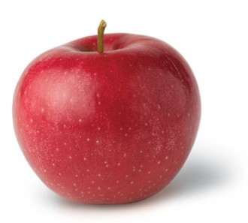
5
five

Slide 7
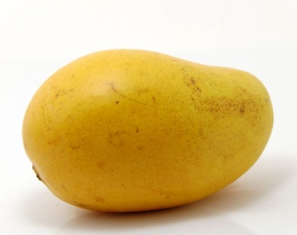
6
six

Slide 8
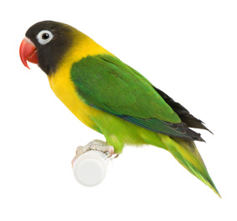
7
seven

Slide 9
5
five

Slide 10
6
six

Slide 11
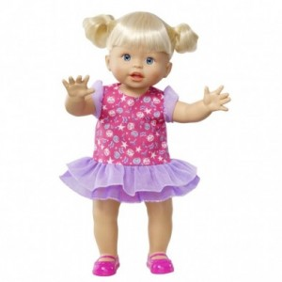
7
seven

Slide 12
Open Your Book
Page no.-8

Slide 13
5
five

Slide 14
6
six

Slide 15
7
seven

Slide 16
Say and write(IW)
5
6
7

Slide 17
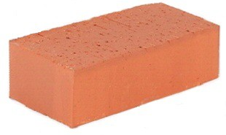
Count and write in figer (GW)
G-1
6
7
G-2
G-3
5

Slide 18
Evalution
Matching
6
A
a
7
B
b
5
C
c

Slide 19
Homework
You will write 1-9
in number with spelling .

