Slide 1
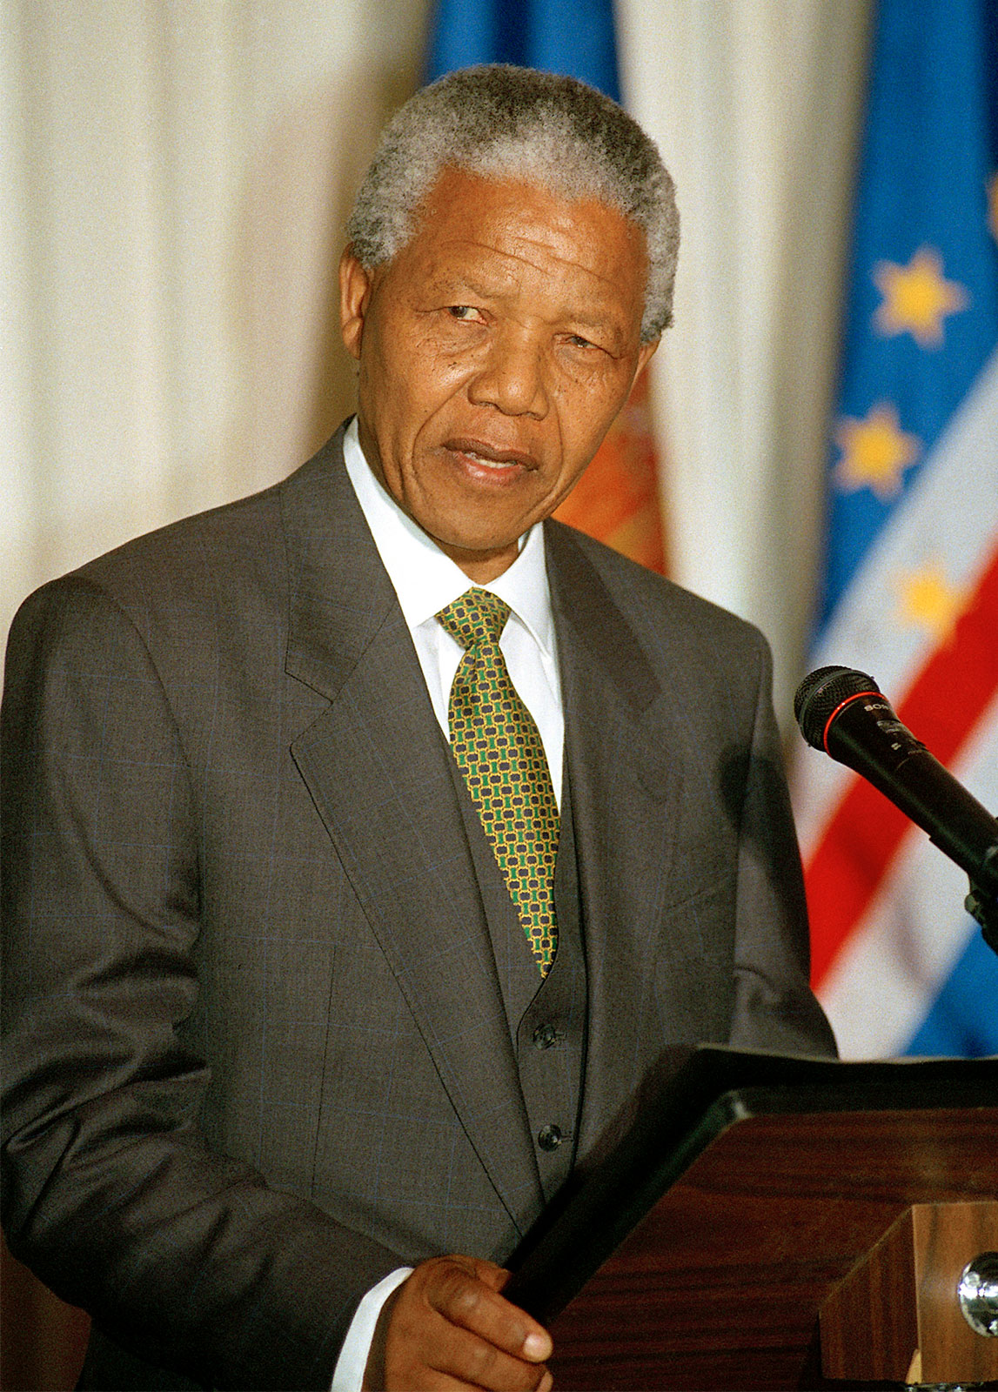
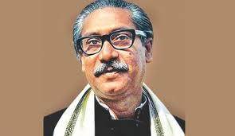
to multimedia class
Notes:
Say greeting to the students.

Slide 2
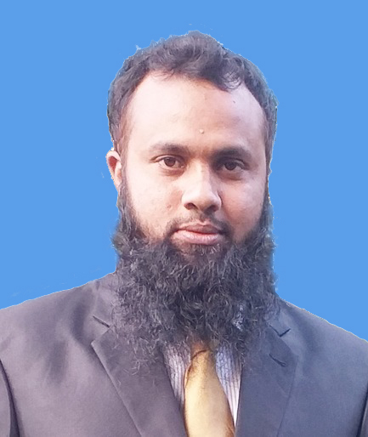
Identity
Md. Jakirul Islam
BA (Hons’), MA in English, B.Ed, LL.B
Lecturer of English
Shaitshala Adarsha High School & College
Brahmanpara, Cumilla.
Contact- jakir.oy@gmail.com (01811285175)
Notes:
Introduce yourself.

Slide 3
Class Identity
Class- XI-XII
Subject- English For Today
Unit- 01
Lesson- 01
Time- 45 min
Notes:
Introduce Subject & Unit-Lesson.

Slide 4
Let’s enjoy a video.
Notes:
Play a video about Nelson Mandela.

Slide 5
Who have you seen in the video?
Nelson Mandela
Can you tell the major two great leaders who were related to the freedom of their nations?
Sheikh Mujibur Rahman
Nelson Mandela
Notes:
Ask the students some questions to infer today’s lesson.

Slide 6
Today’s lesson is on
Nelson Mandela,
from Apartheid Fighter to President
Part-II
Notes:
Declare the lesson.

Slide 7
Learning Outcomes
By the end of the lesson, students will be able
To say meaning of several words.
To give answer to some questions about Nelson Mandela.
To fill in the blanks with clues.
Notes:
Proclaim the learning outcomes.

Slide 8
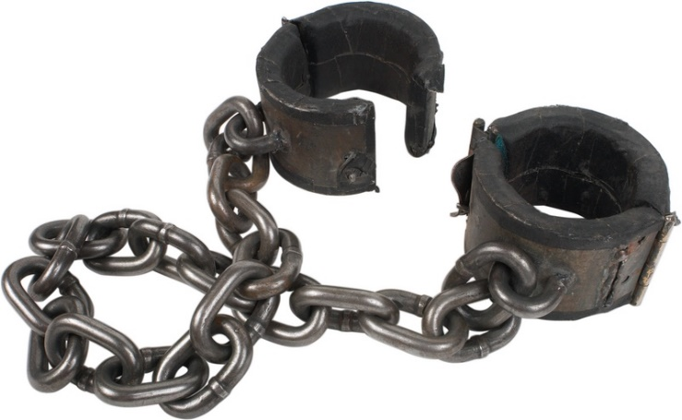
shackles
Restrains, chain
Race-hatred, segregation,
separation,
apartheid
icon
Idol, figure, shape
Notes:
Demonstrate several words along with showing pictures and tell students to infer meaning.

Slide 9
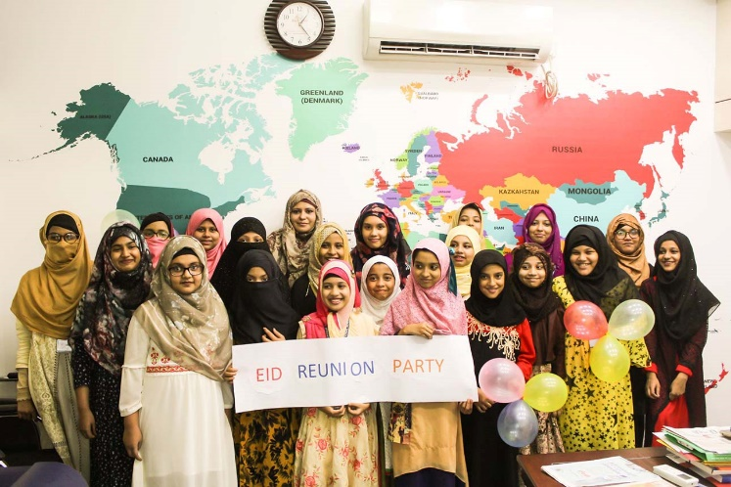
reconciliation
Reunion, rally
A divinely conferred power or
talent
charisma
embody
Organize, form, incarnate
Notes:
Demonstrate several words along with showing pictures and tell students to infer meaning.

Slide 10
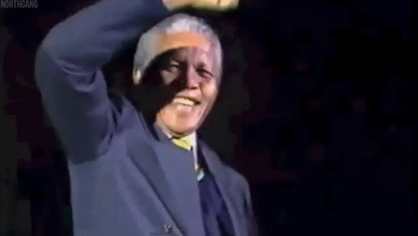
decade
A period of ten years,
deccinary
manifestation
Presentation, expression, exposition, illumination
Soothing, remedy,
recovery, cure
healing
Notes:
Demonstrate several words along with showing pictures and tell students to infer meaning.

Slide 11
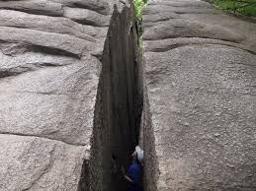
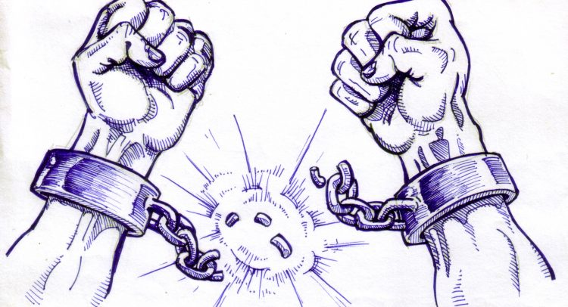
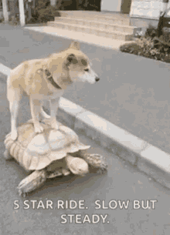
chasm
Cleft, crack, fracture
emancipation
Liberation, freedom
unwavering
Steady, unmoved, firm
Notes:
Demonstrate several words along with showing pictures and tell students to infer meaning.

Slide 12
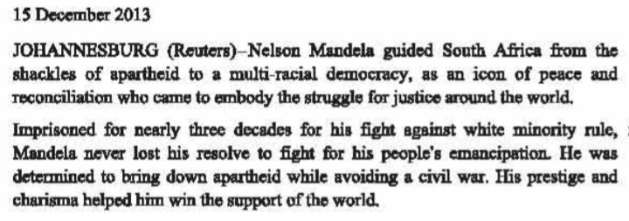
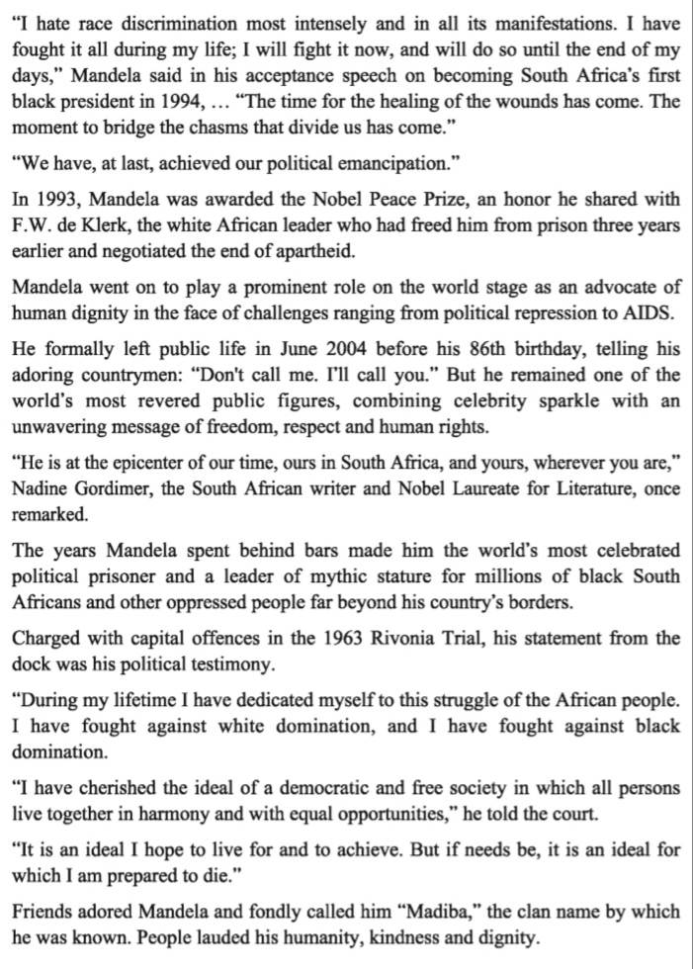
Read the passage silently. 7 min
Notes:
Tell students to read the text silently.

Slide 13
Answer the following multiple questions. 4 min
Notes:
Tell students individually to answer the multiple questions.

Slide 14
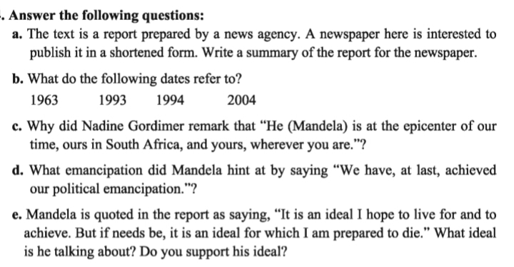
Time
10 minutes
Group Work
How long was Mandela imprisoned? Why was he imprisoned?
12
1
10
11
2
3
4
5
6
7
8
9
Notes:
Arrange a group work, monitor their work.

Slide 15
Question:
Why did Nadine Gordimer remark that “he (Mandela) is at the epicenter of our time, ours in South Africa, and yours, wherever you are.”?
What emancipation did Mandela hint at by saying “We have, at last, achieved our political emancipation.”?
How long was Mandela imprisoned? Why was he imprisoned?
What do the following dates refer to?
1963 1993 1994 2004
Mandela is quoted in the report saying “It is an ideal I hope to live for and to achieve. But if needs be, it is an ideal for which I Prepared to die.” What ideal is he talking about? Do you support this ideal?
Answer:
Mandela was imprisoned for nearly three decades. He was imprisoned for his fight against white minority rule.
Nadine Gordimer remarked so about Mandela because Mandela is a person in general but he is the idol for the world as a leader fighting for right.
In 1963, Mandela was charged with capital offences in the Rivonia Trial.
He was awarded the Novel Prize in 1993
He became Africa’s first black president in 1994.
In 2004, he formally left public life.
By saying this speech, Mandela hinted at the freedom of the black with the white minority rule.
The ideal he is talking about is a democratic and free society living together in harmony and equal opportunities.
I support his ideal because man is born to be free by nature.
Notes:
Give feedback of the group work.

Slide 16
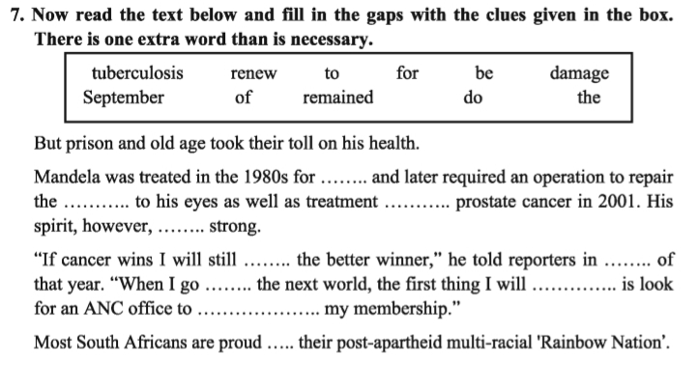
Time
12
1
2
3
4
5
6
7
8
9
10
11
5 min
Pair Work
tuberculosis
damage
to
remained
be
September
to
do
renew
for
Notes:
Arrange a pair work, monitor them and give feedback.

Slide 17
Evaluation
3 minutes
How long was Mandela imprisoned?
1. Nearly three decades
2. What is the meaning of ‘Apartheid’?
2. race-hatred
3. When was Mandela awarded novel Prize?
3. In 1993
4. What do you mean by ‘emancipation’?
4. Liberation
5. How did friends fondly call him?
5. Madiba
Notes:
Evaluate the students by asking some short questions.

Slide 18
Write down works and achievements of Nelson Mandela about 10 sentences.
Notes:
Give them Home Work.

Slide 19
Thank you all
for enjoying
the class.
Notes:
End the class with thanks-giving.

