Slide 1
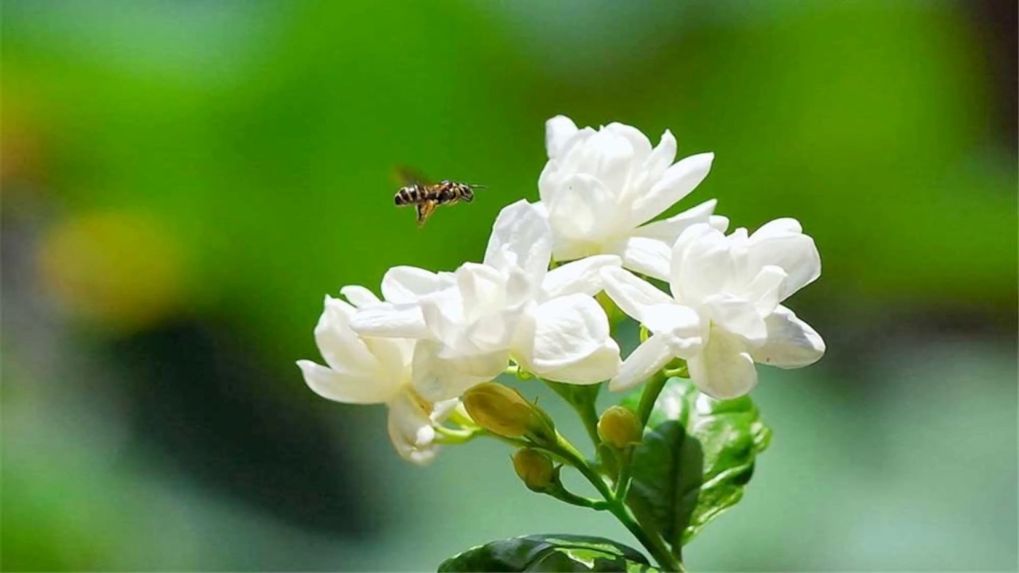
Welcome

Slide 2
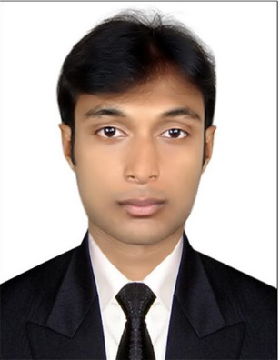
Identity
English For Today
Class : Six.
Lesson 3
Aktaruzzaman
Assistant Teacher (ICT)
Ghugrkati Fazil (Degree) Madrasha
Koyra,Khulna.

Slide 3
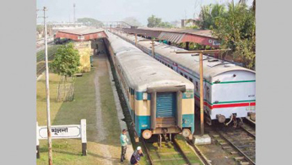
Today`s topic
At a Railway Station

Slide 4
Learning outcomes
After completing the lesson students will be able to…
Read and understand texts.
Talk about people, places and familiar objects in short and simple sentences.
Write paragraph, letter, compositions.

Slide 5
Let`s enjoy a video clip
What is the name of this place ?
A railway station

Slide 6
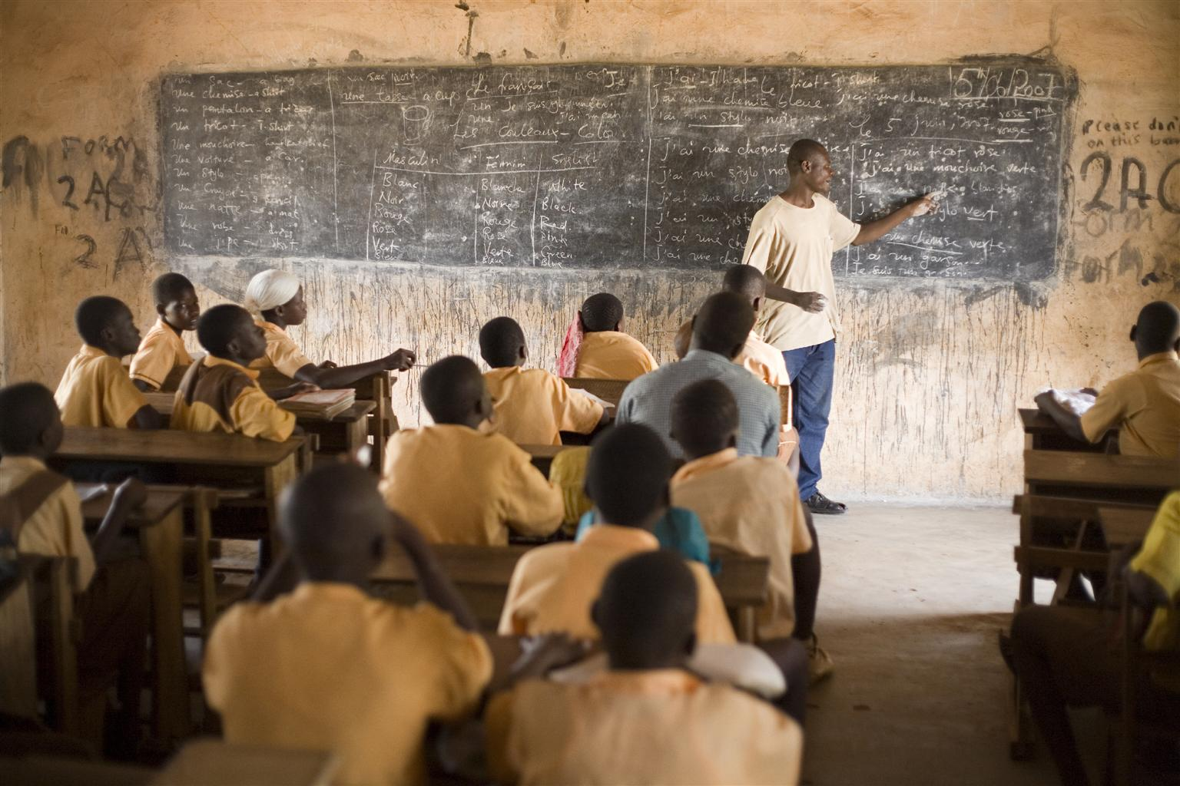
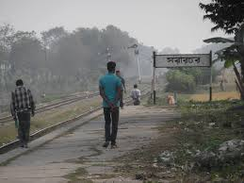
Listen the text attentively then talk with your partner about what the speaker saw and did at the railway station. Use your own words.

Slide 7
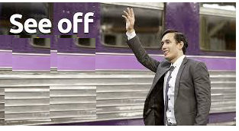
See off
I came to see him off.
Meaning
(Click here)
Good Bye / Bid farewell

Slide 8
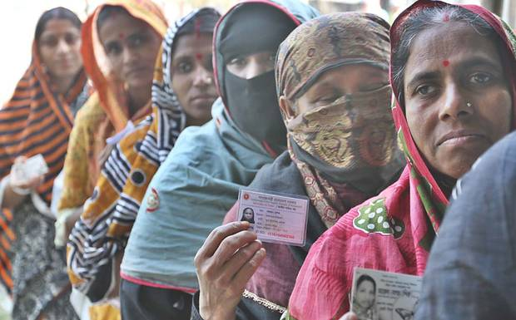
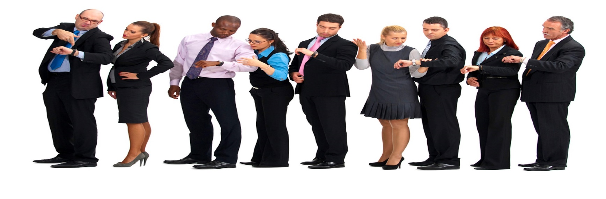
Queue
They are standing in the queue for vote.
Meaning
(Click here)
Line

Slide 9
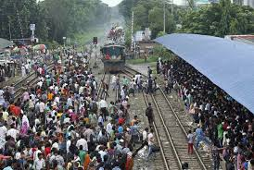
Crowded
There are very crowded in the station.
Meaning
(Click here)
Packed by people.

Slide 10
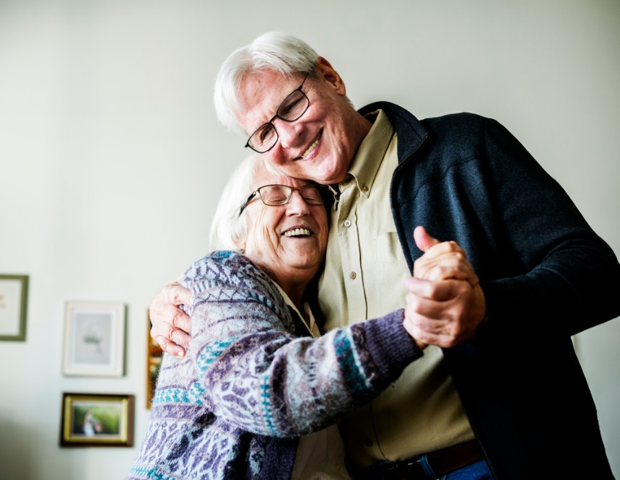
Couple
An old couple is waiting for train.
Meaning
(Click here)
Pair

Slide 11
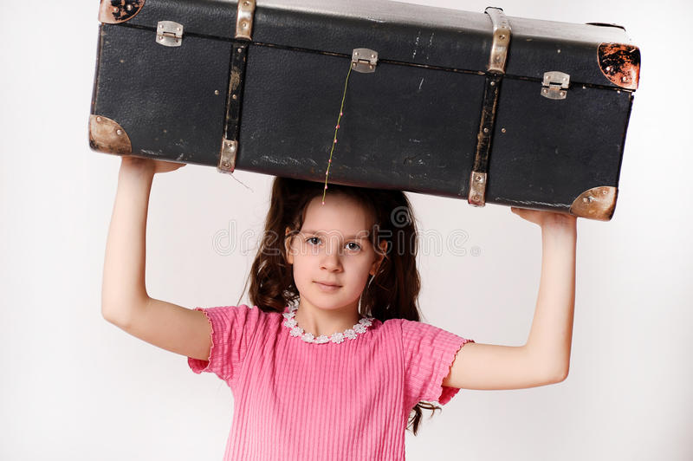
Luggage
A man is carrying his luggage.
Meaning
(Click here)
baggage

Slide 12
Similar and opposite words.
Main Word | Similar Word | Opposite Word
See off | Goodbye | Receive
Long | Far | Short
Quiet | Silent | Busy
Heavy | Weight | Light
Pick up | Take off | Drop
Young | Youth | Old
Now go to the section - A2 and match the words.

Slide 13
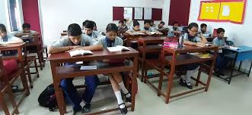
Silent reading
Now go to the next slide and fill in the gaps.

Slide 14
Individual work
Fill in the gaps with the word from the box.
Once the writer and his friend were (a) ---------- the station. They were (b)--------- for the train. His friend © --------- was going to Dhaka and he came to see him (d)--------. He found the station very (e) ------- . There was a long line of people at the (f) -------- . A woman in the line (g) -------- her child tightly. The writer also saw a group of (h) ------ people was talking and taking tea. There was a (i) ------- of old people trying to find a resting place. Another passenger a young (j) ------- was sitting on her luggage and reading a magazine.
Lady
held
waiting
room
crowded
long
young
at
Sajjad
couple
Ticket counter
off

Slide 15
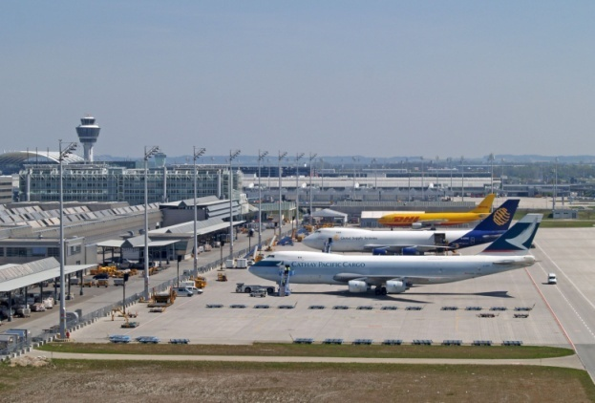
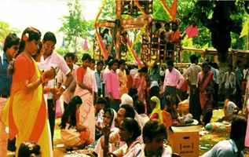
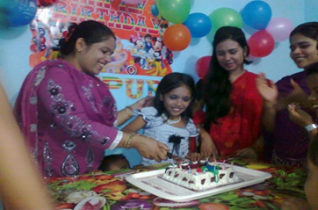
Pair Works
Suppose you went to one of the places listed below.
Describe what you saw, what was happening and what you did there (within five sentences).
1. An Air Port
2. A Village Fair
3. Sumi`s Brith day

Slide 16
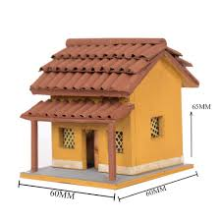
Home works.
Visit your local railway station and write down six sentences on it.
Notes:
There is no railway station, teacher can ask to students to go to bus station, launch ghat, airport, market etc.

Slide 17
GOOD BYE
SEE
AGAIN
YOU
Notes:
Teacher can say it orally.

