Slide 1
Good Morning

Slide 2
GREETINGS
Good morning, students
Teacher
Good morning, teacher
Student’s
Teacher
How are you today ?
Fine
Student’s

Slide 3
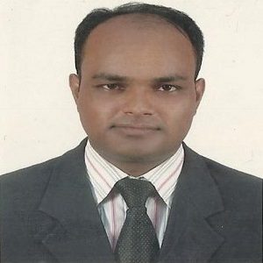
Teacher’s Identity
Lesson Identity
Subject: English. Class: Five. Unit:07, Lesson: 1-2
(Be Healthy)
MD. ABDUL KADER
Assistant Teacher
Borni Govt. Primary School,
Companigonj, Sylhet.

Slide 4
Let’s enjoy a video

Slide 5
Ok, students our today’s lesson is
Be Healthy

Slide 6
Learning outcomes
By the end of the lesson the students will be able to-
Listening:
3.4 understand statements made by the teacher and students.
4.3 enjoy and understand simple poems.
Speaking:
1.1. say words, phrases and sentences with proper sounds, stress
and intonation.
4.1 receipt poems.
Reading:
1.5 read words, phrases and sentences in the text with proper pronunciation, stress and intonation.
6.1 read instructions and carry them out.
Writing:
8.1 make sentences using words and phrases, following instructions.

Slide 7
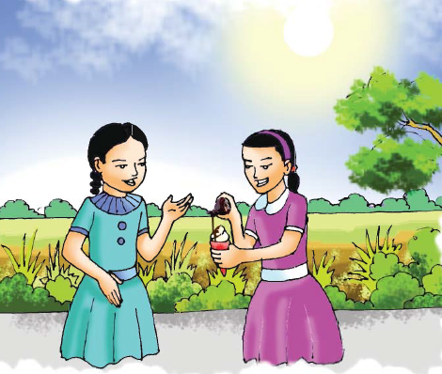
Teacher’s Reading
Now I’m reading the dialogue between Sima and Nasreen
Sima: What are you doing, Nasreen?
Nasreen: I’m putting some chocolate
on my ice-cream. Ice cream
is delicious with chocolate.
Sima: Well, it looks good, but you
shouldn’t eat a lot of chocolate
or ice-cream?
Nasreen: Of course! I don’t eat them
regularly.

Slide 8
Teacher’s Reading
Sima: What kind of food do you eat regularly?
Nasreen: Oh, fruits and vegetables. I love
pineapples and bananas. They are my
favourits. I eat cucumbers and lettuce
a lot, too.
Sima: I eat fruits and vegetables everyday.
Carrots and tomatoes are my favourites,
but I also like strawberries and bananas.
Nasreen: Would you like to try some of my ice-
cream with chocolate? We should eat
it quickly. It will melt soon in this hot
weather.
Sima: OK! Thanks.

Slide 9
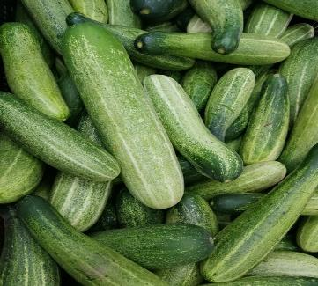
New word
Cucumber
One kind of vegetables

Slide 10
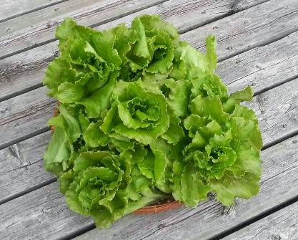
New word
Lettuce
It needs to make salad

Slide 11
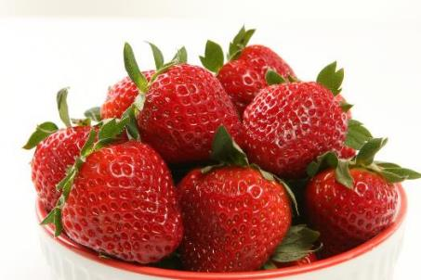
New word
Strawberries
A delicious fruit

Slide 12
New word
Delicious
Enjoyable
Something that tastes pleasant.

Slide 13
New word
Weather
Climate
The temperature of a certain place.

Slide 14
New word
Regularly
Commonly
The event what happens often.

Slide 15
New word
Favourite
Beloved
Such a thing we like most.

Slide 16
Group Work
Green
Write the name of ten healthy food.
Write the name of ten unhealthy food.
Yellow

Slide 17
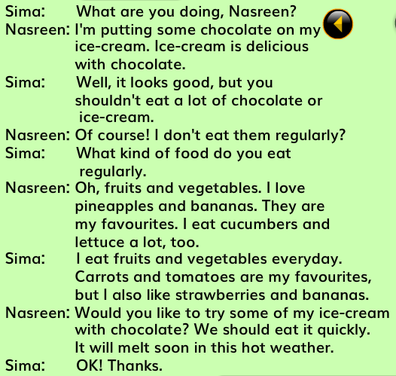
My dear students, read the text silently for 5 minutes.

Slide 18
Now tell me, what have you learnt in this lesson?
We’ve learnt about different foods.
Can you tell the names?
Chocolate
Ice-cream
Strawberries
Pineapple

Slide 19
Checking learning
Write True or False
Sima is putting chocolate on her ice-cream.
Fruits and vegetables are healthy.
Sima likes pineapples.
When Sima and Nasreen are talking the weather is hot.
We should eat a lot of ice-creams.
Sima likes healthy foods.
Chocolate is an unhealthy food.
Nasreen eats cucumbers.
Nasreen doesn’t share her ice-cream with Sima.
Banana is full of vitamins.
False
True
False
False
True
True
True
False
False
True
Check your answer

