Slide 1


Welcome

Slide 2


TEACHER`S INTRODUCTION
Sabuj Kumar Das
Assistant Teacher-English
Attaka K Ali Pilot Secondary School
Fakirhat, Bagerhat

Slide 3

Today`s Topic
Subject:-English First Paper
Class :-Nine
Unit:-8
Lesson:-Four
Lake Baikal.
Time:-50 minutes

Slide 4

Learning Outcomes
By the end of this lesson the SS will be able to --
ask questions
read a text and defined some works
read a text and ticked correct expressions
complete tables
write a paragraph

Slide 5
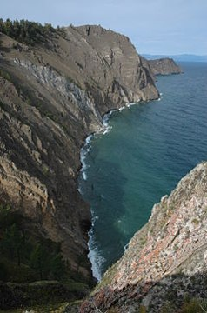
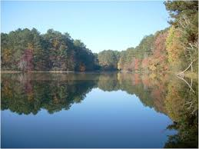
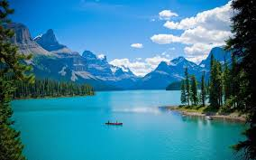
Can you guess what are the pictures about?
Which is the biggest Lake in the World?
Where is it situated?

Slide 6


TODAY`S TOPIC
Lake Baikal

Slide 7

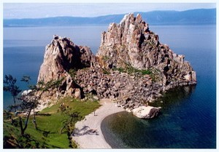
Lake Baikal

Slide 8

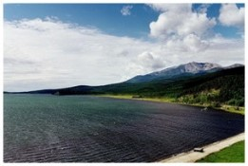
Pictures of Lake Baikal

Slide 9
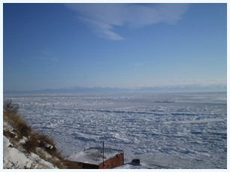
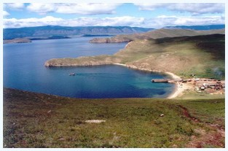
Pictures of Lake Baikal at Different Times of Years

Slide 10
KEY WORDS
A place surrounded by three sides
Lake
Baikal is the biggest Lake in This World

Slide 11

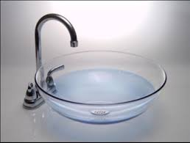
Water basin
Bowl shaped depression filled with water

Slide 12
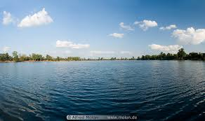
Natural water basin
Lake Baikal is the biggest Water basin in this World

Slide 13

Match the word with their meanings
Words | Meanings
Miracle | Small stream
Basin | Top
Brook | Outstanding
Crest | An act believed to be caused by God
Exceptional | Bowl -shaped depression filled with water

Slide 14


Read yourtext in C silently and complete the chart
Lake Baikal | Information
location
Setting/placed
Length
Width
Maximum depth/highest depth
Occupies an area
Amount of water

Slide 15
Pair Work
Make a list of five attractive features of lake Baikal.

Slide 16

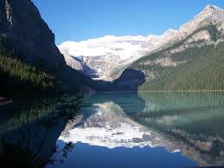
Evaluation
What is the most ancient lake in this world?

Slide 17
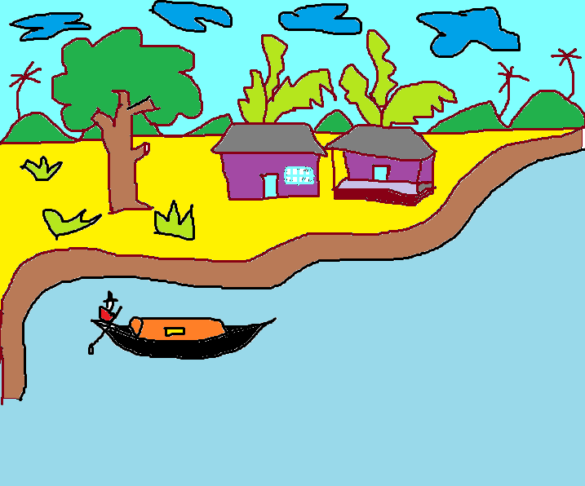
Home Work
Visit a lake or river and then write a paragraph about that Lake/River

Slide 18
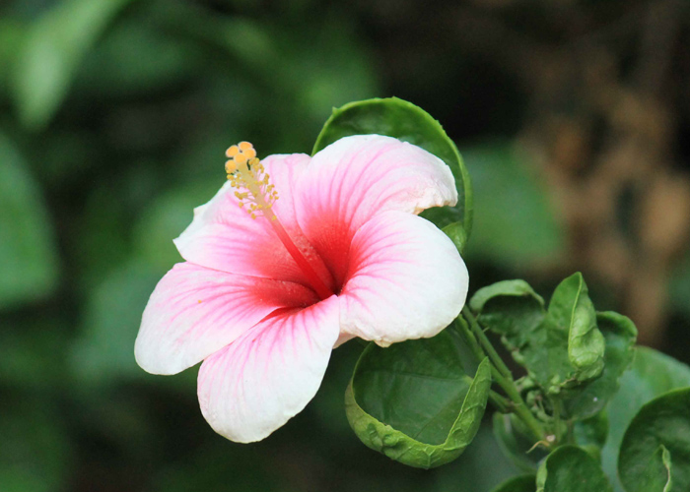
Thanks

