Slide 1
WELCOME

Slide 2
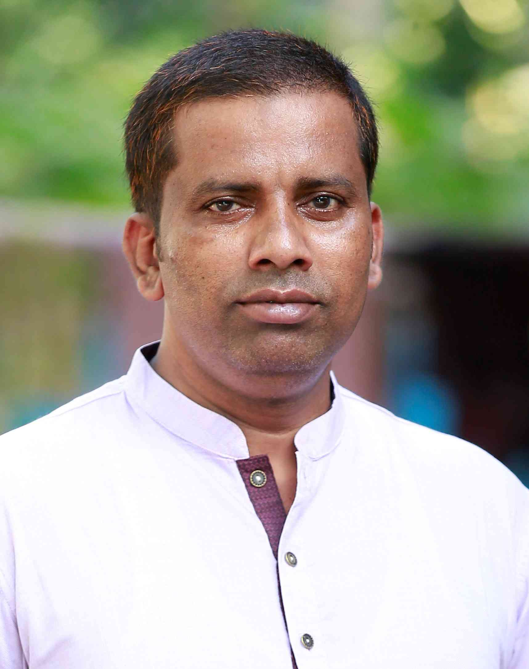
Teacher’s Identity
Saidur Rahman
Assistant Teacher
Guatal Model Government Primary School.
Shibchar,Madaripur.
Mobaile:01715838496

Slide 3
Lesson Introductions:
Class:Two
Subject:English
Lesson:Kaniz’s life
Part of the lesson:This is kaniz…….her friends.

Slide 4
Learning Outcomes
4.2.1. Enjoy simple stories.
3.1.1. Ask and answer simple questions about everyday life.

Slide 5
Let’s we watch a video

Slide 6
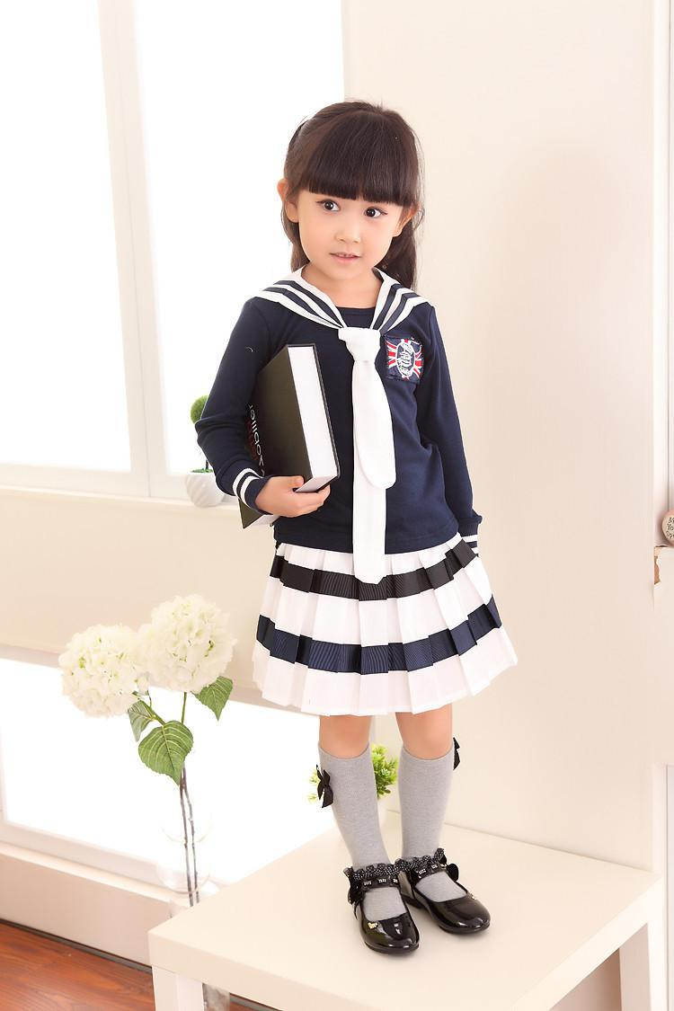
Today’s lesson
Kaniz’s life

Slide 7
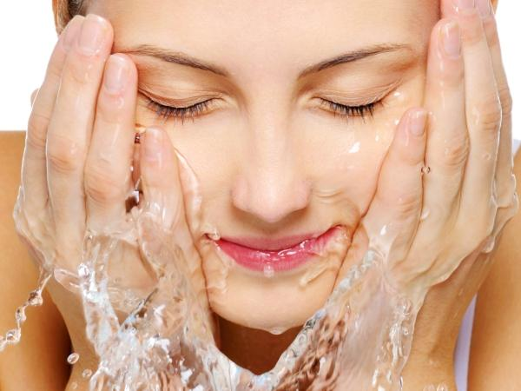
New word
Wash
Clean

Slide 8
This is kaniz.

Slide 9
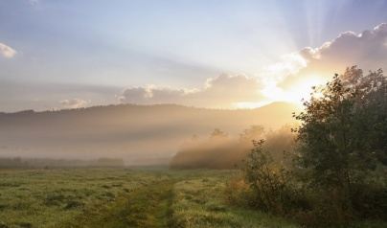
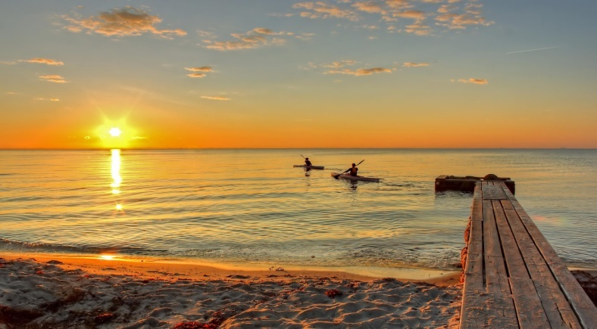
In the morning

Slide 10
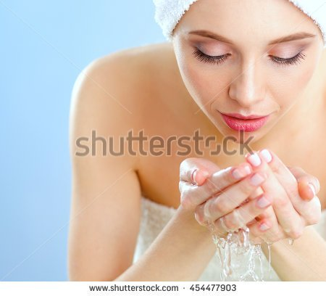
She washes her face.

Slide 11
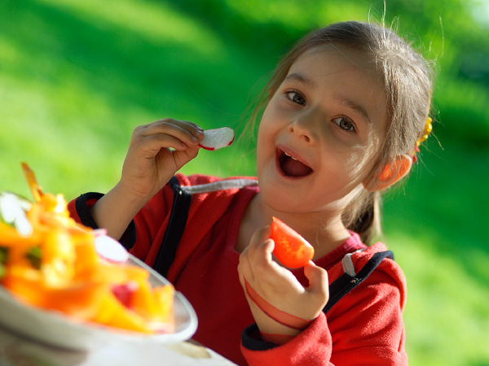
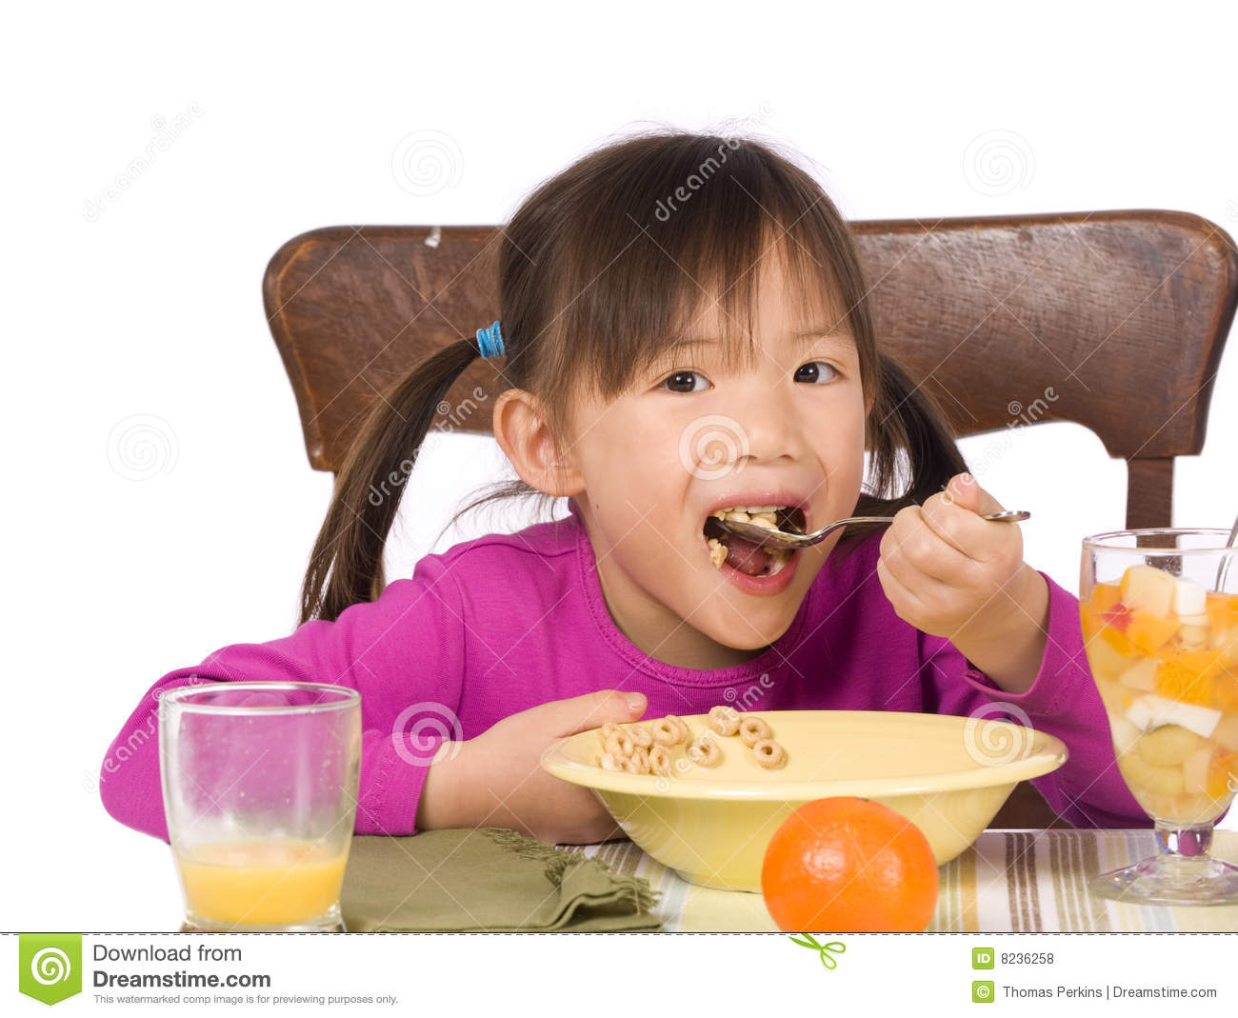
Then,she has breakfast.

Slide 12
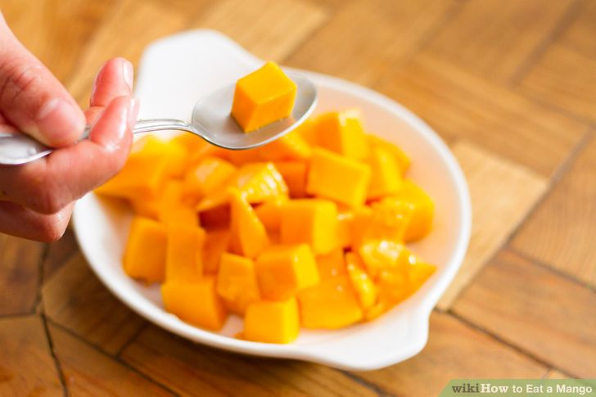
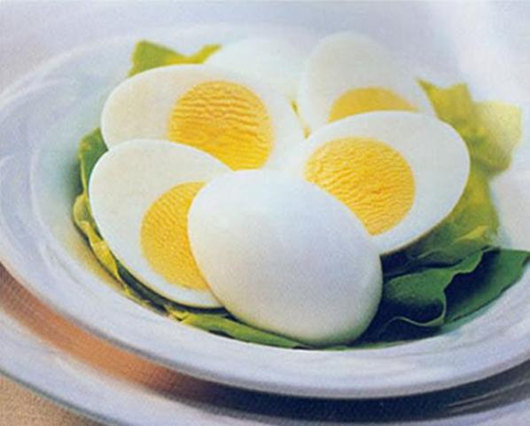
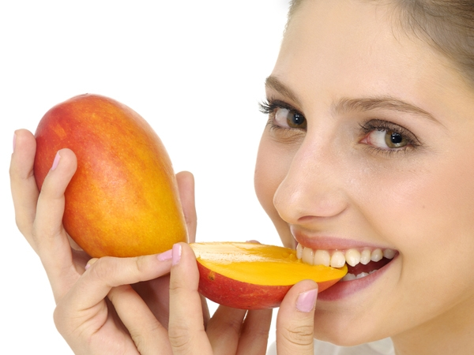
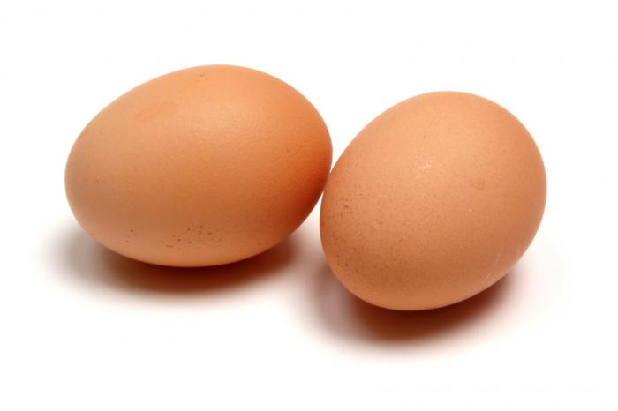
She has eggs and mangoes.

Slide 13
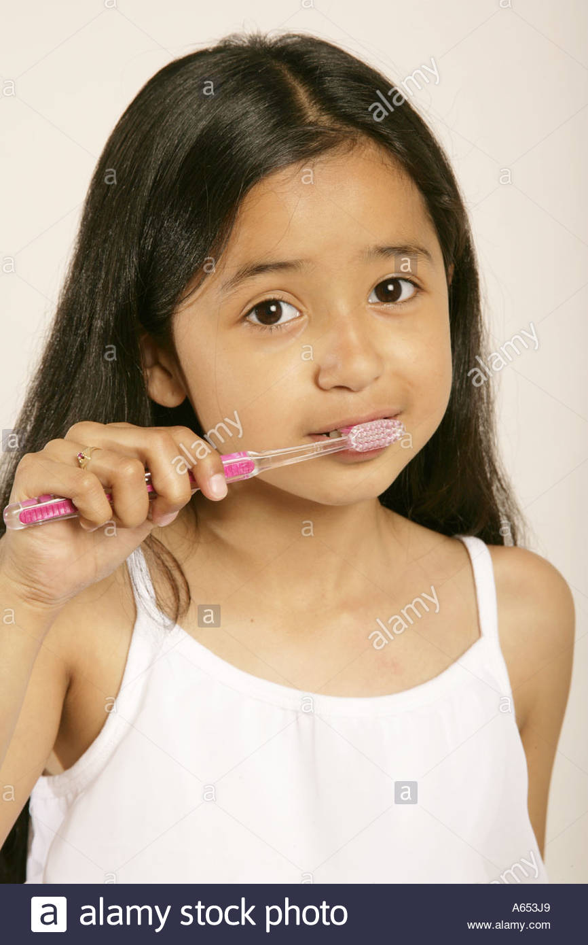
Then, she brushes her teeth.

Slide 14
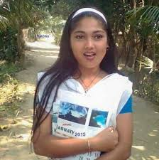
She goes to school.

Slide 15
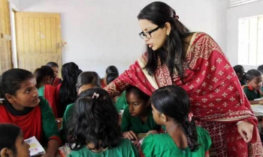
Miss Mariyum is her teacher.

Slide 16
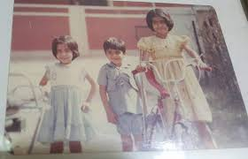
Sujon and Joya are her friends.

Slide 17
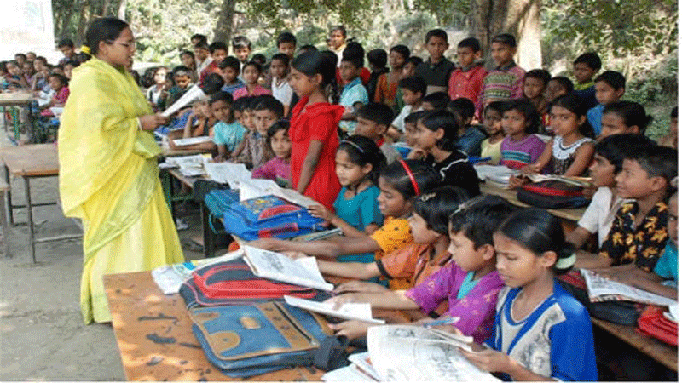
Teacher and students reading

Slide 18
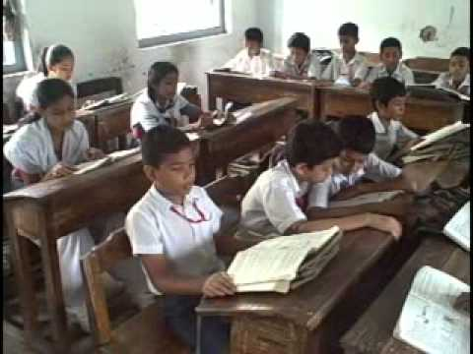
Students reading

Slide 19
Checking Learning
G W
Answer the Questions Oraly:
1. Who is the girl?
Ans:Kaniz is the girl.
2. What does she have for breakfast?
2.Ans:She has for breakfast eggs and mangoes.
3.When does she brush her teeth?
3.Ans:She brushes her teeth in the morning.

Slide 20
Evaluation:
Complete with your information.
a) My name is----------.
b) In the morning,I ------my face.
c) I-------------my breakfast.
d)Then,------my teeth. f)I -------to school. g) My father is ---------.

Slide 21
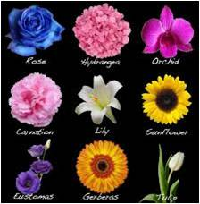
Thank you all for being with me.

