Slide 1


Welcome

Slide 2

Teacher Identity
Dip Narayan Biswas
Assistant teacher
28 No Bisnupur Govt. primary school
Narail Sadar , Narail.

Slide 3

Lesson Identity
Class: Three
Sub : English
Unit:24 ; Lesson : 1-2
Lesson identity: Numbers
Lesson title: A. B.

Slide 4
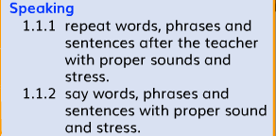


Learning Outcomes
The Student’s will be able to:

Slide 5

Emotion creating…
Let’s watch a video

Slide 6

Title declaration
NUMBER

Slide 7
Now, say the numbers
91
92
93
94
95
96
97
98
99
100

Slide 8


Slide 9
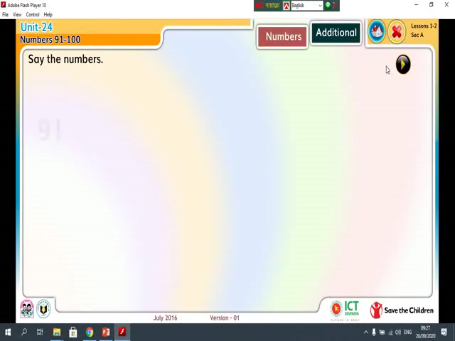
Listen attentively

Slide 10
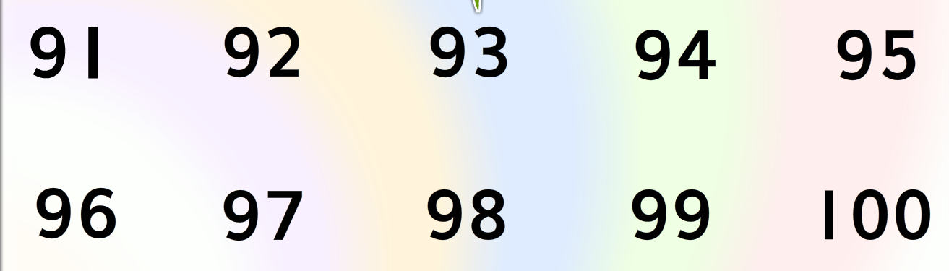
Practice again with me.

Slide 11
Let’s count the numbers
91
95
100

Slide 12
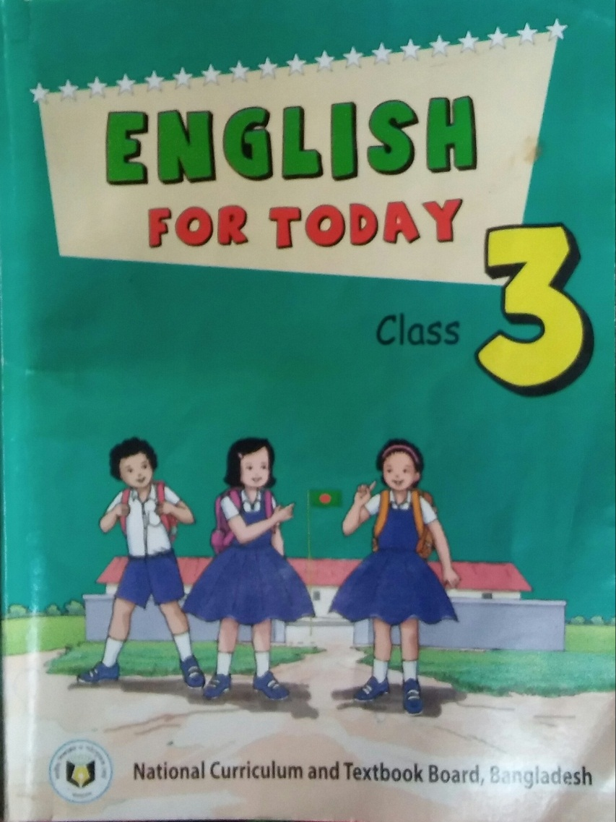
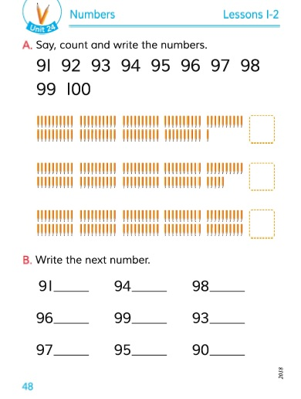
Open your book at page 44.

Slide 13
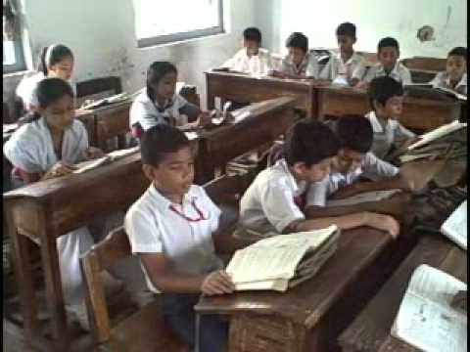
Student’s reading silently

Slide 14
92
95
Write the next number
91
93
94
96
98
97
99
100

Slide 15

Homework
Read out the numbers and Write the missing numbers.

Slide 16

Thanks

