Slide 1
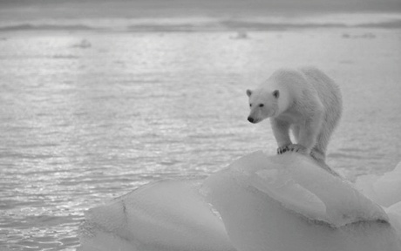
Welcome to my OnlineClass

Slide 2
Introduction of teacher
MUHAMMAD AHSAN HABIB
ASSISTANT. TEACHER
MOHSENUDDIN NURIA FAZIL MADRASAH
Bauphal, Patuakhali
MOB- 01754755169
ahsanhabib251281@gmail.com

Slide 3
Introduction of lesson
Subject: English
Class- 9-10
U-5: Nature & Environment
L- 1: The greed of the roaring river.
ENGLISH FOR TODAY
9- 10

Slide 4
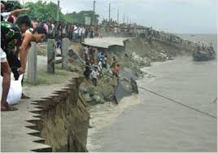
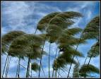
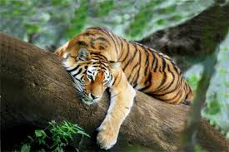
Look At the pictures and discuss with your mates.
These pictures are about our “Nature and Environment”.

Slide 5
Nature and environment (The greed of the roaring rivers)
Today’s Lesson is On

Slide 6
Learning outcomes
After completing this lesson students will be able….
1. read and understand the text through silent reading.
2. ask and answer questions.
3. to say the meaning of key words and making sentences.

Slide 7
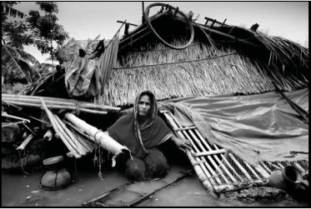
Model reading
Dear students listen the text attentively and then read the text individually and answer the questions given below.

Slide 8
Answer the question from the text.
1. What is river erosion?
2. What do you know about Meherjan`s family?
3. What is the name of three mighty river?
4. How many people become homeless in every year?

Slide 9
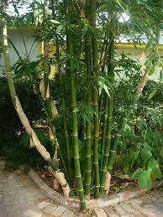
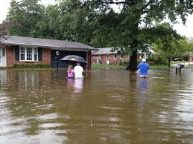
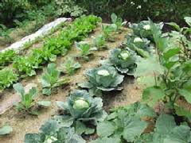
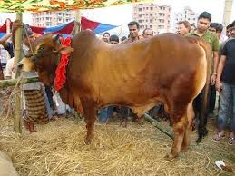
Look at the above pictures and discuss with your mates then write down about the “past life of Meherjan”.

Slide 10
Key word
Erosion
The process of eroding or being eroded by wind, water, or other natural agents.
Meaning:
Meherjan lost all her property due to river erosion.

Slide 11
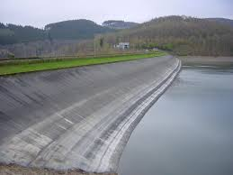
Key word
Embankment
Meaning:
A wall of stone or soil made to keep water back.
Meherjan lives in a slum on the Sirajgong Town Protection Embankment

Slide 12
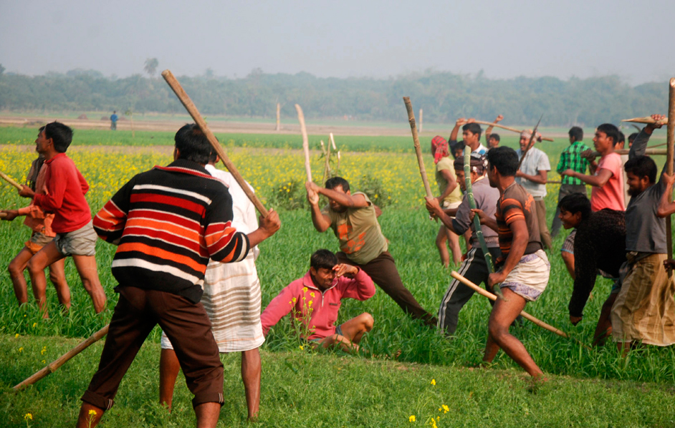
Key word
Cruel
Something Dangerous, Fearful.
Meaning:
Meherjan lead her life in cruel proverty.

Slide 13
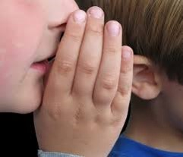
Key word
Whisper
Meaning:
To speak very quietly to somebody so that other people cannot hear what one is saying.
The Mother whispered to me never tell a lie.

Slide 14
Key word
Roar
Meaning:
To make a loud deep harsh sound of tiger, river or any animals etc.
The tiger is roaring for daily meals.

Slide 15
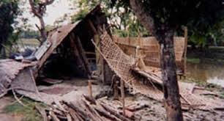
Key word
Slum
A overcrowded urban area inhabited by very poor homeless people.
Meaning:
Meherjan lives in a slum on the Sirajgong Town Protection Embankment

Slide 16
Key word
Unsteady
Meaning:
A libel to fall or shake or moving.
The flame of this candle is unsteady.

Slide 17
Individual Work
Fill in the gaps with right word or words from the box
Victims, affects, close to, slum dweller, slum, Threats, story, due to, proverty, homeless.
Meherjan is a typical (1)homeless woman who lives in a (1) . She lost her shelter and properties (2) the erosion of river Jamuna. She also lost her family. Her husband had died of disease caused by shortage of food and (3) . Now, she is only a (4)
. Like Meherjan there are many people who have become the (5) of river erosion. River erosion is still possing (6) to the lives and properties of thousands of people. People living (7) Rivers are most likely victimes of river erosion. Each year about one lakh people become (8) due to river erosion in Bangladesh. Meherjan’s life is just one (9) of how climate change (10) the lives of thousands of people.
slum
due to
slum dweller
poverty
victims
threats
close to
homeless
affects
Story

Slide 18
GROUP WORK
Write a paragraph about “The River Erosion of Bangladesh”.

Slide 19
Evaluation.
Choose the best answer
1.What does adapt mean ? (i) adjust (ii) unchanged (iii) chaos (iv) dam 2. Embankment represents …………. . (i) dam (ii) river (iii) Erosion (iv) quiver 3. The river Jamuna has consumed (i) the cultivable land (ii) houses
(iii) bamboo bush of Meherjan (iv) all of the above answers.
4. How many peoples become homeless by river erosion?
(i) 2,00,000 (ii) 3,00,000 (iii) 1,00,000 (iv) 4,00,000 .

Slide 20
Home Work
Write a dialogue with your friend about climate change.

Slide 21
Thank You

