Slide 1
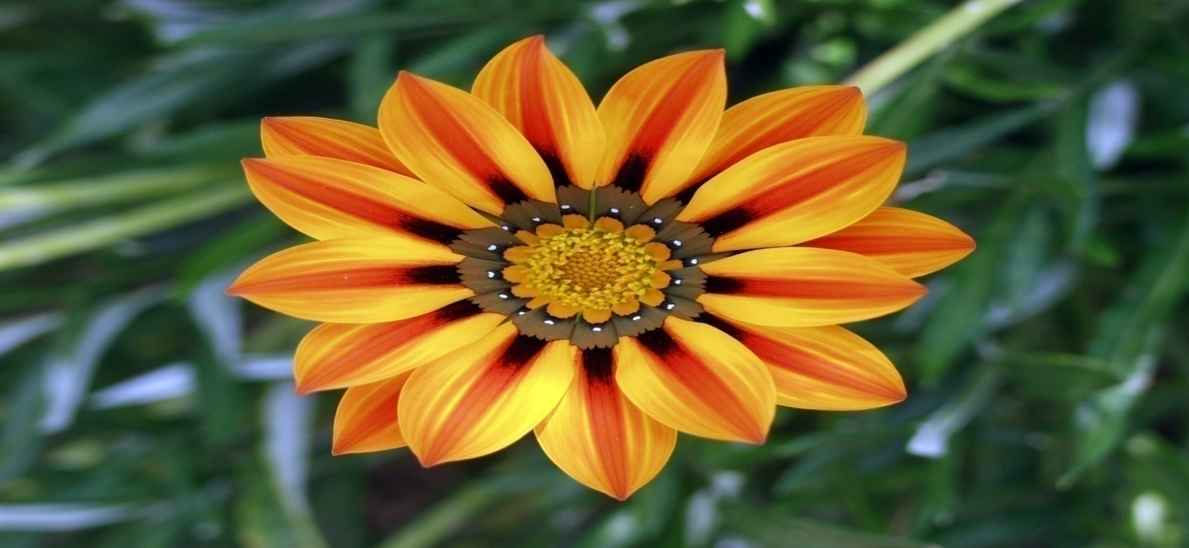
Welcome

Slide 2
Introduction
Md.Aksar Ali
ASST: TEACHER (ENGLISH)
Magura M.U Alim Madrasah,
Kahaloo,Bogura.

Slide 3
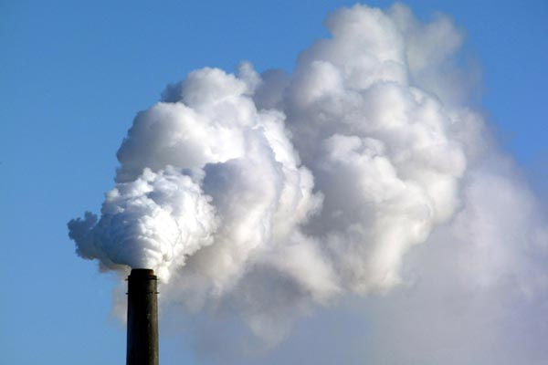
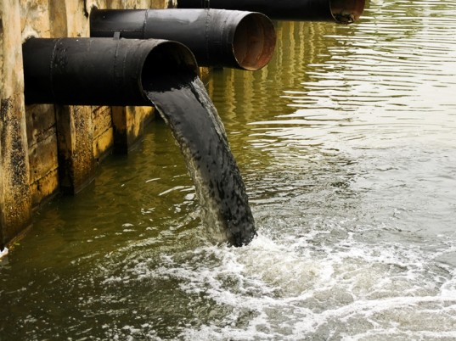
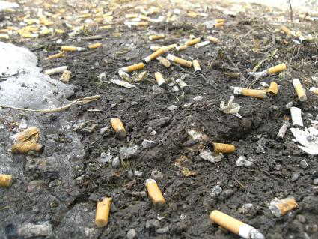
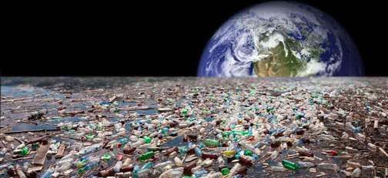
Emission of smoke
Industrial waste
Wastes in soil
Endangered earth for pollution

Slide 4
Title of The Lesson
Environment Pollution.

Slide 5
Learning outcomes
By the end of the lesson learners will be able to …..
say about environment pollution.
write the common source of environment pollution.
narrate the impact of environment pollution
learn important word meanings- environment, pollution, impact, source.

Slide 6
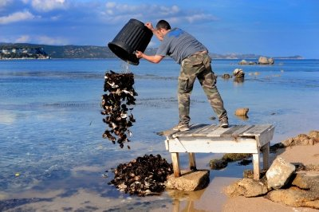
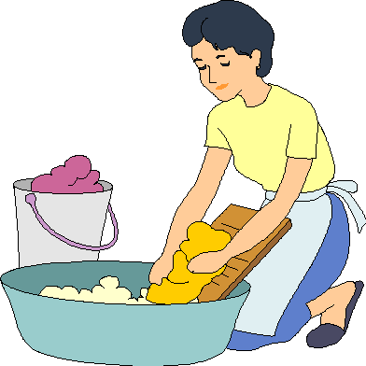
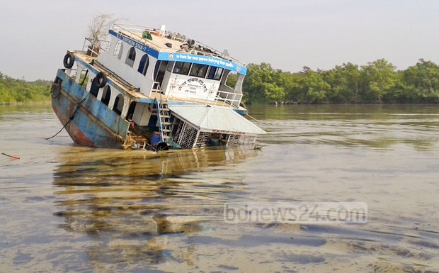
Let’s discuss about different pollution
Throwing industrial waste in water
Throwing domestic rubbish in river
Use of detergent powder
Damaged super tanker

Slide 7
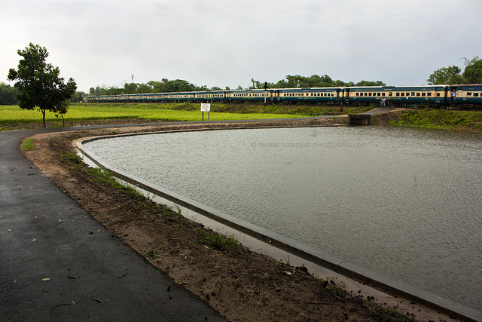
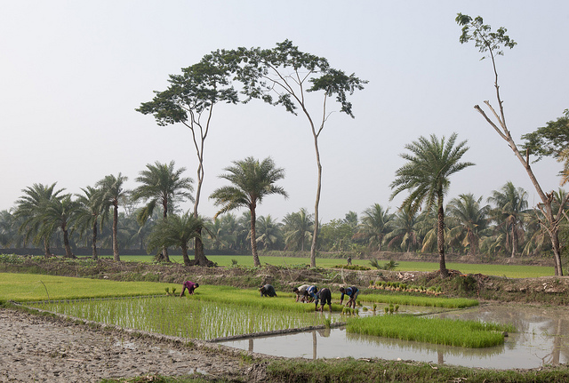
pesticides
pesticides
Using pesticides in field and getting mixed with water
Source of Water Pollution

Slide 8
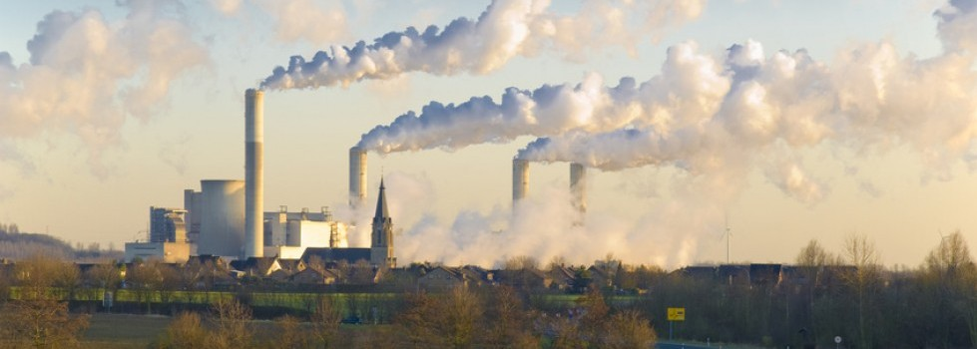
Let’s see some pictures of another pollution
Smoke from brick fields.
Smoke from industries

Slide 9
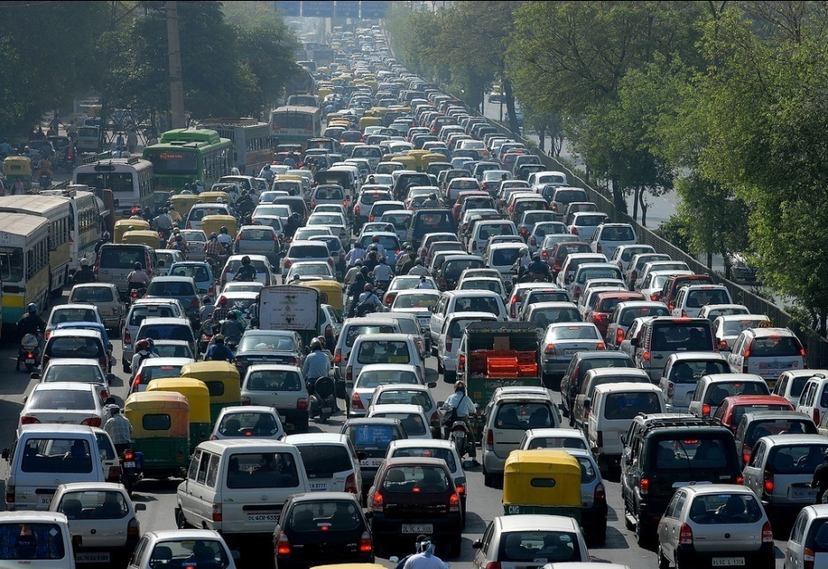
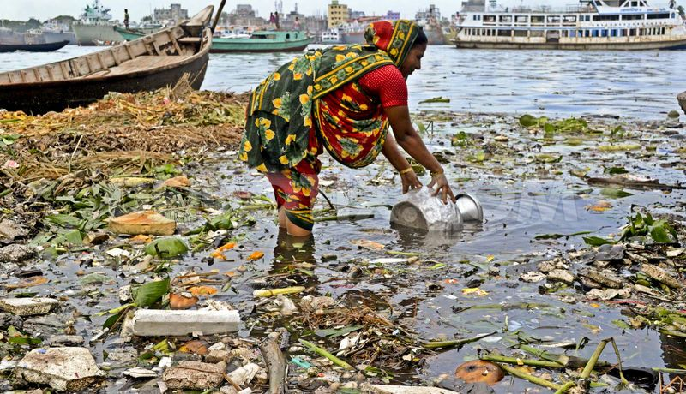
Smoke from vehicles
pollutants
Sources of air pollution

Slide 10
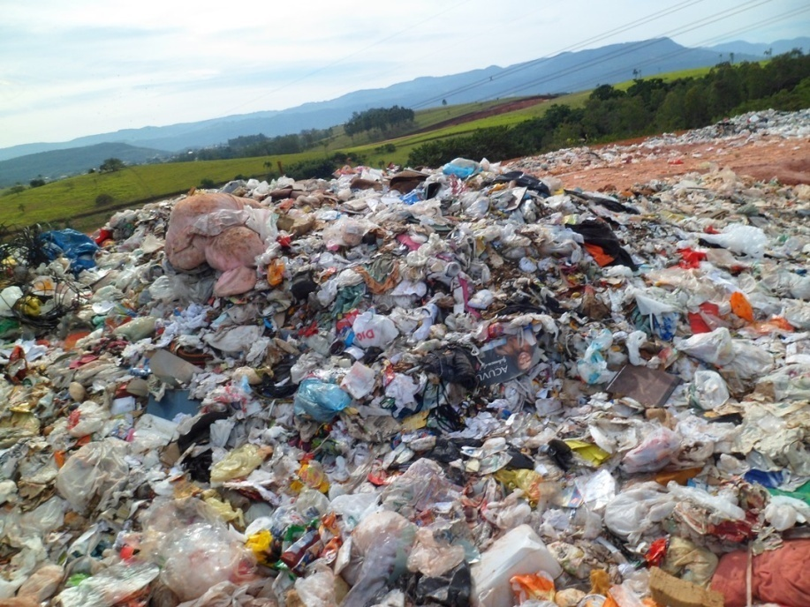
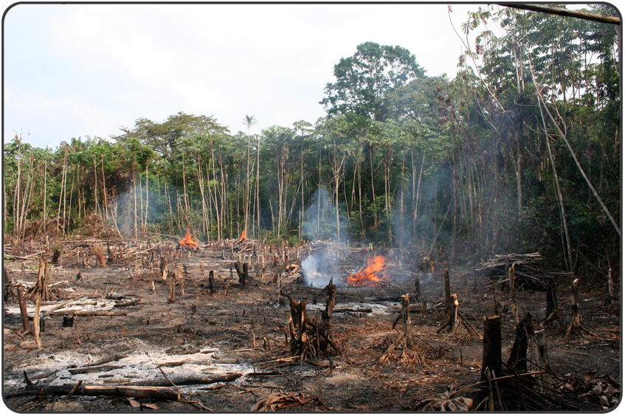
Let’s see some picture of another pollution
Dumped polythene bags
Deforestation

Slide 11
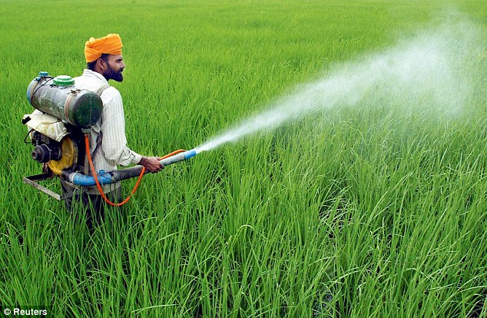
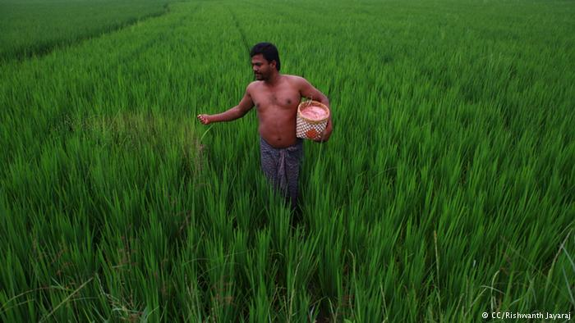
Using insecticides in fields
Using chemical fertilizers
Sources of soil pollution

Slide 12
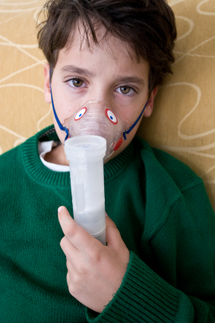
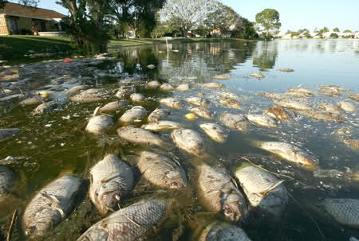
consequences
Sufferer of respiratory disease
Dead fishes for poison

Slide 13
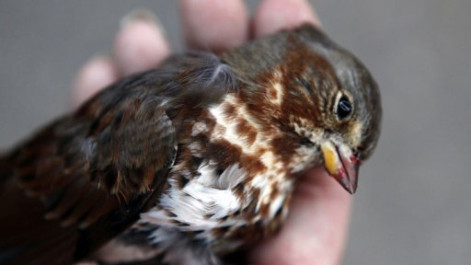
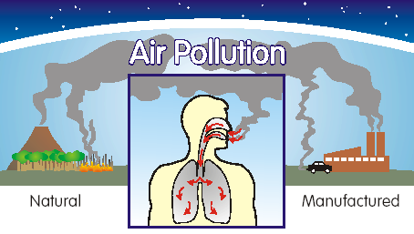
Endangered bird for pollution
Affected human body

Slide 14
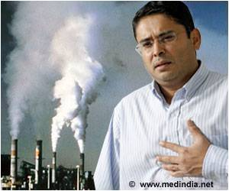
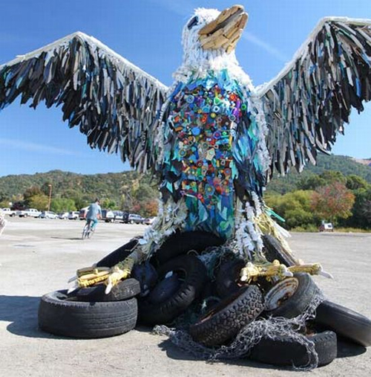
Affected a man for pollution
Symbol of aggression of pollution on earth.
Impact of environment pollution

Slide 15
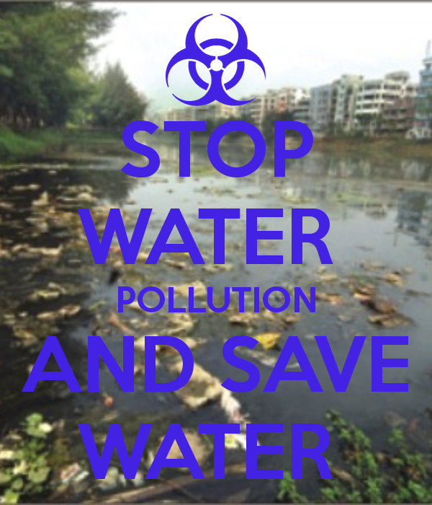

Slide 16
Group Work
Write the causes of environment pollution?

Slide 17
Evaluation
What are the common sources of environment pollution?
How are water, air and soil being polluted?

Slide 18
Home Work
Write the causes and effects of environment pollution.

Slide 19
Thanks to all

