Slide 1
Special Notes
Dear colleagues,
Take my salam first. I have made this content only for the exercise of the students of class ten so that they can prepare well for the SSC examination during this Covid-19 pandemic all over the world. For this reason my content is not like the conventional contents. Please use the content just to help the students to prepare for the examination. My heartiest thanks to all the respected and honorable teachers. Yours’ valuable advice is badly needed to me to go ahead. I strongly hope that you have kind hearts enough to advise me.
Yours faithfully
Md. Abdul Motalab
Senior teacher
Police Lines School and College, Rangpur.
Notes:
This option is very imporant. If you want to make the class fruitful, please follow the instructions in this option carefully before present it in the class.

Slide 2
Welcome
Notes:
Welcome slide.

Slide 3
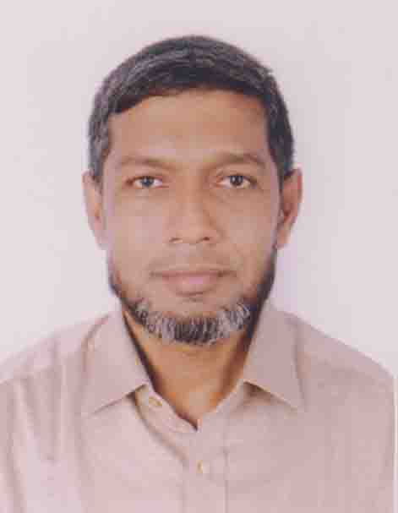
Identity
Md. Abdul Motalab
ENGLISH
Police Lines School and College, Rangpur

Slide 4
WHAT ARE THE STUDENTS DOING HERE?

Slide 5
Our Topic is
Exercise on Right form of verbs

Slide 6
Learning outcomes
After completing this lesson, we will be able to –
prepare for the S.S.C examination
Notes:
Aim of this lesson.

Slide 7
Examination plays an important role in student life. It (a) --- the merit of the students. A pleasant performance in the examination (b) --- for student to be (c)-------- to the next class. Students (d) --- to be precise and accurate while (e) --- the question in the examination. But the real scenario is different. Most of the students (f) --- their examination paper fairly as they (g) --- the questions properly. As a result, they (h) --- a very sorry figure in the examination. If they (i) --- correct in their answers, they certainly (j) --- good marks in the examination.
promote | understand | determine | answer | secure
expect | require | write | be | cut

Slide 8
Answer no-1
a) determines
b) is required
c) promoted
d) are expected
e) answering
f) can not write
g) do not understand
h) cut
i) are
j) will secure

Slide 9
With extreme competition every where, the parents are constantly (a) --- about the results. This is a common sight during the SSC Examinations in thousands of families. Special prayers (b) --- in families (c) --- such an examinee. The parents (d) --- special care of their children. They (e) --- sure that their wards get along with studies without the slightest of problems. Parents (f) --- to mazars and temples and (g) --- for the examinees. Sometimes they (h) --- cash money and kinds for their wards. Parents of an examinee usually (i) --- worried until the result (j) ---
offer | make | pray | publish | have
give | worry | become | take | go

Slide 10
Answer no-2
a) worried
b) are offered
c) having
d) take
e) make
f) go
g) pray
h) give
i) become
j) is published

Slide 11
destroy | remove | regard | know | open
shine | work | bring | occur | close
Idleness (a) --- destruction for anyone. There is a proverb (b) --- idleness that idleness is the conspiracy of the evil. It is similar to destructive power in the sense that power is still (c) -------- everything. Those who are idle can never (d) --- in life because idleness (e) --- the gate of prosperity. The gate of prosperity can be (f) --- when one (g) --- hard. An idle brain (h) --- as a devil’s workshop because many bad and harmful thoughts (i) --- in an idle brain. We should always try our best to (j) --- idleness.

Slide 12
Answer no-3
a) brings
b) regarding
c) destroying
d) shine
e) closes
f) open
g) works
h) is known
i) occur
j) remove

Slide 13
disturb | help | possess | like | hurt
lead | behave | come | be | want
Gentility is the state of being gentle. And he who (a) --- this quality is a gentleman. He (b) --- with all gently. He never (c) --- any one whimsically. And, so he (d) ---by all. A gentleman (e) --- the symbol of peace and prosperity. He never (f) --- clash and conflict. He wants to (g) --- his life peacefully. He doesn’t want to (h) --- anybody’s personal life. Rather he (i) --- forward to (j) --- him/her.

Slide 14
Answer no-4
a) possesses
b) behaves
c) hurts
d) is liked
e) is
f) wants
g) lead
h) disturb
i) comes
j) help

Slide 15
make | quicken | bring | have | occupy
deepen | gain | transmit | be | change
Information technology has (a) --------- the process of globalization. In the field of information technology internet has (b) --------- greatly. It has (c) ------- the world smaller and (d) --------- the world within our reach. It can (e) -------- information within a short time. It (f) --------- also (g) -------- a great change in banking sectors. It has (h) --------- our knowledge and (i) -------- our life attern. So, we cannot help (j) ------- knowledge of it.

Slide 16
Answer no-5
a) quickened
b) occupied
c) made
d) brought
e) transmit
f) has
g) brought
h) deepened
i) changed
j) gaining

Slide 17
try | spoil | waste | drift | stuck
overcome | have | face | choose | prepare
A ship without a rudder (a) --------- at the mercy of the wind and waves. Even if it (b) ---------, it cannot reach the goal. Similarly, a man without an aim simply (c) --------- his time and energy (d) ------- one thing after another. Once this aim is fixed, it should (e) --------- to. It is because of the fact that a man (f) --------- an aim (g) --------- the difficulties he has to (h) ------ to reach the goal of life. (i) ------ of a career means fixing your aim in life. It makes you in (j) --------- life for struggle.

Slide 18
Answer no-6
a) drifts
b) is not spoiled
c) wastes
d) trying
e) be stucked
f) having
g) can overcome
h) face
i) choosing
j) preparing

Slide 19
build | rise | damage | act | breed
control | lack | have | resist | prepare
Self-control (a) --------- all other virtues. Man generally (b) -------- in impulses and strong desires. Vicious desires (c) --------- the purity of heart and mind resulting in the degradation of human nature. It is self-control that can help a man (d) ------- up a pure character which is very essential to (e) --------- above the level of inhumanity. A man who (f) --------- tolerance (g) ------- himself. He cant (h) ------- the problems that he faces in society. A man devoid of self-control (i) ------- a strong sense of humanity whereby he can (j) --------- his harmful passions.

Slide 20
Answer no-7
a) breeds
b) acts
c) damage
d) to build
e) rise
f) have
g) cannot
h) control
i) lacks
j) not resist

Slide 21
come | believe | ordain | predetermine | try
have | overcome | happen | accept | be
Many Bangladeshis (a)------- a kind of conservative outlook. They (b) --- that everything in this world (c) --- and all that (d) --- to them (e) --- by God. From this belief, the poor generally (f) --- their poverty and all their sorrows and sufferings without (g) --- much to (h) --- them. But we the Bangladeshis (i) --- out of such wrong belief. Otherwise, we will never (j) --- able to see the prosperity of our nation.

Slide 22
Answer no-8
a) have
b) believe
c) is predetermined
d) happen
e) is ordained
f) accept
g) trying
h) overcome
i) should come
j) be

Slide 23
develop | seen | expect | make | think
get | communicate | help
As the world communication system is (a) ---- day by day. The world seems to be (b) ---- smaller. For the development of communication system, now we can easily (c) ----- with the people of other countries with a moment. Now, the world (d) ----- to be a village and the countries seem (e) ---- familiar. If we (f) ---- our mutual understanding and co-operation, we can (g) ----- our world better place, we should never (h) ---- other as enemies but as friends. By (i) ---- other, we can also (j) ----- help from them.

Slide 24
Answer no-9
a) developing
b) getting
c) communicate
d) is seemed
e) getting
f) developing
g) make
h) think
i) helping
j) except

Slide 25
mould | take | shape | get | exercise
grow | learn | teach | influence | form
A mother (a) -------- an undeniable influences in (b) ------- of children’s character arid in (c) ------ their future destiny. The things that they learn at home (d) ------- a firm root in them. And it goes without saying that this learning they (e) --------- mostly from their mother as they live under her direct supervision and constant care. This is why a child (f) ------ the language first from its mother. The culture of the family also (g) ------ the children’s habits and manners. Mother should (h) ------- her children how to (i) --------- the habit of good manners to (j) ------ up in gentle environment.

Slide 26
Answer no-10
a) exercises
b) forming
c) shaping
d) take
e) get
f) learns
g) influences
h) teach
i) mould
j) grow

Slide 27
Thank You
Notes:
Ending slide.

