Slide 1
WELCOME
To
My Class

Slide 2
Presentation
For
Students of Class- Nine
By-
Saiful Islam
Asst. Teacher (Comp.)
Akua Chamuria Dakhil Madrasah
Kalihati, Tangail.

Slide 3
behind
Mina was running _________ the car.
on
The book is ________ the table.
So, our today’s topic is ………………………..……..?

Slide 4
Preposition

Slide 5
Aims and Objectives:
By this lesson you will be able to-
earn writing and speaking skill.
b) use the correct preposition.
c) say about preposition and their uses.

Slide 6
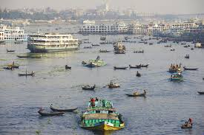
Dhaka is on the buriganga.
Preposition
He sat beside me.
Preposition

Slide 7
The identification of preposition -
Pre means before and position means place
So, Preposition means “the place before noun or pronoun.”
Preposition is a word that is placed before a noun or pronoun to show its relation with other words in the sentence.

Slide 8
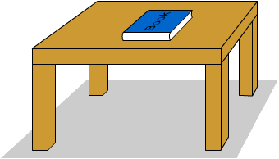
above
The sun is _________ the car.
on
The book ________ the table.

Slide 9
Fill in the blanks with preposition from the box
Before, into, at, of, above, in
a. The boy lives ………. Mirpur …….. Dhaka.
b. He entered ……. The room.
c. The sky is …….. Us.
d. He died ……… heart failure.
e. He went away ……. Lunch.

Slide 10
Homework:
Write ten sentences using the following prepositions.
On, over, above, in, into, between, among, behind, in front of, down

Slide 11
Thanks everybody

