Slide 1
Welcome to my multimedia classroom

Slide 2
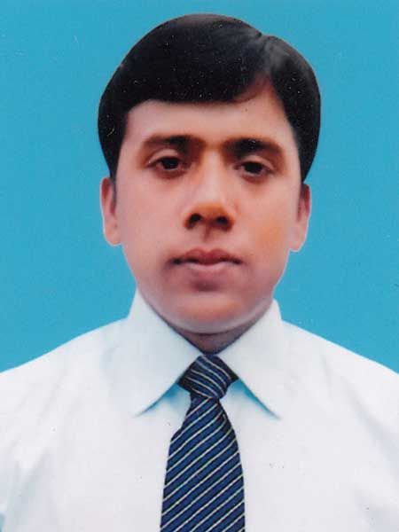
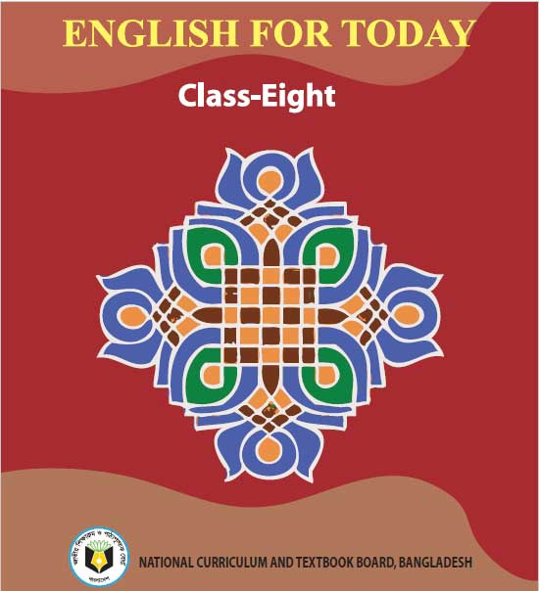
About me and book
Md. Robiul Islam
Assistant Teacher English
Pioneer Girls’ High School, Khulna.
ICT4E Ambassador, Khulna Sadar, Khulna
ENGLISH For TODAY
Class- Eight
Time- 40 Minutes
Date- 05/09/2020

Slide 3
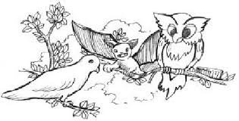
Bat
Dove
Owl

Slide 4
Today we are going to read about-
Unit - 5
Making difference
Lesson- 6
The truthful dove (2)

Slide 5
After we have studied this lesson, we will be able to -
Read and understand text through silent reading.
Infer meaning from text.
Ask and answer question.

Slide 6
Synonyms
Fascinating, admiring
Wondering
Antonyms
Apathy, disinterest
[ wuhn-der-ing ]
Noun
Synonyms
unfaithful, untrue
Insincere
Antonyms
real, sincere
[in-sin-ˈsir]
Adjective

Slide 7
Synonyms
Conversation, dialogue
Speech
Antonyms
Quiet, silence
Noun
Synonyms
Appreciation, applause, acclaim
Praise
Antonyms
Blame, criticism, neglect
[ preyz ]
Noun

Slide 8
Synonyms
Anchor, Entertainer, Manager
Host
Antonyms
Guest, Visitor
Noun
Synonyms
Pleased, Thankful
Grateful
[ greyt-fuhl ]
Antonyms
Ungrateful, Thankless
Adjective

Slide 9
A. Look at the picture and talk about it.

Slide 10
B. Read more about the three birds and write answers to the following questions.
All this time the dove was listening to her friend’s false praises. She was wondering how insincere his praises were. The dove hung her head down and was quiet. The owl got impatient. He wanted to hear more praises. He looked at the dove and asked, “Don’t you have any good thing to say about me?” The bat joined the owl, “ Yes, don’t you have any words of praise for our kind host?” The dove was ashamed of her friend bat and kept her eyes down. The owl urged the dove, “Come on, say something!”
The dove lifted her head slowly and said, “ Master owl, thank you very much for the shelter you have given me, thank you for the food you have offered me. I will remain ever grateful for this.

Slide 11
Questions. Work in pairs.
1. What does the word ‘insincere’ mean in the story?
2. Why did the dove think that the bat is insincere?
3. What made the owl impatient?
4. Why was the dove ashamed of her friend?

Slide 12
C. True or false. If false, give the correct information.
1. The bat was very sincere when he praised the owl.
2. The owl wanted to hear more good things about himself.
3. The dove was very harsh to the owl.

Slide 13
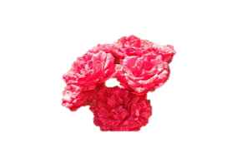
Grammatical Task
The dove was listening to her friend’s false praises.
Structure
Subject
+
Was/were
+
Verb – with ing
+
Object
Past Continuous Tense

Slide 14
Home Work
Write a paragraph about “Birds of Bangladesh.”

Slide 15
Thank You

