Slide 2
Good Afternoon

Slide 3
Teachers Identification
Binay Bikash Chakma
Assistent teacher
Manikchhari Muslim Para Govt. Primary School
Manikchhari, Khagrachhari.

Slide 4
Lessons Identification
English for today
Class – One
Unit- 17
Lesson- 4-6
(Alphabet-Nn)
Page- 35

Slide 5
Learning Outcomes: Students will be able to
1.2.1-recognize and read the alphabet both small and capital(non-cursive)
1.1.1- to practice letter shapes/simple writing patterns. etc.

Slide 6
Look at the picture
What’s this?
Ball

Slide 7
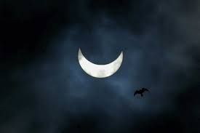
Look at the picture
What’s this?
Moon

Slide 8
Look at the picture
What’s this
N
n
Net

Slide 9
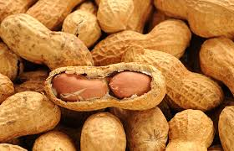
Look at the picture
What’s this
N
n
Nut

Slide 10
Let’s see a video

Slide 11
Open your English book at page 35

Slide 12
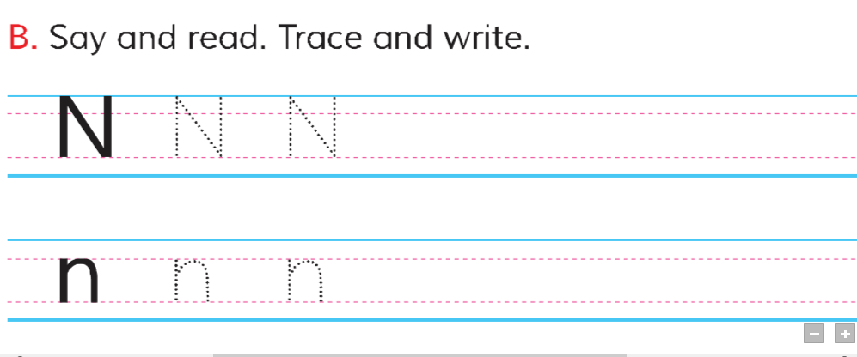
N
N
N
n
n
n

Slide 13
n
n
e

Slide 15
n
n
n

