Slide 1
Note for the teachers
Here in this content, necessary vocabularies are explained. The classroom teacher may add or deduct vocabularies according to their own classroom demand.
The teachers are requested to follow the notes given below the slides.

Slide 2
Welcome
To
Multimedia Class

Slide 3
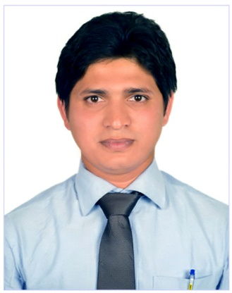
Babinton Chandra Das(Kiron)
Assistant Teacher(English)
Hon’s & Masters in English
IELTS & Phonetics
Farakkabad High School,
Chandpur Sadar, Chandpur.

Slide 4
Class-(viii)
Sub-Eng first paper
Time-45 minutes

Slide 5
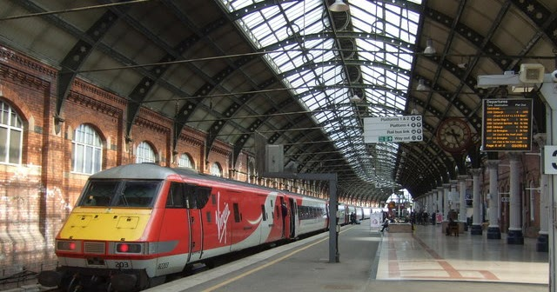
Look at the following pictures. Discuss with your partner what you see in them.
Railway Station
Where train stop?
Train

Slide 6
Today’s Topic

Slide 7
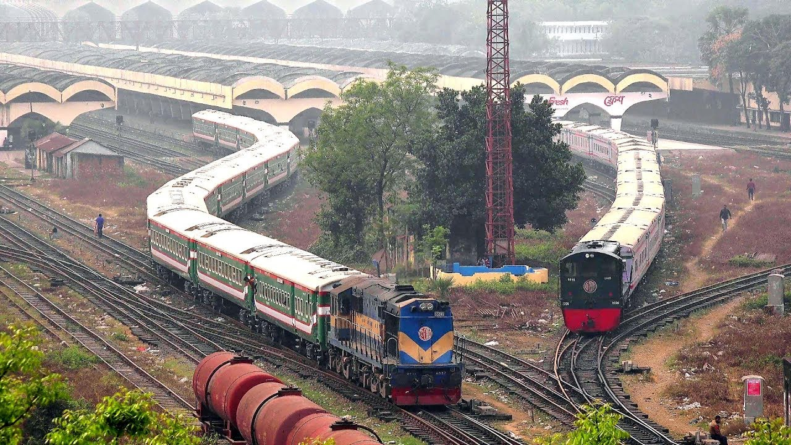
At A Railway Station

Slide 8
Learning outcomes
After completing the lesson students will be able to…
read and understand texts
Talk about people, places and familiar objects in short and simple sentences
Write paragraph.

Slide 9
Read the passage silently individually. Time 5 minutes
Find out the words and underline the following words- See off, long, quiet, heavy, pick up

Slide 10
Match a word from Comumn A with a word in Column B that has an opposite meaning.
Culumn A | Column B
See off | Vacant
Long | Light
Quiet | Busy
Heavy | Receive
Pick up | drop
Crowded | short

Slide 11
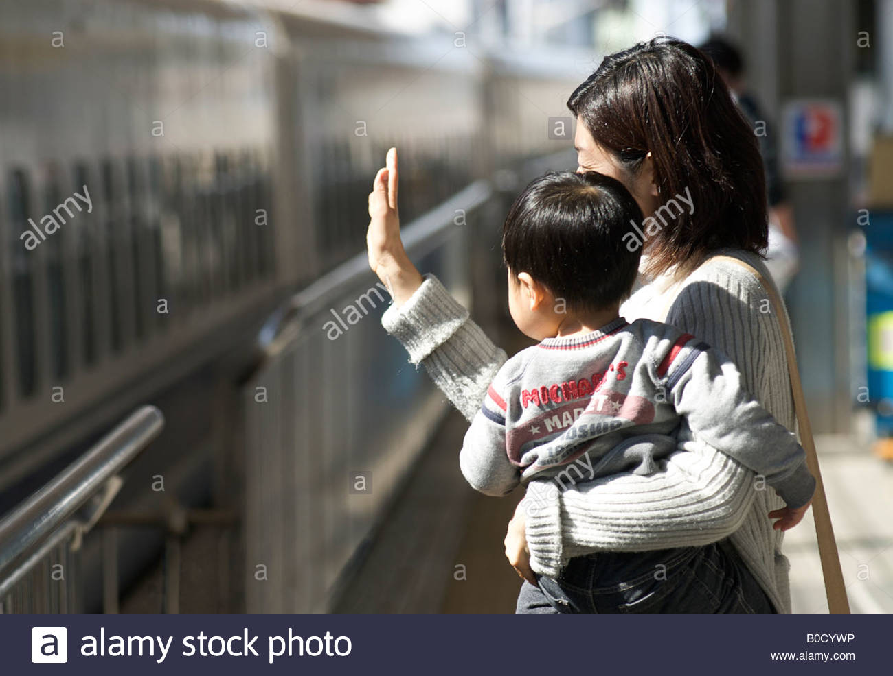
See off
My mother came to see me off at the station.

Slide 12
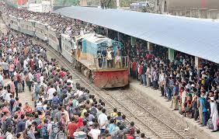
Crowded
There are very crowded in the station.

Slide 13
Couple/pair
An old couple looks very beautiful.

Slide 14
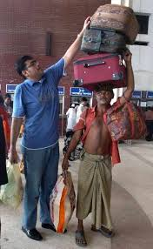
Luggage
A man is carrying his luggage.

Slide 15
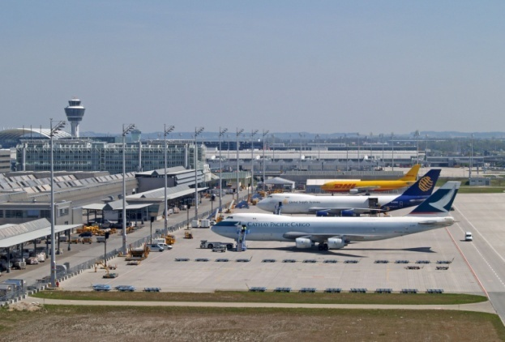
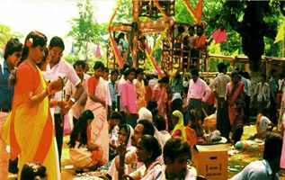
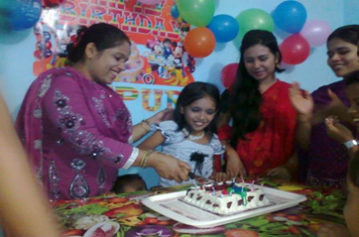
Pair Works
Suppose you went to one of the places listed below.
Describe what you saw, what was happening and what you did there (within five sentences).
1. An Air Port
2. A Village Fair
3. Sumi`s Brith day

Slide 16
HOME WORK
Write a paragraph on” A Railway Station’

Slide 17
Good bye
See you the next class

