Slide 1
Welcome to all

Slide 2
Introduction
Md Shahneoaz
Assistant Teacher (English)
Jalalabad B/L High School,Sylhet.
E-mail: shahneoazmd@yahoo.com
Cell: 01631712091
Class: ix
English 1st paper
Unit-4, Lesson-5 (D)
Time- 45 Minutes

Slide 3
Answer the questions
1. What is needed to lead a life well?
2. What is needed to buy food?
3. Do all can earn same amount of money?
Can you say how we can earn a handsome amount of money?

Slide 4
Topic: Let’s become skilled workforce

Slide 5
Learning Outcomes:
After finishing this lesson students will be able to-
say what the common language is to communicate.
describe the reason of being the common language.
write a paragraph by describing the importance of learning English..

Slide 6
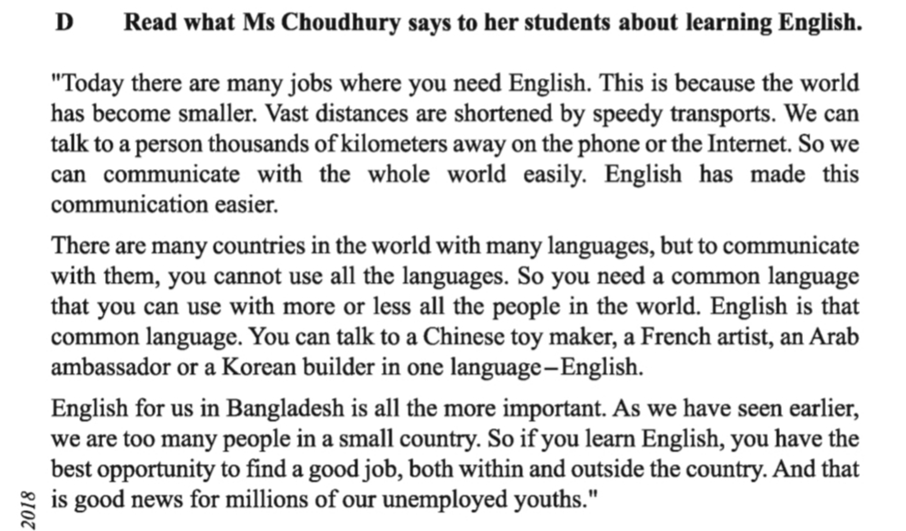
Read the passage in unit-4, lesson-5 (D)
Silent Reading

Slide 7
Let’s be introduced with new Words:
Job
Work/Service
You have done an excellent job.

Slide 8
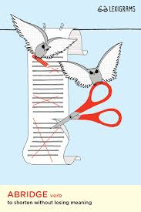
Let’s be introduced with new Words:
Shorten
Reduce/Lessen
Her life was shortened by the accident.

Slide 9
Let’s be introduced with new Words:
Speedy
Faster
Shueb Akhtar was one of the speedy bowlers of the world.

Slide 10
Let’s be introduced with new Words:
Communicate
Contact
Now we can communicate with others by mobile phone so easily.

Slide 11
Write answers to these questions:
Group Work
1. Describe briefly the things that have made the present world smaller.
Ans. The things that have made the present world smaller are speedy transports, phone and internet.
2. Give reasons why a common language is needed in today’s world.
Ans. To communicate with the people of the world, we can not use all the languages they speak in. So a common language is needed.
3. Why is English needed all the more in Bangladesh?
Ans. English is needed all the more in Bangladesh because we have an acute unemployment problem. So, if we learn English, we have the best opportunity to find a good job , both within and outside the country.
4. How can our youths become a skilled workforce?
Ans. Our youths can become a skilled workforce by getting training in various trades and, most importantly, learning English.

Slide 12
answer to the questions orally:
Evaluation
1. Which language has achieved the status of common language?
Ans. English
2. Do we need to learn English?
Ans. Yes
3. Why?
Ans. To be a skilled workforce.
4. What will you do to learn English?
Ans. We will follow what our teachers instruct and practice inside and outside of the classroom.

Slide 13
Write a paragraph on “Importance of learning English”.

Slide 14
Thanks a lot for being with me

