Slide 1
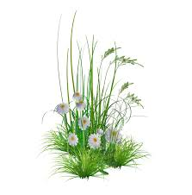
WELCOME

Slide 2
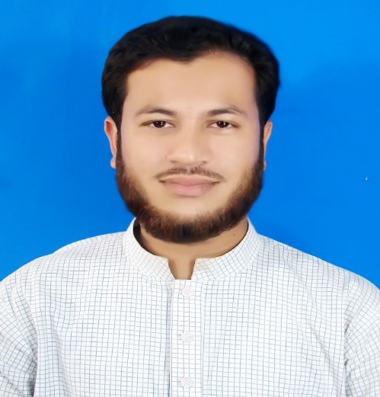
Teacher Introduce
Md.Oli Ullah(Hasnain)
Assistant Teacher
65 No. Chandroprosad GPS.
Bhola sadar,Bhola.

Slide 3
Subject-English
Class-One

Slide 4
Learning outscome
1.1.1 Practice letter shapes.
1.2.1 Recognize and read the alphabet both small and capital letter.

Slide 5
Hello song

Slide 6
Alphabet

Slide 7
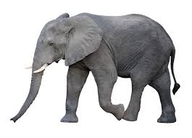
Elephant

Slide 8
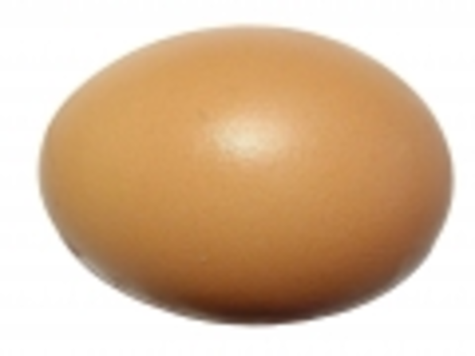
Egg

Slide 9
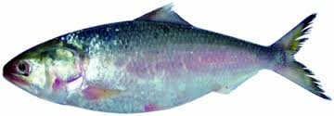
fish
Fish

Slide 10
E E e e elephan
t E E e e egg
F F f f fish

Slide 11
PW E e
GW F f
PW E e
GW F f

Slide 12
Evulation
Match the lrtter
F e
E f

Slide 13
Trace the letter
E e F f

Slide 14
THANKS

