Slide 1
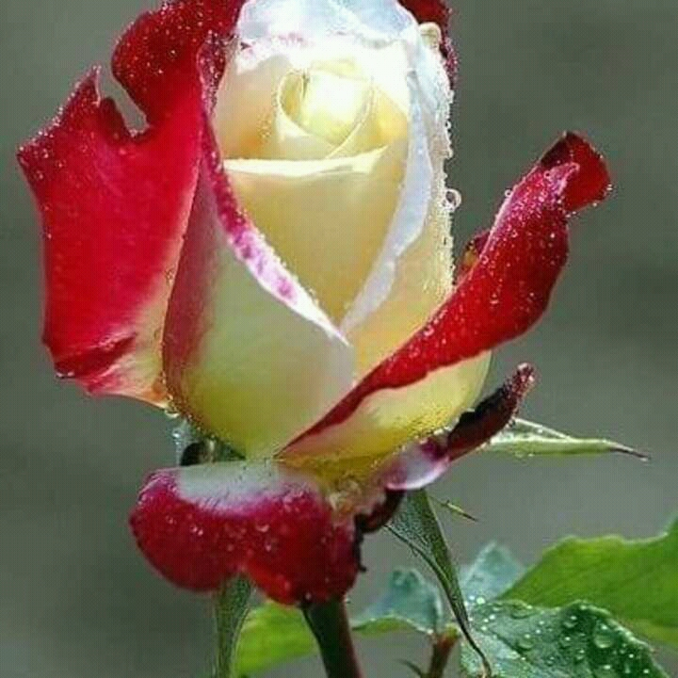

Welcome

Slide 2
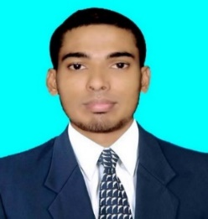

Class: Nine/Ten 50 mints
Subj: English Part-1
Unit: Two
Lesson: 1 Date: 19.03.2019
Md. Ziaul Hoque
Lecturer in English
Bazemahal Obayedia Fazil (degree) Madrasah
Email: ziahoque63@gmail.com
Cell: 01717655693

Slide 3


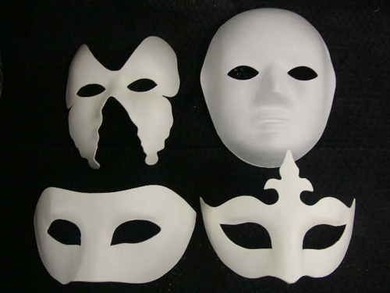
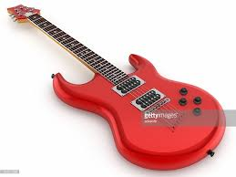
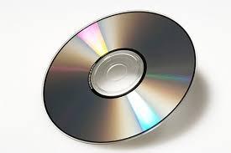
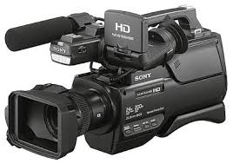
Book
Adobe Photoshop
Mask
Mask
Mask
Guitar
Disk
Video Camera

Slide 4
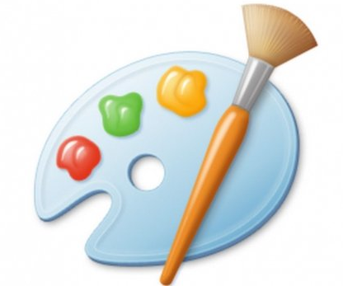
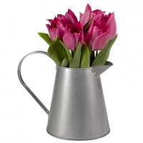
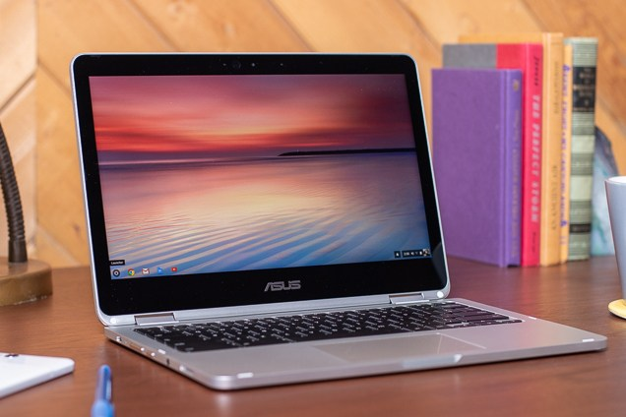

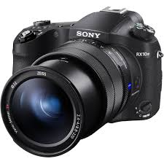

Dye & Paint Brush
Vases
Laptop
Music
Camera
Photo Negative

Slide 5

Have you any favourite pastime?

Slide 6

Learning Outcomes
After we have studied the lesson, we will be able to
Participate in discussion and debates on pastimes.
Tell the names of free time activities in a logical sequence.
Be introduced with various pastime hobbies.

Slide 7
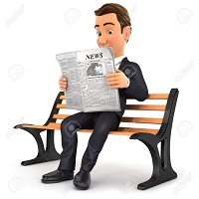
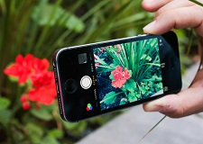
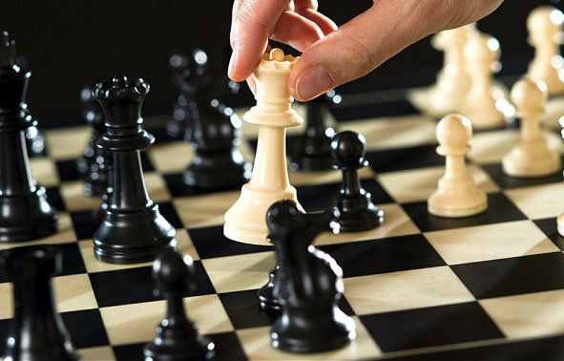
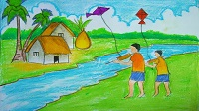
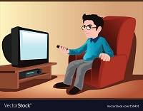
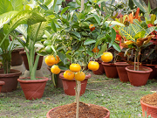
Reading news paper
Taking photo
Playing chess
Flying kite
Watching TV
Gardening

Slide 8
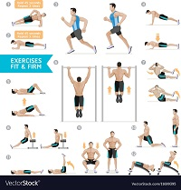
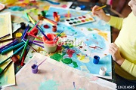
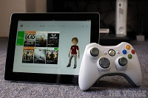
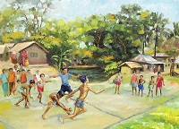
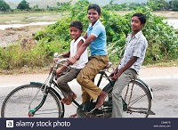
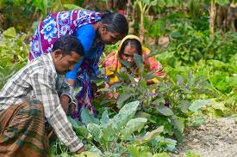
Exercising
Painting
Playing Computer Game
Playing Ha-du-du
Riding Bicycle
Planting

Slide 9
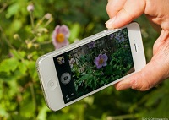
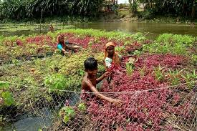
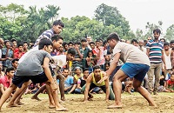
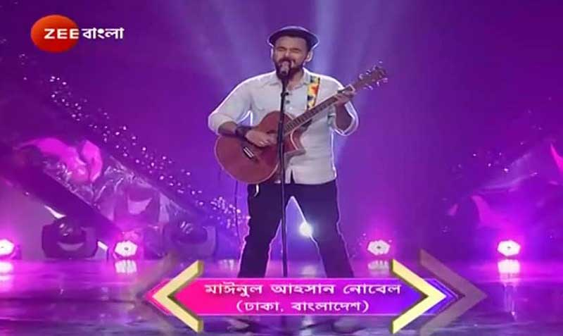
Individual work
What do you like doing in your free time?
Tell the names of the activities in the following pictures---
Playing Ha-du-du
Singing
Taking Photo
Reading News Paper
Gardening

Slide 10

Video

Slide 11
Group work
Discuss the activities showed in the video.
What are the pastimes here?

Slide 12
Read the text attentively.
Hi, I’m Shyam. I’m from Magura. Though district headquarters, it’s a small town. I’m in grade 9 now in Chander Hut Bidyaloya. I love games and sports very much. My father was an athlete in his student life. He inspires me to follow his footsteps and take part in games and sports or do some exercise besides my studies. So I get up early in the morning and take a walk with my father almost every day. At school, during break I play kabadi, gollachut, badminton, table tennis, and carom. Playing football in the nearest college ground is a passion for me. I like watching television too. I watch sports programmes on different TV channels during my free times. I wish I could be an amateur photographer in future – not to snap only personal photographs at different parties but to shoot our beautiful Bangladesh. I’m sure that soon photography will be my most favourite pastime.

Slide 13
Pair Work

Slide 14
Write down five sentences with the mentioned words.
Riding
Walk
Gardening
Watch
Reading
He is riding a bicycle.
In the morning my father goes out for a walk daily.
In my free time I would like to do gardening.
I watch Discovery channel on TV.
Reading news paper is my important pastime activity.

Slide 15
Evaluation
What do you mean by pastime?
Tell five pastime activities?

Slide 16
A pastime is any hobby or activity that we do to pass the time.
Pastime
Five Pastime Activities
Gardening
Playing Game
Reading News Paper
Listening Music
Watching TV

Slide 17
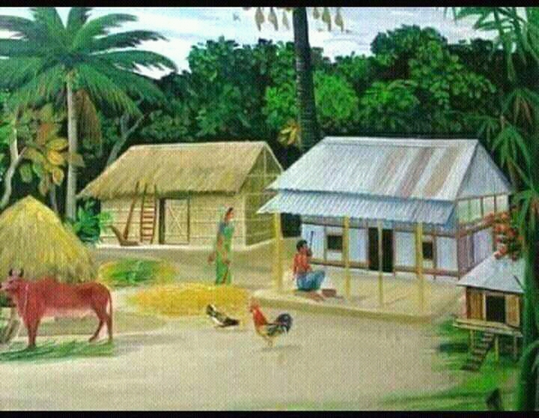
Home Work
Write a paragraph on Pastime.

Slide 18
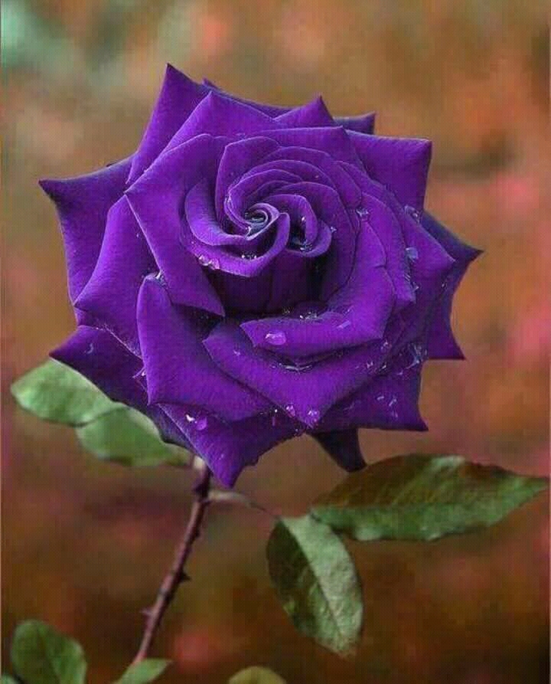
Thank
You

