Slide 1
Welcome

Slide 2
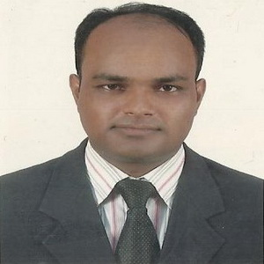
Md. Abdul Kader
Assistant Teacher
Borni Govt. primary School,
Companiganj, Sylhet.
TEACHER IDENTITY
Class : Five
Subject : English for today
Unit: 12
Lesson: 1
Title: Write to me soon!
Part: “B” (Doctor’s Advice)
LEASON IDENTITY

Slide 3
GREETING
Good morning, students
Teacher
Good morning, teacher
Student’s
Teacher
How are you today ?
Fine
Student’s

Slide 4
Dear students, can you remember
what we had learnt yesterday?
Yes, we had learnt about the disease Flu.

Slide 5
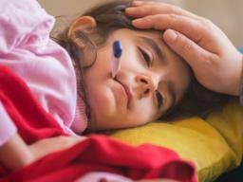
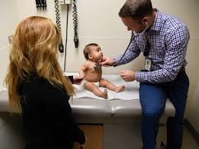
Let’s see some pictures and read description
A sick baby.
A Doctor is Checking a baby.

Slide 6
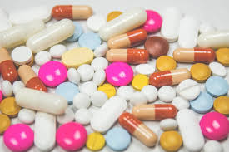
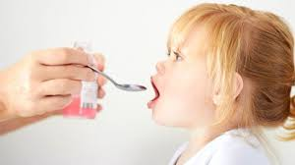
Let’s see some pictures and read description
A child is taking medicine.
There have some medicine.

Slide 7
Can you guess what is our today’s lesson?
Today we will read…
The doctor’s advice

Slide 8
Learning Outcomes
By the end of the lesson Students will be able to…
Listening:
1.3.1 recognize which words in a sentences are stressed .
2.1.1 carry out simple commands and instructions.
Speaking:
1.1.2 say sentences with proper intonation.
6.2.1 talk about people, objects, events etc.
Reading:
1.7.1 read paragraphs, dialogues, stories, letters and
others texts.

Slide 9
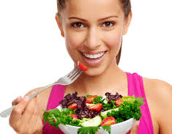
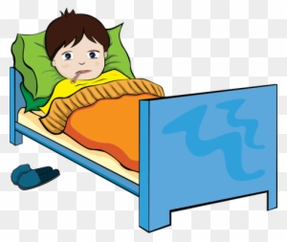
Let’s read the advices given to Sima by her Doctor.
Eat food that gives your body energy. Try to eat,
even if you aren’t hungry. You need to be strong.
Rest! Stay at home. Don’t go to school or work.

Slide 10
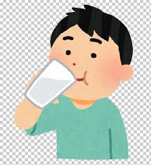
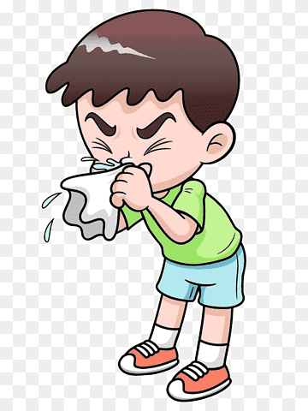
Let’s read the advices given to Sima by her Doctor.
Drink a lot of water or juice.
They are better than soft drinks.
Are you coughing or sneezing?
Cover your mouth and nose!
Use a tissue, not your hand!

Slide 11
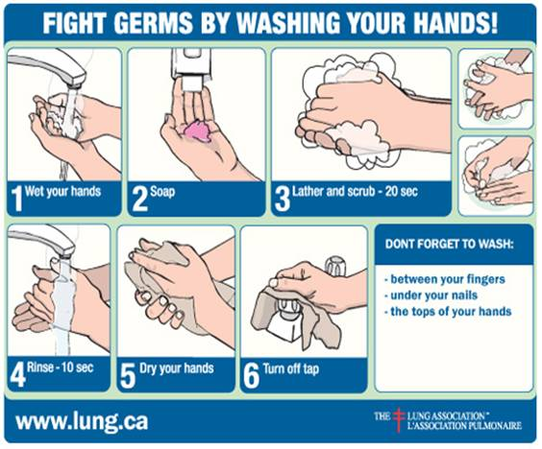
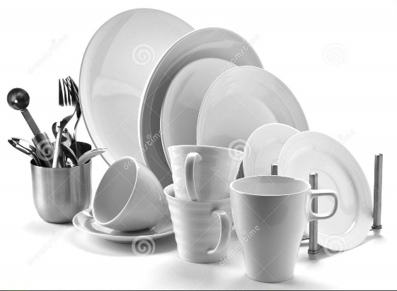
Let’s read the advices given to Sima by her Doctor.
Wash your hands regularly.
Use your own plate, glass and cup.
Other people can catch your illness
From these things.

Slide 12
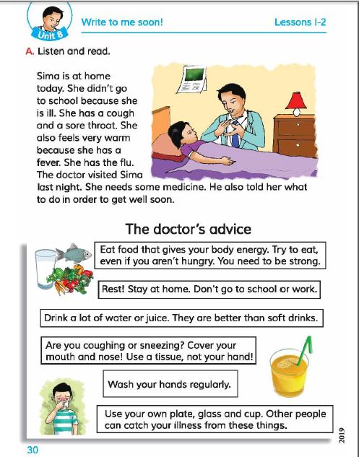
Now, open at page 30 of your text book.

Slide 13
Individual Work
Answer the following questions:
What food does Sima need to eat?
Where should Sima stay?
What is better than soft drinks?

Slide 14
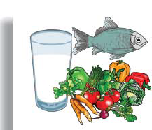
Teacher’s Reading
Eat food that gives your body energy. Try to eat, even if you aren’t hungry. You need to be strong.
Rest! Stay at home. Don’t go to school or work.

Slide 15
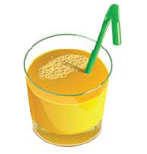
Teacher’s Reading
Drink a lot of water or juice. They are better then soft drinks.
Are you coughing or sneezing? Cover your mouth and nose! Use a tissue, not your hand!

Slide 16
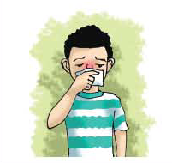
Teacher’s Reading
Wash your hand regularly.
Use your own plate, glass and cup. Other people can catch your illness from these things.

Slide 17
New Word
energy
Meaning
dynamism

Slide 18
New Word
hungry
Meaning
starving

Slide 19
New Word
strong
Meaning
solid

Slide 20
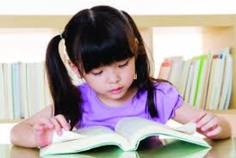
Students’ silent reading.
Read the text silently. You must maintain proper
punctuation marks.

Slide 21
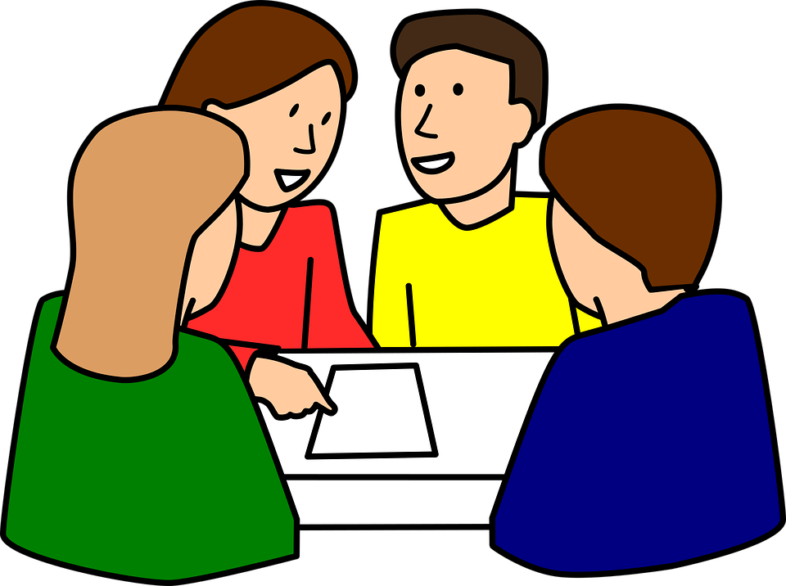
Group Work
Read the instructions of the doctor with proper stress
and intonation one by one in your groups.

Slide 22
Review today’s lesson.
Can you tell me what have we learnt from today’s lesson?
Yes, we learnt today…
How to stay healthy.
How to keep others healthy.

Slide 23
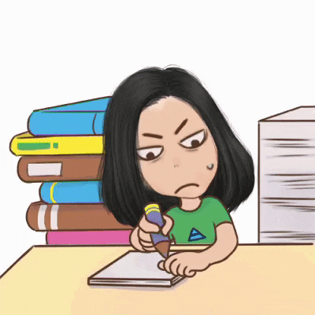
HOME WORK
You will write at least five sentences about “how to stay healthy and keep others healthy.”

Slide 24
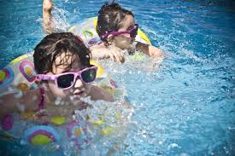
Thanks all

