Slide 1
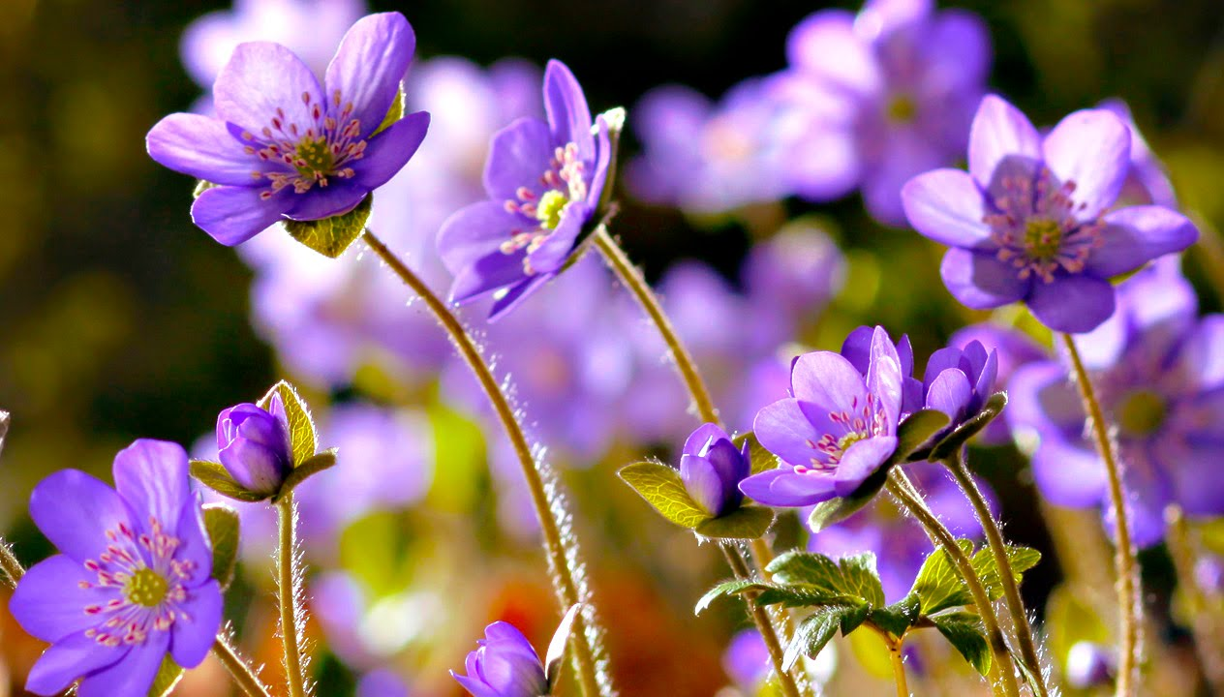
Welcome.
Notes:
Teacher may use this slide to welcome the students to start the class. This picture is set here because this topic is related to it. Teacher may change it.

Slide 2
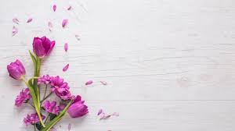
Introduction
Md. Aksar Ali
Assistant Teacher (English)
Magura M.U Alim Madrasah, Kahaloo, Bogura
Class-VIII
English First Paper
Notes:
Introduction of the teacher and the calss.

Slide 3
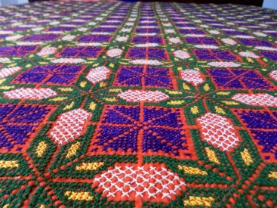
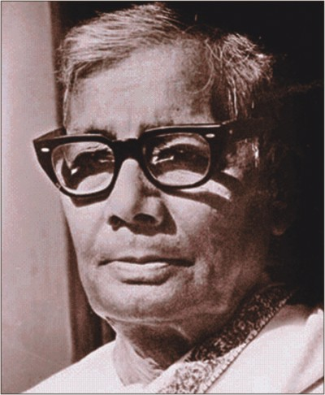
Do you know him?
Jasimuddin (1903-1976)
Notes:
This slide is to introduce Pallikobi Jasimuddin and his period to the students.

Slide 4
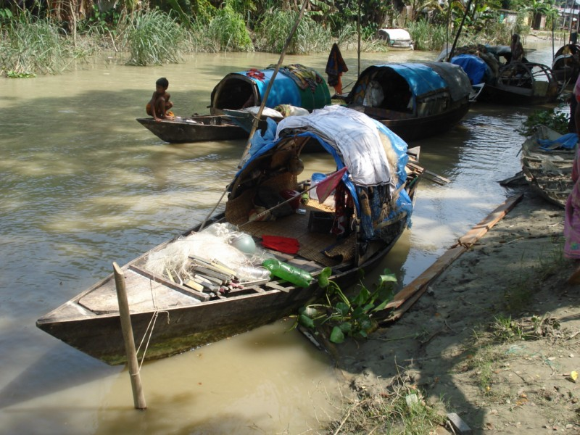
Do you know some of his famous works?
Yes.
Sujon Badiar Ghat
Nakshi Kanthar Math
1929
1933….
Jasimuddin
Jasimuddin
Notes:
Famous works of Jasimuddin Nakshi Kanthar Math published in 1929, Sujon Badiar Ghat first published in 1933.

Slide 5
Let’s observe
a video
What have you observed in the video?
Nakshi Khantha
Notes:
The video is for taking out the name of today’s lesson from the students.

Slide 6
Our today’s lesson is…
Nakshi Kantha
Unit-1, Lesson-2
Notes:
Lesson declaration.

Slide 7
Learning Outcomes
By the end of the lesson, learners will be able to…
ask and answer questions
read and understand text through silent reading
infer meaning from context
write a paragraph on that
Notes:
Bothe the four skills will be focused in this lesson.

Slide 8
A Look at the picture and the questions. Then ask and answer the questions with your partner.
1 What do you see in the picture?
2 What is it called?
3 Have you seen it before? Where?
4 What do we do with it?
Notes:
Main class started from here. Teacher may go ahead according to animation.

Slide 9
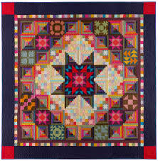
Quilt
cover
blanket
comforter
bedding
Nakshi Kantha is a kind of embroidered quilt.
Notes:
Teacher may go slow according to animation.

Slide 10
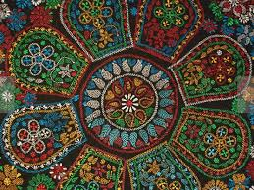
Artistic
Meaning
creative
imaginative
inventive
Nakshi kantha is made with artistic design.
Notes:
Teacher may go slow according to animation.

Slide 11
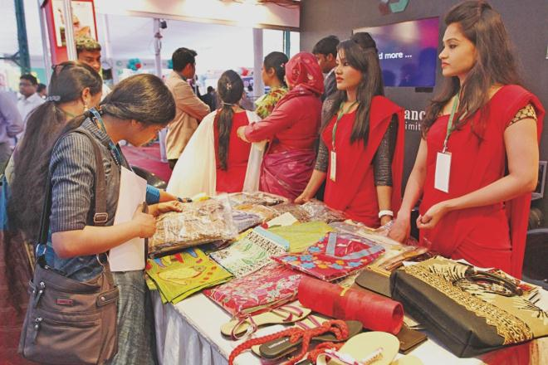
Commercially
Meaning: business purpose/trade
Nakshi kantha is now made commercially.
Notes:
Teacher may go slow according to animation.

Slide 12
Traditional
Meaning: old-fashioned/old style/legendary
Nakshi kantha is a kind of traditional craft.
Notes:
Teacher may go slow according to animation.

Slide 13
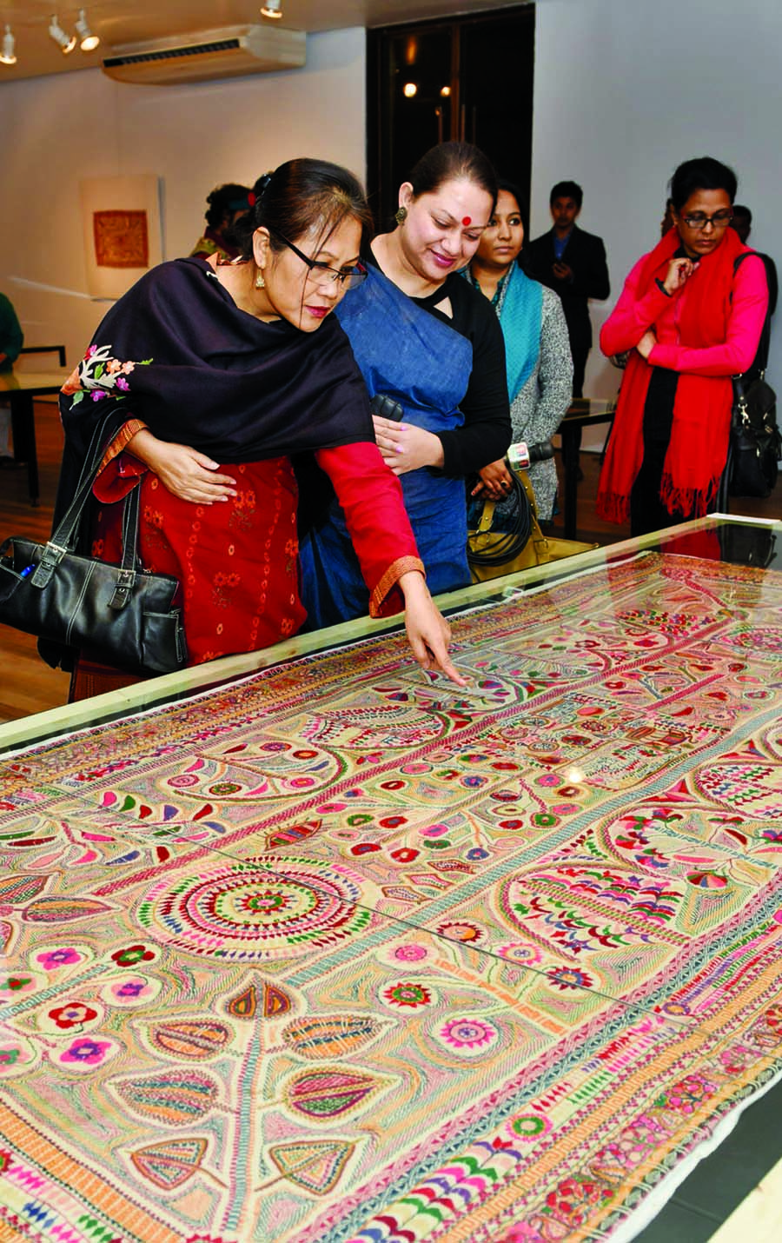
Demand
want
call
request
There is a great demand of Nakshi kantha.
Notes:
Teacher may go slow according to animation.

Slide 14
Pattern
designed
shaped
format
It looks very beautiful because of its artistic pattern.
Notes:
Teacher may go slow according to animation.

Slide 15
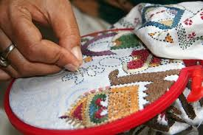
Embroidered
designed
beautified
ornamented
decorated
Quilt is embroidered with thread and needle.
Notes:
Teacher may go slow according to animation.

Slide 16
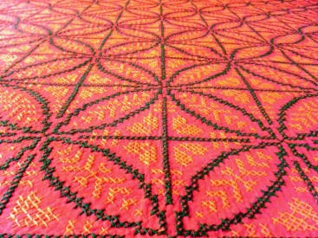
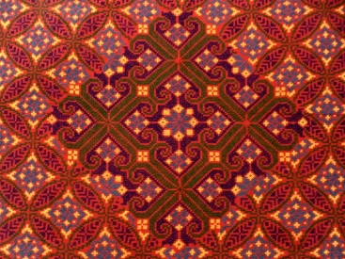
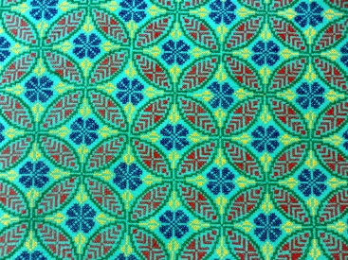
What is a Nakshi Kantha?
Let us know more.
Notes:
Teacher may go slow according to animation.

Slide 17
Now read the text to know about Nakshi Kantha.
Notes:
Teacher may ask the students to open their text book to read section B silently. He will just observe and help the students in silently reading .

Slide 18
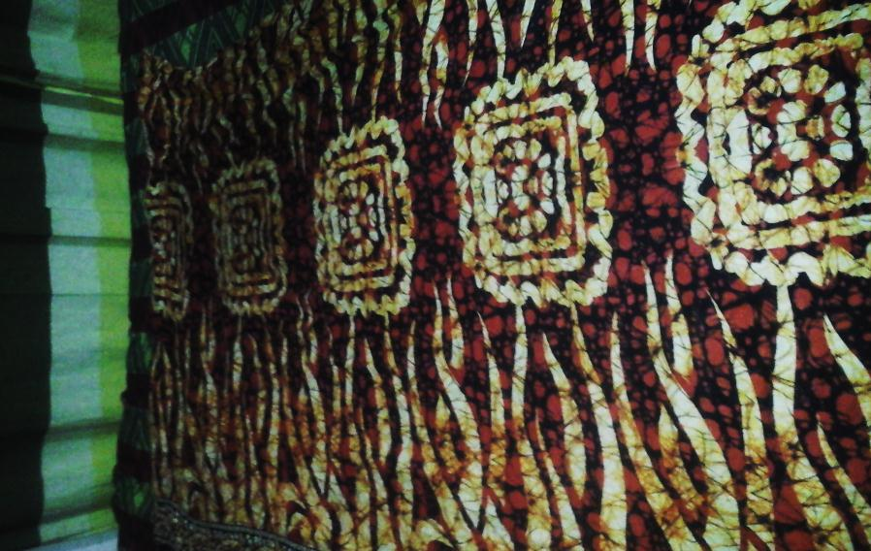
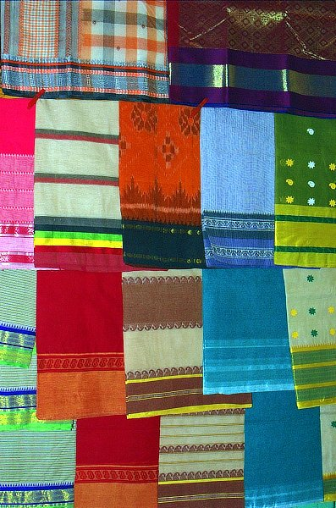
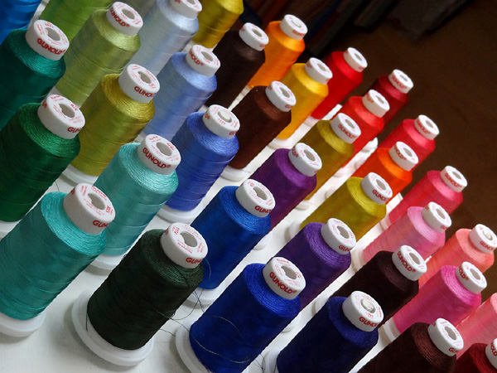
C Write a paragraph describing how the nakshi kantha is made. Start like this: Old or new cloth and coloured thread are needed. First the cloth is folded, then……
Notes:
Teacher will make this option understand the students to write a paragraph. They may begin with the help of the pictures.

Slide 19
D Do you like a ……..
Nakshi Kantha.
or an ordinary kantha? Why?

Slide 20
E. Complete the sentences with given clues
Bengali, patterns, embroidery, years,fashion,art, rural, designs, quilt, noksha
Check your answers
patterns.
Nakshi kantha means artistic ________
The name was taken from a ________ word _______
The art has been practised in ______Bengal for _____
Nakshi kanthas are now sold in ________ shops.
Nakshi kanthas now in great demand because of their colourful ________and ________
Nakshi kathas are a kind of _____
Bengali
noksha
rural
years
fashion
patterns
designs.
quilt.
Notes:
Teacher may ask the students this option to fill up with the words given in the box. Then he can show the answer for checking if they are correct or not.

Slide 21
F Write down five questions for the completed statements in E above.
One is done for you.
1. What does noksha means?
Match your answer.
2. What word was taken as the name from?
3. Where has the art been practised? How long?
4. Where are they sold now?
5. Why are Nakshi Kanthas in a great demand?
6. What are Nakshi Kanthas?
Notes:
This slide is for grammar part. Teacher may use board to discuss interrogative sentence. Specially the use of ‘Wh’ question. He may show the structure of ‘Wh’ question like ( Wh+Av+sub+Mv+ex…… and much more).

Slide 22
May Allah bless you all.
Notes:
Last greeting.

